Slide 1
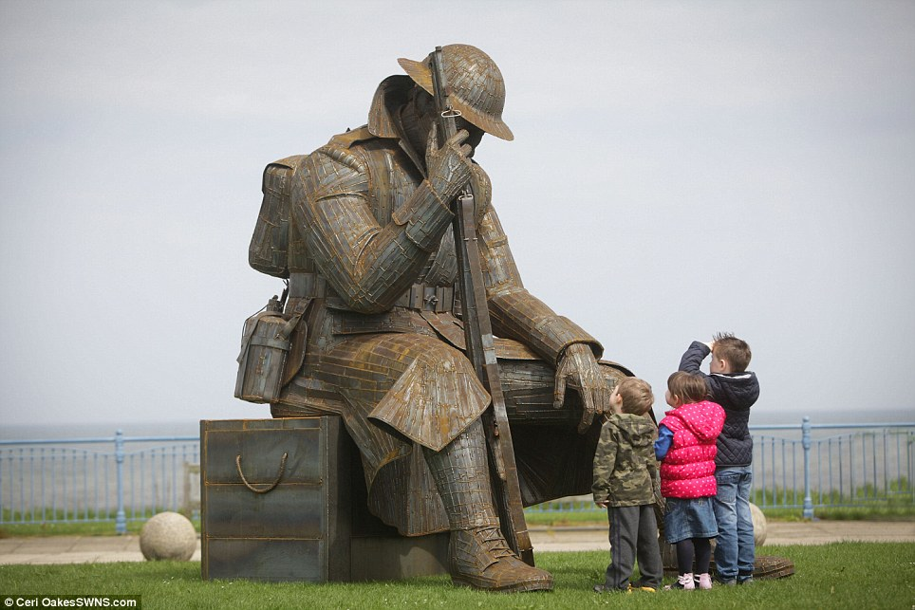
Memorialization
How and Why should we remember The Great War?

Slide 2
Was it worth the cost?
Close to 61,000 Canadians were killed during the war, and another 172,000 were wounded. Many more returned home broken in mind and body. The small colony of Newfoundland suffered 1,305 killed and several thousand wounded.
World War One was one of the deadliest conflicts in the history of the human race, in which over 16 million people died. The total number of both civilian and military casualties is estimated at around 37 million people. The war killed almost 7 million civilians and 10 million military personnel.

Slide 3
How should we feel?
The photo is of a young granddaughter watching her grandfather break into tears at her school's Veterans Day Assembly.

Slide 4
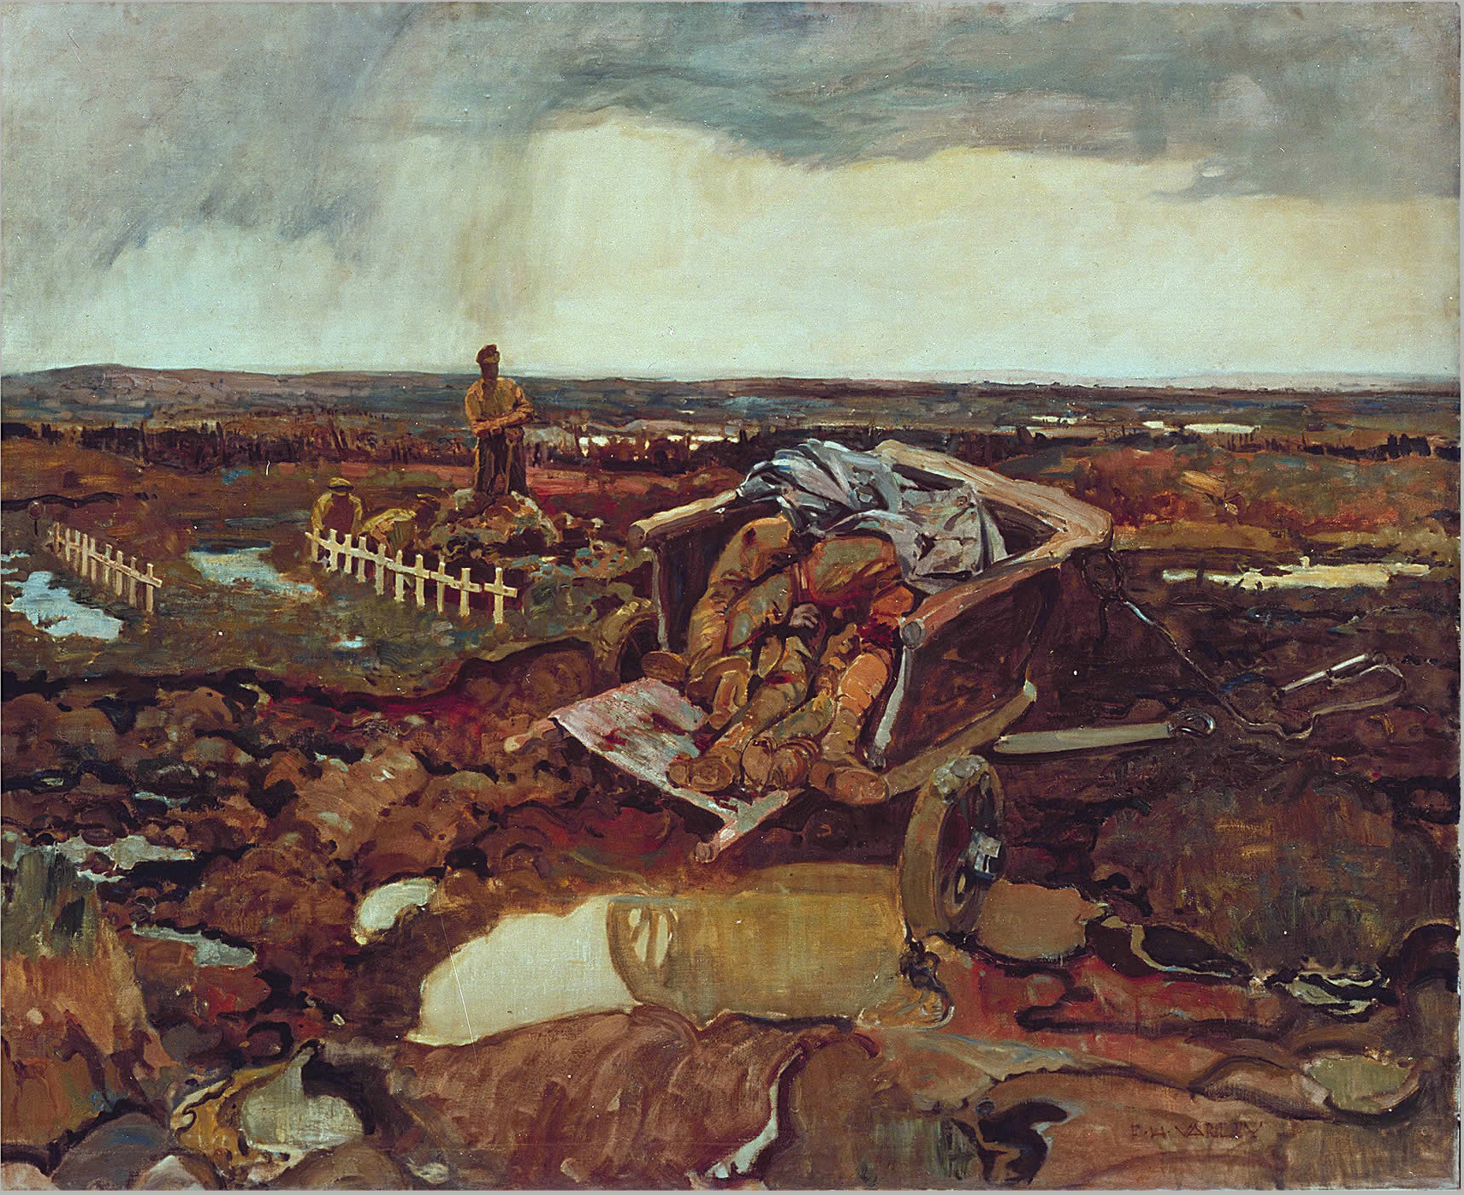
For What?
Notes:
Frederick Varley's For What? portrays a cart filled with bodies collected from the battlefield. It starkly portrays the horror of war and questions its purpose.

Slide 5
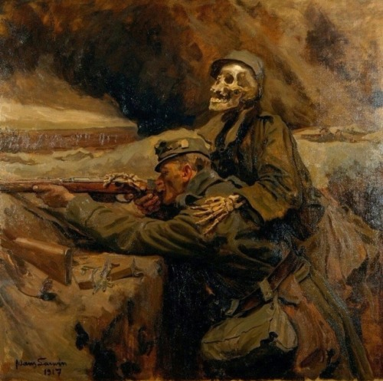
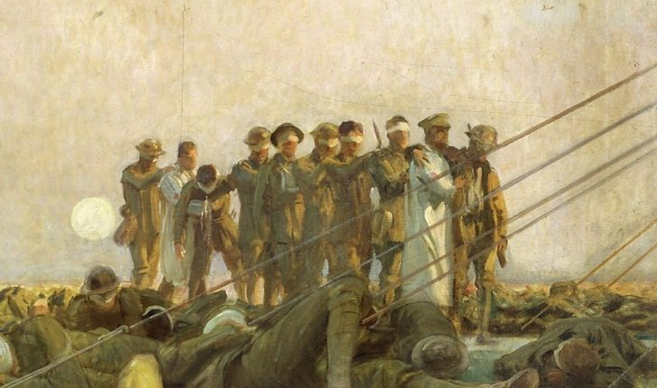

Slide 6
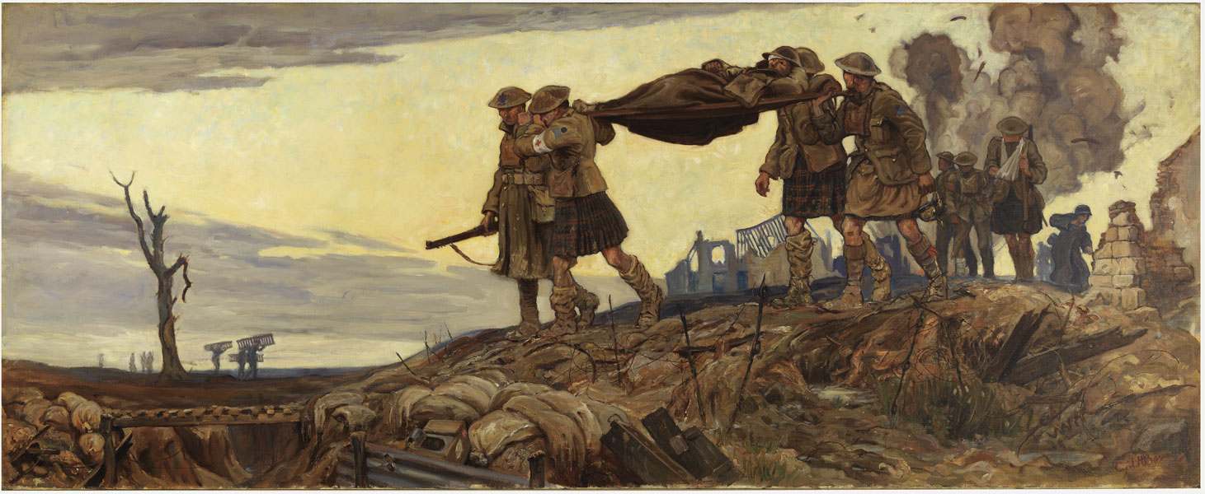

Slide 7
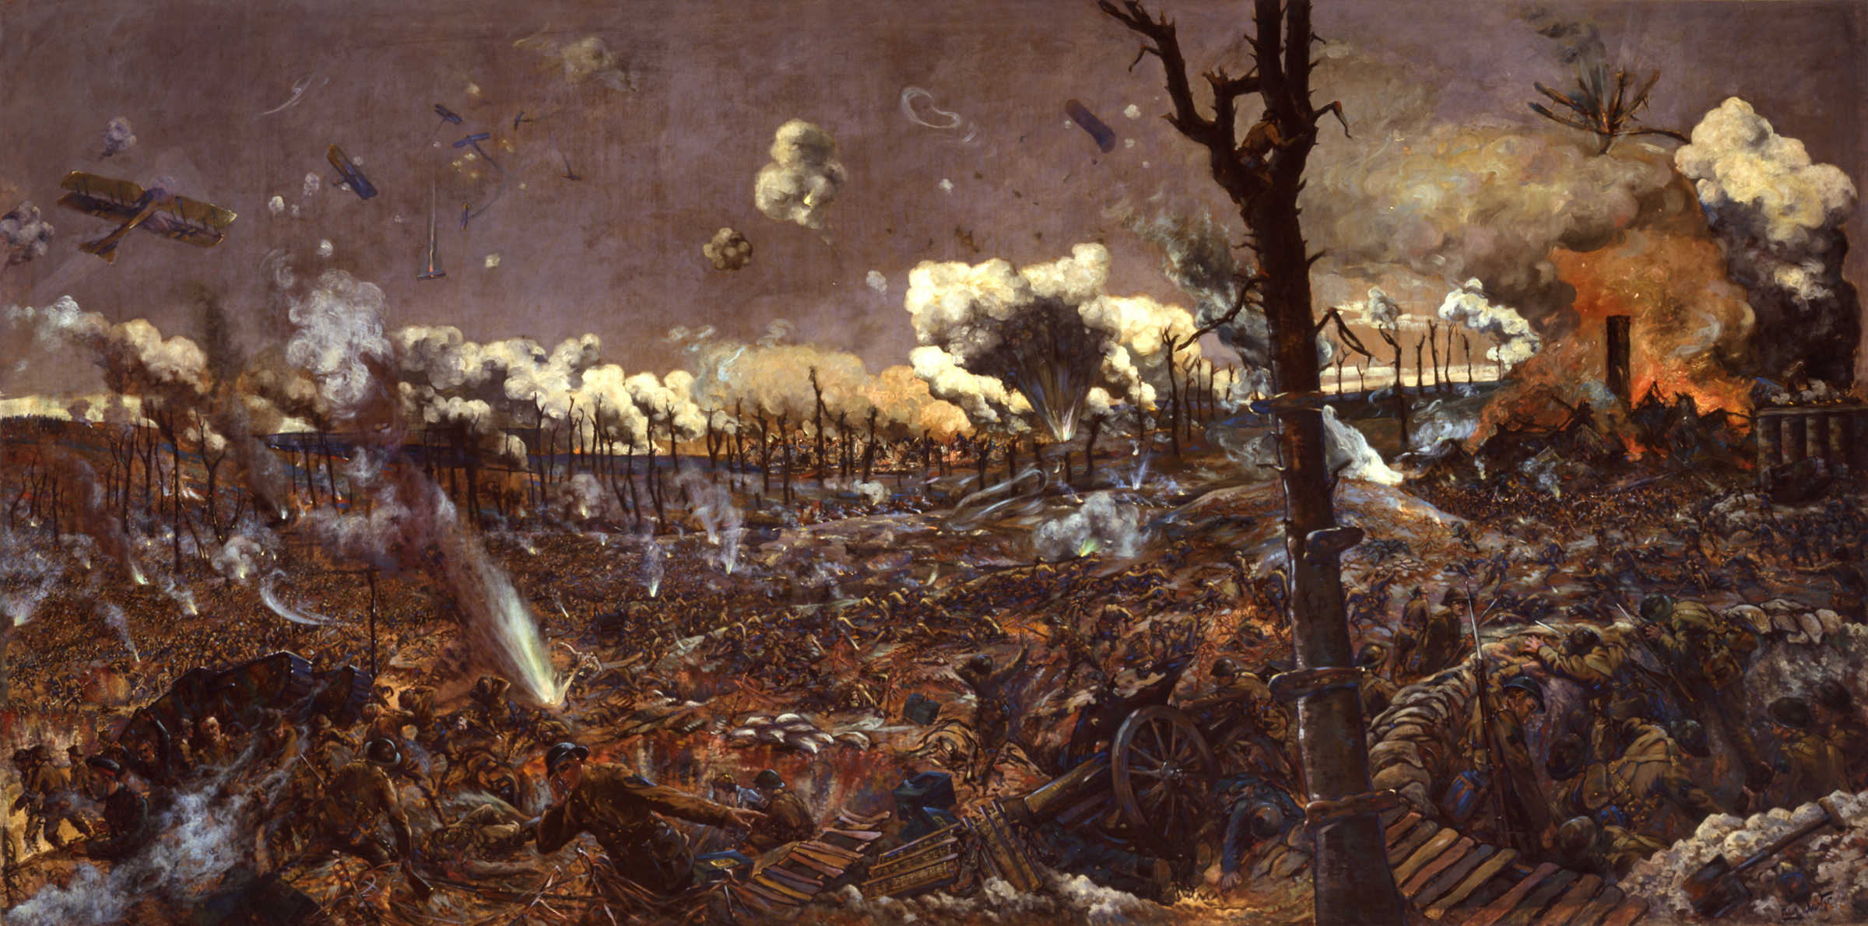

Slide 8
Why do we have monuments for WW1?
The Great War of 1914-1918 was so terrible and inflicted such large numbers of casualties on all sides that when it was over it was believed by many to be “The War to end All Wars”.
What happened to the bodies of the fallen soldiers? Did they return to their country of origin?

Slide 9
Preserving the memory of the people involved in the fighting, those people who were forever to be scarred by their involvement in the First World War, and the places ravaged by the war, was at the heart of a desire in the 1920s to find a way to mark their participation in such a large-scale, world-changing event.
But is it important to remember? Why?

Slide 10
How do we memorialize the Great War?
Memorials to the First World War are many and varied. Official and private memorials are to be found on the battlefields of the various theatres of that war and in the home nation of those who served from the many countries which were involved in it.
We have poems, music, and other art forms that commemorate those who lost their lives in WW1.
Notes:
Memorial rolls of honour were put up in factories, sports clubs, railway stations, schools, universities and so on. Church windows were designed and dedicated to military units or individuals. Memorial buildings were constructed to provide “living memorials”, for example, as community centres, places for rehabilitation or worship

Slide 11
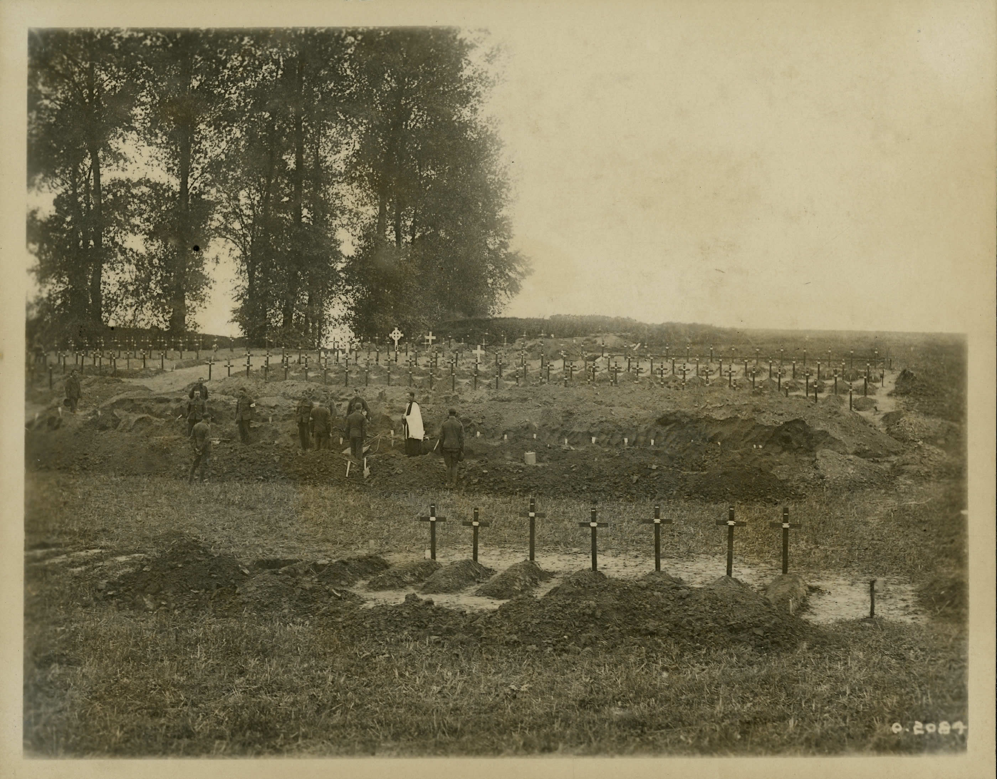
Notes:
Burial Ground at the Somme
Over a million Allied and German soldiers were killed or wounded during the Battle of the Somme in 1916. By the end of the four-month campaign, the battlefield resembled an enormous graveyard. It took months to clear away or disinter corpses for proper reburial. This photograph appears to show a grave digging team re-interring more than a dozen soldiers in individual plots.

Slide 12
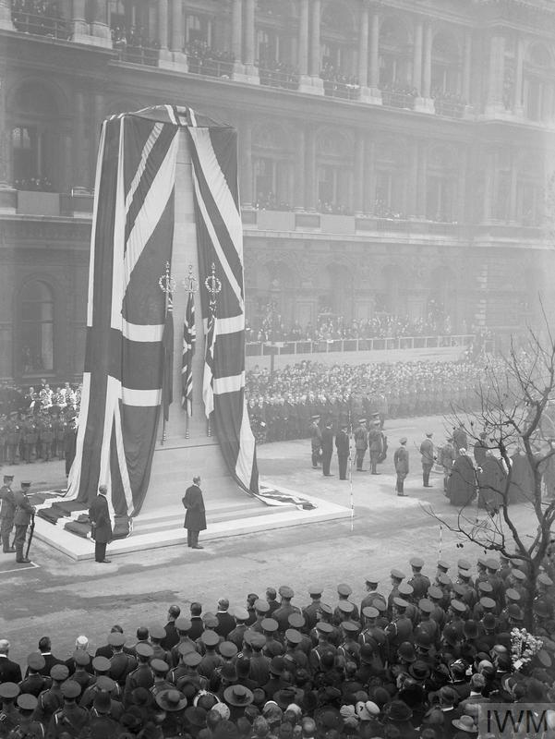
The Cenotaph is a war memorial on Whitehall in London, England.
Notes:
The Cenotaph is a war memorial on Whitehall in London, England. Its origin is in a temporary structure erected for a peace parade following the end of the First World War, and after an outpouring of national sentiment it was replaced in 1920 by a permanent structure and designated the United Kingdom's official national war memorial.
The first cenotaph was a wood-and-plaster structure designed by Sir Edwin Lutyens and erected in 1919.
It was one of a number of temporary structures erected for the London Victory Parade (also called the Peace Day Parade) on 19 July 1919. It marked the formal end of the First World War that had taken place with the signing of the Treaty of Versailles on 28 June 1919. As one of a series of temporary wooden monuments constructed along the route of the parade, Whitehall's was not proposed until two weeks before the event.

Slide 13
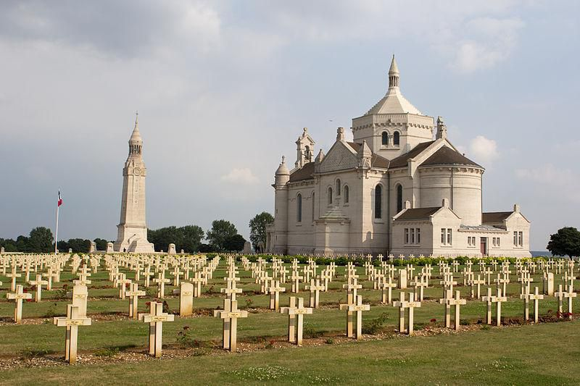
Notes:
The Notre Dame de Lorette military cemetery near Arras in northern France is the burial place of 40,000 French soldiers. Each grave is marked with a simple white cross bearing the soldier’s name

Slide 14
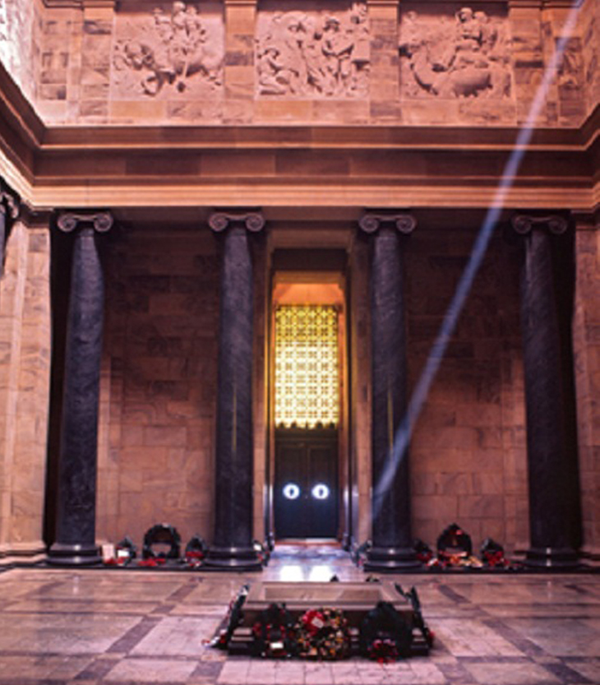
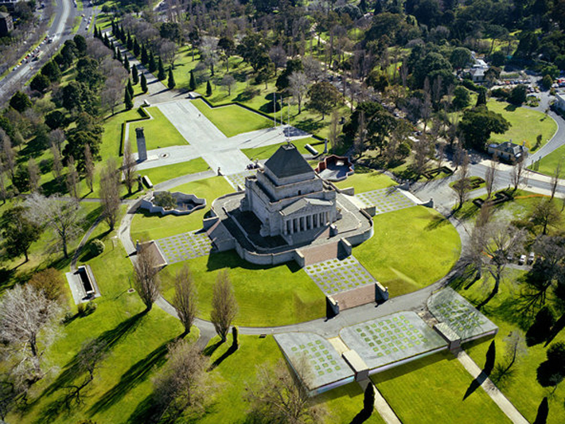
Notes:
Built to remember Victoria’s war dead of 1914–18, this is one of Australia’s great memorials. Inspired by the mausoleum to Mausolus, King of Caria, at Halicarnassus in Turkey, the shrine was inaugurated in November 1934. The sanctuary contains the Stone of Remembrance inscribed with the words “Greater Love Hath No Man”, designed so that a shaft of sunlight (or artificial light) falls on the word “Love” held at 11am on 11 November each year. More than 120 ceremonies are held at the shrine each year.

Slide 15
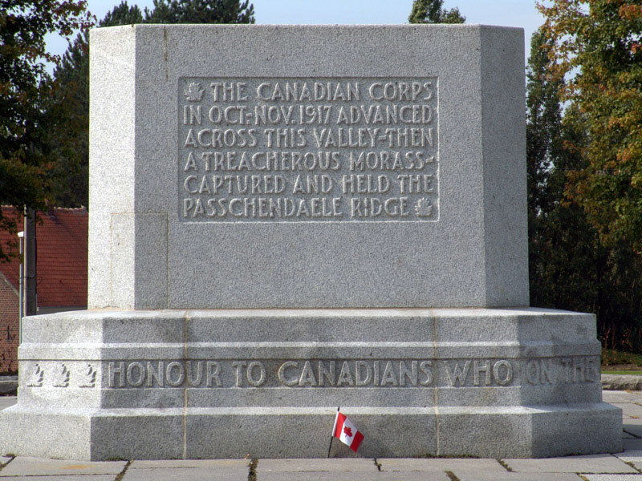
Notes:
Few battlefield areas evoke the tragedy of the Ypres salient more than Passchendaele, around the modern village of Passendale. The area is littered with memorials to individual battles and regiments, including the Canadian Memorial at Crest Farm, the 85th (Nova Scotia Highlanders) Battalion Memorial, and memorials to French soldiers and the British Seventh Division, both at Broodseinde.
Cemeteries in the area include the Passchendaele New British Cemetery, containing 2,101 British and Commonwealth burials, and the vast Tyne Cot cemetery to the southwest of Passendale. In Zonnebeke, the Passchendaele Memorial 1917 Museum contains a large display of military artifacts.

Slide 16
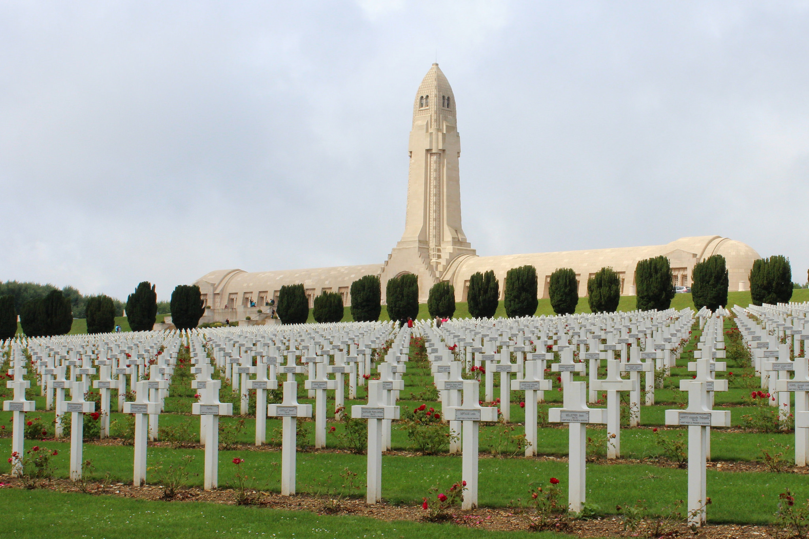
Notes:
This is arguably one of the most powerful memorials on the Western Front. Work on a provisional ossuary – a building where bones of the dead are kept – began in 1920 to provide a sanctuary for the hundreds of thousands of bones that were scattered throughout the Verdun battlefield site. Work on a permanent ossuary began in 1920, and bones were transferred here from the battlefield from 1927. The ossuary cloister contains the bones of 130,000 unidentified soldiers, arranged according to the area of the Verdun battlefield in which they were found.

Slide 17
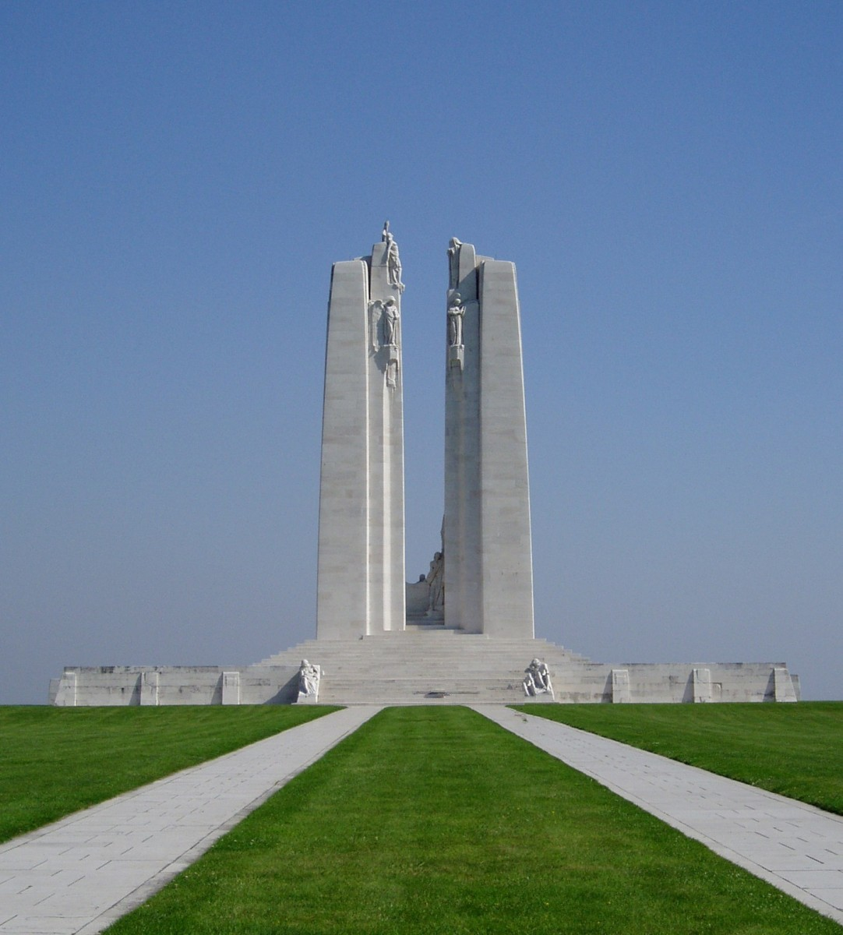
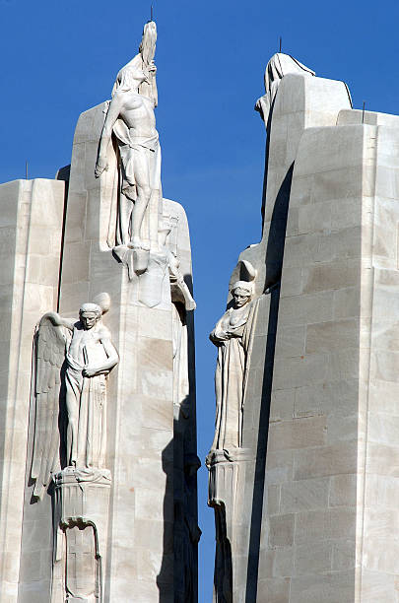
Notes:
Situated on land granted by France to the Canadian people, the memorial towers over the scene of Canada’s most recognizable First World War engagement, the Battle of Vimy Ridge, fought from 9 to 12 April 1917. The imposing structure was designed by Walter Allward, one of Canada’s most famous sculptors, whose commissions included the national memorial commemorating Canada’s participation in the South African War (1899-1902).
Allward began work on the Vimy memorial in 1925 and completed it 11 years later at a cost of $1.5 million. It is adorned by 20 allegorical figures representing faith, justice, peace, honour, charity, truth, knowledge, and hope. A key figure, “Canada mourning her fallen sons,” speaks to the country’s wartime losses. The Vimy Memorial is inscribed with the names of 11,285 Canadians who were killed on French soil and have no known graves.

Slide 18
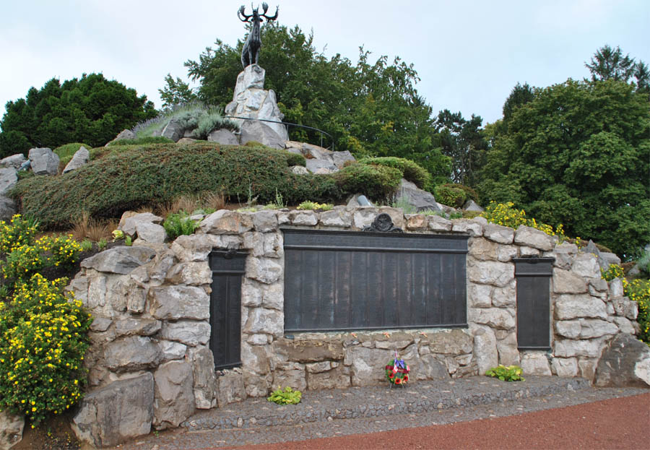
Notes:
The Caribou is one of 5 such memorials on the Western Front which commemorate the location where the 1st Battalion of the Newfoundland Regiment was in action. The caribou is the emblem of the Newfoundland Regiment. The sculptor of the bronze caribou was an Englishman called Basil Gotto.
The Caribou Memorial is situated on the high ground at the western side of the park, behind the British July 1916 Front Line, from where the 1st Battalion the Newfoundland Regiment began it's advance into the attack on that fateful morning. The shrubs around the rocks are native plants from Newfoundland.
At the base of the Caribou there are three bronze panels listing 814 names for the Memorial to the Newfoundlanders Missing. These are Newfoundlanders who died on land and at sea in the First World War and who have no known graves.
The Caribou can be accessed by a path and there is an orientation table giving an overview of the park. From here there is an excellent view of the Memorial Park and across the landscape to Beaumont village and to Thiepval on the high ground of the southern bank of the Ancre River.
There are 5 Caribou Memorials on the Western Front
Newfoundland Memorial Park, Somme battlefield near Beaumont Hamel
Geudecourt (1916), Somme battlefield near Bapaume
Harelbeke (1918), near Courtrai (Kortrijk)
Masnières (1918), near Cambrai
Monchy-le-Preux, near Arras

Slide 19
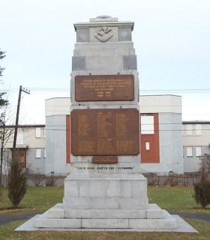
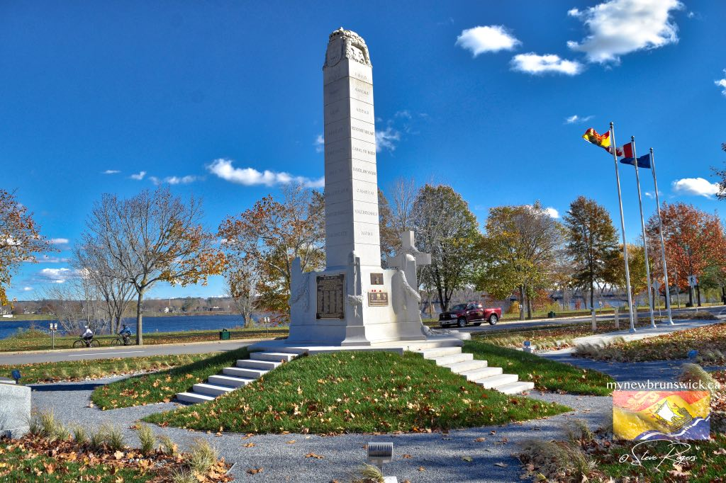
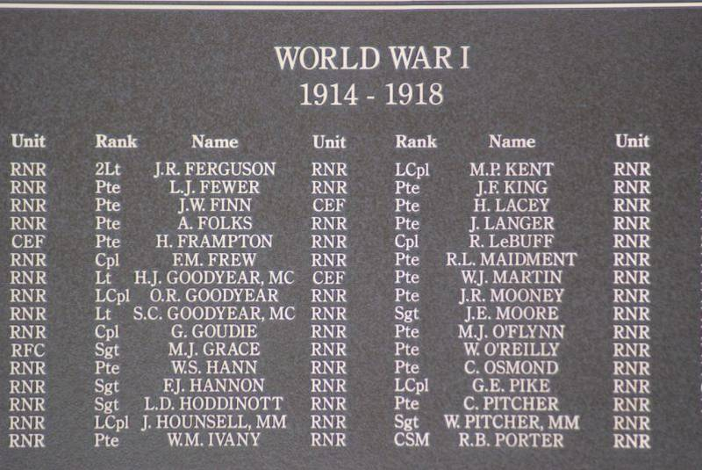
Notes:
War Memorial in Grand Falls Newfoundland and the Fredericton Cenotaph
Memorial University was founded and named as a tribute to the Newfoundlanders that lost their lives in WW1 and WW2.

Slide 20
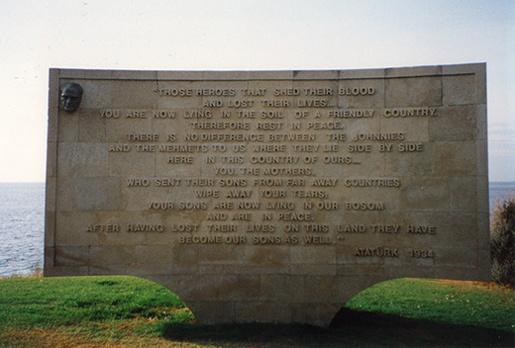
Notes:
Gallipoli - Memorial at Anzac Cove by Ataturk. "Those heroes that shed their blood and lost their lives… You are now lying in the soil of a friendly country. Therefore rest in peace. There is no difference between the Johnnies and the Mehmets to us where they lie side by side here in this country of ours… You, the mothers, who sent their sons from faraway countries wipe away your tears; your sons are now lying in our bosom and are in peace, after having lost their lives on this land they have become our sons as well." Ataturk, 1934

Slide 21
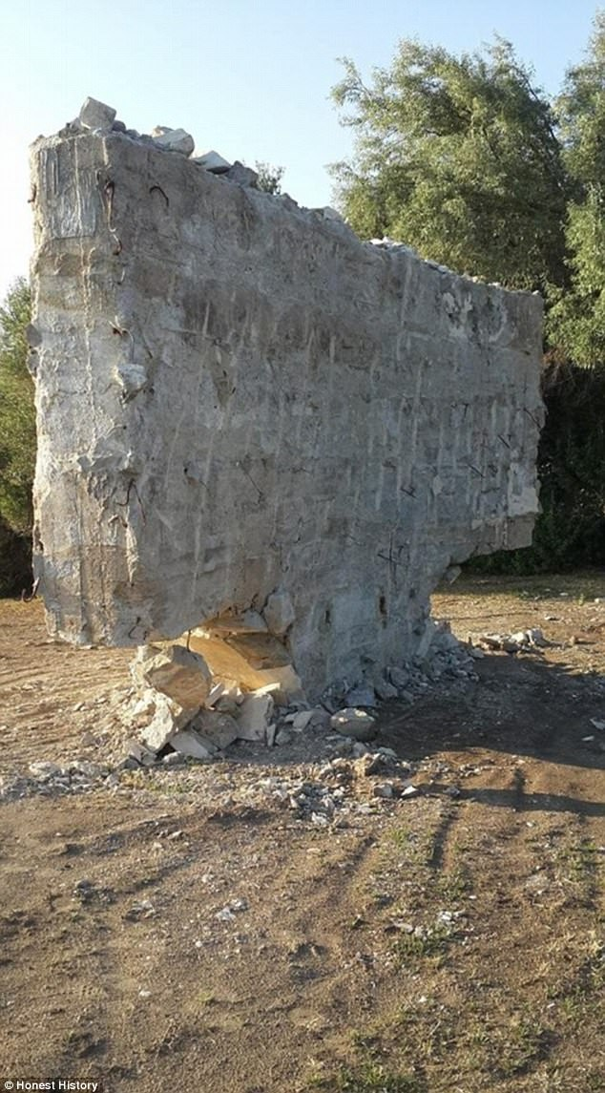
A “renovation” of an Anzac Cove memorial honouring Australian soldiers may be replaced by an inscription that reflects the Turkish Government's Islamic interpretation of the role diggers played in the Gallipoli invasion.
Notes:
A photograph shared on social media on May 19 shows a destroyed monument with words attributed by Turkey's founding father Mustafa Kemal Ataturk scratched out.
His words compared Australia's deceased 'Johnnies' to the Ottoman's 'Mehmets,' and gave them his blessing to be buried in his country.
While the Turkish Government has reassured the Australian Government they are undergoing refurbishment on the memorials at Gallipoli, sources say this process could be a ploy to make a political statement to reflect Turkey's shift to focus on religion and culture under the leadership of Recep Tayyip Erdogan.
Soldiers from the Australian Imperial Force in a trench at Lone Pine, during the Gallipoli Campaign, 1915 Digger is a military slang term for soldiers from Australia and New Zealand.
Although the Gallipoli campaign resulted in heavy casualties and ultimately ended in withdrawal for the Allies, the campaign became strongly linked with the emergence of national identity in Australia and New Zealand.

Slide 22
What about Germany?
The centenary of the outbreak of World War One has caught Germany off guard, while Britain, France, the United States and others mark it with battlefield tours, television programs, exhibitions and plans for ceremonies on the day, in August.
Germans aren’t sure how, or even if, they should commemorate a war that cost them 13 percent of their territory, all their colonies, huge reparations and 2.5 million lives. The government is under fire for its inactivity.
Notes:
By the time of the Armistice on 11th November 1918 the defeated German Armies on The Western Front had withdrawn from regions of France and Belgium which they had occupied under German military rule for up to four years. They had abandoned their memorials dedicated to their own fallen comrades and battles they had won.
As the defeated enemy they could only hope that the Allies would respect any German military memorials for the loss in human life that they represented. It would take until the mid 1920s before the Germans were able to establish formal relations with France and Belgium to allow preservation work to be carried out on German military cemeteries and surviving German memorials.

Slide 23
“Most Germans don’t want to have anything to do with the militaristic past,” said Stefan Scheybal, a mason who tends graves at the Invalids’ cemetery where Manfred von Richthofen was buried, a plot of land now bisected by a busy cycle path.
“We were brought up to scorn patriotism and everything about our belligerent history, so no one really feels a connection to World War One,” said Scheybal, 51. “Most Germans don’t care who the Red Baron was. Only English people come to see his grave.”

Slide 24
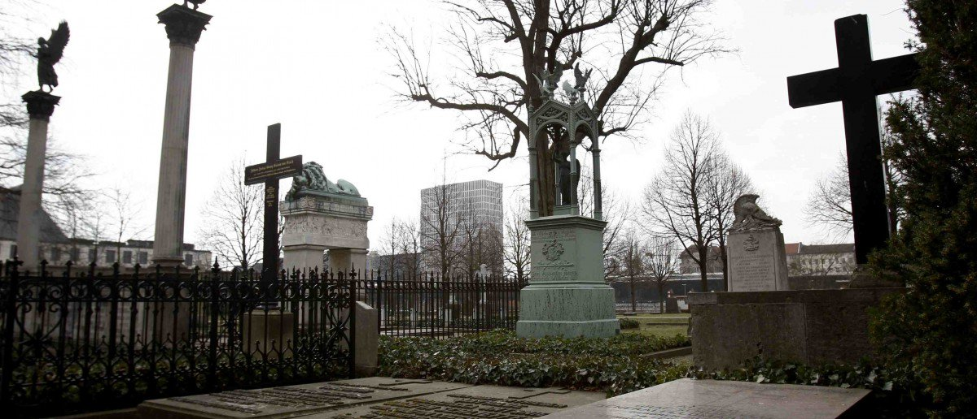
Notes:
A general view of the grave of field marshal Alfred von Schlieffen, at Invaliden cemetery in Berlin
“But that’s due to the collective memory of World War Two, as that overshadows World War One in every category from the loss of lives to the level of German guilt,” he told Reuters.
Another reason the war is so little remembered is that the Nazis manipulated its legacy for nationalistic propaganda in their march to power in 1933. Defeat was cast as the result of betrayal of the army by weak, defeatist civilians and communist revolutionaries.

Slide 25
Thoughts and Questions to Ponder
Many of these monuments were erected long after the end of the war. What does it say about the people who erected them?
What can we learn about the countries and groups that erect monuments to past events?
Are all monuments a good idea?

Slide 26
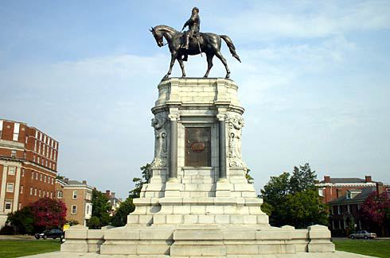
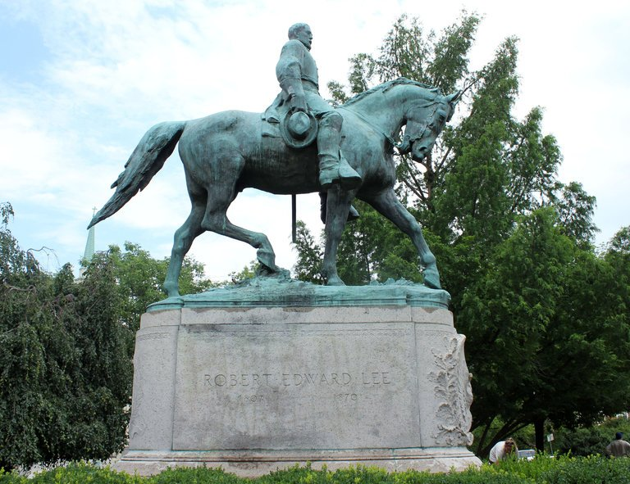
Notes:
Robert E. Lee Memorial Statue – This statue of the right was at the heart of the Charlottesville protest/riot last year.
The Charlottesville city council voted in February for it to be removed from the recently renamed Emancipation Park (formerly Lee Park). The decision came as part of a movement to challenge the ubiquity of Confederate symbols in the South.
In the decades after the Civil War, memorials celebrating the south’s valiant effort and glorious defeat appeared all over the region. They embodied the myth of the “lost cause” – the idea that the war had been fought to defend states’ rights, rather than slavery. In this interpretation, the south only lost because of the industrial might of the northern “aggressor”.
Many of these monuments were erected in the 30s – 50s, possibly to remember the past but more than likely to hamper the civil rights movement as racial segregation was an issue and the movement was gathering steam for the eradication of segregation.
Lee is one of the most frequent figures to be memorialised in statues, aside from the common soldier. In 2016, the Southern Poverty Law Center catalogued all publicly supported spaces dedicated to the Confederacy, finding 203 examples named for Robert E. Lee. Streets, highways, counties, cities, parks, monuments and 52 public schools are named for the Confederate general. Up until 2015, Lee’s birthday was officially marked in five states.

Slide 27
Notes:
Sir John A. Macdonald was one of the founders of the Dominion of Canada and during his terms as prime minister (1867-1873 and 1878-1891), the transcontinental railway was built. But he also served during the time the federal government approved the first residential schools in the country.
“He built this country but decided Indigenous people did not have a place in this country. They were disposable,” said James Daschuk, an assistant professor of history at the University of Regina and author of Clearing the Plains.
“He set up treaties and broke them, starved thousands of people on reserves, and was the architect for the relationship between Canada and First Nations … and the racism still festers today.”
Who: Edward Cornwallis is a soldier and politician who founded Halifax in 1749.
Controversy: Cornwallis issued an order dubbed the “Scalping Proclamation” in October 1749, in response to an attack on colonists, which paid out a government-funded bounty to anyone who killed a Mi’kmaq adult or child. The death toll of the attacks that occurred is not known, according to the Canadian Encyclopedia, but dozens of people claimed rewards.

Slide 28
Final Thoughts
What are your final thoughts on memorials?
Notes:
These memorials are supposed to help us remember and to be thankful for those who fight during the war but are we supposed to learn something from them?
What is the value of these monuments and memorials?
What are we supposed to learn?
Have we learned anything at all?

