Slide 1
The Challenge of Persia
The Persian Wars, 499-479 BCE

Slide 2
Classical Greece
Greece was not alone in the ancient world.
Other civilizations were developing around the Mediterranean.
One of the largest and most powerful was the Persian Empire.
The Persian empire was huge compared to the Greek empire.

Slide 3
Notes:
This empire was ruled by the King of Kings, Cyrus the Great. AKA: The Great King, King of Kings, King of Anshan, King of Media, King of Babylon, King of Sumer and Akkad, King of the Four Corners of the World

Slide 4
As the Greeks began to expand their influence into the Mediterranean they came into contact with the Persians from the east.
There were Greek states on the eastern side of the Aegean Sea. They were known as the “Ionian” city states.
Cyrus the Great, and his army, destroyed Lydia at Sardis in 546 BCE and absorbed Greek colonies in Asia Minor.

Slide 5
The Greeks wanted to be free from this foreign rule, and fought for independence. Athens supported the Ionian Greeks of Asia Minor.
Miletus staged a revolt in 499 BCE with support from Athens but were crushed by the Persians just 5 years later.
Although the Persians defeated the Ionians, they held a “grudge” against Athens for challenging their control.
Notes:
The Greeks valued their freedom and independence and often fought back against the Persians but were often defeated.

Slide 6
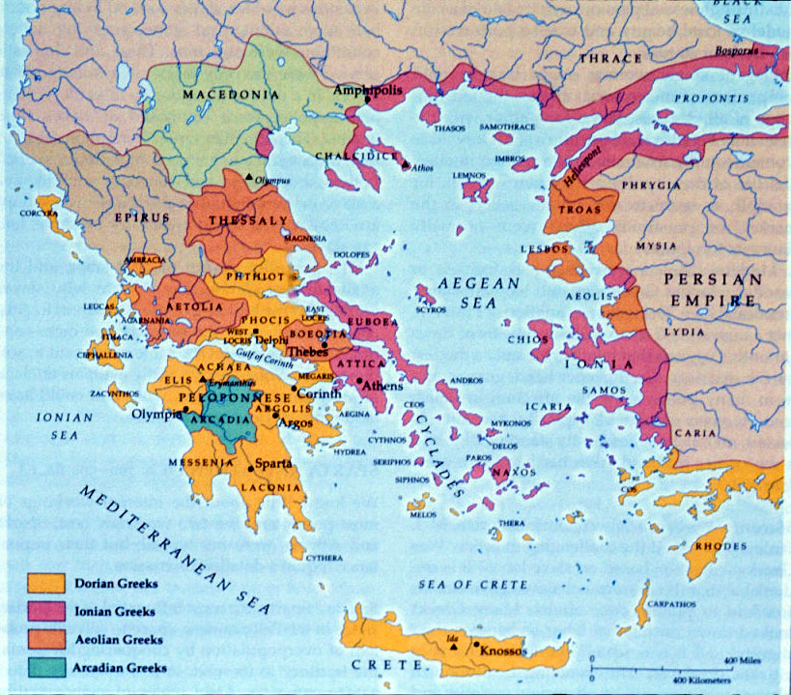

Slide 7
The Persians came three times, and fought three huge battles - Marathon, Thermopylae, and Salamis.
Each time the Persians were convinced they could easily conquer the Greeks. Each time, the Greeks drove them away.
What the Persians didn’t realize, but soon learned, was that the Greeks were incredible warriors.
The Athenians had an extremely strong navy.
The Spartan army was fearless, and had trained their whole life for war.

Slide 8
Battle of Marathon
In 490 BCE, the Persians landed on the plains of Marathon, only 42 km from Athens under the leadership of Darius I.
The battle of Marathon is one of history's most famous military engagements. It is also one of the earliest recorded battles.
In September of 490 BC a Persian armada of 600 ships erupted an invasion force of approximately 20,000 infantry and cavalry on Greek soil just north of Athens.
Notes:
Darius had one of his slaves say to him every meal “Sire, remember the Athenians” as the Persians were still bitter over the Athenian involvement in the Ionian revolt 9 years earlier.

Slide 9
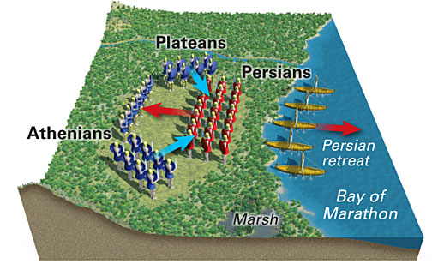
An estimated 6,400 Persians were slaughtered while only 192 Greeks were killed.
This defeat of the Persians was a huge positive for the Greeks as it showed that the seemingly undefeatable Persians could be beaten.
Notes:
Although the Athenians were outnumbered they managed to defeat the Persians by overwhelming the Persian hoard on its wings and trapping the core Persian fighters in the middle.
Undaunted by the numerical superiority of the invaders, Athens mobilized 10,000 hoplite warriors to defend their territory.
The remaining Persians escaped on their ships and made an attempt to attack what they thought was an undefended Athens. However, the Greek warriors made a forced march back to Athens and arrived in time to thwart the Persians.

Slide 10
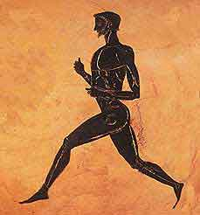
Upon their victory they had a messenger, named Pheidippides, run from Marathon to Athens proclaiming victory, this is where we get the distance for our modern day marathon. BTW, he apparently dropped dead upon his arrival.
Notes:
Pheidippides also ran a total of 250 km in two days relaying messages and even went to Sparta to ask for help. The Spartans couldn’t come until the next full moon, much too late as the Persians had already arrived.

Slide 11
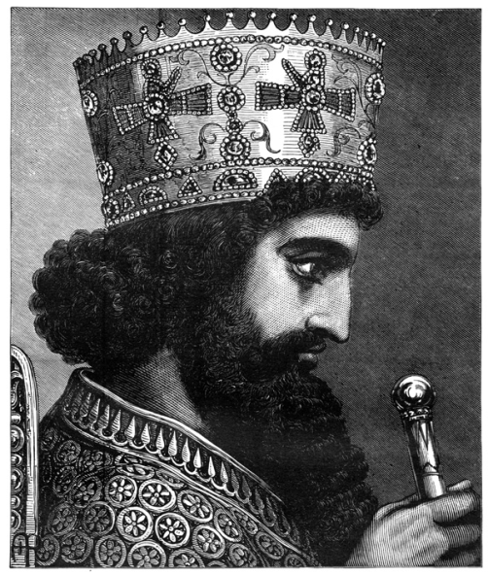
King Xerxes
After the death of Darius I in 486 BCE, Xerxes became the new Persian monarch.
Xerxes vowed revenge on Greece and planned a major invasion. His army numbered over 180,000 troops and thousands of warships and supply vessels.
The Greeks knew of this coming invasion and many Greek states collaborated with the Spartans in preparation for the attack. One Athenian leader, Themistocles, built a navy and eventually the Greeks had a navy of about 200 vessels.
Notes:
After becoming aware of the Persian defeat at the Battle of Marathon, Darius began planning another expedition against the Greek-city states; this time, he, not Datis, would command the imperial armies. Darius had spent three years preparing men and ships for war when a revolt broke out in Egypt. This revolt in Egypt worsened his failing health and prevented the possibility of his leading another army. Soon after, Darius died. I
There has been talk of Xerxes’ army was upwards of a million troops that was so large that they “drink the rivers dry”.

Slide 12
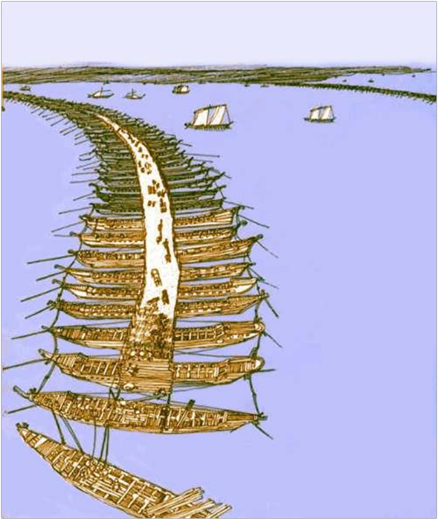
Xerxes’ army was so large it took weeks to cross the Hellespont using a makeshift bridge built from lashing boats together. This saves the Persia army a trip of 1300 km on their way to Greece.

Slide 13
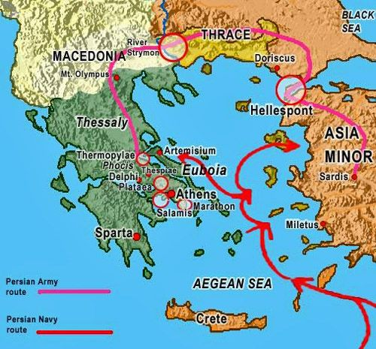

Slide 15
Battle of Thermopylae
Despite the overwhelming odds the combined forces of the Athenians, Spartans and other Greek states unified under a common goal to try to defend against the Persians.
The Greeks choose a defensive position at the pass of Thermopylae to hold off the Persians. This pass was along the main road into central Greece and was narrow enough to funnel Persian troops into a smaller line that would force smaller numbers of Persians to fight the waiting Spartans.

Slide 16
SHEG Documents - Reading
Question to answer:
How many Persians were at the battle of Thermopylae?

Slide 17
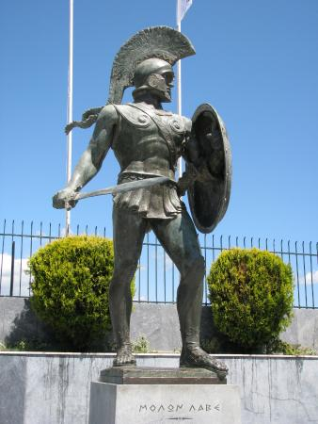
The Last Stand
A Greek force of 7000 troops held of the Persians for two days with superior fighting from 300 Spartans including their leader, Spartan King Leonidas.
While the Greeks fought bravely they were betrayed by a traitor who showed the Persians how to outflank the Greek troops using a mountain pass.
The Spartans fought until the last man fell.
Notes:
When the Persians first arrived at Thermopylae they sent a messenger to make an offer with the Spartan king. The first messenger told the Spartans to surrender as the Persian archers would darken the skies with arrows, Leonidas responded with “That is good news, We will fight in the shade”. They then asked Leonidas to join up with the Persian Empire and just “lay down their weapons” Leonidas responded by telling the messenger to “come take them”. (cold shivers)
Leonidas sent away other Greeks as they learned about the spy but the Spartans didn’t seem to mind, they just focussed on preparing for battle: combing their hair and beards and stretching and gymnastics.
Xerxes had an advisor, an old Spartan king that had fallen out of favour with the Greeks and had hoped to regain land when the Persians conquered Greece. Xerxes asked him what the Spartans were doing, Demaratus told him they were preparing to fight to the death as he had warned at the beginning of the Persian invasion of mainland Greece.

Slide 18
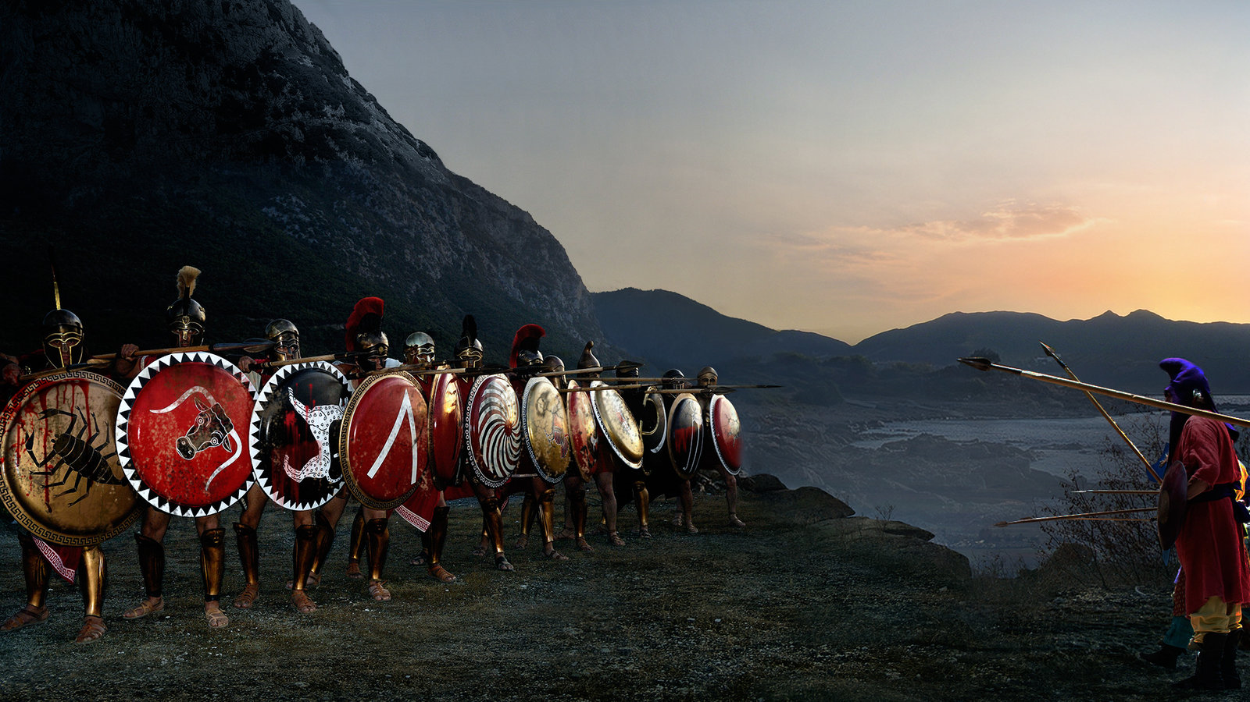

Slide 19
The Battle of Salamis
Under the opposing threat of the Persian invasion the Athenians abandoned their city and fled to the nearby island of Salamis.
Themistocles ordered all able-bodied men on the remaining Greek ships and assembled them into the straits of Salamis, a narrow body of water that the Athenians knew much better than the Persians.

Slide 20
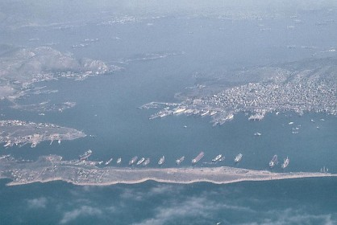
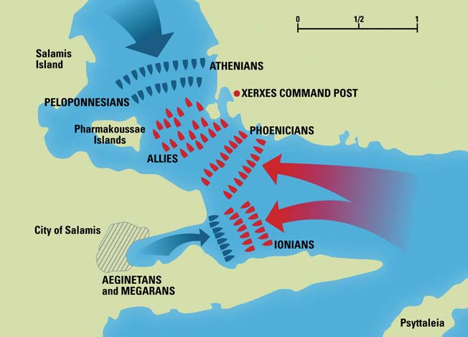

Slide 21
Trickery
Themistocles, posing as a traitor, dispatched a messenger to Xerxes telling them that the Greek fleet will be fleeing and if the Persians attacked the following day they would surly win as many Greeks would be disgusted with the cowardice of fleeing and turn on their countrymen.
Xerxes fell for the trick and sent his ships in where the Greeks took advantage of the chaos and familiar waters to destroy over 200 Persian ships while only losing 40.
The Persian fleet retreated back to the Hellespont and Xerxes went back east to Persia.

Slide 22
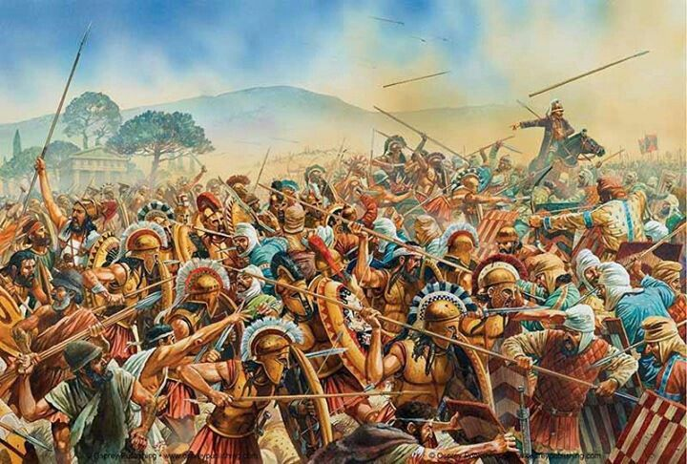
A few months after the Battle of Salamis in 489 BCE the Greek fleets defeated the last remaining Persian troops at Plataea in Boeotia and at Cape Mycale in Ionia. These final defeats drove the remaining Persians out of Greece and freed the remaining city-states from Persian control.

Slide 23
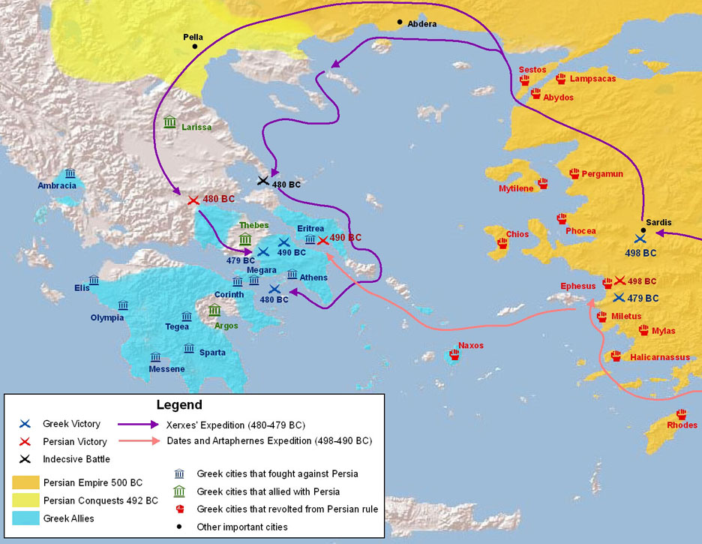

Slide 24
Questions
What effects do you think victory in the Persian Wars would have on the development of ancient Greece?
The Persian War was a pivotal point in history for not only Greece but western society as a whole. Use the space below to talk about why this Greek victory was so important to us today.
Notes:
Their victory over the Persian invaders gave the fledgling Greek city states confidence in their ability to defend themselves and belief in their continued existence. The battle is therefore considered a defining moment in the development of European culture.
It was a unifying force that brought Greeks together (temporarily), improved relations between city states.
A Persian victory would’ve been the end of democracy as Persia was ruled by a King (monarchy). If Greek Democracy ended, it, and Greek cultural influences, would not have spread throughout the western world like it did.

