Slide 1
The Shot Heard ‘Round the World
One of the many

Slide 2
Who do you think is the most important and significant person in the last century?
Consider:
Who has had the biggest impact on global issue? Who has influenced world events to the greatest degree? What person has changed the face of the planet?

Slide 3
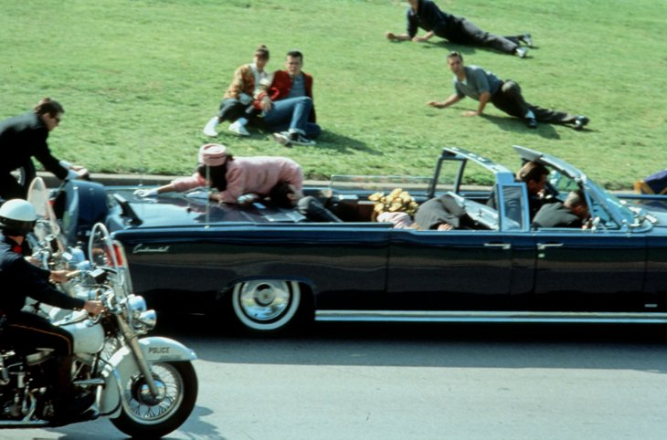
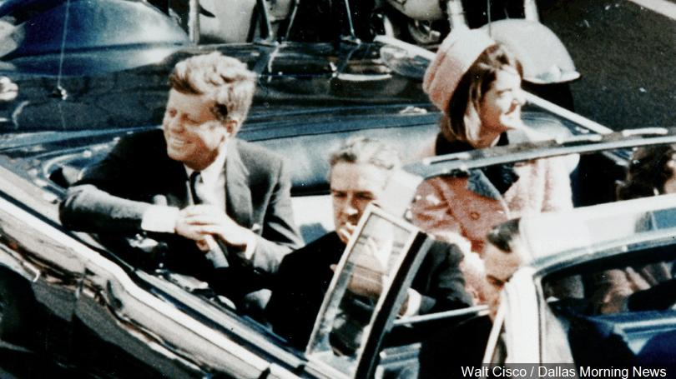
November 22, 1963
Notes:
In 1963, JFK was assassinated by Lee Harvey Oswald just as the FBI reported. For years people have been suggesting conspiracies that claim that other more nefarious groups had been involved and to many this idea is comforting. Comforting because it is easier to believe that a greater power or influential group must be behind these defining moments in history and not just some nobody.

Slide 4
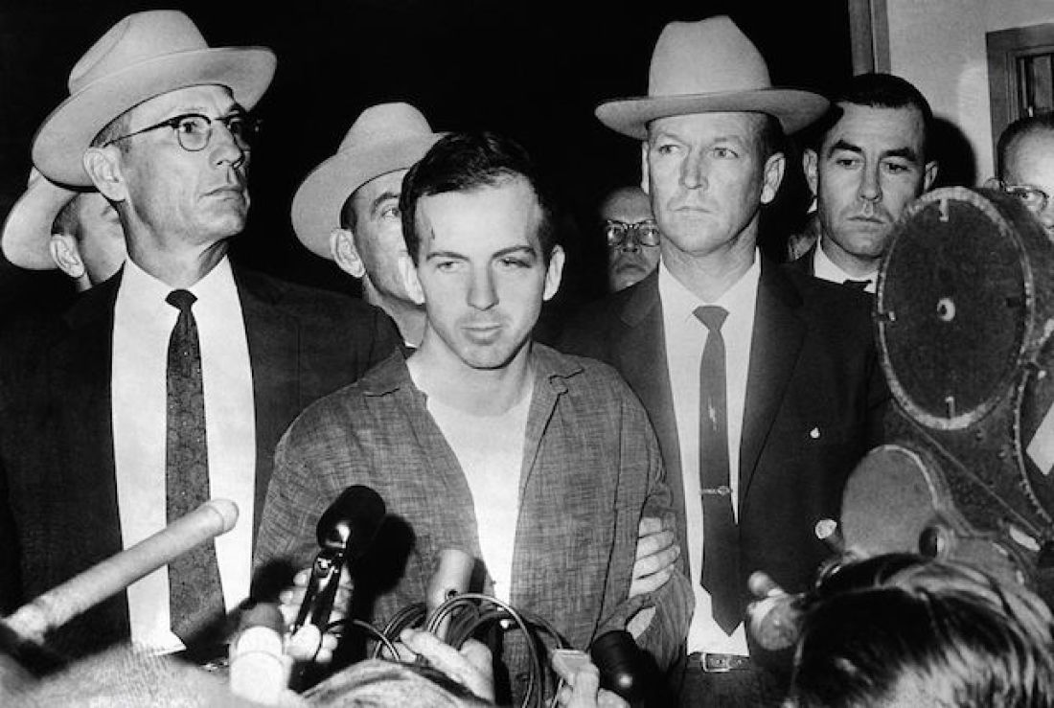
Lee Harvey Oswald
Notes:
In terms of significant American History Oswald was a nobody, especially when compared to a JFK. Oswald didn’t do anything of importance other than pull a trigger. But that simple action changed the world, he changed the POTUS immediately. This example of terrorism has solidified Oswald as a somewhat notable figure in history.

Slide 5
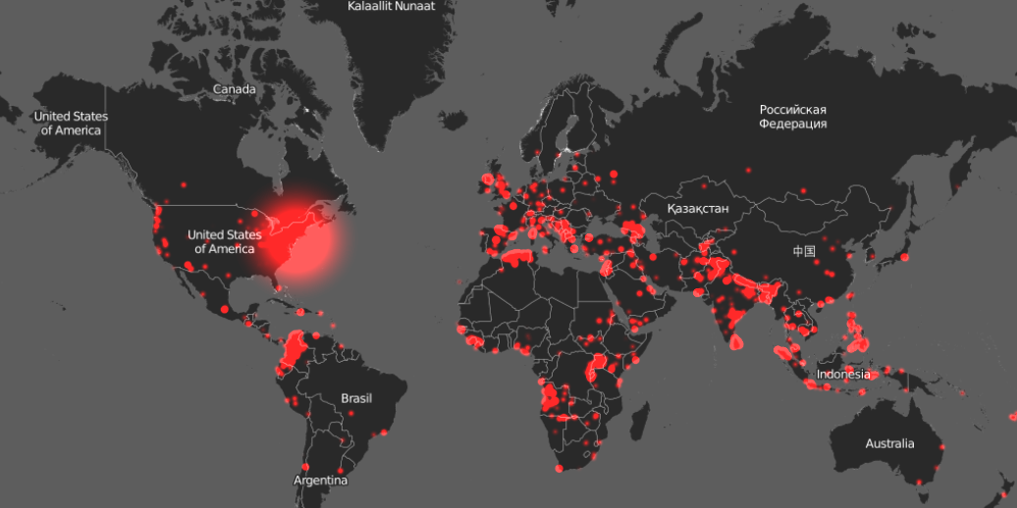
Data from the Global Terrorism: The last two decades of terrorist activity.
Notes:
When we look at modern day terrorism we have to understand that although many people talk about how we are living in an era of terrorism they seem to forget that we’ve been living in the aftermath of a case of terrorism that started just over a 100 years ago.

Slide 6
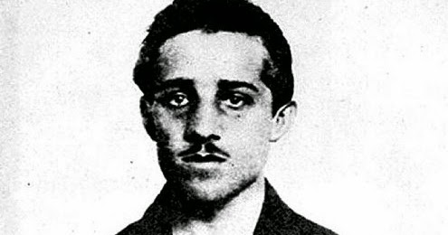
Gavrilo Princip
'I am a Yugoslav nationalist and I believe in the unification of all South Slavs in whatever form of state and that it be free of Austria.'
Notes:
I would argue with anyone that the most significant and influential person in the last 100 in world history is Gavrilo Princip. This name is one that many of you and most of the general public would not recognize. How could someone of so little fame and achievement on the world stage be credited with shaping the world as we know it? If Gavrilo Princip never had been would we have a 9/11? If Princip had never been we wouldn’t have had a WW2 because Princip is the reason why we had a first world war.

Slide 7
Gavrilo Princip, a Bosnian-Serb nationalist whose assassination of the Archduke of Austria-Hungary arguably launched World War I.
Though Princip's actions were designed to unite his people and not to start a world war, he inadvertently set into motion a chain of events that would change the world forever.
“There is no need to carry me to another prison. My life is already ebbing away. I suggest that you nail me to a cross and burn me alive. My flaming body will be a torch to light my people on their path to freedom.”
Notes:
In 1894, Gavrilo Princip was born to a poor family in what is now Bosnia-Herzegovina in southeastern Europe. During Princip's lifetime, his homeland was in a tense political situation. Ethnic Slavs (including Princip's family) populated southeastern Europe, which had been controlled by other empires for several centuries. Austria-Hungary controlled the region beginning in 1908. As a result, nationalism was growing, and Princip was one among many who wanted to separate from Austria-Hungary and create an independent Slavic state.

Slide 8
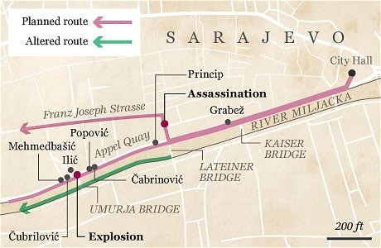
Notes:
The events of June 28th, 1914 played out in a story that seems out of Hollywood. Princip and other members of the rebel group the Black Hand find themselves lining the parade route of the soon-to-be reigning monarch of Austria-Hungary. Now Austria-Hungary were the controlling country that ruled over Bosnia and many people in Bosnia, including Princip and his fellow conspirators, wanted to become members of a larger Serbian kingdom, remember back to the reading on Nationalism.

Slide 9
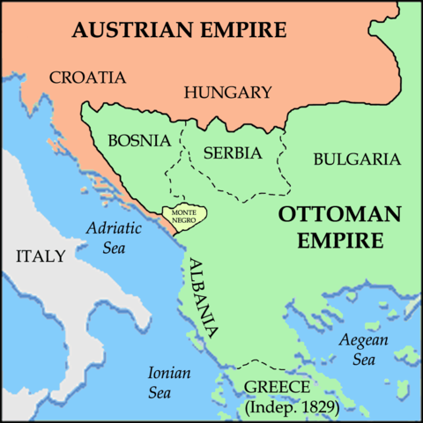
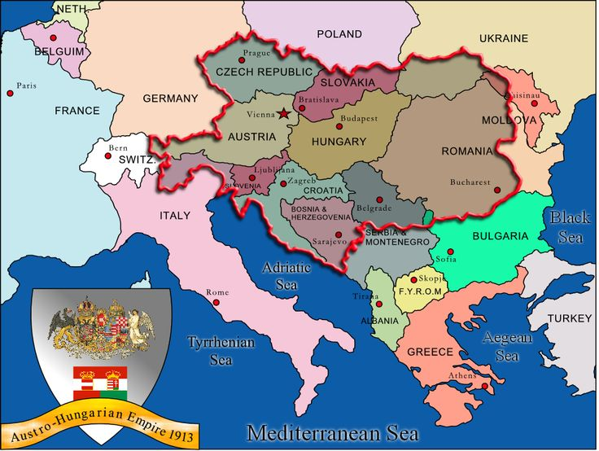
Notes:
On June 28th Princip and up to 20 other terrorists/freedom fighters (might be 6) show up to Sarajevo with murder on their minds. They want to kill this heir to the throne. This heir, Archduke Francis Ferdinand and his wife are visiting Sarajevo to watch military maneuvers which just so happens to coincide with the anniversary of the biggest loss in Bosnian history (Battle of Kosovo)that happened a few hundred years earlier (the Serbs are very patriotic). This region in the Balkans have been battling it out for years in an attempt to gain independence from the Ottoman Turks and now the Bosnia were under the control of these Austria-Hungarians.
Ottoman Bosnia – 1463-1878
Austro-Hungarian rule – 1878-1918

Slide 10
Primary Source
Borijove Jevtic, one of the conspirators gave this eyewitness account:
"When Francis Ferdinand and his retinue drove from the station they were allowed to pass the first two conspirators. The motor cars were driving too fast to make an attempt feasible and in the crowd were many Serbians; throwing a grenade would have killed many innocent people.
Notes:
Like JFK in ’63 the Archduke’s parade route was published ahead of time and he will be travelling in an open car with his wife. The would be assassins have spread themselves out along the route but at first the car is travelling too fast or there are too many Serbs in the crowd and many of the members of the Black Hand do not get a chance at their target.

Slide 11
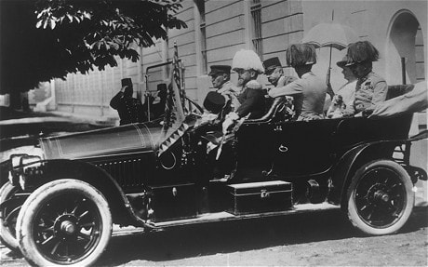
Notes:
Eventually one assassin sees an opportunity and runs at the car with a bomb (more like a grenade by our standards). He throws the grenade but the duke ducks behind the door of his car and the grenade bounces off the door and doesn’t explode until the next car in the motorcade passes over it. 20+ people are hurt and people scatter. The assassin shoves a cyanide pill into his mouth and runs for the river. The pill doesn’t work, other than makes him vomit and the river, possibly due to the time of the year is only 6 inches deep, he’s captured and dragged away for interrogation. It seems all is well for the Archduke.

Slide 12
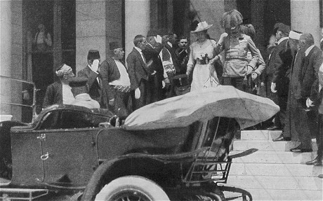
Notes:
The parade is over but the Archduke goes to the town hall to lodge a complaint. The would-be assassins all break off as their opportunity has passed them by. After an hour the Archduke and his wife and some officials decide to go to the hospital to check on those who were wounded following an unplanned route. The driver didn’t realize the route to the hospital was not along the planned route and makes a wrong turn, he stops that car in and begins to turn around and who should be on that random corner at that specific time? 19 year old Gavrilo Princip.

Slide 13
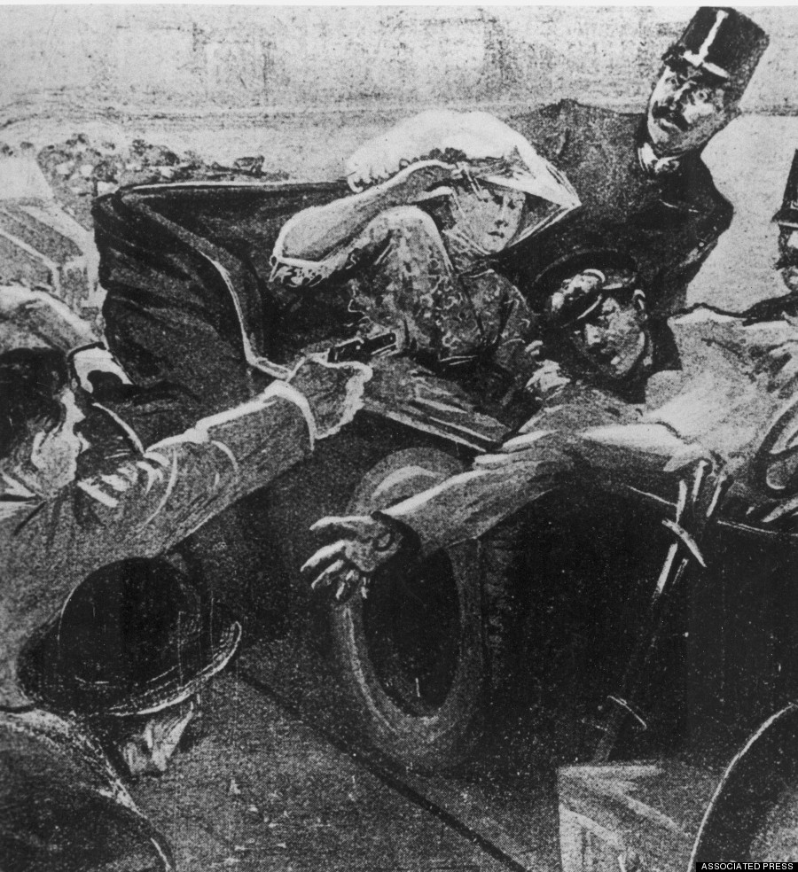
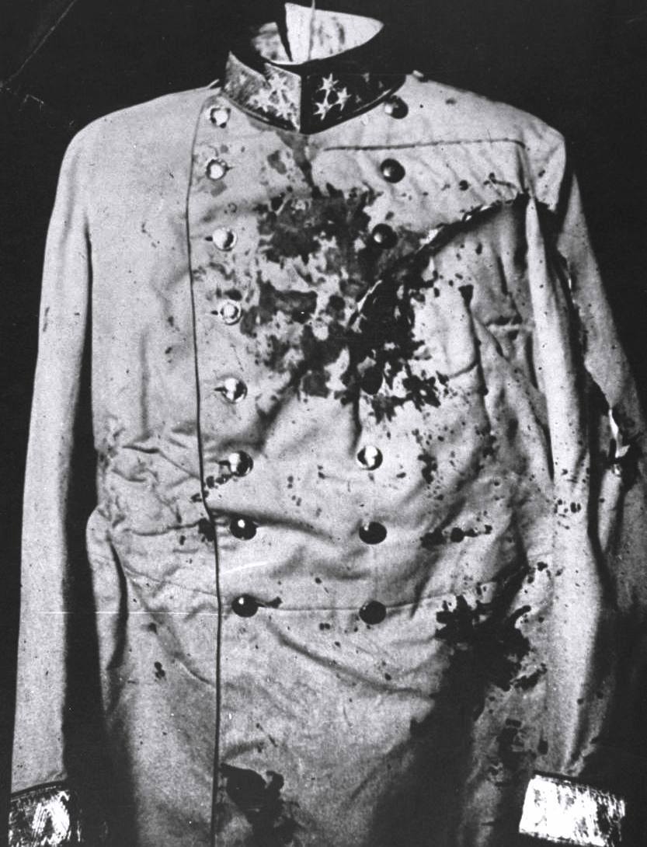
Notes:
Princip whips out his pistol and from just a few feet away, shoots both the Archduke and his wife. This has got to be one of the most coincidental events in history.

Slide 15
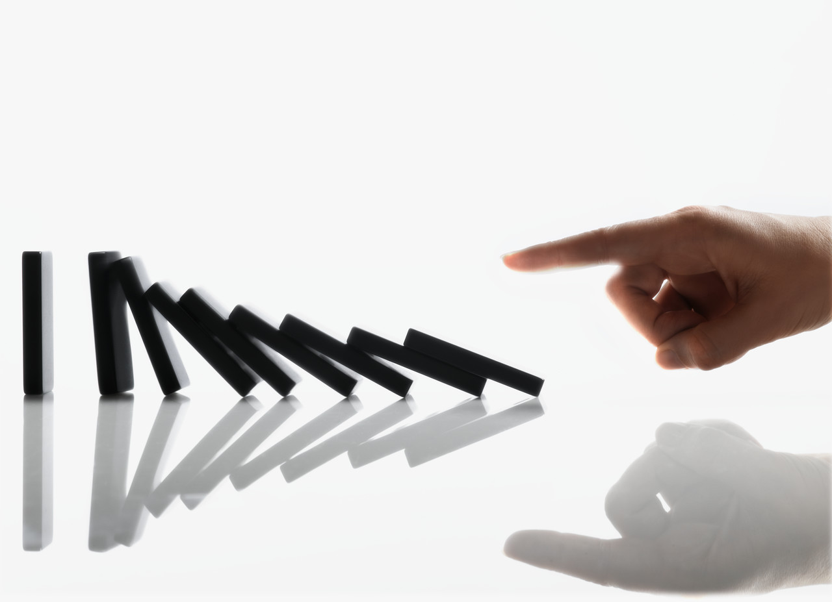
Action - Reaction
Notes:
Now one thing you need to remember is that Princip’s actions were not necessarily the most important action but rather the responses of the victims to that action that is monumental. The response to this action would set in motion an event that will become the deadliest war the planet has even experienced up to this point.

Slide 16
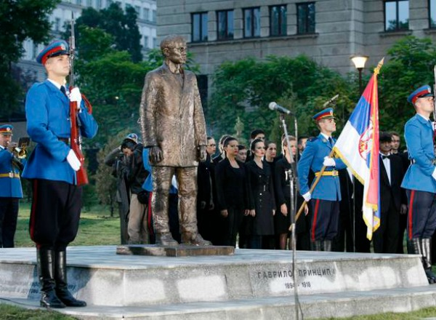
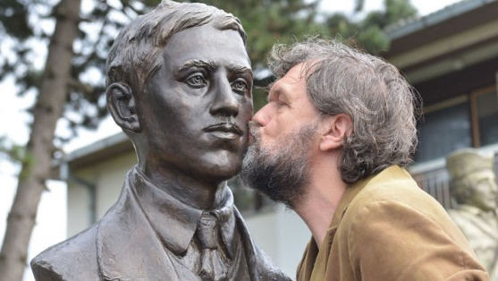
Notes:
To the Serbs of Bosnia the assassins and Gavilo Princip are remembered as national heroes and freedom fighters but to many other they are classified as terrorists and murderers.

Slide 17
Reactions
The German ambassador at Vienna described Austria’s reaction to the assassination:
“Here I hear serious people express the desire of settling accounts with the Serbs once and for all. A series of conditions should be sent to the Serbs, and if they do not accept these, energetic steps should be taken.”
Dispatch from the German ambassador at Vienna July 10, 1914

Slide 18
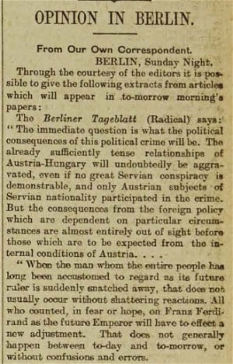
Reactions
The Austro-Hungarians didn’t know if the Serbian govt were directly involved in the assassination but they didn’t really care.
The Austro-Hungarians feared if they were to retaliate that Russia would get involved as they had been supporters of Serbia. In an attempt to balance the scale Austria-Hungary asked for support from Germany.
Notes:
The German Emperor, William II, gave Austria-Hungary a blank cheque, essentially promising to give them full support if was broke out with Russia.

Slide 19
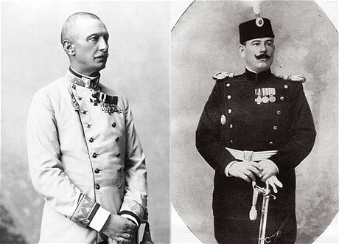
The Black Hand
Notes:
Black Hand, secret Serbian society of the early 20th century that used terrorist methods to promote the liberation of Serbs outside Serbia from Habsburg or Ottoman rule and was instrumental in planning the assassination of the Austrian archduke Franz Ferdinand (1914), precipitating the outbreak of World War I. The society was formed; its members were primarily army officers with some government officials. Operating from Belgrade, it conducted propaganda campaigns, organized armed bands in Macedonia (before the Balkan Wars, 1912–13), and established a network of revolutionary cells throughout Bosnia. Within Serbia it dominated the army and wielded tremendous influence over the government by terrorizing officials; it became so powerful that its authority challenged that of the government.

Slide 20
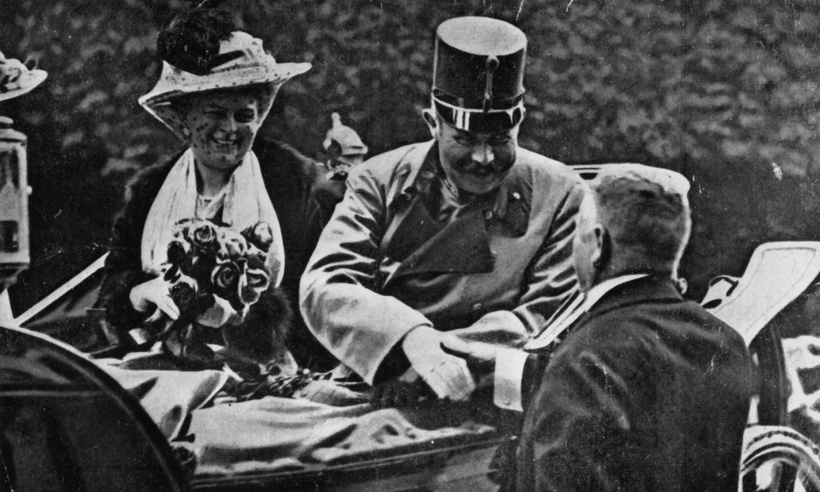
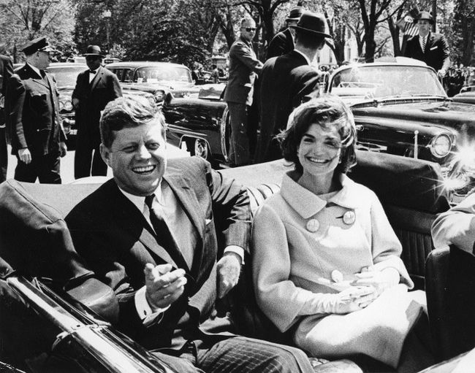
To connect it back to the JFK story we have to consider what was the connections between the Black Hand and outside influences? Was it a small terror group or were they an example of “state sponsored terrorism”? Was there a rival power behind this assassination?
Notes:
Why I mentioned JFK was because his name had been in the news lately and the FBI documents about his death have become public. It appears that Oswald did have some connections with the largest American rival, Russia. (Oswald’s reported meeting with a KGB officer in Mexico City nearly two months before the assassination.)

Slide 21
Questions to Consider
Why, if this is true, wasn’t it release to the general public?
It was in the midst of the Cold War and if this information had been released it could’ve escalated into WW3, with nukes.
Do you see the connections between the JFK and Ferdinand assassinations?
How might foreign governments influence one another’s citizens?
Notes:
The Cold War refers to the period between the end of the Second World War and the collapse of the Soviet Union in 1991, during which the world was largely divided into two ideological camps — the United States-led capitalist “West” and the Soviet-dominated communist “East.”
It has become evident that Russians were involved in undermining the 2016 US Presidential Elections and Russian actors organized both anti-Islam and pro-Islam protests in the same location at the same time on May 21, 2016. - http://www.businessinsider.com/russia-trolls-senate-intelligence-committee-hearing-2017-11

Slide 22
Task
Read The Logic of Power by Walter Jones
Create a graphic organizer for the information contained in it
Be prepared to discuss it

