Slide 1
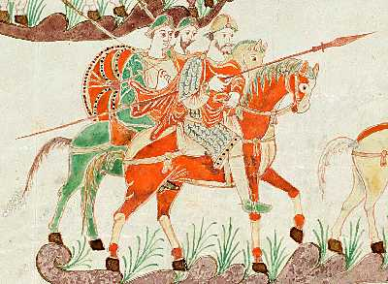
Rise of the Franks and Feudalism

Slide 2
The Frankish kingdom was the strongest of the early German states and developed new laws based on the importance of family in Germanic society.
The Germanic peoples had begun to move into the lands of the Roman Empire by the third century.
The Visigoths occupied Spain and Italy until the Ostrogoths, another Germanic tribe, took control of Italy in the fifth century.
By 500, the Western Roman Empire had been replaced by a number of states ruled by German kings.
Roman influence was even weaker in Britain.
Notes:
The merging of Romans and Germans took different forms in the various Germanic kingdoms. Both the kingdom of the Ostrogoths in Italy and the kingdom of the Visigoths in Spain retained the Roman structure of government.
However, a group of Germanic warriors came to dominate the considerably larger native populations and eventually excluded Romans from holding power.
When the Roman armies abandoned Britain at the beginning of the fifth century, the Angles and Saxons, Germanic tribes from Denmark and northern Germany, moved in and settled there. Eventually, these peoples became the Anglo-Saxons.

Slide 3
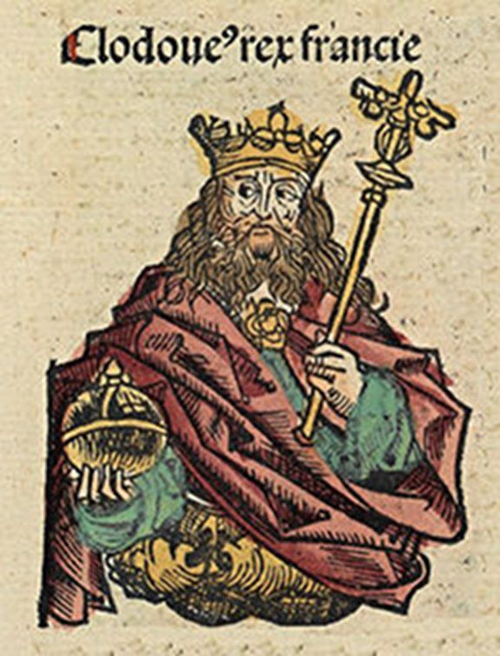
The Rise of the Franks
Only one of the German states on the European continent proved long lasting—the kingdom of the Franks. The Frankish kingdom was established by Clovis, a strong military leader who around 500 became the first Germanic ruler to convert to Christianity.
Clovis found that his conversion to Christianity won him the support of the Roman Catholic Church, as the Christian church in Rome was now known.
By 510, Clovis had established a powerful new Frankish kingdom that stretched from the Pyrenees in the southwest to German lands in the east—modern-day France and western Germany. He defeated the many Germanic tribes surrounding him and unified the Franks as a people.
Notes:
During a battle with another Germanic tribe, however, Clovis’s army faced certain destruction. Clovis was reported to have cried out, “Jesus Christ, if you shall grant me victory over these enemies, I will believe in you and be baptized.” After he uttered these words, the enemy began to flee, and Clovis soon became a Christian.

Slide 4
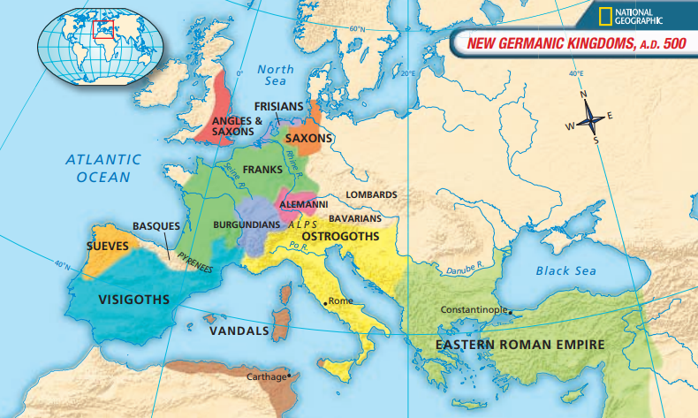
Germanic Kingdoms
Of all these kingdoms only the Franks, Ostrogoths, Visigoths and the Basques have survived to this day.

Slide 5
Christianity and the Pope
By the end of the fourth century, Christianity had become the supreme religion of the Roman Empire. As the official Roman state fell apart, the Church played an increasingly important role in the growth of the new European civilization.
Western Christians came to accept the bishop of Rome—the pope—as head of the Church, but they did not agree on how much power he should have. In the sixth century, a strong pope, Gregory I, known as Gregory the Great, strengthened the power of the papacy (office of the pope) and the Church.
Notes:
Gregory I, pope from 590 to 604, was also leader of the city of Rome and its surrounding territories (later called the Papal States), thus giving the papacy a source of political power. Gregory I increased his spiritual authority over the Church in the West. He was especially active in converting non-Christian peoples of Germanic Europe to Christianity. He did this through the monastic movement.

Slide 6
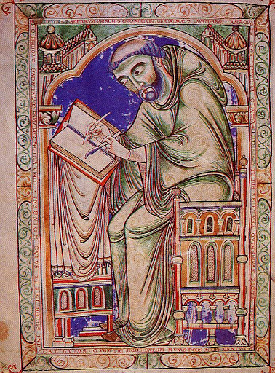
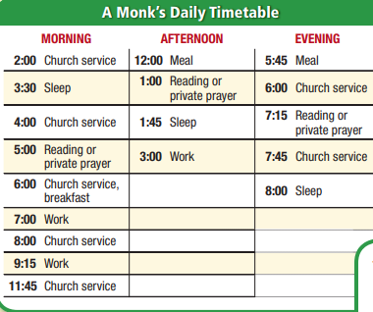
Monasticism
Notes:
Monks were men who devoted their lives to the Church. They took vows of poverty, chastity, and obedience. They also took a vow of stability, swearing to remain in the monastery until death, closed off from the rest of the world. St. Benedict established a daily timetable for monks. Along with Church service and prayer, monks worked. They did manual labor along with intellectual work, creating illuminated manuscripts and transcribing religious works.
Monks became the new Christian heroes, an important force in the new European civilization. The monastic community set the highest ideal of Christian life and provided a moral example to all. Monks were the social workers of their communities, providing schools for the young, hospitality for travelers, and hospitals for the sick. They also taught peasants carpentry and weaving and made agricultural improvements that they passed on to others. Monasteries became centers of learning.

Slide 7
The New Roman Empire?
During the 600s and 700s, the Frankish kings gradually lost their power to the mayors of the palace, chief officers of the king’s household.
It wasn’t until 768 with Charlemagne that Europe witnessed a new Empire appear. He greatly expanded the Frankish kingdom and created what came to be known as the Carolingian Empire. At its height, this empire covered much of western and central Europe.
As Charlemagne’s power grew, so too did his prestige as the most powerful Christian ruler. One monk even described Charlemagne’s empire as the “kingdom of Europe.” In 800, Charlemagne acquired a new title— emperor of the Romans.
Notes:
One of them, Pépin, finally took the logical step of assuming the kingship for himself and his family. Pépin was the son of Charles Martel, the leader who defeated the Muslims at the Battle of Tours in 732. Upon Pépin’s death in 768, his son became the new Frankish king. This powerful ruler is known to history as Charles the Great, or Charlemagne.

Slide 8
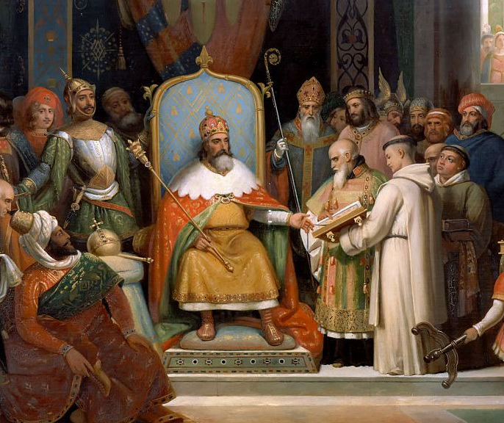
Charlemagne
Did you know? Charlemagne served as a source of inspiration for such leaders as Napoleon Bonaparte (1769-1821) and Adolf Hitler (1889-1945), who had visions of ruling a unified Europe.
Notes:
Charlemagne had a strong desire to promote learning in his kingdom. This desire stemmed from his own intellectual curiosity and from the need to educate Catholic clergy and government officials. His efforts led to an intellectual revival sometimes called the Carolingian Renaissance, or rebirth. This revival involved renewed interest in Latin culture and classical works—the works of the Greeks and Romans.

Slide 9
The End of the Carolingian Empire
The Carolingian Empire was weakened from within by division after Charlemagne’s death and from outside by enemy attacks. Local nobles became more important as people turned to them for the protection that the empire could no longer provide. The result was feudalism, a new political and social order in Europe.
The Carolingian Empire began to fall apart soon after Charlemagne’s death in 814. Less than 30 years later, it was divided among his grandsons into three major sections: the west Frankish lands, the eastern Frankish lands, and the Middle Kingdom. Local nobles gained power while the Carolingian rulers fought each other.
Notes:
Charlemagne held his empire together with his personal power and prestige as a leader and the strong administrative system he established. His death created a vacuum of leadership that left the empire vulnerable. The Frankish tradition of dividing an estate among the surviving heirs also weakened the empire. As the Germanic tribes had moved into the Roman Empire and helped create a new European civilization, new invaders entered Europe and influenced its culture.

Slide 10
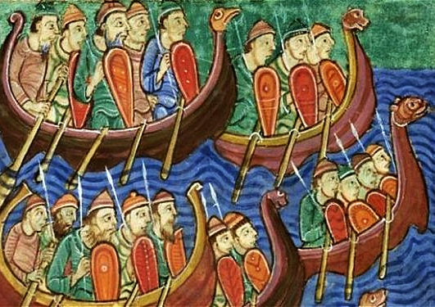
More Invasions!
In the ninth and tenth centuries, western Europe was beset by a wave of invasions.
The Muslims attacked the southern coasts of Europe and sent raiding parties into southern France.
The Magyars, a people from western Asia, moved into central Europe at the end of the ninth century, settled on the plains of Hungary, and invaded western Europe.
The most far-reaching attacks of the time, however, came from the Norsemen or Northmen of Scandinavia, also called the Vikings.
Notes:
Beginning in 911, the ruler of the west Frankish lands gave one band of Vikings land at the mouth of the Seine River, forming a section of France that came to be known as Normandy. The Frankish policy of settling the Vikings and converting them to Christianity was a deliberate one. As a result of their conversion to Christianity, the Vikings were soon made a part of European civilization.

Slide 11
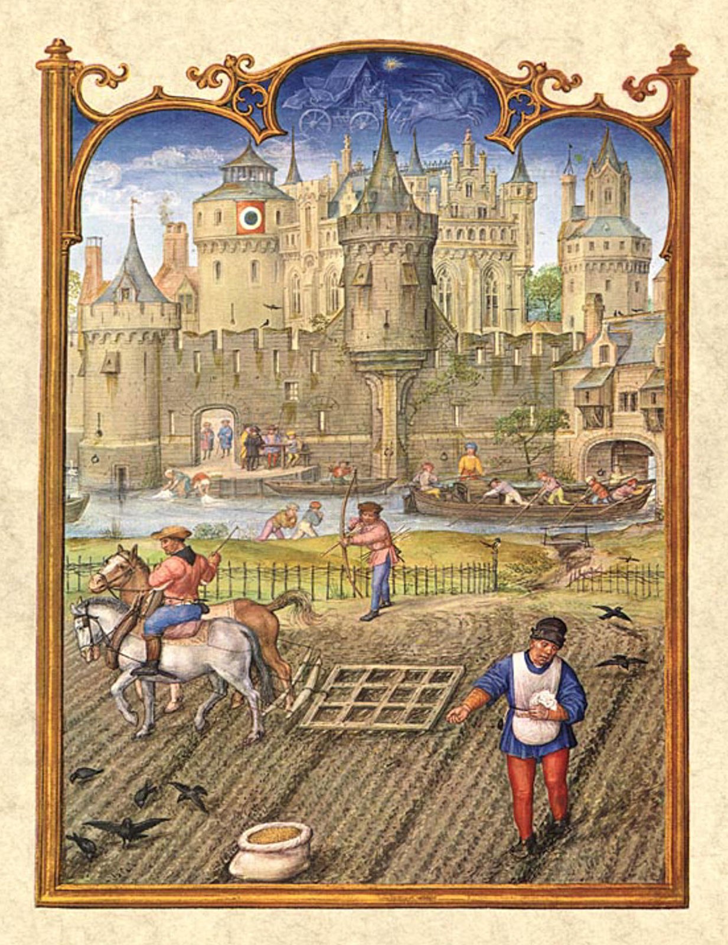
Introduction of Feudalism
At the heart of feudalism was the idea of vassalage. In Germanic society, warriors swore an oath of loyalty to their leaders and fought in battles for them. The leaders, in turn, took care of the warriors’ needs. By the eighth century, a man who served a lord in a military capacity was known as a vassal.
Notes:
The Vikings and other invaders posed a large threat to the safety of people throughout Europe. Rulers found it more and more difficult to defend their subjects as centralized governments such as the Carolingian Empire were torn apart. Thus, people began to turn to local landed aristocrats, or nobles, to protect them. To survive, it became important to find a powerful lord who could offer protection in return for service. This led to a new political and social order known as feudalism.

Slide 12
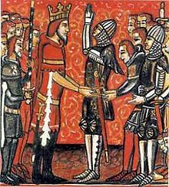
The Feudal Contract
PRIMARY SOURCE
“The man should put his hands together as a sign of humility, and place them between the two hands of his lord as a token that he vows everything to him and promises faith to him; and the lord should receive him and promise to keep faith with him. Then the man should say: ‘Sir, I enter your homage and faith and become your man by mouth and hands [that is, by taking the oath and placing his hands between those of the lord], and I swear and promise to keep faith and loyalty to you against all others.’”
— A Source Book for Medieval History
Notes:
In feudal society, having loyalty to one’s lord was the chief virtue. The relationship between lord and vassal was made official by a public ceremony. To become a vassal, a man performed an act of homage to his lord (see above)
Feudalism came to be characterized by a set of unwritten rules—known as the feudal contract—that determined the relationship between a lord and his vassal. The major obligation of a vassal to his lord was to perform military service, usually about 40 days a year.

Slide 13
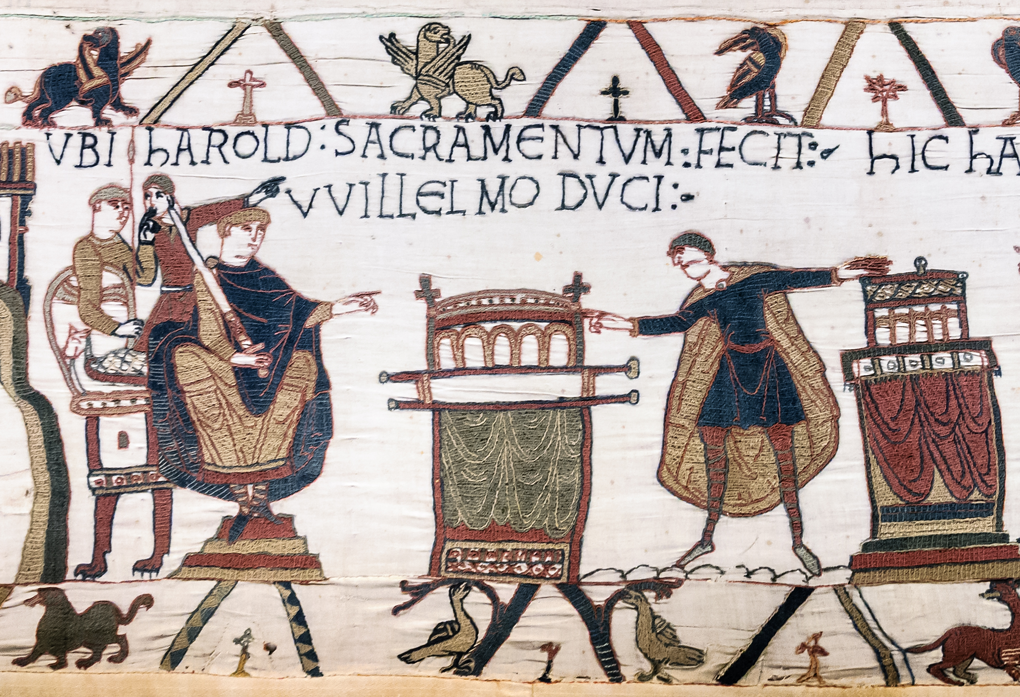
Feudalism became very complicated
By the ninth century, the grant of land made to a vassal had become known as a fief. Vassals who held fiefs came to hold political authority within them.
The vassals of a king might also have vassals who would owe them military service in return for a grant of land taken from their estates.
Those vassals, in turn, might likewise have vassals as well. At that level, the vassals would be simple knights with barely enough land to provide income for their equipment.

Slide 14
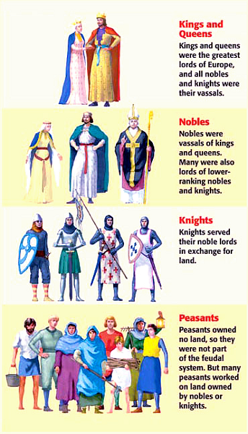
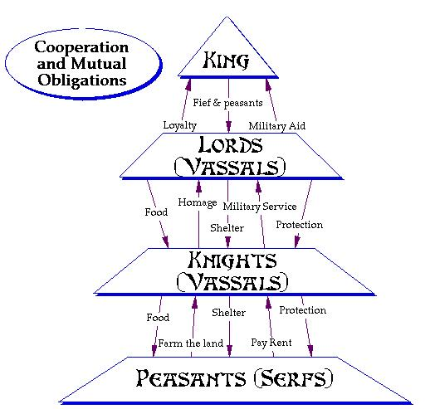
Notes:
From roughly 800 to 1500, the social system of feudalism provided security for most of Europe. Feudalism involved a complex web of obligations for people at all levels of society. Kings awarded tracts of land, called fiefs, to nobles. As vassals to the king, nobles pledged their loyalty and promised military services as a knight. Wealthier nobles subdivided their land into fiefs for lesser nobles and thus had vassals of their own. Peasants and serfs were not a formal part of feudalism. They were tied to the land. For them, the feudal order meant security.

Slide 15
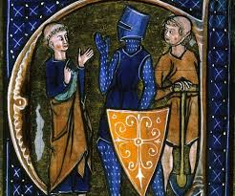
Feudalism had 3 main functions:
It regulated the distribution of land and, therefore, wealth.
It ensured protection of all people of a territory.
It provided a structure which determined each person's place, rights, and responsibilities in society.

Slide 16
Merits of Feudalism:
It saved the common men from the foreign invaders.
Feudal Lords were able to save the common men from the tyranny of the King. The common men get respite. A healthy society was created in Europe by feudalism.
Slavery could not thrive in Europe due to feudalism
Knights showed their Chivalry.
Feudalism put an end to the worriness of the people.
The relation between Lord and a Vassal was Cordial. They fulfilled the need of each other.
Notes:
By saving people from the clutches of invaders and plunders, it created a healthy society.
3. Since the Vassals were under a Lord, they could not be sold as chattels. Thus, feudalism gave a terrible blow to the slavery system in Europe.
4. They considered saving weak from the strong as their prime duty. They also showed honour to women. Due to the Knights, feudalism became popular in Europe.
5. Their duty was finished when they paid their ‘Homage’ to the Lord. Then the Lord had to give him fief and save him.

Slide 17
Demerits of Feudalism:
It divided the society into two classes, the feudal class and the peasantry.
Feudalism discouraged nationalism. As war became a regular feature among the Lords, it created hurdles in the formation of nation state.
Political unity of Europe was lost.
Feudalism made the condition of peasants deplorable. It became difficult on their part to earn their livelihood from a small quantity of land.
Notes:
The Lords acquired more wealth and power In due course of time they hated the Vassals and did not do any good for them. This created dark clouds in the mental horizon of common men.
3. This gave way to war and conspiracy among the Lords in Europe. Thus, the dream of the creation of sovereign states was shattered on the rock of frustration.

Slide 18
The end of Feudal Society in Western Europe
Feudalism declined with the rise of towns and a money economy when land ceased to be the only important form of wealth. With the development of new methods of fighting, in which infantry armed with the pike and the longbow played a predominant part, the nobles began to lose their position as an exclusive and privileged military class.
Feudalism lasted a very long time in Europe. While most countries turned away from this form of political and social order it wasn’t until 1806 (France) when it truly disappeared.

