Slide 1
The Lasting Impact of War…in Canada
Outcome: Students will comprehend the effects of war on individuals and societies.

Slide 2
Total War
Total war is warfare that includes any and all civilian-associated resources and infrastructure as legitimate military targets, mobilizes all of the resources of society to fight the war, and gives priority to warfare over non-combatant needs.
As the war dragged on into 1915 governments on the “homefront” began to take control over their economies and began rationing civilian goods in order to meet the demands of the military.
Notes:
By 1915 the war had devolved into a stalemate on the Western front as both sides looked to expand the war with help from new allies. Bulgaria joined up with the Central Powers and Italy enters the war on the side of the Allies, despite having a prior agreement with Germany and the Austrians. Japan also added some assistance in the Pacific but mostly to reap the spoils of German colonies in the Pacific as they would be to occupied with fighting in Europe to defend Pacific colonies.

Slide 3
“Total War” and Women
With many able-bodied young men serving overseas women were asked to fill a new role in society.
Women were thrust into occupations that had once been considered beyond their capacity.

Slide 4
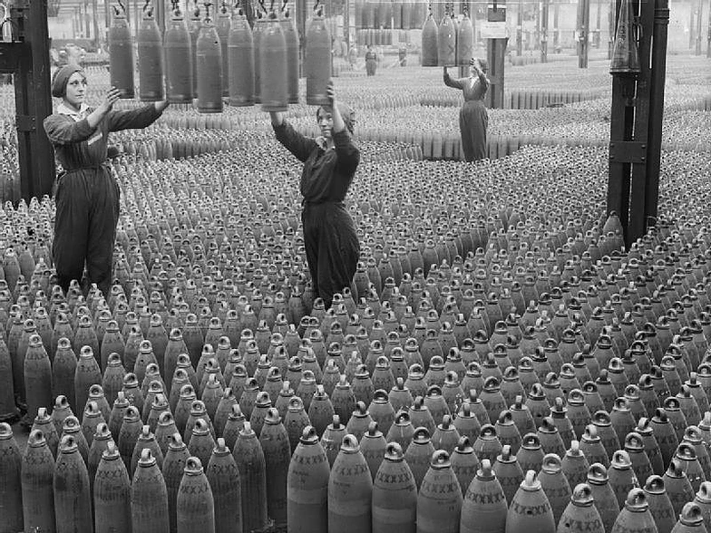
Women in the Workplace
According to the Imperial Munitions Board, about 35,000 women worked in munitions factories in Ontario and Québec during the First World War.

Slide 5
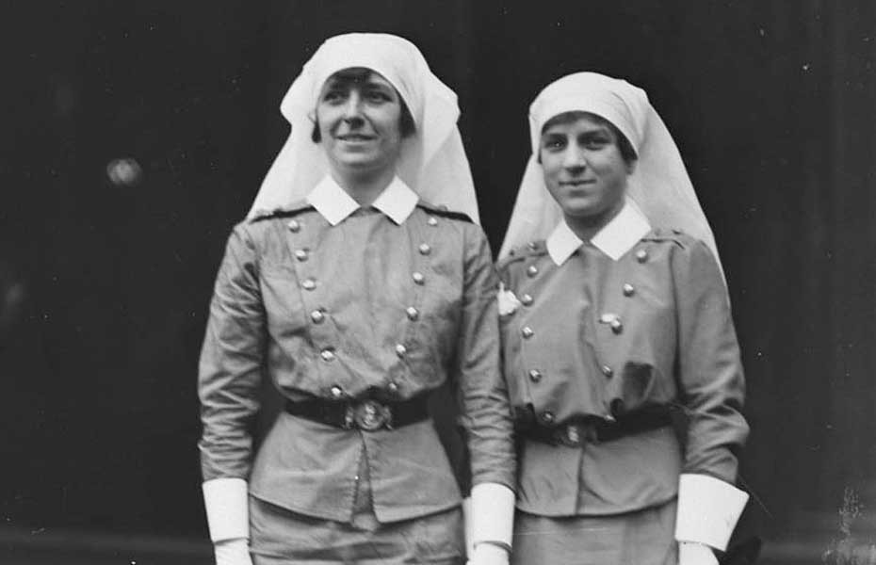
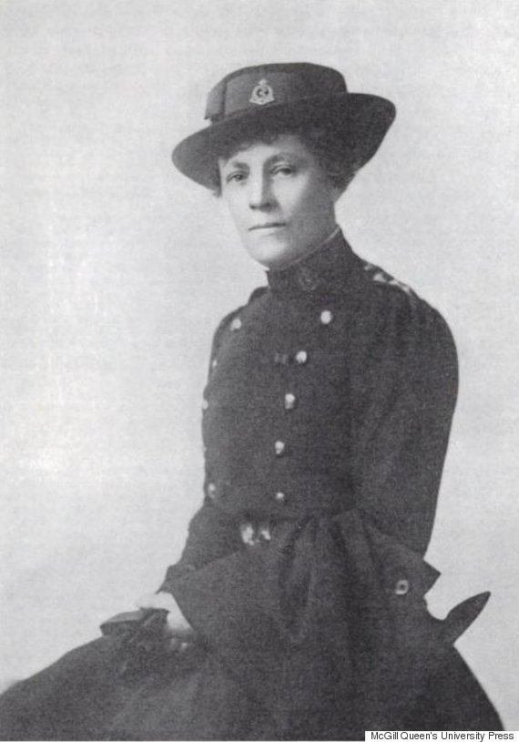
Women and the War Effort
While women didn’t participate in fighting many women traveled to Europe to work as nurses, ambulance drivers and staff officers.
2800 women worked as “nursing sisters” during WW1 while another 6000 worked in the civil service.
With their blue dresses and white veils, they were nicknamed the “bluebirds” and were greatly respected because of their compassion and courage.
Notes:
Margaret Macdonald was made Matron-in-Chief of the Canadian nursing sisters and, on Nov 4th, 1914, she was granted the rank of Major. She was the first woman in the British Empire to be given this rank.
Nursing sisters, like male doctors, witnesses the devastation of the war on a regular basis and often had to put their lives at risk at the Front Lines in France, in the Mediterranean and Africa. 46 nursing sisters died during the war, 15 of which died aboard the Llandovery Castle, a hospital ship that was sunk by German u-boats.

Slide 6
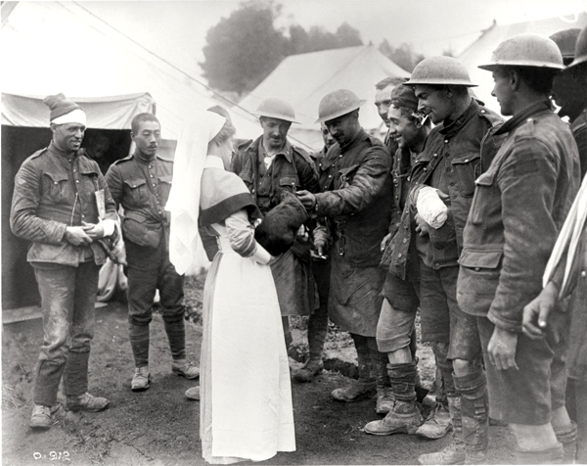
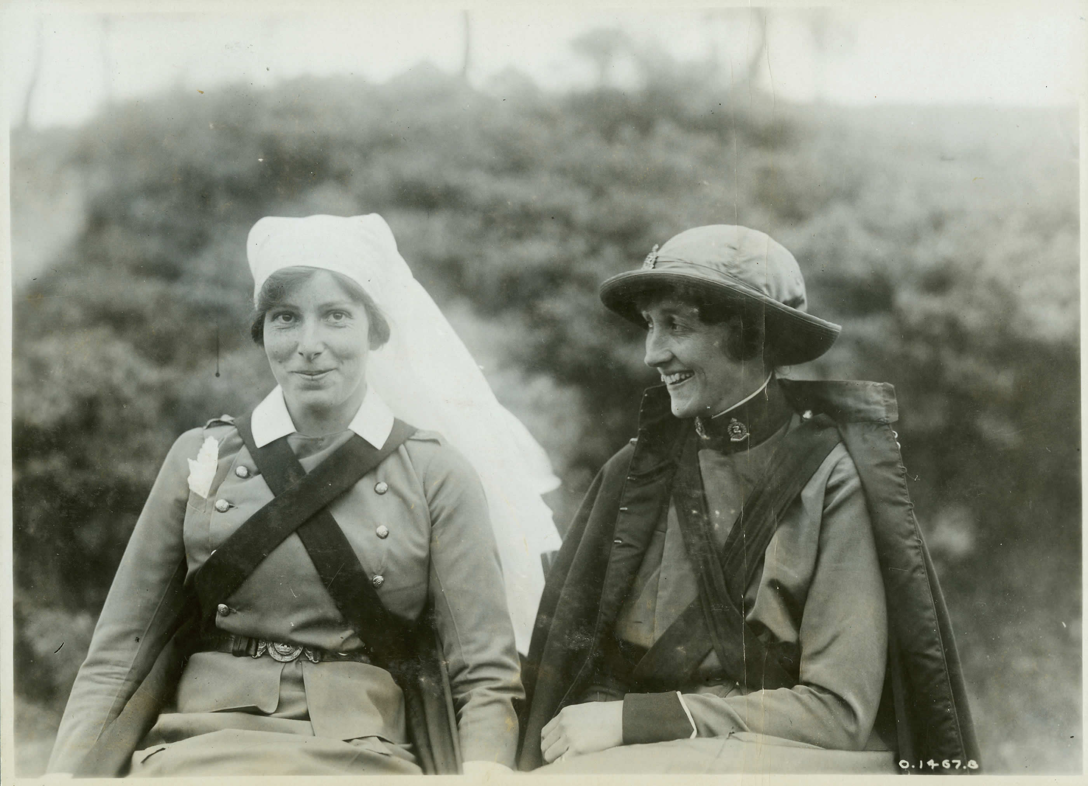
Nursing Sisters
Notes:
A total of 3,141 Nursing Sisters served in the Royal Canadian Army Medical Corps and 2,504 of those served overseas in England, France and the Eastern Mediterranean at Gallipoli, Alexandria and Salonika. By the end of the First World War, approximately 45 Nursing Sisters had given their lives, dying from enemy attacks including the bombing of a hospital and the sinking of a hospital ship, or from disease. The beautiful Nursing Sisters’ Memorial in the Hall of Honour in the Parliament Buildings in Ottawa is a loving tribute to their service, sacrifice and heroism.

Slide 7
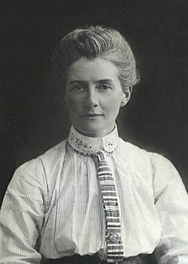
Sacrifice
The First World War saw great courage and sacrifice on the part of many nurses, such as Britain’s Edith Cavell.
Notes:
. She was a nurse who remained in Brussels, Belgium, after the Germans occupied the city early in the war, tending to wounded soldiers of all countries. However, in addition to this work, Cavell helped captured British, French and Belgian soldiers escape to the neutral Netherlands (where most would eventually make it to England). When her activities were discovered, she was executed as a spy, but not before she helped about 200 men escape the Germans.

Slide 8
Women and the Anti-War Movement
Canadian women have impacted warfare as much as warfare has impacted them. Some have significantly affected the character of the Canadian military by climbing its ranks and promoting its activities, while others have joined pacifist and anti-war movements that have sharply criticized the military.
Many Canadian women have undertaken leading roles in the struggle against war. This was especially the case during the First World War, when women across Europe and North America organized for peace on an unprecedented scale.
Notes:
A number of mainstream women’s organizations, such as the National Council of Women of Canada (NCWC) and the National Committee of Women for Patriotic Service (NCWPS), openly or tacitly supported the war. Other women contested the war at its outset, but became increasingly convinced of its necessity.

Slide 9
War Impact on Women
Prominent suffrage leaders Nellie McClung, Emily Murphy and Flora MacDonald Denison, for instance, all held to their longstanding pacifist beliefs when war broke out in 1914, but later changed their position as they became convinced that Germany’s attacks on Britain could only be stopped through military defeat.
As McClung wrote in her 1917 book, The Next of Kin, “When I first saw the troops go away, I wondered how their mothers let them go, and I determined I would not let my boy go.”

Slide 10
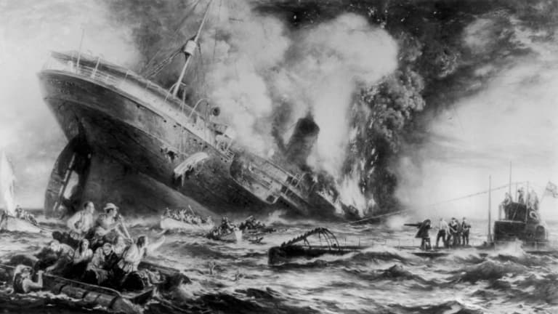
Attitudes Change
But after a German submarine sank the British passenger ship RMS Lusitania in 1915, her position changed: “Then I said we were waging war against the very Prince of Darkness. […] I knew it would be better — a thousand times better — to be dead than to live under the rule of people whose hearts are so utterly black.”
Notes:
On May 7, 1915, less than a year after World War I (1914-18) erupted across Europe, a German U-boat torpedoed and sank the RMS Lusitania, a British ocean liner en route from New York to Liverpool, England. Of the more than 1,900 passengers and crew members on board, more than 1,100 perished, including more than 120 Americans. Nearly two years would pass before the United States formally entered World War I, but the sinking of the Lusitania played a significant role in turning public opinion against Germany, both in the United States and abroad.

Slide 11
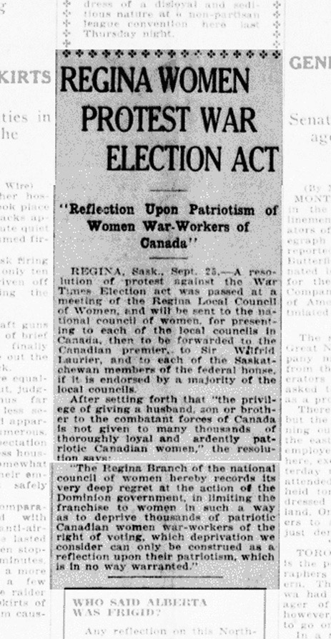
Suffrage
In 1917, amidst the tremendous reconfiguration of labour practices on the home front, the movement for women’s suffrage won a major victory with the passage of the Wartime Elections Act, which granted some women the right to vote in federal elections.
Suffrage at this time was limited to women working in the armed forces and the wives, mothers and sisters of soldiers overseas. At the same time, however, the Act revoked voting rights from Canadian citizens of enemy-alien birth who were naturalized after 1902.
Notes:
Today, most historians view the Act partly as the product of women’s growing presence in the public sphere and partly as a move by Prime Minister Robert Borden to bolster electoral support for his government.

Slide 12
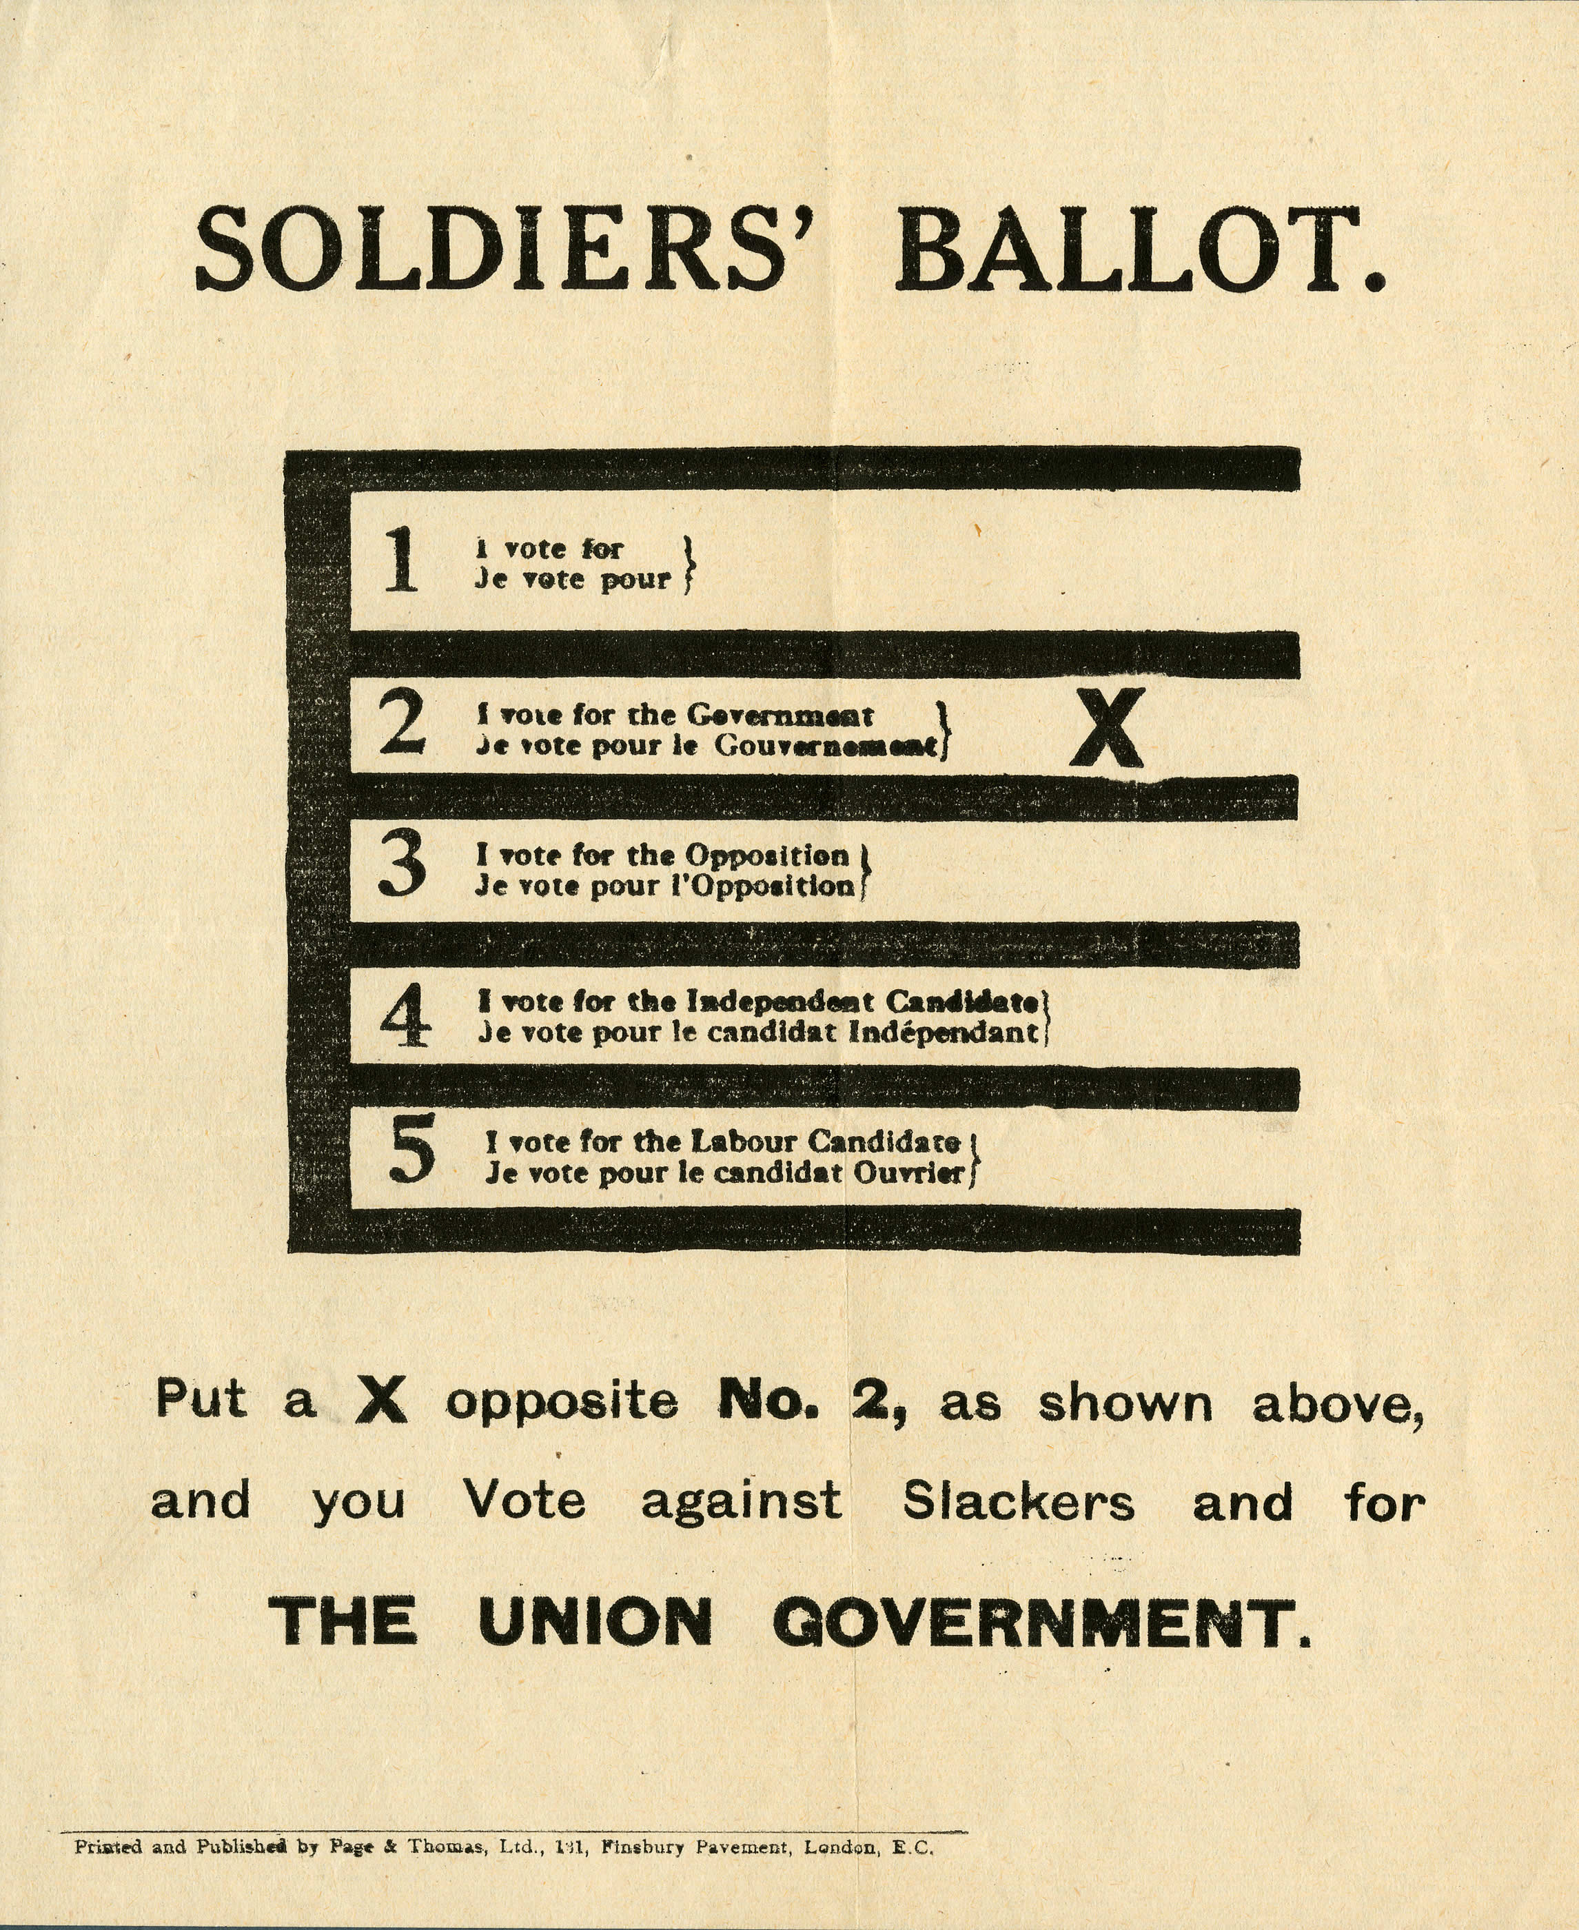
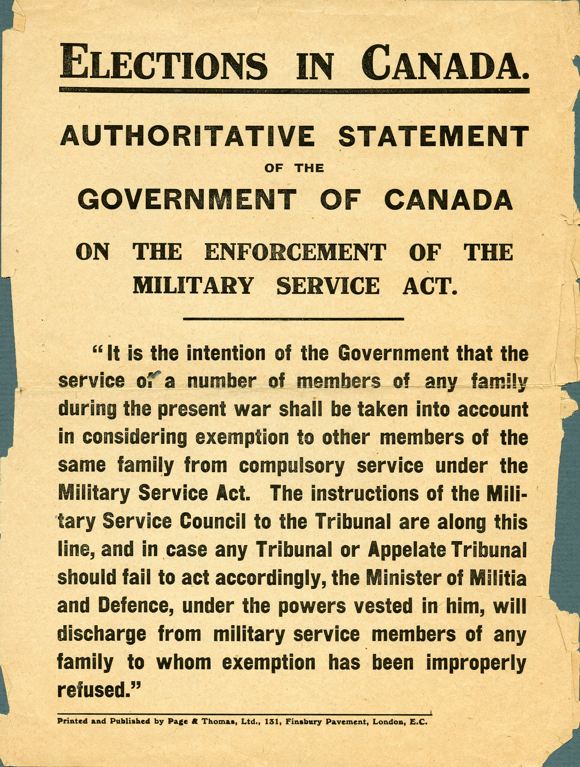
Notes:
a)Broadsheet produced by the Union government showing soldiers how to cast their votes in the 1917 election. This leaflet notes that a vote for the Union government is a vote against slackers.
b)This pamphlet informed voters that under the Military Service Act families who had already contributed someone to military service would be considered for exemption. This certainly would have appealed to families with loved ones overseas who wanted to see the war's burden shared more evenly. In April 1918, after German offensives on the Western Front had worried the government about the prosecution of the war, it cancelled almost all exemptions. This affected farmers' sons in the greatest numbers. The only remaining exemption was a result of the "death, disablement or service of other members of the same family while on active service."

Slide 13
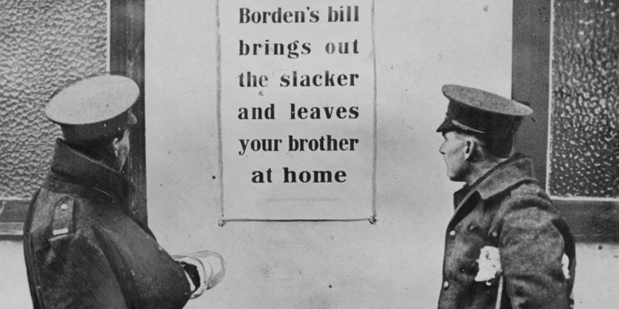
Conscription Crisis
A broadly popular but divisive measure, conscription polarized provinces, ethnic and linguistic groups, communities, and families, and had lasting political effects on the country as a whole.
French-speaking Canadians continued their protests as well, and young men by the tens of thousands joined others from across Canada in refusing to register for the selection process.
An effort to arrest suspected draft dodgers was highly unpopular across the province and, at its worst, resulted in several days of rioting and street battles in Quebec City at Easter, 1918.
Notes:
. For many Canadians, it was an important and necessary contribution to a faltering war effort; for others, it was an oppressive act passed dishonestly by a government more British than Canadian.
French-speaking Canadians continued their protests as well, and young men by the tens of thousands joined others from across Canada in refusing to register for the selection process. Of those that did register, 93 percent applied for an exemption.
The violence left four civilians dead and dozens injured, and shocked supporters on both sides.

Slide 14
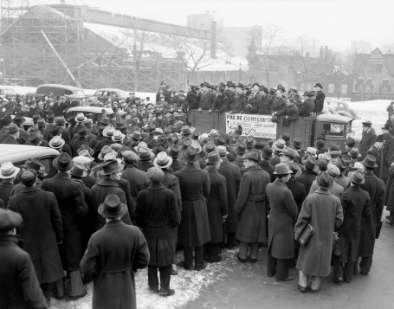
Conscription
Conscription would have minimal impact on Canada’s war effort. By the Armistice in November 1918, only 48,000 conscripts had been sent overseas, half of which ultimately served at the front.
More than 50,000 more conscripts remained in Canada. These would have been required had the war continued into 1919.

Slide 15
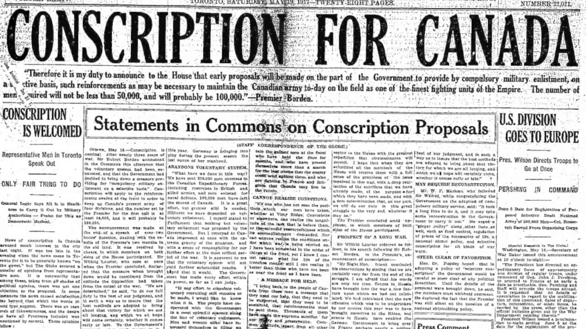

Slide 16
Questions
How would you feel if you were conscripted to fight after knowing about how awful the fighting was in Europe?
How would you feel if your son or husband was conscripted for the war effort?
How would you feel if your son was overseas fighting and young men in your neighbourhood refused to enlist to fight?

Slide 17
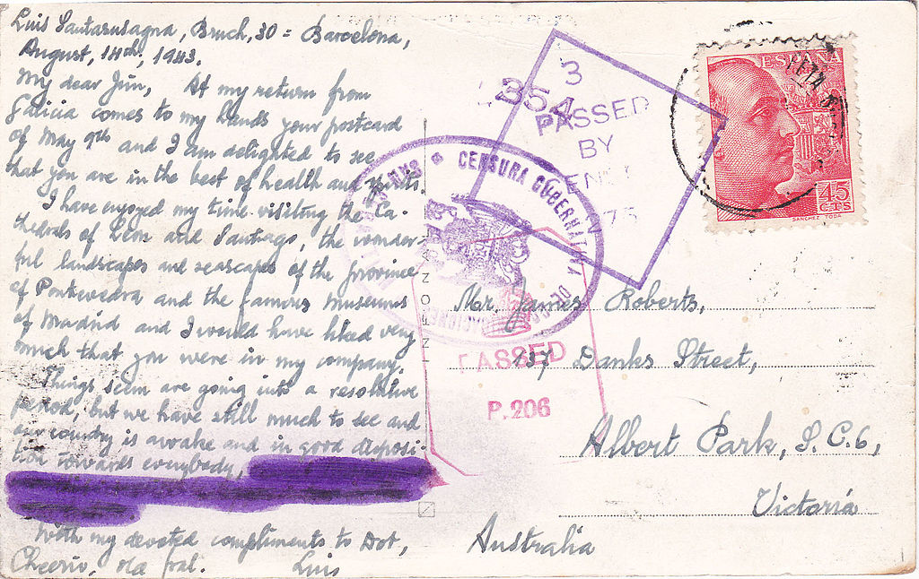
Censorship
The control of sensitive military information was a wartime necessity, but the government’s role in information management extended far beyond the surveillance and editing of soldiers’ letters from the front.
An official censor in Canada monitored newspapers and other publications for material that might harm the war effort, while federal officials threatened editors and publishers with jail time if they failed to comply with warning notices.

Slide 18
Propaganda
Large-scale propaganda campaigns became a part of everyday life. Posters urged enlistment and other forms of war support, and asked citizens to contribute to charitable campaigns, buy Victory Bonds, or ration scarce items such as meat or fuel.
Their imagery relied on patriotic symbols, recognizable icons, and historical figures to identify the war with popular and worthy causes. Public parades, rallies, and charitable events encouraged voluntary contributions and the shaming or embarrassment of those who were not “doing their bit.”

Slide 19
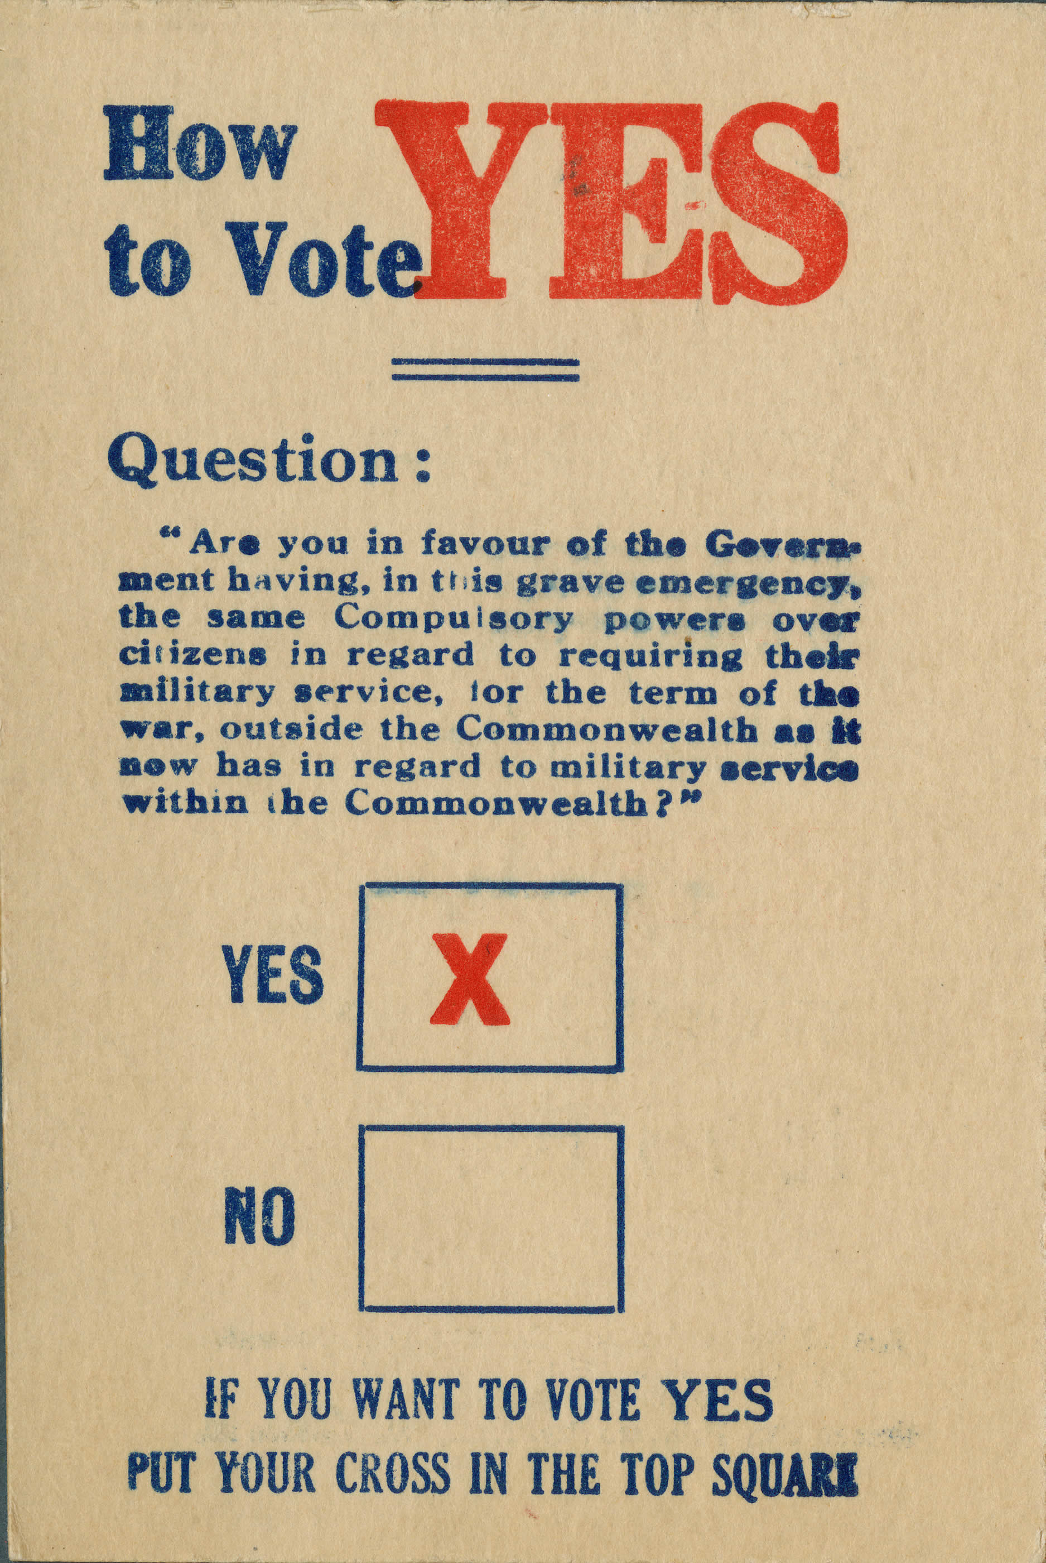
Leaflet urging a yes vote for conscription. The reverse of the card warns the reader, "Before you cast your vote think what the Kaiser would like it to be."
The Allied press and propaganda demonized the Kaiser, Germany's king, as a warlord. The pro-conscription forces ultimately proved successful in Canada's 1917 election.

Slide 20
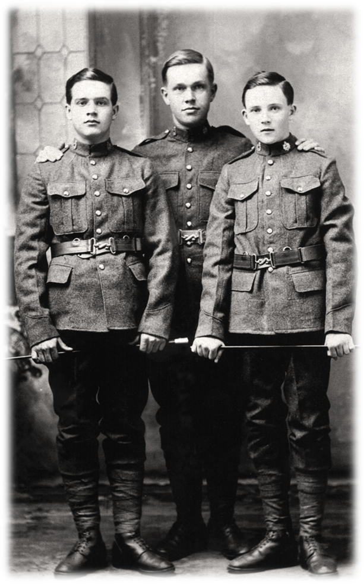
Returning Soldiers
The population of Canada was around 8 million in the early 1910s.
620 000 Canadians served in the war.
66 000 were killed.
170 000 were injured.
Notes:
Around 50% of men from ages 16-30 served in the war.
10% of those that served were killed.

Slide 21
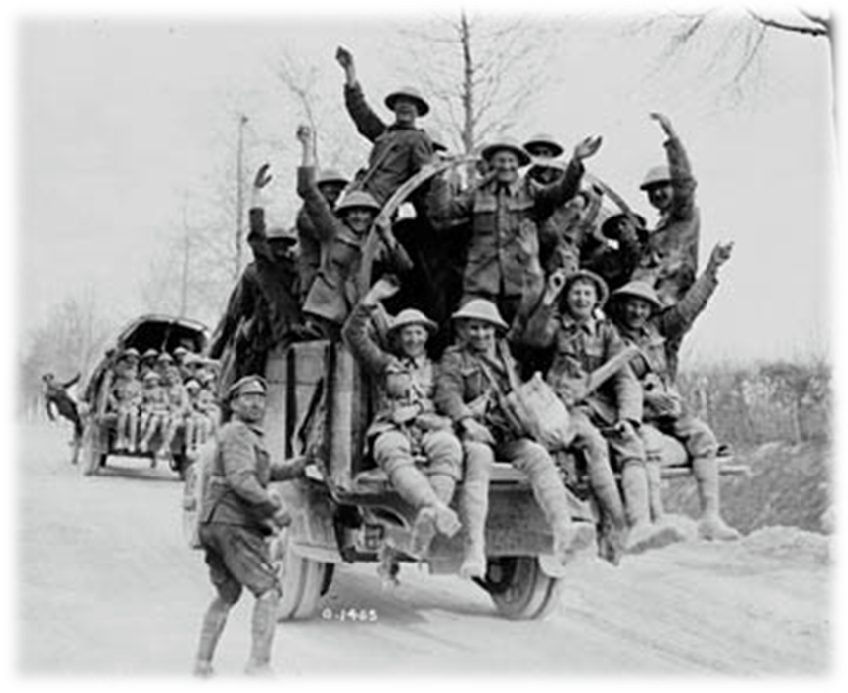
After the War
After the war, Canadian soldiers returned to life in Canada.
Life was difficult for returned soldiers, especially those that were injured. Why?
Notes:
After the war ended so did the demand for Canadian products, which created a slump in the Canadian economy. The Prairies and the Maritimes felt it the hardest as the price for wheat and fish dropped.
In addition, the war created a temporary spike in the cost for goods and services, after the war ended the prices remained high while wages for workers were lowered. To make matters worse many returning soldiers couldn’t find employment and therefore struggled to provide for themselves and their families.

Slide 22
Shell Shock
Reading and discussion

