Slide 1
The Myceneans

Slide 2
Settlers
Around 2500 BCE Greece was settled by a metal-using agricultural people from Europe and Asia.
Later in time these Indo-European invaders settled peacefully into Greek society.
The main focus for these mainland Greeks was warfare as these people had lived in fortified palaces and were often made up on powerful monarchies.
Notes:
Indo-European - relating to the family of languages spoken over the greater part of Europe and Asia as far as northern India.

Slide 3
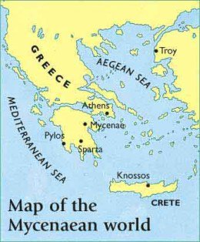
Trade
They traded with the Minoan civilization which had been around earlier and played a roll in there demise.
Relied heavily on fishing for their food source.
They traded raw goods such as oil, animal skins and jewellery.
Notes:
The name Mycenaean comes from the name of the city that was the centre of this early Greek civilization called Mycenae.
Historians have learned that Mycenaean monarchies developed extensive commercial networks for trade with Egypt, Syria, and Italy. Smaller empires like those on Crete fell to military conquests by the Mycenaean military as they spread their influence around the Mediterranean Sea. We see evidence of Mycenaean pottery found throughout the Mediterranean region.

Slide 4
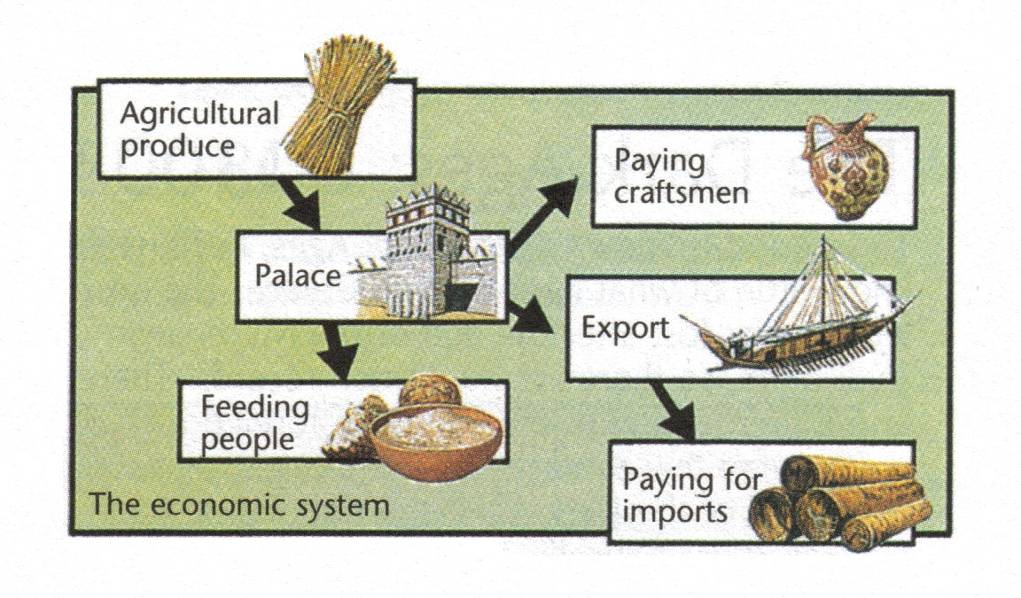
Mycenaean Economic System

Slide 5
Cities
Cities grew larger with monarchies that lived in palaces with civilians scattered outside of its walls.
Art, which resembled Minoan art, flourished under the Mycenaean age.
Agriculture also became more efficient.

Slide 6
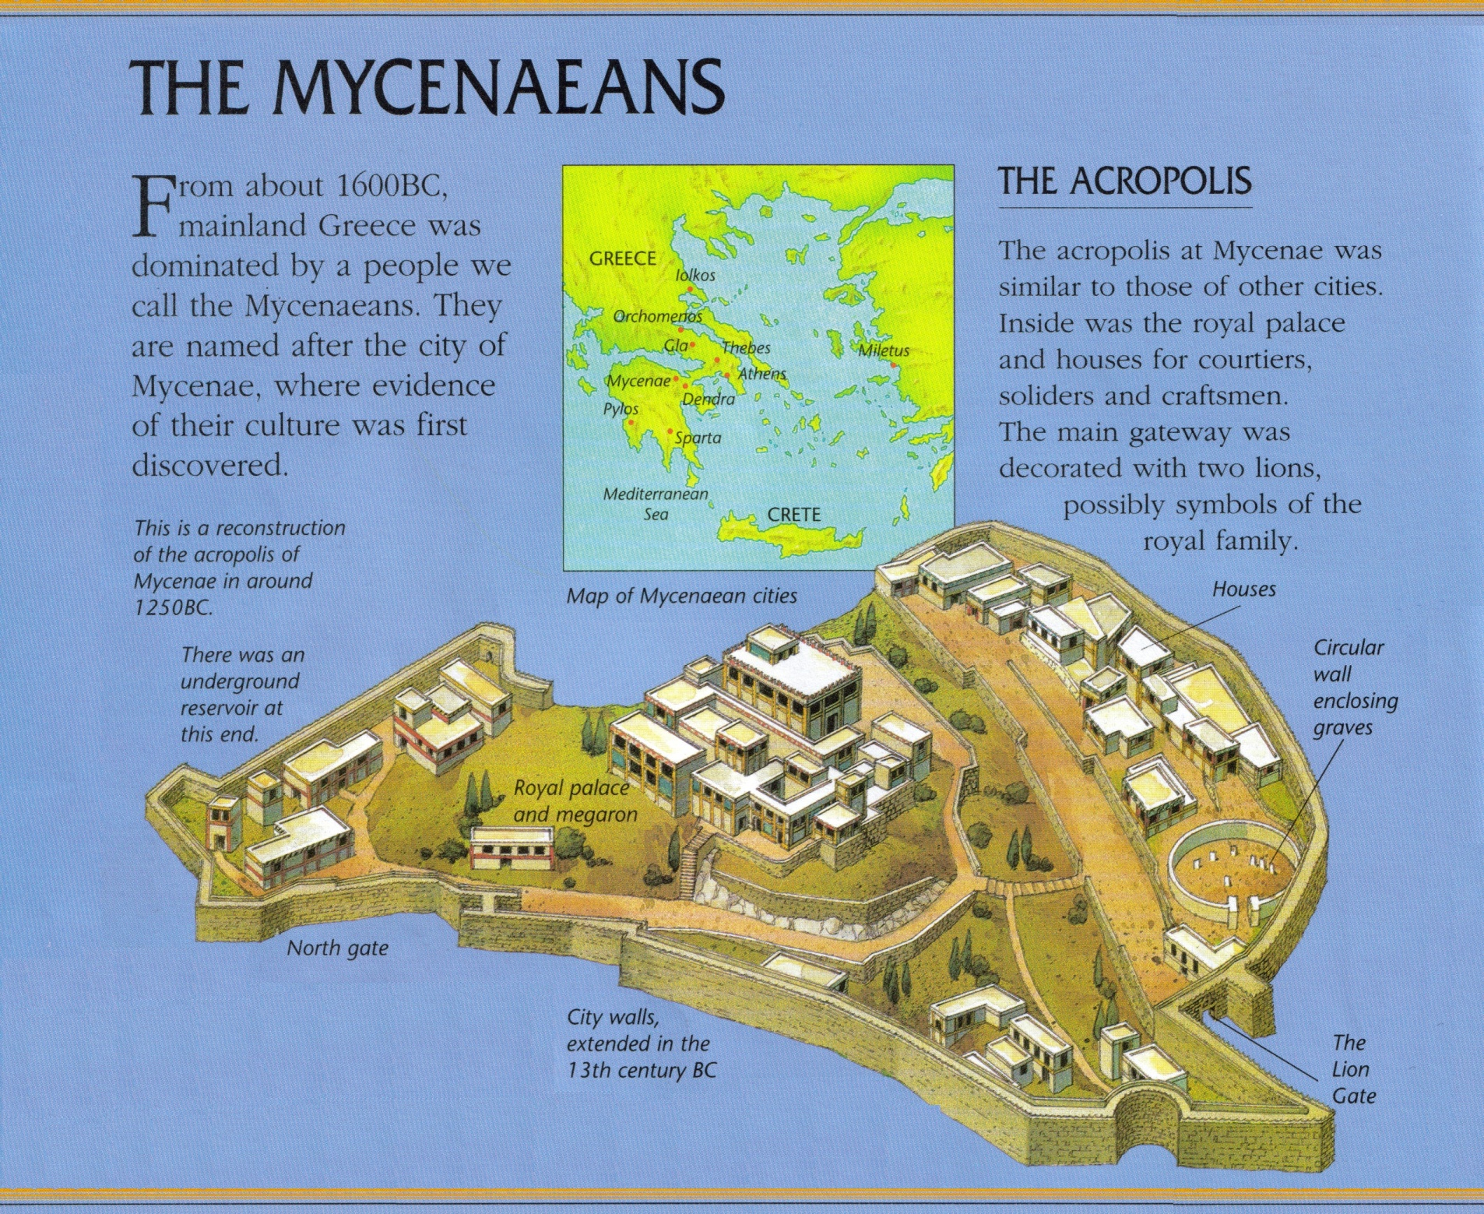
Notes:
An Acropolis is a citadel or fortified part of an ancient Greek city, typically built on a hill.

Slide 7
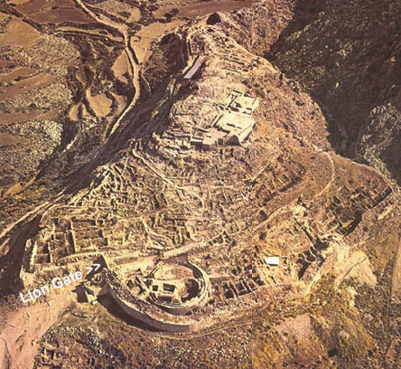

Slide 8
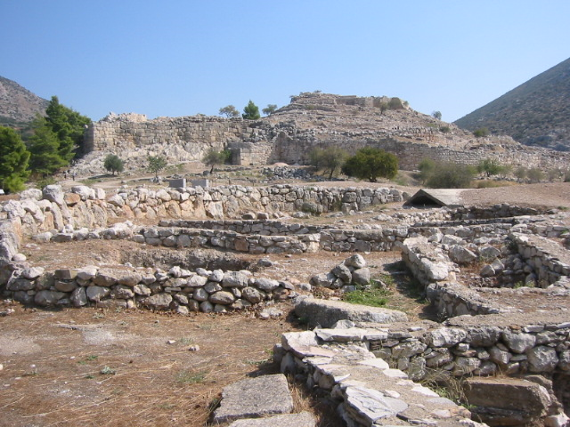

Slide 10
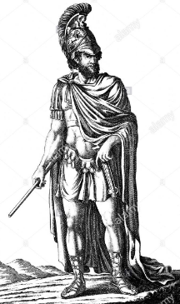
Political Power
Society was headed by a king with a large administration.
Unlike the Minoans, these kings became very wealthy and did not share with the rest of society.
These Mycenaeans dominated the Mediterranean region between 1600 BCE and 1100BCE.

Slide 11
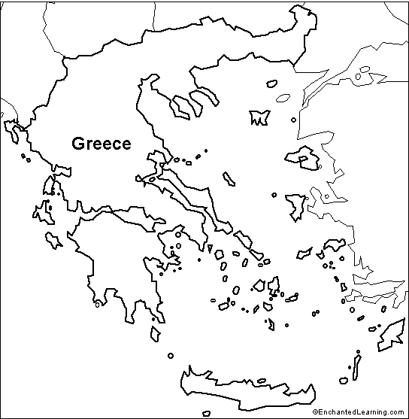
The Mycenaean Region
Notes:
The Mycenaean's established the cities of Athens, Pylos, Thebes and Tiryns. They also controlled the island of Crete.

Slide 12
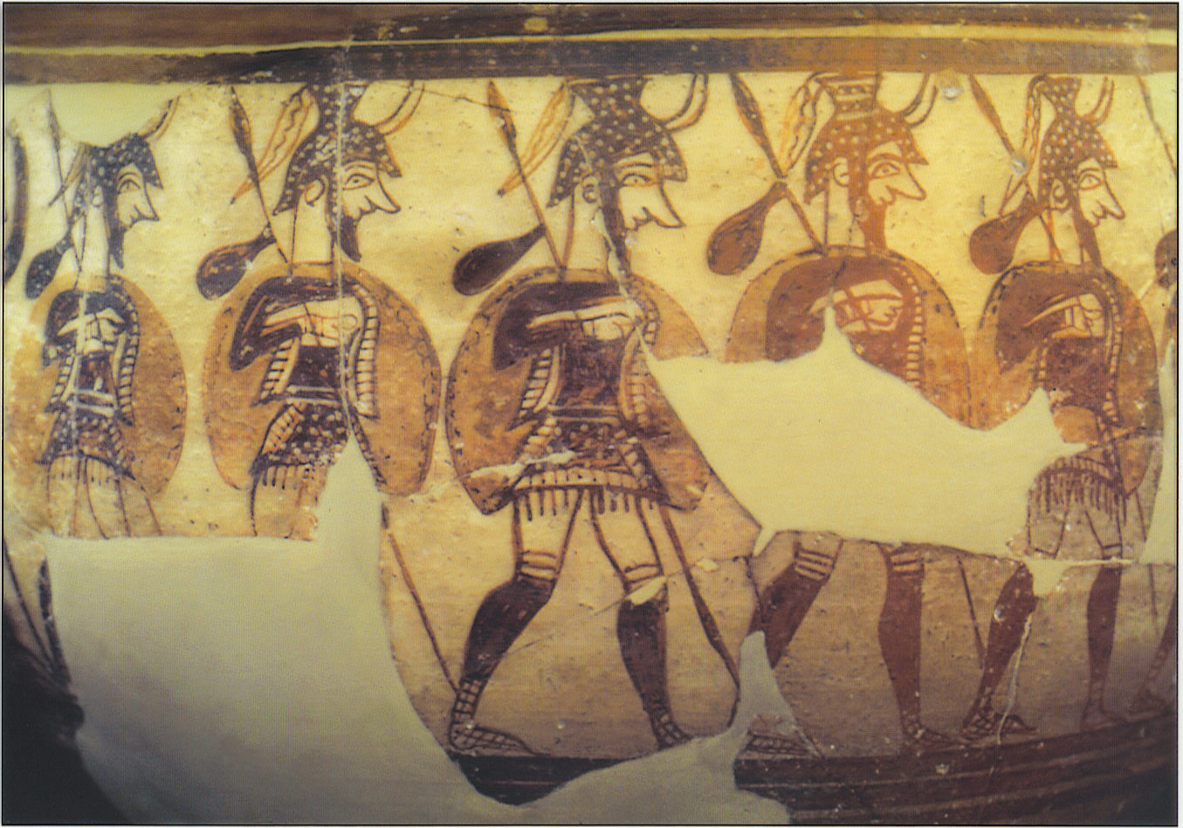
The People
Mycenaean society constantly geared for battle and invasion.
Their cities were heavy fortified with thick outer walls.
They were always on the defensive and prided themselves on heroic deeds in battle.
Notes:
Society was dominated by the King and his warriors with artisans and farmers and merchants making up the “middle class”. Slaves were the lowest member of the society, but these slaves and their owners were very prosperous due to trade.

Slide 13
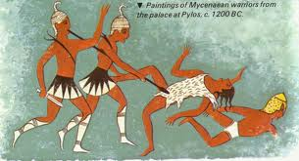
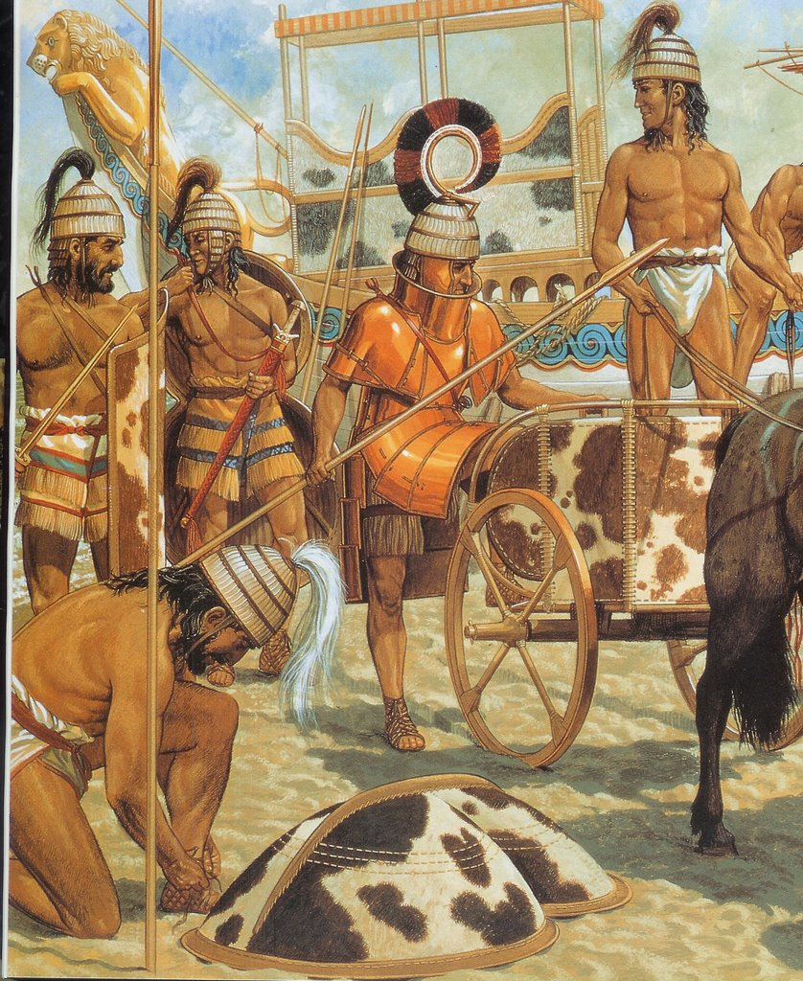
Notes:
Known to go looking for trouble.
Most famous of their raids was the war against Troy.

Slide 14
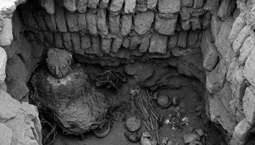
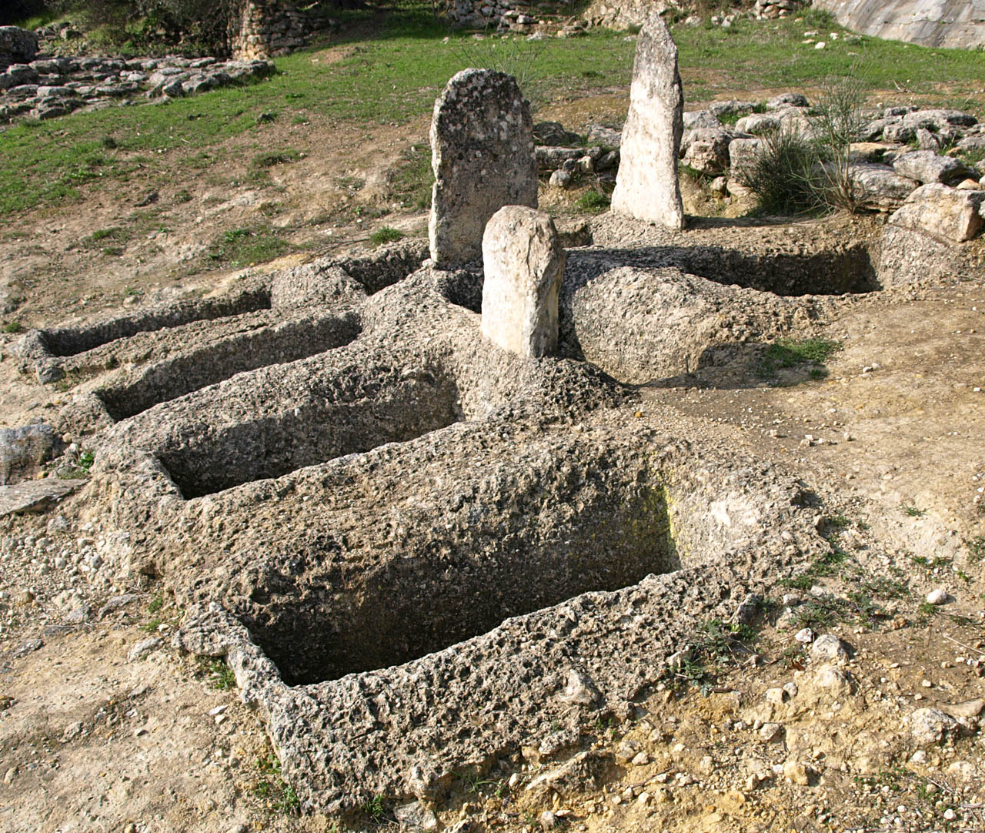
Burial Practices
Earliest graves were Shaft Graves
By 1500 BC were using the Tholos Tombs (bee-hived shaped)

Slide 15
Notes:
The larger tombs of the wealthy were very extravagant and often filled with art and riches to accompany the dead into the afterlife.

Slide 16
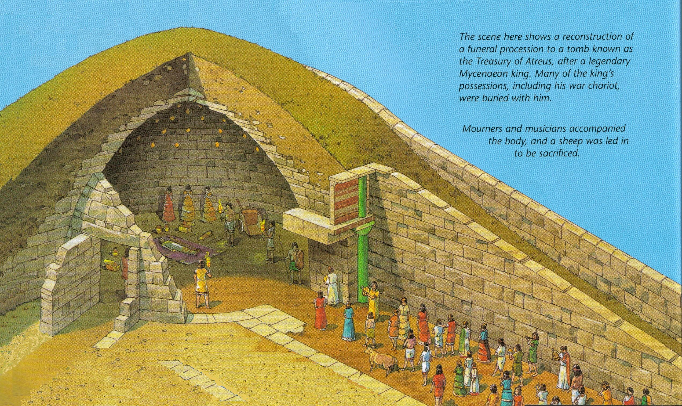

Slide 17
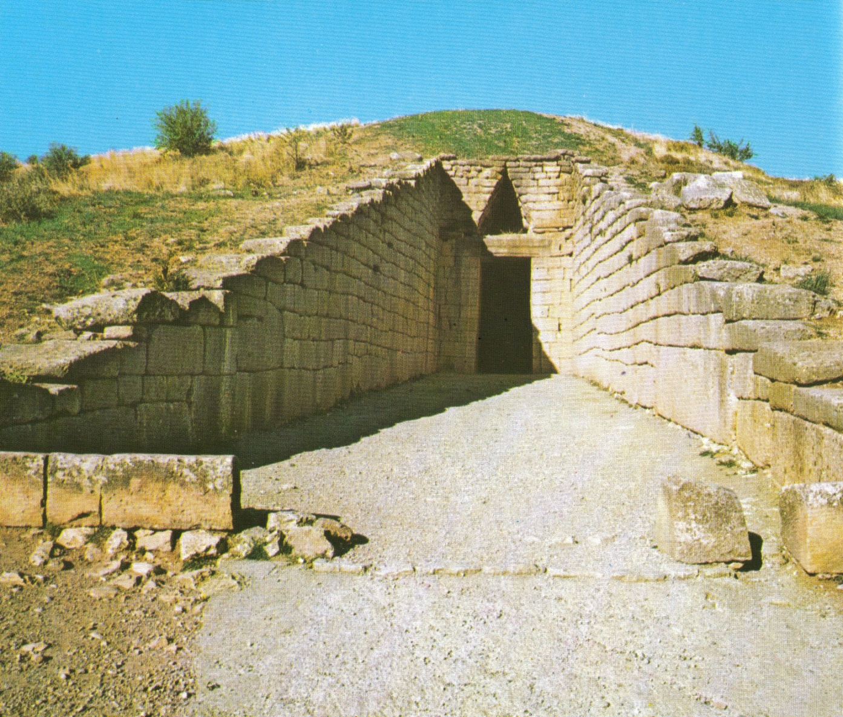

Slide 18
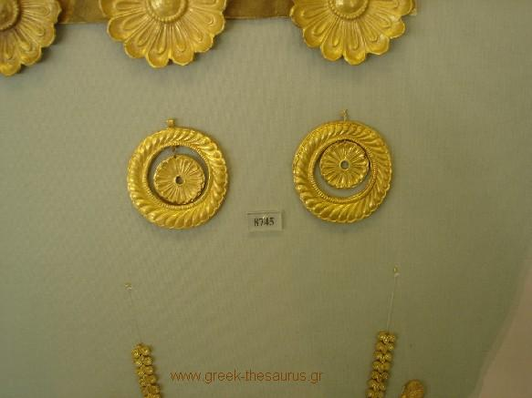
Tomb Treasures

Slide 19
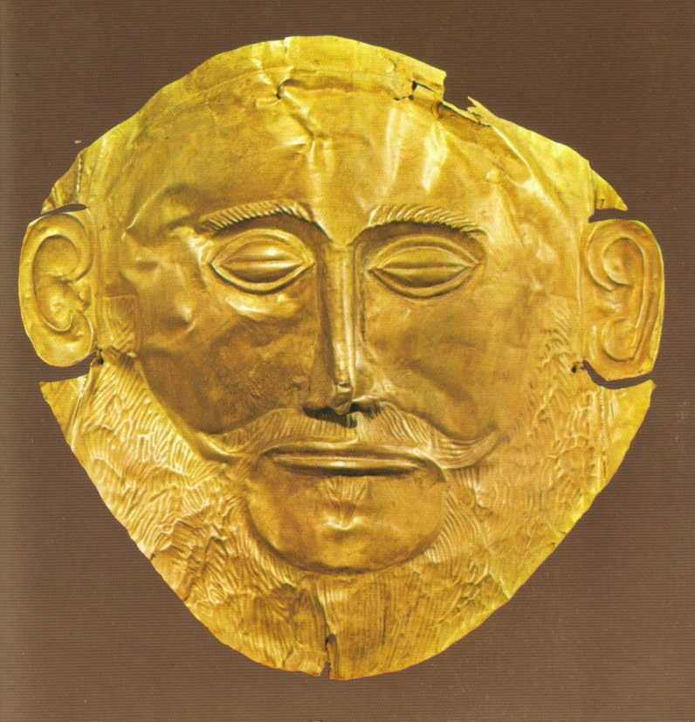
Mask of Agamemnon?
This mask was thought to have belonged to King Agamemnon but has since been shown to pre-date Agamemnon by 300 years.
Agamemnon was the king who oversaw the sacking of the City of Troy.

Slide 20
Disappearance
They destroyed Troy, while at the peak of their power and conquered Crete.
Suddenly disappeared from history around 1100 BCE.
Possible reasons are:
an economic collapse
City-states fighting
overrun by another Greek peoples, possible the Dorians & other sea peoples
Major earthquakes
Notes:
The Dorians were one of the four major ethnic groups among which the Hellenes (or Greeks) of Classical Greece considered themselves divided (along with the Aeolians, Achaeans, and Ionians). The regions that included the Dorians were located on the western portion of the mainland of Greece.

Slide 21
Greek Dark Ages – 1100 BCE-750 BCE
Following the fall of the Mycenaean civilization, Greece enters the "Greek Dark Ages” that lasts roughly 300 years.
This period in Greek history is “dark” because nothing was written down and therefore little is known.
During this dark time many Greeks left the mainland and sailed across the Aegean Sea to various islands or to Asia Minor, to a place called Ionia, in modern day Turkey.

Slide 22
Polis – City-states
Greeks developed small, secure, independent communities. These became known as city-states or “polis” (community of people).
These rarely exceeded 20,000 people except for the two largest:
Athens
Sparta
In order to find additional food, the Greeks set up “apoikai ” (away homes or colonies).

Slide 24
Art and Writing
At some point during the 8 century BCE the Greeks adopted the Phoenician alphabet and made reading and writing much easier and assessable to everyone.
The works of Homer, one of the greatest poets of all-time, appeared during this dark age of the Greeks.

Slide 25
Homer’s writings reinforced values such as courage and honour, values that will influence many Greeks in the rebirth of Greek civilization.

Slide 26
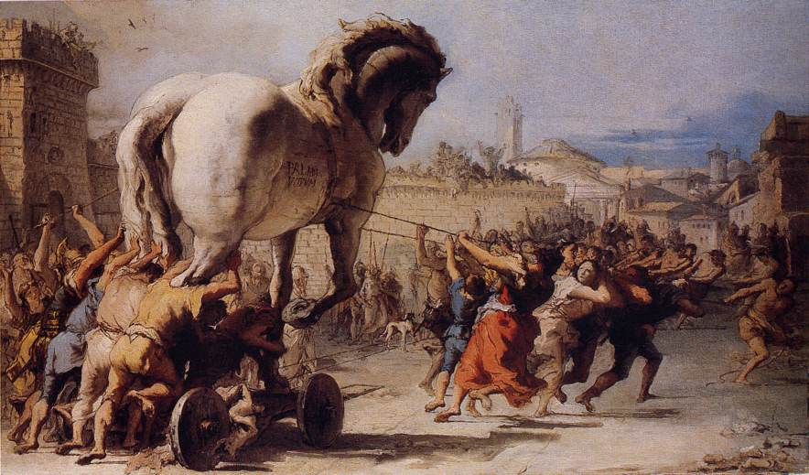
Homer
Was a great poet (bard) as well as a writer. He wrote:
The Odyssey – the heroic adventures of Odysseus
The Iliad – the great Trojan War
Stories tell of Greek society and culture before the Dark Ages.
Stories used to be passed on orally through story telling.
Notes:
Homer’s writing gave generations of Greek males a model of heroism and honour. He also instilled how young Greeks should be proud of their heritage and the actions of their heroic ancestors.

Slide 27
Written Language
Used what they had learned from the Minoans to create their language.
We are able to read it as it is an early form of the Greek language.

Slide 29
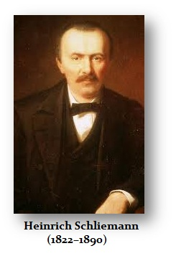
Discovery
Mycenaean civilization was rediscovered in 1873 by Heinrich Schliemann. He uncovered the legendary city of Troy, located in modern day Turkey.
He used the poetry of Homer to locate this lost city of ancient Greece.

Slide 30
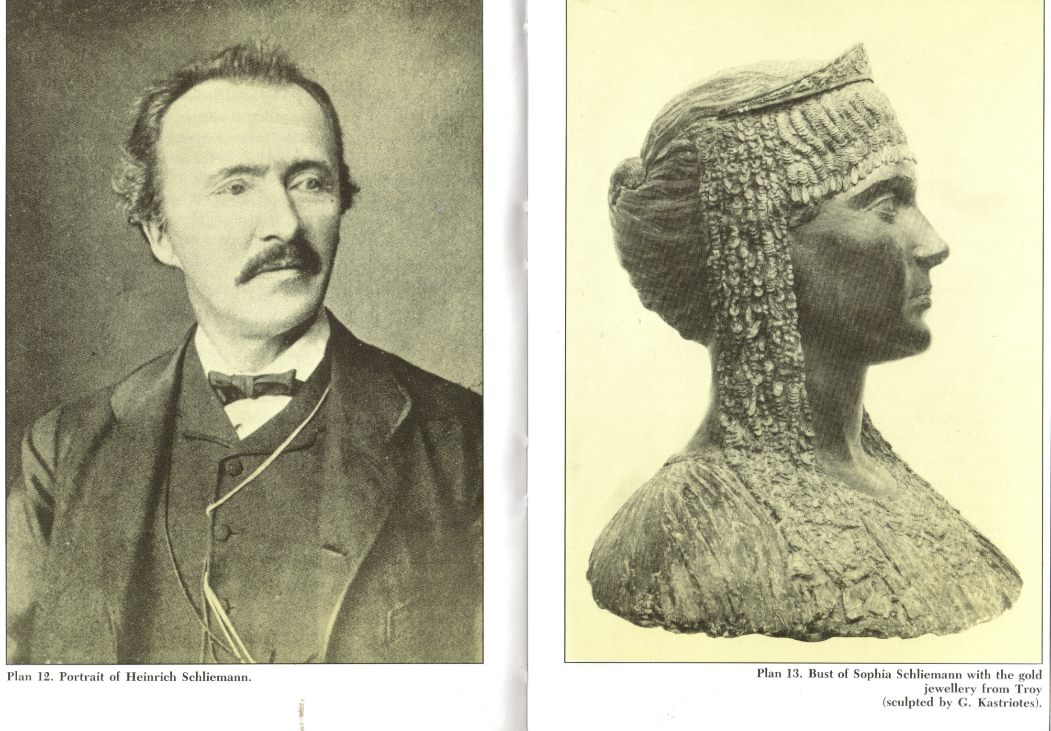

Slide 31
Helen of Troy
Notes:
In Greek mythology, Helen of Troy also known as Helen of Sparta, or simply Helen, was the daughter of Zeus and Leda. In Greek myths, she was considered the most beautiful woman in the world. By marriage she was Queen of Laconia, a province within Homeric Greece, the wife of King Menelaus. Her abduction by Prince Paris of Troy brought about the Trojan War.

Slide 32
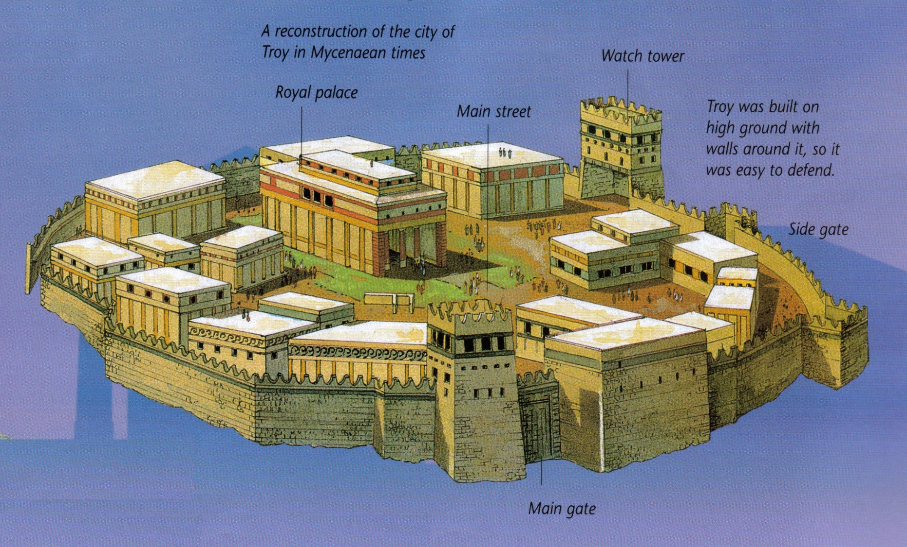
City of Troy

Slide 33
Questions
How was Homer’s Iliad and The Odyssey significant to Greeks during the Dark Ages of Greece? Do we have writers/artists today that fill the same role as Homer? Name some…
Artifact Examination Activity – What can we learn about the two early Greek civilizations based on their artwork?

