Slide 1
World War 2

Slide 2
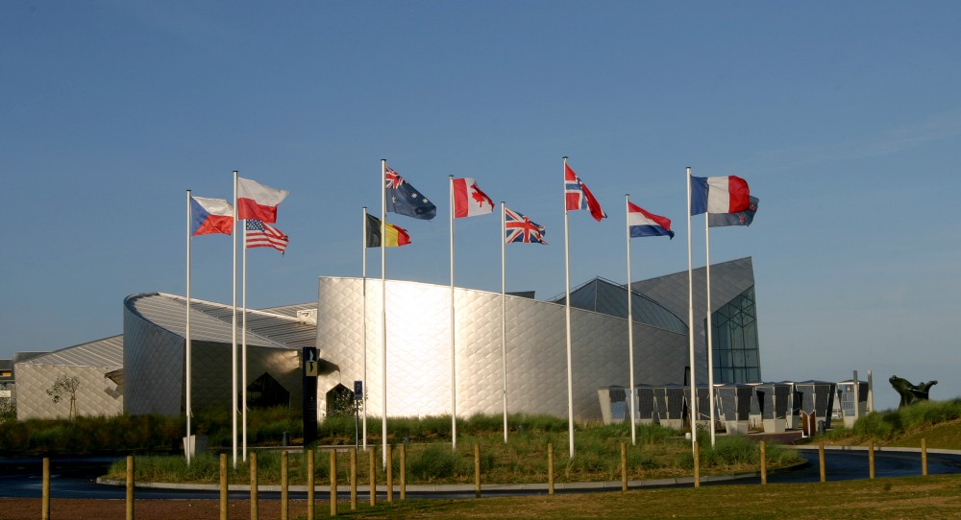
Canada in WW2
Historians generally agree that the Second World War was a major event that helped shape Canada’s identity as a nation as they made a significant contribution to the war effort.
Nearly 1 in 10 Canadians served in the armed forces and millions were involved in the war effort at the home front.
The Juno Beach Centre opened in 2003
Notes:
Home front is the informal term for the civilian populace of the nation at war as an active support system of their military. Military forces depend on "home front" civilian support services such as factories that build materiel to support the military front.

Slide 3
The Road to War
In the summer of 1939, nearly 12 million Canadians anxiously watched events unfold in Europe. It was nearly 20 years to the day when The Treaty of Versailles was signed by Germany which essentially ended the First World War.
While many factors led to growing tensions in places around Europe, Asia also experienced increasing conflict between Japan and China. It is debatable to what exactly lead to the outbreak of WW2 rather it is a combination of issues.
Notes:
In the 1930s both Germany and Japan invaded neighbouring countries in an attempt to gain resources and land for their growing Empires. Japan had already annexed Korea in 1910 and made a quick conquest on Manchuria. At first many world powers tried to ignore these acts of aggression instead of facing the potential of another global conflict.

Slide 4
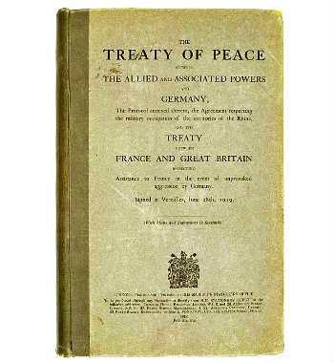
The Treaty of Versailles
The Treaty of Versailles was signed between the Allied Powers and Germany on June 28, 1919. This officially ended World War I.
The treaty was extremely harsh on Germany. It forced Germany to "accept the responsibility for causing all the loss and damage" of the war. Germany was forced to disarm, give up land to France, and to pay reparations of 132 billion Marks (around $442 billion today).

Slide 5
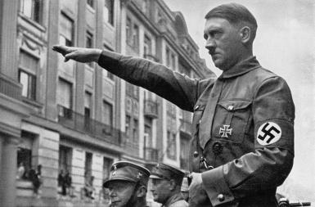
Rise of the Nazi Party in Germany
As we discussed, Adolf Hitler and the National Socialist party (the Nazi Party) were elected to power in 1933 by using growing anger over the Treaty of Versailles to fuel his push for leadership over the German people. After Hitler was elected he outlawed other political parties, therefore he became the dictator, or only ruler.
Notes:
Hitler had set his sights in the East to the Soviet Union as his first goal. He wanted to conquer the Soviets, resettle the land for Germany and have the Slavic people enslaved and used to rebuild the Third Reich.

Slide 6
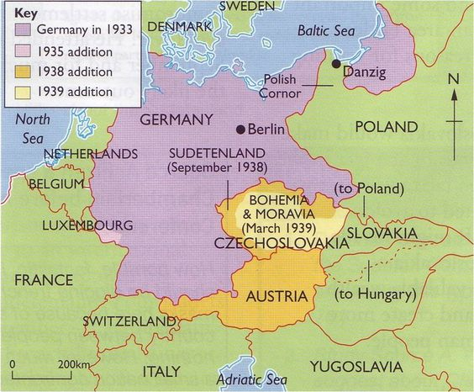
Problems Arise
After he seized power, Hitler looked to break the Treaty of Versailles and began to annex, or reoccupy, territories that were taken away from Germany after the First World War.
Rhineland, Austria, Sudetenland, Czechoslovakia and Poland all fell to Germany in the lead-up to WW2.
Notes:
Annexing is incorporating territory into an existing political unit, such as a town, city or, in this case, a country.
Prior to the annexing Hitler and Germany began a military draft on March 9, 1935 and expanded the military from 100,000 to 550,000 troops – this was a direct violation of the Treaty of Versailles. Britain, France, and Italy condemned Germany’s actions but failed to take action. Keep in mind that the Great Depression was creating internal struggles in all the nations who should've intervened.
Hitler was convinced the West wouldn’t take action and one year after the draft was created he sent troops into the Rhineland – a demilitarized zone which France had control over. The French wouldn’t do anything with British backing and the British chose not to retaliate with force. The London Times noted that the Germans were only “going back into their own garden.”

Slide 7
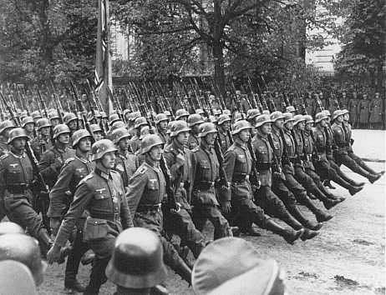
Appeasement
Leaders from Britain, France and the United States, who had written the treaty, did not take a stand against these violations in hopes to avoid another global conflict.
They adopted a policy of appeasement where they relaxed the terms of the treaty in hopes of satisfying German demands and allowing peace.
Notes:
While all of this was happening Hitler was gaining allies, most notably, Benito Mussolini. In ‘35 Italy invaded Ethiopia and drew disapproval from France and Britain, so he turned to Hitler and welcomed his support from Italy’s attempts to re-establish the Roman Empire of the past. In ‘36 both Germany and Italy sent troops to Spain to help out with the Spanish Civil War. In November of ’36 Germany signed an agreement with Japan to fight together against the spread of Communism.
In ‘38 Hitler threatened Austria with invasion and forced the Austrian Chancellor to put the Nazi Party in charge of the govt, the next day Germany annexed Austria.

Slide 8
Czech ya’ later
Adolf Hitler and British Prime Minister Neville Chamberlain shake hands on Sept. 30, 1938 -- the day they signed the Munich Agreement, sealing the fate of Czechoslovakia.
Notes:
On Sept 30, ‘38 Hitler demanded the return of the Sudetenland to Germany as it was occupied by mostly German people. During the Munich Conference all of his demands were met as he threatened a “world war” in order to get what he wanted. British PM Chamberlain believed it was a good thing as they avoided war and Hitler told him that he wouldn’t make anymore demands…
In’39 he invaded Bohemia and Moravia in western Czechoslovakia and the east became a puppet state under Nazi Germany…Czechoslovakia had fallen as the West just watched it happen.

Slide 9
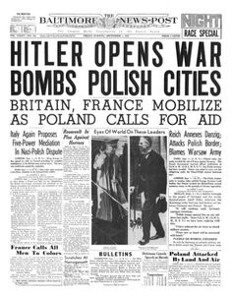
Poland Invaded
On 1 September 1939, 62 German divisions supported by 1,300 aircraft began the invasion of Poland.
At 8pm on the same day, Poland requested military assistance from Britain and France.
Two days later, in fulfilment of their April 1939 pledge to support the country in the event of an attack, Britain and France declared war on Germany. World War II had begun.
Notes:
Hitler demanded the port of Danzig in Poland and the French and British official turned to Stalin and the Soviets in an attempt to negotiate military agreements in an attempt to contain this growing threat in Germany.
A week prior to the invasion of Poland Hitler and Stalin had signed a non-aggression pact that promised the Soviet Union control over eastern Poland and the Baltic States, meanwhile Hitler anticipated that he would be fighting the Russians soon enough.

Slide 10
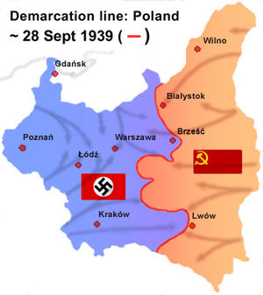
Poland Invaded
As Germany entered Poland from the west the Soviet Union decided to invade from the east as they now understood that the Polish government had ceased to exist.
The Germans and Soviets had a non-aggression pact and had agreed to divide Poland between them.

Slide 11
Global Context - Japan
In 1931 Japanese soldiers, dressed as Chinese, blew up a section of a railway in Japanese owned Manchuria. This “Mukden Incident” was a way that japan justified invading and taking all of Manchuria.
While hostilities broke out in 1931 the official Second Sino-Japanese War started in 1939 and lasted until 1945.
Notes:
Throughout the early 20th century the Japanese had maintained special rights in Manchuria, and they had felt that the neutrality of the area was necessary for the defense of their colony in Korea. They were thus alarmed when their position in Manchuria was threatened by the increasingly successful unification of China in the late 1920s

Slide 12
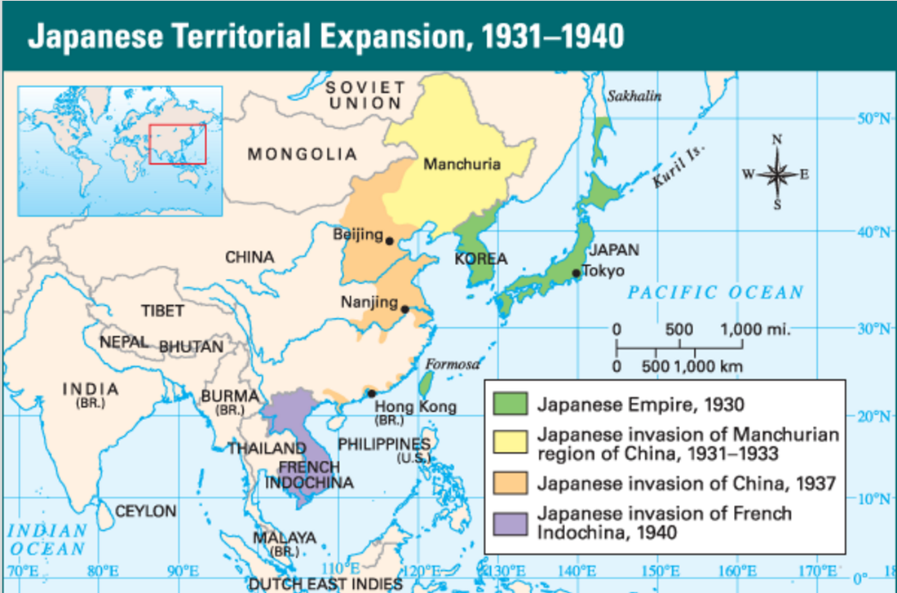

Slide 13
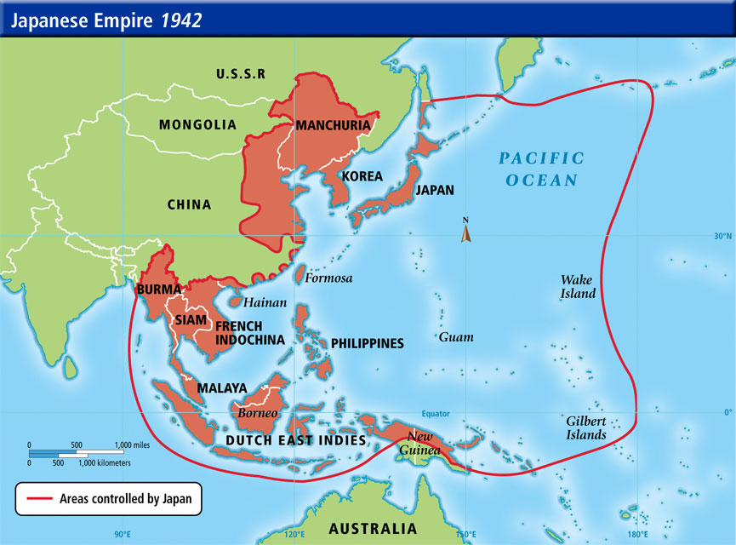

Slide 14
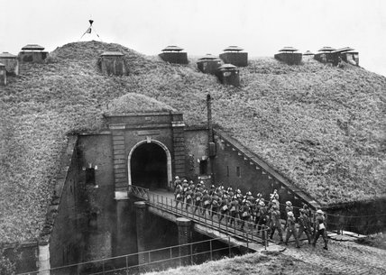
Global Context
Britain and France had mobilized their troops in fear of a German attack.
France was relying on the Maginot Line of fortifications built after WW1 to defend against another German invasion…it failed.
Notes:
The Maginot Line was not a continuous line of forts as some believe. In parts, especially in the south from Basle to Haguenau, it was nothing more than a series of outposts as the steep geography of the region and the River Rhine provided its own defence between France and Germany. The Line comprised of over 500 separate buildings but was dominated by large forts which were built about nine miles from each other.

Slide 15
Question – Reading and Writing Activity
In 1914, when war was declared, there was widespread celebration. There was no celebration in 1939. Why not?
Read The Section “The Japanese Path to War” found on pages 859 – 861. Answer questions 4, 6 and 7 on page 861.

