Slide 1
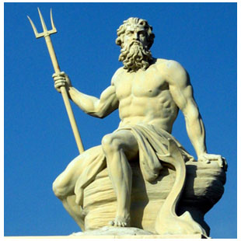
Greek Religion
Gods and Goddesses
Zeus is not happy about this

Slide 2
Show time
Read the scripts, and act the play
Notes:
3 groups in total, so maybe 8-9 students per group.
Need to find a fun way to group the kids.

Slide 3
How do we know
Homer
Hesiod Theogony

Slide 4
what kind of gods did they get?
Human-like – anthropomorphic
Beautiful
Immortal
Not so moral
Notes:
Human-like: they look like humans; Xenophanes commented that if
oxen, horses and lions had hands, then they would depict their gods as oxen, horses and lions.
Do they eat, do they poop, do they sleep, do they regrow lost limbs? Encourage students to ask crazy questions about the gods, and look for answers in the future readings.
It is interesting to compare this with Christianity and Islam.

Slide 5
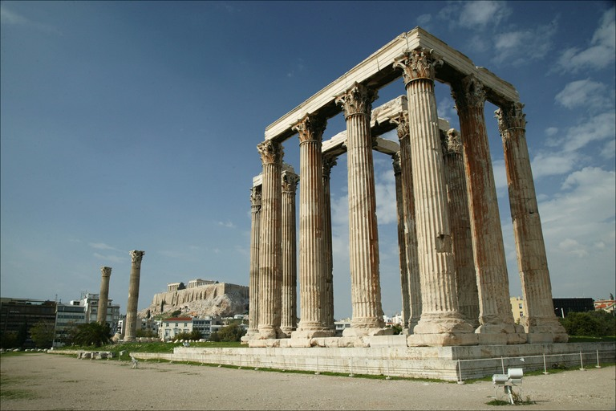
Religion was fundamental to Greek society and affected every aspect of Greek life.
Temples dedicated to gods and goddesses were the major buildings in Greek cities.
The gods were worshipped through sacrifice
The Temple of Olympian Zeus, once the largest temple in Greece, and now only a few columns remain standing.
Notes:
, which often took place at a festival, and prayer.
Homer describes a sacrifice and all its component parts; in this case the goddess Athena came to
receive the sacrifice (doc. 3.9). The gods would always receive their share of an animal killed for
consumption: Athena received the thigh bones and fat (docs 3.10–11, 3.18). Festivals were held all
year round, and to make sure the gods were not forgotten calendars of when the sacrifices were to be
made were inscribed, recording when sacrifices were to occur and what the victim was to be, as well
as the share the priests and others could expect for performing their religious duties

Slide 6
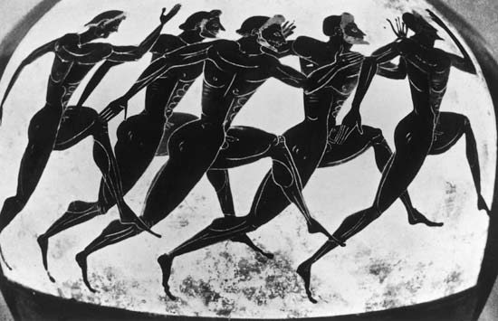
Games at Olympus
Festivals were one way that Greeks honored their Gods and Goddesses. Some festivals were held at special locations to ensure the Gods would be pleased.
Athletic games were often held at Olympus to worship Zeus. The first record of these “games” was in 776BCE.
Notes:
Athens held upwards of 60 annual festivals and Sparta held around 30, in both city-states competitions were common which ranged from sports to music to drama.
The name Marathon^{[n 1]} comes from the legend of Philippides or Pheidippides, the Greek messenger. The legend states that he was sent from the battlefield of Marathon to Athens to announce that the Persians had been defeated in the Battle of Marathon (in which he had just fought),^{[3]} which took place in August or September, 490 BC. It is said that he ran the entire distance without stopping and burst into the assembly, exclaiming "we have won!", before collapsing and dying.

Slide 7
Looking into the Future
The Greeks also had a desire to learn the will of the gods.
To do this, they made use of the oracle, a scared shrine where a god or goddess reveled the future through a priest or priestess.
The most famous of these oracles was the Oracle of Apollo at Delphi, located on Mount Parnassus.

Slide 8
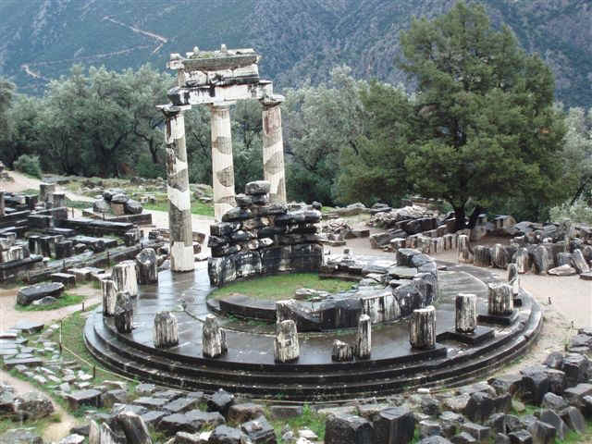
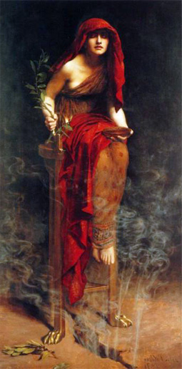
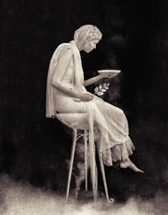
Oracle at Delphi
Notes:
Perhaps the most famous consultant of the Delphic oracle was Croesus (Kreesus), the fabulously rich King of Lydia (Troy) who, faced with a war against the Persians, asked the oracle’s advice. The oracle stated that if Croesus went to war then a great empire would surely fall. Reassured by this, the Lydian king took on the mighty Cyrus. However, the Lydians were routed at Sardis and it was the Lydian empire which fell, a lesson that the oracle could easily be misinterpreted by the unwise or over-confident. The oracles were always open to interpretation and often signified dual and opposing meanings.

Slide 9
Afterlife
It is dreadful
Read the documents, and tell us how it is like.

Slide 10
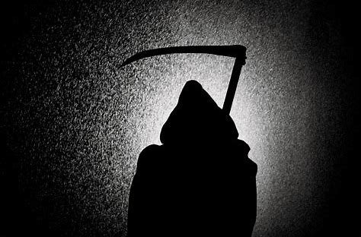
Tragedy for human

Slide 11
https://www.youtube.com/watch?v=nd5Y2xj71f0

