Slide 1
Greek Theatre

Slide 2
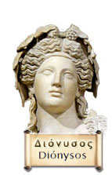
The Opening Night
The ancient Greeks enjoyed many forms of leisure and entertainment but above all the citizens of Greek City-States enjoyed drama.
The Greek theatre history began with festivals honoring their gods. A god, Dionysus, was honored with a festival called "City Dionysia".
In Athens, during this festival, men used to perform songs to welcome Dionysus. Plays were only presented at the City Dionysia festival.
Notes:
The City of Dionysia was a four day event and was a competition held every March. The events started with a sacrifice to the god Dionysus. Most of the plays were tragedies but each day ended with a comedy. A panel of 10 judges picked the best performance after the 4th day.

Slide 3
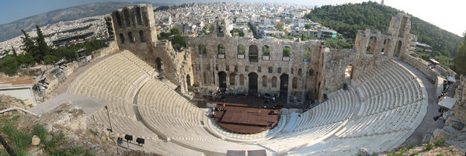
Athens
Athens was the main center for these theatrical traditions.
Athenians spread these festivals to its numerous allies in order to promote a common identity.

Slide 4
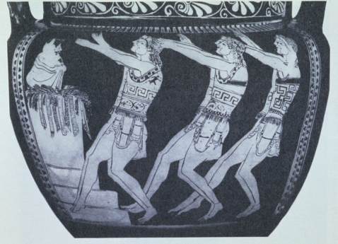
Multi-Tasking
At the early Greek festivals, the actors, directors, and dramatists were all the same person.
After some time, only three actors were allowed to perform in each play. Later on a few non-speaking roles were allowed to perform on-stage.
Due to limited number of actors allowed on-stage, the chorus evolved into a very active part of Greek theatre. Music was often played during the chorus’ delivery of its lines.

Slide 5
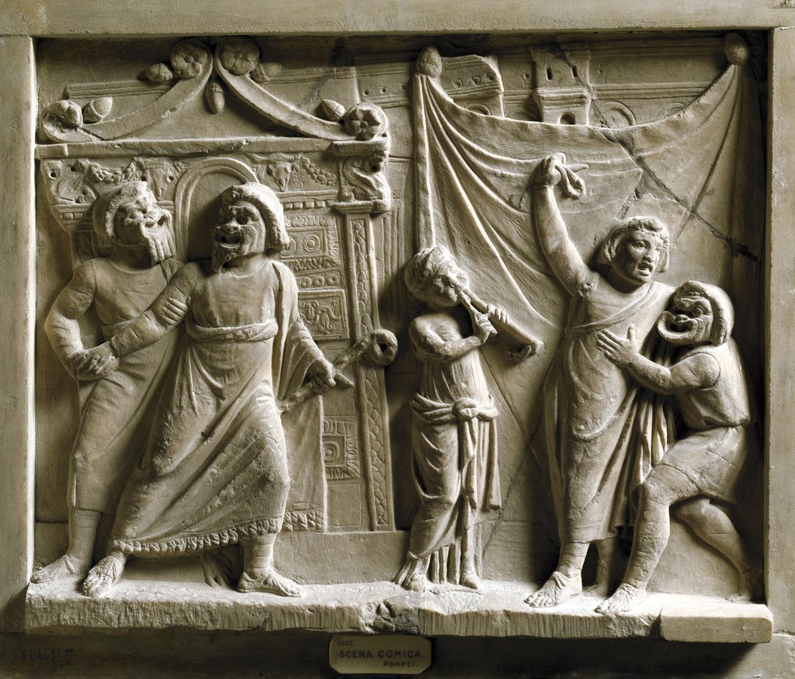
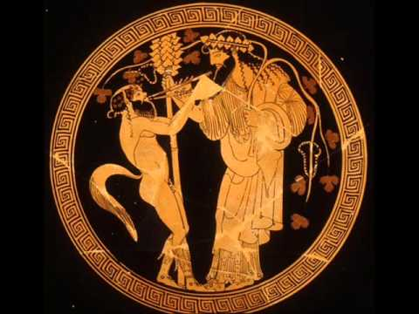
Types of Performances
Tragedy, comedy, and satyr (satire) plays were other theatrical forms.
Tragedy and comedy were viewed as completely separate genres. Satyr plays dealt with the mythological subjects in a comedic manner.

Slide 6
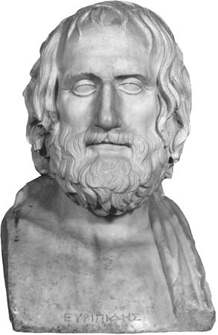
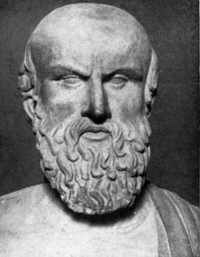
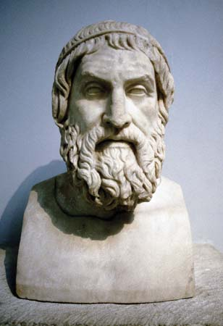
Tragedy Plays
Thespis is considered to be the first Greek "actor" and originator of tragedy.
Aristotle's Poetics contain the earliest known theory about the origins of Greek theatre. He says that tragedy evolved from dithyrambs, songs sung in praise of Dionysus at the Dionysia each year.
Three well-known Greek tragedy playwrights of the fifth century BCE are Sophocles, Euripides and Aeschylus.

Slide 7
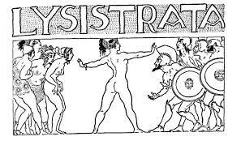
Comedies
Comedy was also an important part of ancient Greek theatre. Comedy plays were derived from imitation.
Many comedies were written but out of these only 11 plays survived.
Lysistrata, a comic account of one woman's extraordinary mission to end The Peloponnesian War. Lysistrata persuades the women of Greece to withhold sexual privileges from their husbands and lovers as a means of forcing the men to negotiate peace — a strategy, however, that inflames the battle between the sexes.
Notes:
It's 411BCE and Athens is locked in the grip of a terrible war with Sparta. Although the war has been going on for years, things have recently taken a bad turn for Athens: they suffered a serious defeat in Sicily just two years before.
To make sure the sex-strike is effective, they will doll themselves up with makeup and put on their skimpiest clothes, to drive their husbands wild with desire.
Eventually, a deal is reached, and the two sides go off to have a party. The play ends with demonstrations of dancing from both sides, in a gesture of unity, trust, and friendship.

Slide 8
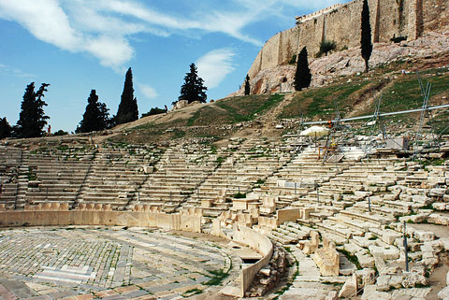
Greek Theatres
Theatre buildings were called a theatron. The theaters were large, open-air structures constructed on the slopes of hills. They consisted of three main elements: the orchestra, the skene (tent or building), and the audience.

Slide 9
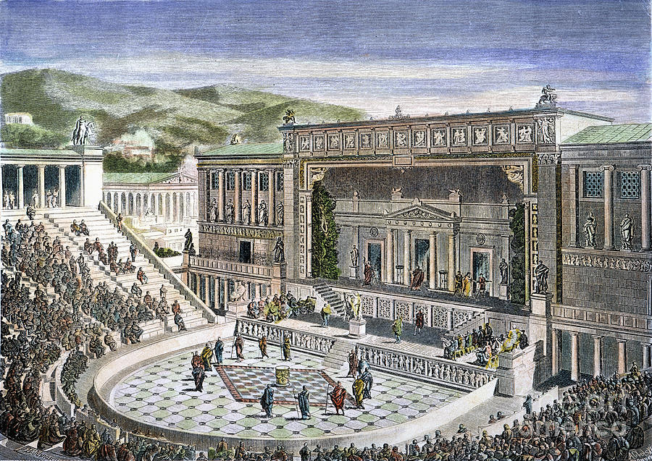

Slide 10
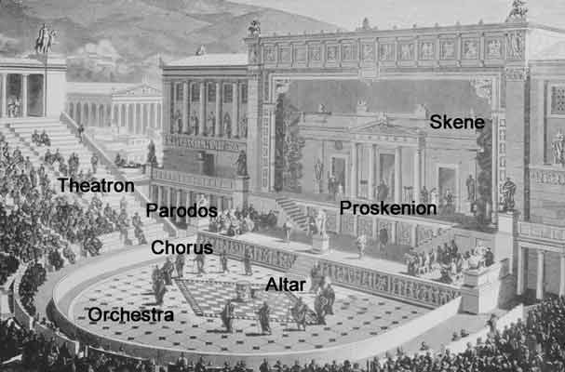

Slide 11
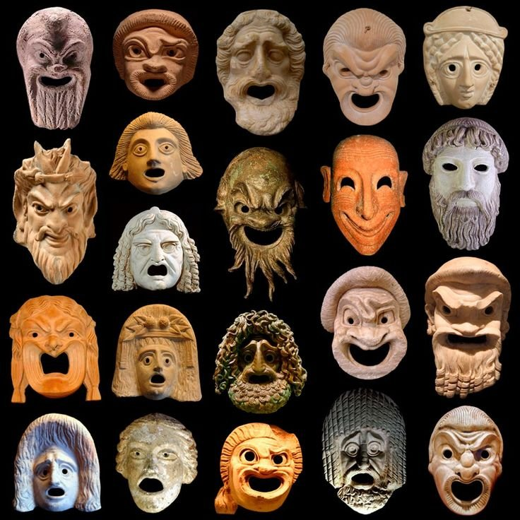
Acting
The cast of a Greek play in the Dionysia was comprised of amateurs, not professionals (all male).
Ancient Greek actors had to gesture grandly so that the entire audience could see and hear the story. However most Greek theatres were cleverly constructed to transmit even the smallest sound to any seat.

Slide 12
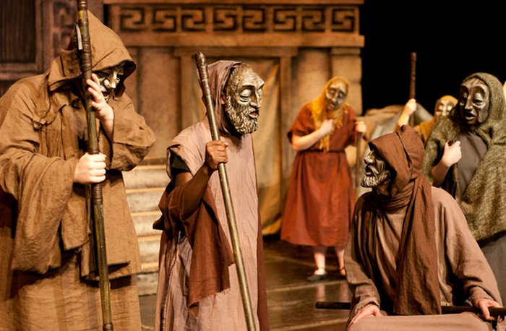
Costumes and Masks
The actors were so far away from the audience that without the aid of exaggerated costumes and masks they couldn’t express their emotions.
The masks were made of linen or cork, so none have survived. Tragic masks carried mournful or pained expressions, while comic masks were smiling or leering.
The shape of the mask amplified the actor's voice, making his words easier for the audience to hear.

Slide 13
Greek’ish Plays Activity
This activity will require you to participate in two brief plays based in Ancient Greece. Take a moment to read over your part(s) and familiarize yourself with names and pronunciations. Read through the play once on your own so you can make your cues and add proper dramatic gestures.
King Midas and the Golden Touch
Pandora’s Box

