Slide 1
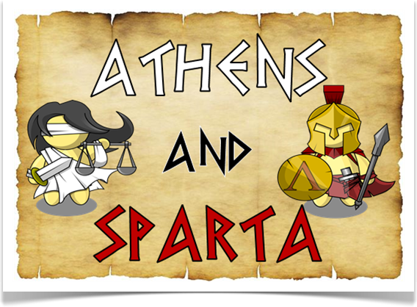
Athens and Sparta

Slide 2
Compare and Contrast Activity
This lesson will require you to discover the similarities and differences between Sparta and Athens. Using the paper provided create a visual to compare these two city-states.
Use the text book to further your learning.
The two most influential city-states of Ancient Greece were also bitter rivals. They were close together on a map, yet far apart in what they valued and how they lived their lives.

Slide 3
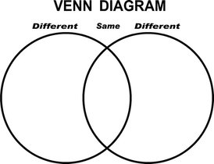
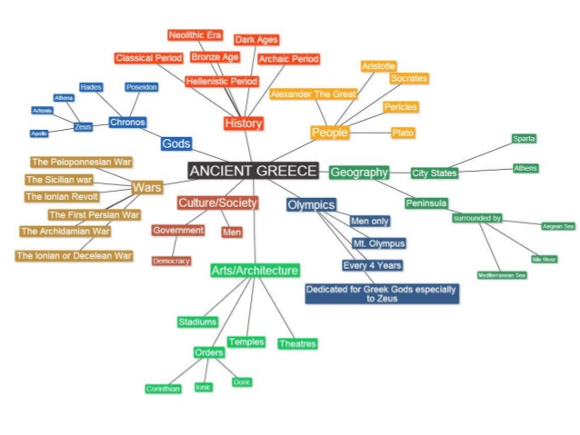

Slide 4
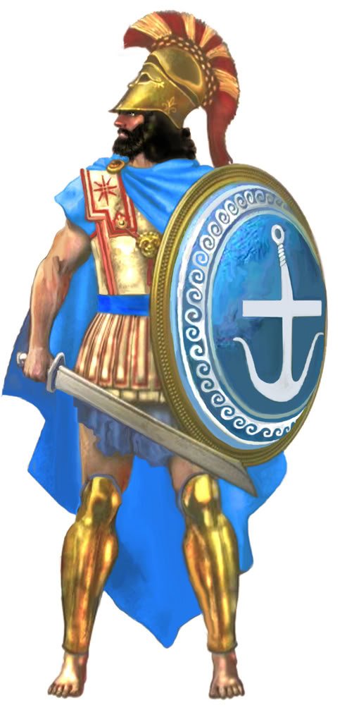
Athens

Slide 5
Athenian Government
Athens was run by a Limited Democracy.
It is considered to be the birthplace of Democracy after varied attempts at leadership options.
Democracy means ‘Ruled by the people’.
A group, or council, of approximately 500 men sat in the Agora and made decisions for the citizens.
Control rotated on a regular basis.
Notes:
Agora – a central public space

Slide 6
Athens – Military and War
Not fighters, mostly focused on education and the arts.
Worked closely with others to trade and share ideas.
Did have very large, strong Navy which allowed Athens to expand their influence across the Mediterranean Sea and Greece.

Slide 7
Athenian Lifestyle
Athenians worshipped Gods very closely:
Athena was their central Goddess
Some young men joined the Army or Navy.
Many more went to school to study the Arts of Science and Math
Athenians respected thinkers.
They valued knowledge.
Notes:
The Athenians considered a well-rounded education essential for all citizens.

Slide 8
Athenian Growth
Athenians ‘imported’ ideas and materials from their many allies through trade.
Athenians saw growth as developing the city:
This promoted architectural wonders, moving art and engineering feats.
Athens was famous for its fine pottery.

Slide 9
Athenian Women
Were judged on beauty and appearance:
Wore makeup and very elaborate jewellery.
Were dependants of their fathers and husbands:
could not own property and could not vote
The women of Athens had few rights and little freedom. Upon marriage all possessions become the property of the husband.
Spent most of their time managing the household affairs.

Slide 10
Athenian Economy
Agriculture was strong and vital to the economy.
A great fleet of boats helped Athenians trade with allies.
Ideas and goods were traded relatively freely in and out of Athens.
Athenians used metal coins.
Marble was another commodity that was profitable for Athens.
Notes:
Commodity - a raw material or primary agricultural product that can be bought and sold, such as copper or coffee.

Slide 11
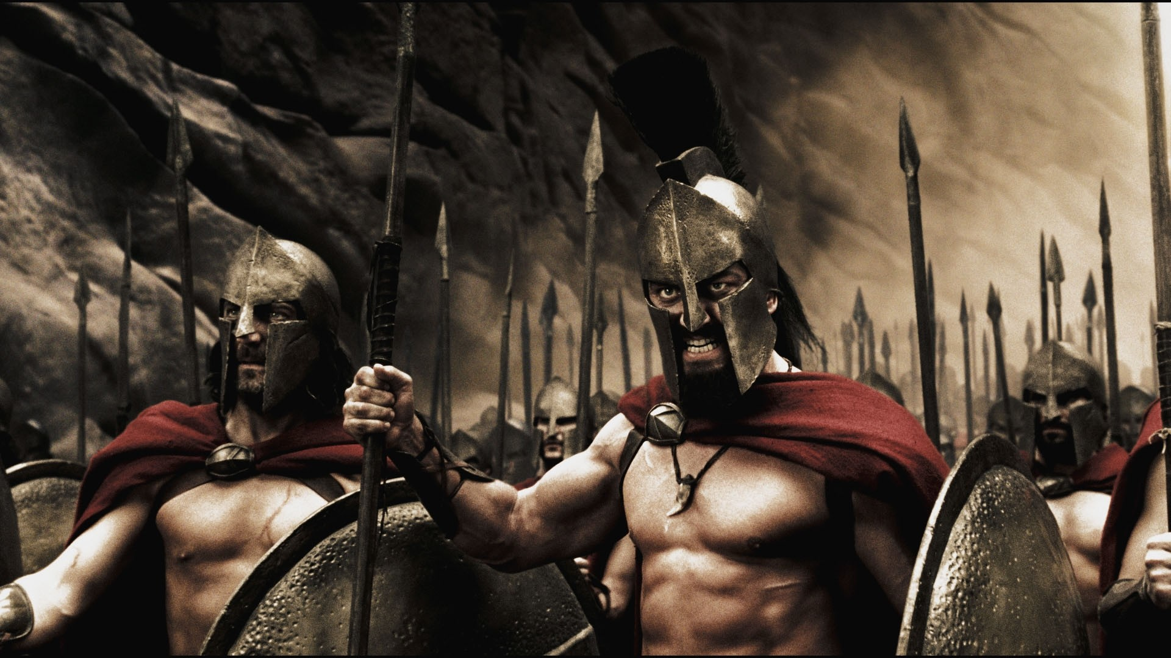
Sparta
aka: Lacedaemonians
Notes:
A laconic phrase or laconism is a concise or terse statement, especially a blunt and elliptical rejoinder. It is named after Laconia, the region of Greece including the city of Sparta, whose ancient inhabitants had a reputation for verbal austerity and were famous for their blunt and often pithy remarks.

Slide 12
Spartan Government
Spartans lived under an Oligarchy.
Some representation was elected by the citizens of Sparta.
Most of the power laid in the hands of two Kings:
One king controlled the military and one controlled the govt.
This power was passed down to the sons of each king
Freedom of choice was very limited for Spartans
A council of 28 aristocrats advised the kings but an Assembly of all male citizens over 30 met outside the city walls to vote on proposals.
Notes:
Oligarchy – govt controlled by a very few individuals
When voting on proposals the winning side was the one that shouted the loudest, not necessarily who had the most people.

Slide 13
Spartan Military and War
Spartan life revolved around war and the protection of Sparta.
Sparta didn’t seek to conquer as they isolated themselves from the outside world.
Boys were taken from home at 7 for military training, which lasted until 60 years of age.
Most feared City-State despite only having 10,000 official citizens at any one time.
Notes:
Although Sparta only had 10000 Spartiates they did have thousands of helots(slaves) that served the Spartans.
Babies were left abandoned if they didn’t pass an inspection of physical attributes.

Slide 14
Spartan Lifestyle
Spartans were notorious for living a simple, frugal, minimalist lifestyle. They ate only what they needed, kept their bodies fit, did not spend money wastefully.
Men lived together in a military barracks until 30, even if married.
Worship of the Gods was important and could trump even there thirst for battle.
Obedience was a virtue and often they were not allowed to travel abroad.
Notes:
Spartans were discouraged from studying philosophy, literature and the arts.
Spartans would often make sacrifices before battles and after battles.

Slide 15
Spartan Growth
To Spartans, growth meant expansion into new lands in order to capture slaves (helots). Spartans focused on dominating the region around Sparta to protect their way of life.
Why trade with others when you can force them to give what you want?
This promoted dominance and bigger, stronger military forces.

Slide 16
Spartan Women
Judged on physical toughness and physique. Trained like the boys at an early age.
Competed in sports like the men.
A bigger, buffer mother created bigger, buffer sons.
Girls were raised to be mothers and wives of warriors.
Had many responsibilities and freedoms compared to other Greek women as they had to defend and run the day-to-day activities of Sparta when the men were at war.
Notes:
No political or legal status

Slide 17
Spartan Economy
Spartan rulers limited trade in order cut down on sharing ideas with other City-States.
Spartans did not amass wealth as it distracted from military focus.
When Sparta wanted to receive goods they used force.
Helots were slaves captured in all lands invaded
Spartans were able to focus on war rather than chores

