Slide 1
Obedience to Authority & the Psychology of Evil
Stanley Milgram & Philip Zimbardo

Slide 2
Psychologists trying to understand Evil
Philip Zimbardo, Stanford University
Stanley Milgram, Yale University

Slide 3
Obedience is compliance with commands given by an authority figure. In the 1960s, the social psychologist Stanley Milgram did a famous research study called the obedience study.

Slide 4
Milgram’s Obedience to Authority Experiment
Electric Shocks administered by subject to ‘fake’ volunteer participant.
Shocks ranged from 15 volts to 450 volts at steadily increasing levels.
Last level is lethal dose of electricity.
In Milgram’s original experiment all subjects went to 300 volts, and 65% went to the lethal 450 volts.
This has been replicated many times.
Notes:
Milgram told his forty male volunteer research subjects that they were participating in a study about the effects of punishment on learning. He assigned each of the subjects to the role of teacher. Each subject was told that his task was to help another subject like himself learn a list of word pairs. Each time the learner made a mistake, the teacher was to give the learner an electric shock by flipping a switch. The teacher was told to increase the shock level each time the learner made a mistake, until a dangerous shock level was reached.
Throughout the course of the experiment, the experimenter firmly commanded the teachers to follow the instructions they had been given. In reality, the learner was not an experiment subject but Milgram’s accomplice, and he never actually received an electric shock. However, he pretended to be in pain when shocks were administered.
Prior to the study, forty psychiatrists that Milgram consulted told him that fewer than 1 percent of subjects would administer what they thought were dangerous shocks to the learner. However, Milgram found that two-thirds of the teachers did administer even the highest level of shock, despite believing that the learner was suffering great pain and distress. Milgram believed that the teachers had acted in this way because they were pressured to do so by an authority figure.
In everyday situations, people obey orders because they want to get rewards, because they want to avoid the negative consequences of disobeying, and because they believe an authority is legitimate. In more extreme situations, people obey even when they are required to violate their own values or commit crimes. Researchers think several factors cause people to carry obedience to extremes:
People justify their behavior by assigning responsibility to the authority rather than themselves.
People define the behavior that’s expected of them as routine.
People don’t want to be rude or offend the authority.
People obey easy commands first and then feel compelled to obey more and more difficult commands. This process is called entrapment, and it illustrates the foot-in-the-door phenomenon.

Slide 5
Milgram wrote:
“…the essence of obedience consists in the fact that a person comes to view himself as the instrument for carrying out another person's wishes, and he therefore no longer sees himself as responsible for his actions. Once this critical shift of viewpoint has occurred in the person, all of the essential features of obedience follow."

Slide 6
Zimbardo’s Stanford Prison Experiment
Subjects were screened and divided equally into guards or prisoners.
Prisoners were arrested and held in cells at the university.
Guards gradually began to engage in dehumanizing and evil behavior towards the prisoners.
He ended the experiment after a few days as the guards were heading out of control and the prisoners were suffering break downs.
Notes:
Zimbardo (1973) was interested in finding out whether the brutality reported among guards in American prisons was due to the sadistic personalities of the guards (i.e., dispositional) or had more to do with the prison environment (i.e., situational).
To study the roles people play in prison situations, Zimbardo converted a basement of the Stanford University psychology building into a mock prison. He advertised asking for volunteers to participate in a study of the psychological effects of prison life,
More than 70 applicants answered the ad and were given diagnostic interviews and personality tests to eliminate candidates with psychological problems, medical disabilities, or a history of crime or drug abuse. The study comprised 24 male college students (chosen from 75 volunteers) who were paid $15 per day to take part in the experiment.
Within hours of beginning the experiment some guards began to harass prisoners. At 2:30 A.M. prisoners were awakened from sleep by blasting whistles for the first of many "counts." The counts served as a way to familiarizing the prisoners with their numbers. More importantly, they provided a regular occasion for the guards to exercise control over the prisoners.
During the second day of the experiment, the prisoners removed their stocking caps, ripped off their numbers, and barricaded themselves inside the cells by putting their beds against the door. The guards called in reinforcements. The three guards who were waiting on stand-by duty came in and the night shift guards voluntarily remained on duty.
Putting Down the Rebellion
The guards retaliated by using a fire extinguisher which shot a stream of skin-chilling carbon dioxide, and they forced the prisoners away from the doors. Next, the guards broke into each cell, stripped the prisoners naked and took the beds out. The ringleaders of the prisoner rebellion were placed into solitary confinement. After this, the guards generally began to harass and intimidate the prisoners.
Conclusion: People will readily conform to the social roles they are expected to play, especially if the roles are as strongly stereotyped as those of the prison guards. The “prison” environment was an important factor in creating the guards’ brutal behavior (none of the participants who acted as guards showed sadistic tendencies before the study). Therefore, the findings support the situational explanation of behavior rather than the dispositional one.

Slide 7
Zimbardo wrote:
"Good people can be induced, seduced, and initiated into behaving in evil ways. They can also be led to act in irrational, stupid, self-destructive, antisocial, and mindless ways when they are immersed in 'total situations' that impact human nature in ways that challenge our sense of the stability and consistency of individual personality, of character, and of morality."

Slide 8
The 7 social processes that grease "the Slippery slope of evil":
Mindlessly taking the first small step (‘All evil begins with the 15 volt shock’)
Dehumanization of others
De-individuation of self (anonymity)
Diffusion of personal responsibility
Blind obedience to authority
Uncritical conformity to group norms
Passive tolerance of evil through inaction or indifference

Slide 9
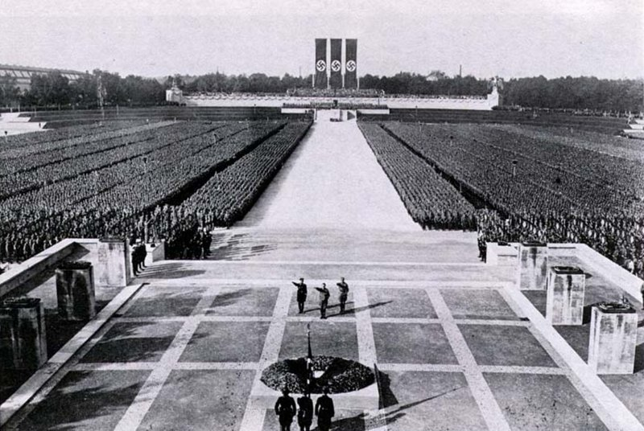

Slide 11
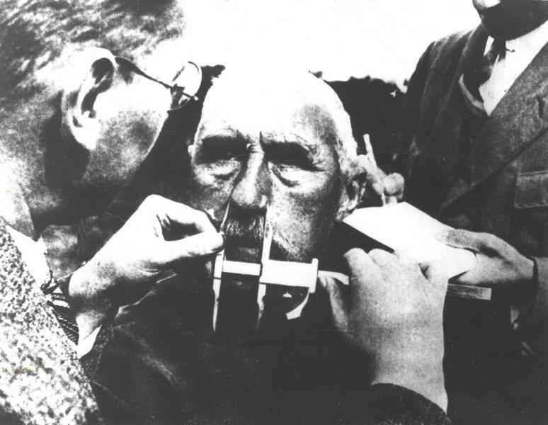

Slide 12
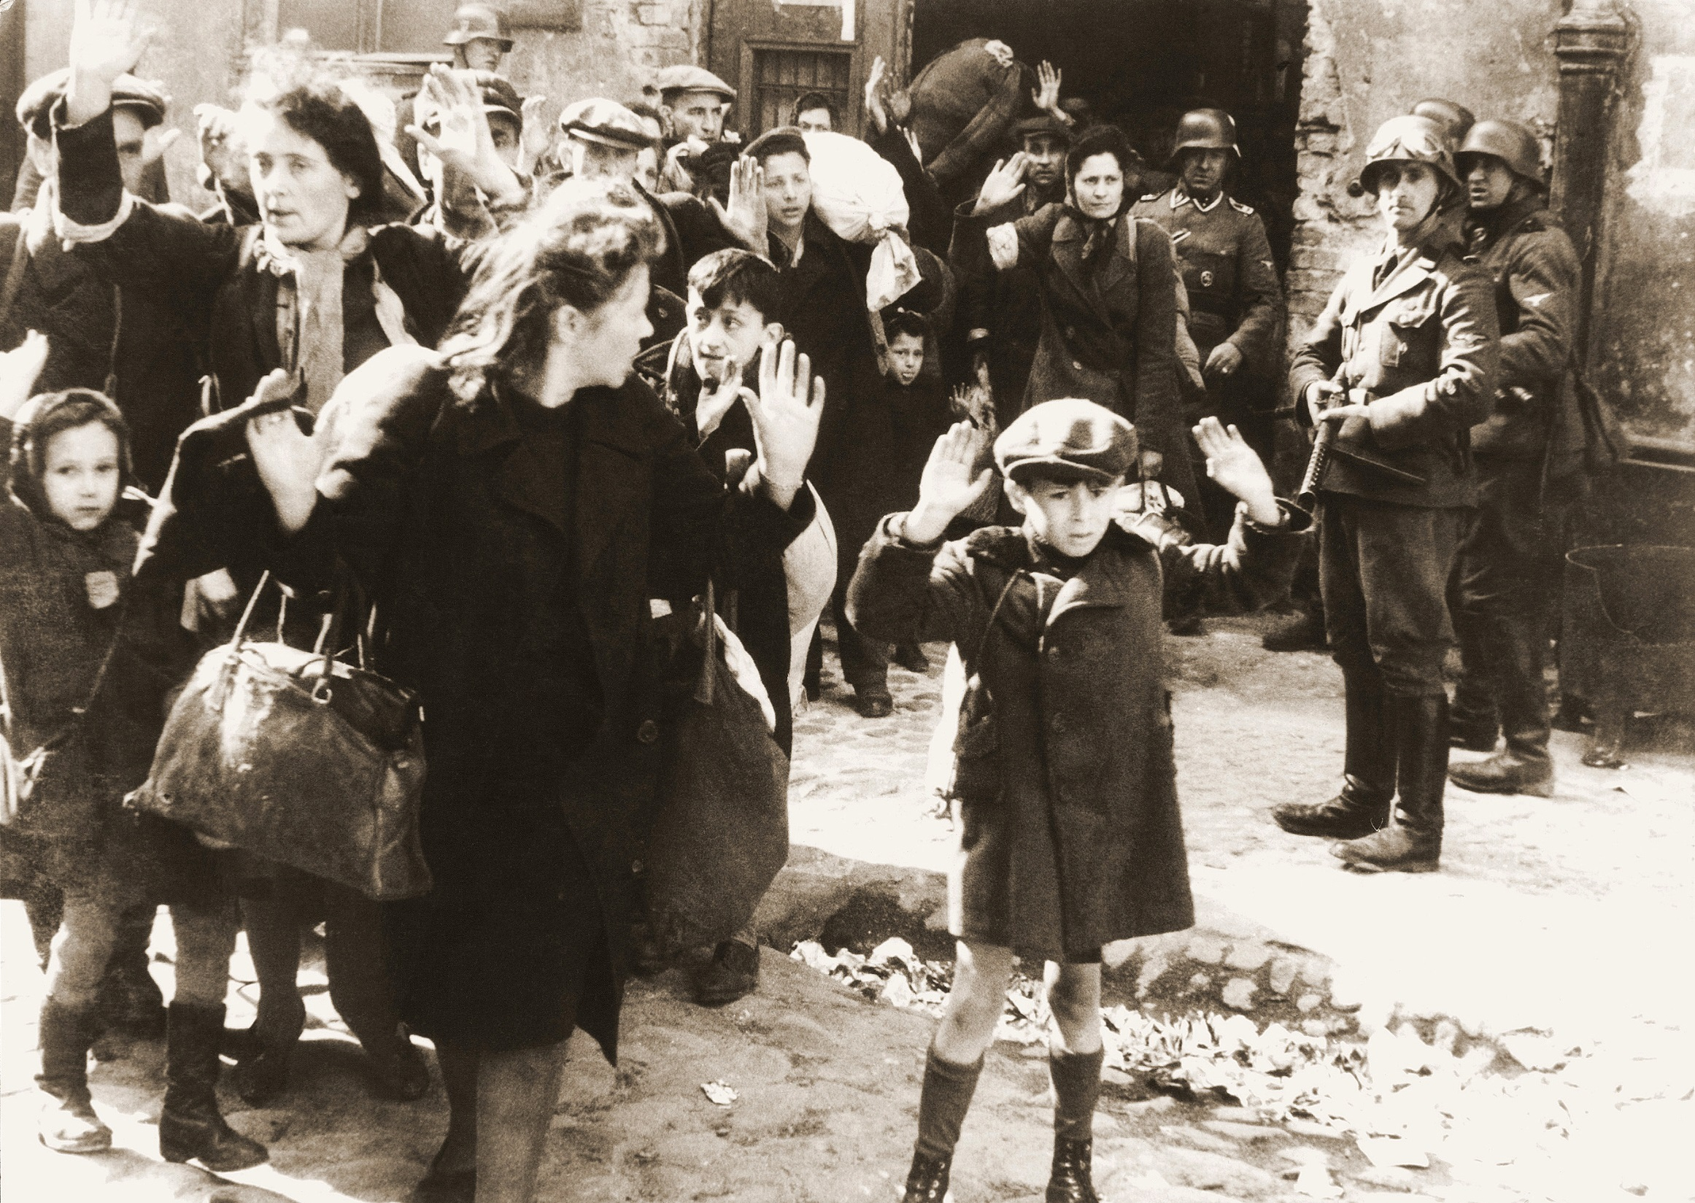

Slide 13
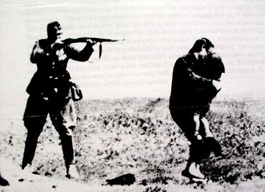

Slide 14
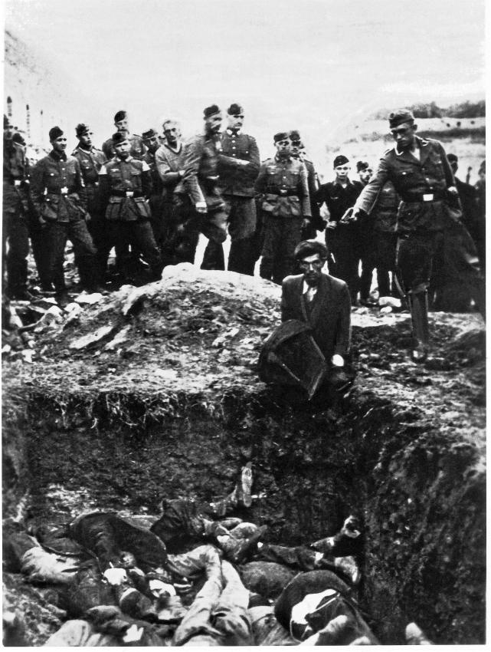

Slide 15
Lessons for us today:
These experiences showed that people have a strong tendency to comply with authority figures and people will readily conform to the social roles they are expected to play.

