Slide 1
Canada after the Conquest
1774 - 1811

Slide 2
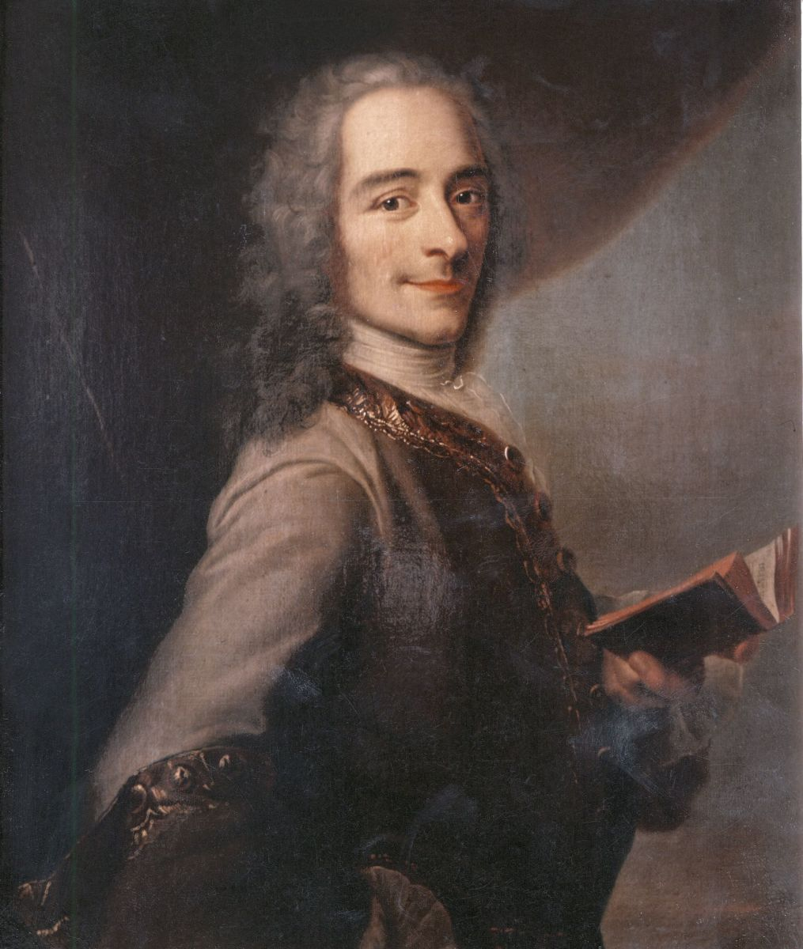
New France? Meh
Quelques arpents de neige
- Voltaire
Notes:
“a few acres of snow”
This off hand comment suggests that France wasn’t terribly traumatized with the loss of New France to the British. While the Acadians were rounded up and deported the rest of the Canadiens (Fr for Canadians) lived their lives just as they always did, life went on.

Slide 3
Canada: The Failed Republic?
“Who is a Canadian? Well, the political answer is that he is an American who avoided Revolution…”
- Scholar and theorist Northrop Frye
Notes:
With the help of the French the Thirteen Colonies of the eastern seaboard broke free of British rule in 1775 and formed a new political union: the United States of America. This American Revolution ultimately created not one country but two: the newly formed US of A and the scattered northern colonial leftovers that would eventually be pieced together to form the Dominion of Canada.
The war between Britain and France was costly for both sides. Britain had “won” with the capture of New France but a new atmosphere of violence was obvious after the colonies deemed Britain a “tyranny” and called for “No taxation with representation”. This impending disaster forced Britain to revamp it’s policies regarding the French Canadians.
FYI: The National debt in Britain soared to $130 million from the cost of the war against France and her allies. (the most Britain ever collected in taxes per year was $15 million.)

Slide 4
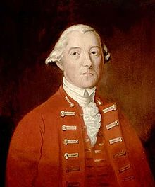
Guy Carleton
In 1766, Gov Murray was replaced by Sir Guy Carleton, an Irish officer and the 1st Baron of Dorchester, and he became the new lieutenant governor of Quebec.
He was concerned about security, due to the growing discontent in the 13 Colonies to the south.
Attempted to win over the French as he never believed that they would assimilate into British culture or the Anglican faith.
Notes:
Murray joined the British army in 1739/40 and served in the West Indies and Europe. Sent to North America in 1757 as a lieutenant colonel during the Seven Years’ War, he commanded a brigade in 1758 during the successful British siege of Louisbourg, in what is now Nova Scotia, under Jeffery Amherst. He was one of General James Wolfe’s three brigadiers in the British expedition against Quebec in 1759. After the British captured the city, Murray was made its military governor. When the French capitulated in 1760, he became military governor of Quebec district; he became the first civil governor of Quebec after its formal cession to Great Britain in 1763.
As governor, Murray opposed repressive measures against French Canadians, and his conciliatory policy led to charges against him of partiality.
He was also concerned about France reclaiming New France and a possible revolt from the French Canadian majority ( 1627 British troops and 500 immigrants vs 69,275 conquered French citizen and 7400 Aboriginal people)
Carlton predicted that the French in Canada would exist “to the end of time.”

Slide 5
Carleton spent 4 year in London working with British authorities to restructure the governmental framework of Quebec.
Carleton also sympathized with the old French elites and made agreements with the well established French-Canadian seigneurs and clergy in hopes of achieving a peaceful governing system for Quebec.
He didn’t think that the British system would work in Quebec as it was very restrictive towards those how could participate in politics.
Notes:
The British were aware of the growing discontent in the south so they were very willing to appease the French Canadians as they didn’t want to fight a two front battle in the “New World”. He returned to Canada with all his recommendations approved.
By keeping the seigneurial system he hoped to maintain a hierarchical system for govt and society as a whole. He supported the aristocracy and the close connection between the church and the state.
At the time Britain law did not allow Catholics in Quebec to vote or to hold office, a clear problem for the vast majority of citizens.

Slide 6
Meanwhile in Atlantic Canada
The Atlantic colonies were quite different.
In 1758, the first elected legislative assembly in Canada had convened in Halifax.
PEI gained an elected assembly in 1773
New Brunswick was created in 1784 when it was separated from NS.
The real power still remained in the hands of the executive council and the colonial governors.
Notes:
The elected assemblies could enact laws but they could all be blocked by the governor, the council, or the British govt.
It wasn’t until 1848 that NS had an elected, responsible govt, it was the first Canadian colony to have done so.

Slide 7
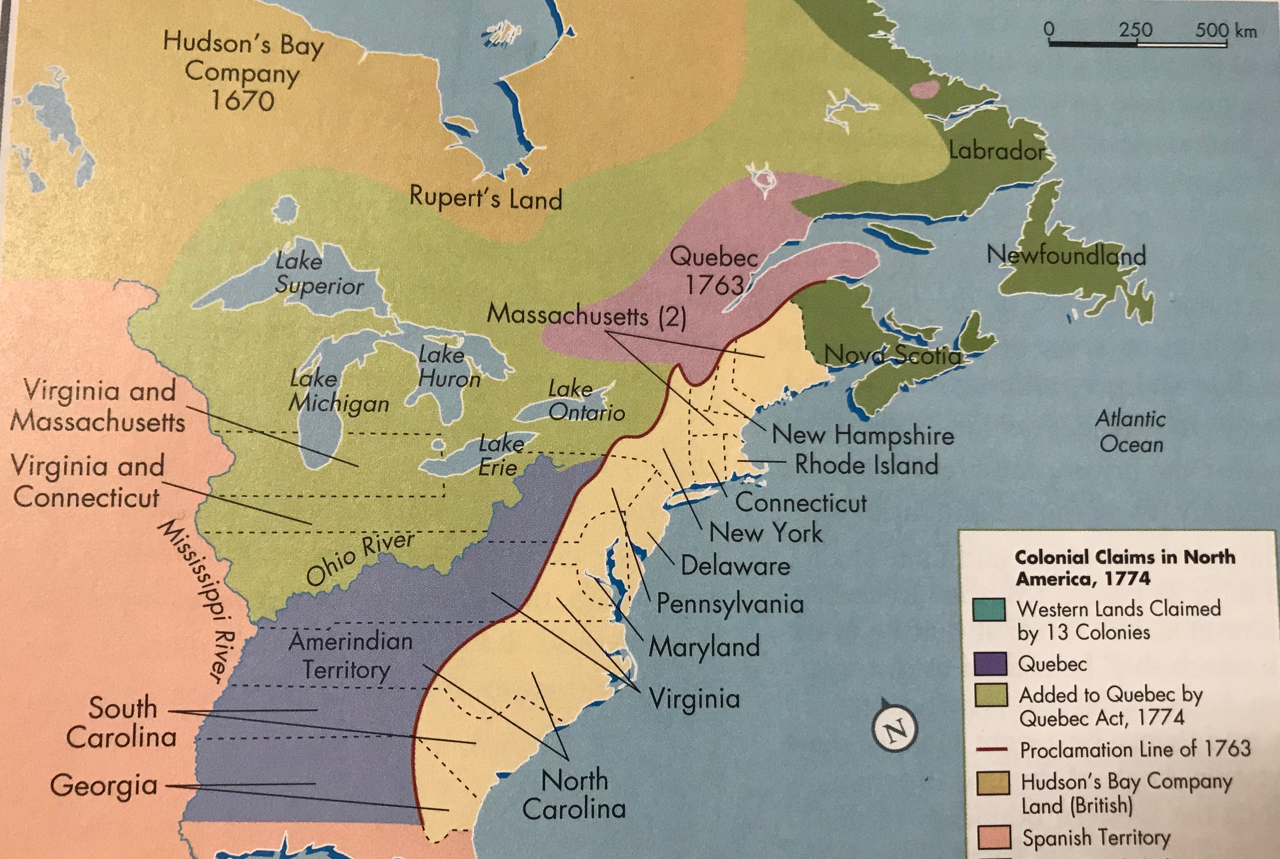

Slide 8
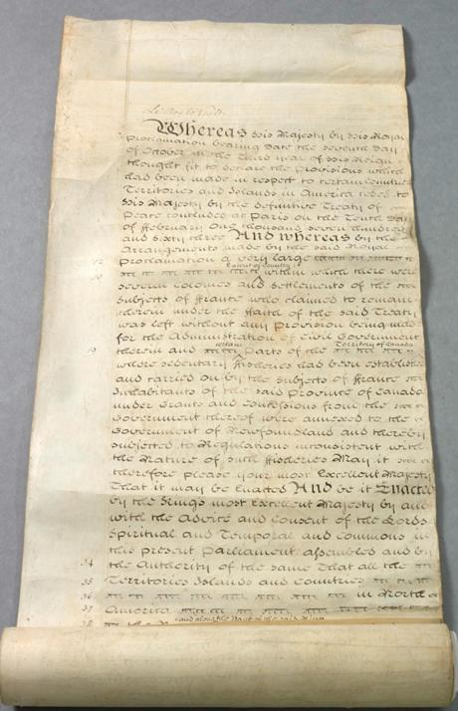
The Quebec Act of 1774 Highlights
French civil law was reinstated for matters of property.
English law was retained for criminal matters.
The seigneurial system of land holding was confirmed.
The Roman Catholic Church was granted rights not allowed back in Protestant Britain, including the right to raise money through tithes.
Notes:
Without French and Aboriginal representation the British Parliament passed this act which was for Quebec only, nothing was connected to the 13 Colonies or English speaking Nova Scotia. The French Catholics were judged as unique in North America.
This new Quebec Act revoked much of the Royal Proclamation of 1763. The Quebec Act never included the possibility of granting them an elected assembly but rather they would be administered by the governor and a hand picked council – but one that would include French Canadians.
One significant tidbit of info about the Royal Proclamation was that their was no mention of Aboriginal rights at all, something that would have severe consequences for the First Nations community in the coming years.

Slide 9
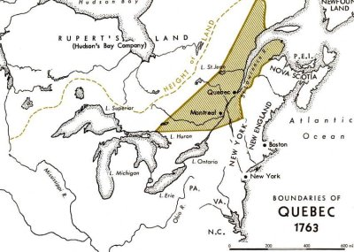
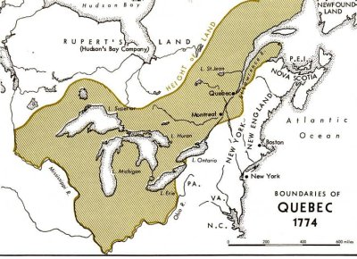
Royal Proclamation vs Quebec Act
Notes:
This Quebec Act set off protests in the American colonies as Carleton allowed the Anglo merchants more territory in the south. The Ohio valley and the Great Lakes were given back to France and with it the heart of the Old French Fur Trade.
This Act blocked the Americas from expanding into the interior of the continent…no wonder they wanted to break from Britain.

Slide 10
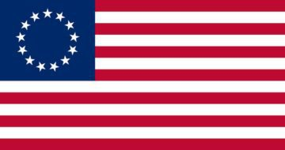
Join Us! Join US! Join the US!
In 1775, the American colonies invited the Canadians to send a delegation to the Continental Congress in an attempt to lure Canada into joining the revolution against the British.
No one took up the offer. Why?
Notes:
Read quote from Canadian History for Dummies, pg 143

Slide 11
Why Didn’t We Revolt?
English Canadians: some of which were recent arrivals for the American colonies were pleased with having access to all the land added by the Quebec Act, possibly they decided to remain neutral and avoid any unnecessary fighting.
French Canadiens: were urged by the clergy and the seigneurs to resist the call of the Americans. G. Washington and the rebels denounced the Catholic Church and French law. Also, the Americans were seemingly less tolerant compared to the British who had given the French plenty of flexibility with the new Quebec Act.
Notes:
These reasons are debateable by many historians
Both the Americans and the English assumed that Canadiens would help support them both sides would be sadly mistaken.
English colonies were also wary that Britain could possibly revoke any sense of governmental control at any time as the British didn’t hide that elected assemblies were a privilege and not a right. Britain could take away any Canadian input and have a British governor make all decisions.

Slide 12
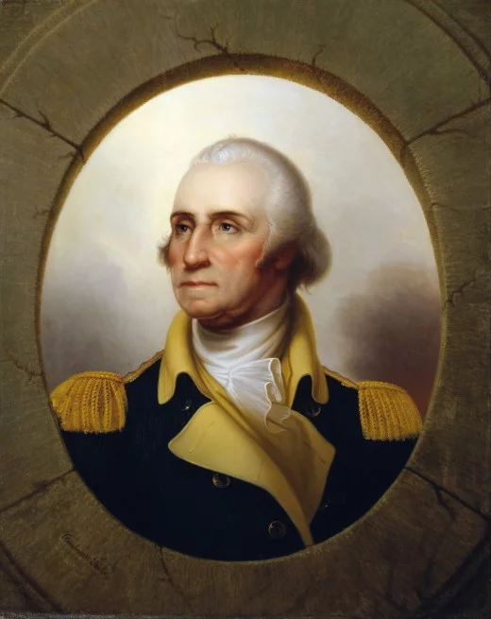
Canada must be demolished! -American rebel leader
In 1775, George Washington – wealthy slave owner and future first president of the United States of America decides to invade Canada.
The Americans were convinced that Canadians yearned to be “liberated” and they didn’t want Canada to be used as a base of operations for the British…also Canada has a lot of land just sitting there waiting to be claimed.
Notes:
It appears that the US were an expansionist country right from the start.

Slide 13
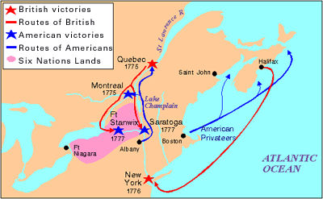

Slide 14
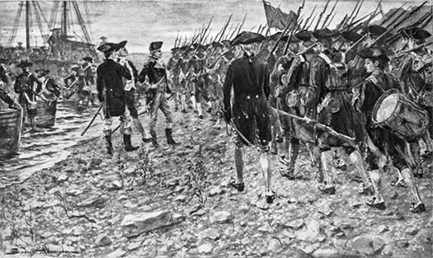
The Capture of Montreal
In September 1775 rebel General Richard Montgomery led American forces on the first major offensive of the invasion, seizing the forts at Ticonderoga and Crown Point in northern New York, and Fort Chambly in Québec.
With 1,700 militia troops, Montgomery then captured Fort Saint-Jean outside Montréal in November – prompting Carleton to abandon Montréal and flee to Québec. The Americans occupied Montréal without a fight on 28 November.
Notes:
I have the pleasure to acquaint you with the surrender of Chambly to Major Brown and Major Livingston, which last headed about three hundred Canadians…. The troops are in high spirits…. Col. Warner has had a little brush with a party from Montreal. The enemy retired with the loss of five prisoners and some killed some of the prisoners (Canadians) are dangerous enemies, and must be taken care of…
Extract of a letter from General Montgomery, dated camp before St. John’s, October 20, 1775 …

Slide 15
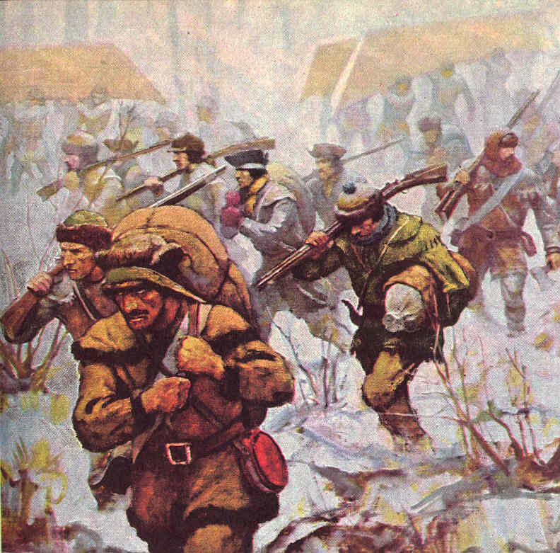
The Siege of Quebec
On Dec 3rd, the Americans, or what was left of them, converged on Quebec.
The French Canadians remained neutral to the whole affair and even sold supplies to both the American and British. Carleton was not please as he expected the French Canadiens to support his cause.
Notes:
Benedict Arnold, British officer turned rebel, led the assault on Quebec but the harsh overland route through the wilderness proved nearly fatal as half of his troops had deserted, were incapacitated due to disease or died before the first shot was fired.

Slide 16
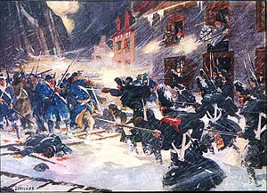
Disaster for the Americans
Eventually the Canadiens turned against the Americans and threw their weight into the defense of the city.
The Americans launched an attack on Dec 31 in the middle of a snowstorm. Montgomery was shot dead in the first skirmish but they pushed on only to be trapped in the narrow streets in a blinding storm.
400 Americans were taken prisoner and 100 lay dead in the street, some not discovered until the spring melt.
Notes:
Americans had started to loot habitant farms and terrorize families and they also attempted to pay for provision with “worthless” paper money from America.
Britain only lost 3 men in the battle for Quebec, which had been an utter disaster for the Americans.

Slide 17
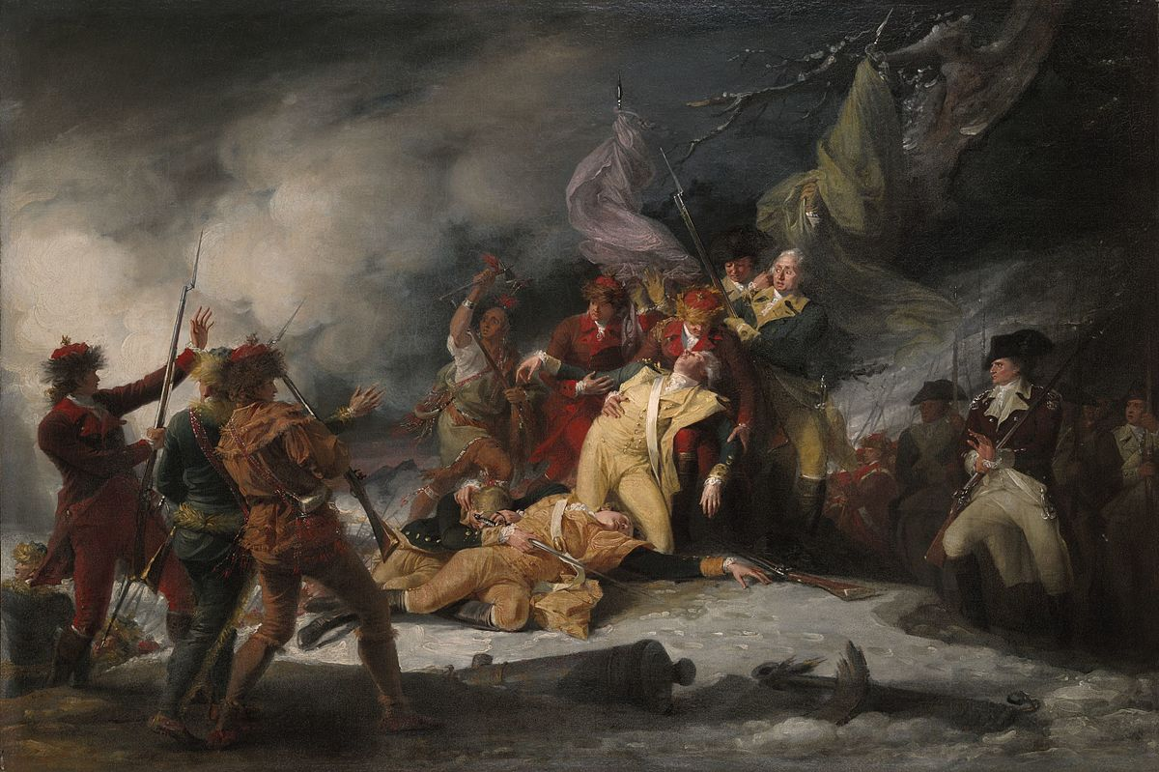
Death of Montgomery
Notes:
Montgomery had died and Arnold was wounded and had to retreat, he later crossed back to the British side and was forever labeled as a “turncoat” to the Americans. The Americans withdrew from Canada on July 2, 1776 and on the 4th they issued a Declaration of Independence becoming a self-proclaimed govt of a new republic. Governor Carleton was receive a knighthood for his leadership in Quebec despite some grumbling about how he let too many Americans escape.

Slide 18
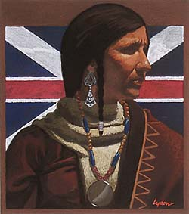
Additional Information
During the American Revolution, the Mohawk, Onondaga, Cayuga, and Seneca Peoples of the Six Nations Iroquois Alliance fought along side the British as they believed it was the only way to retain any claim on land in the Ohio Valley and Great Lakes Regions.
The British military created an official dept exclusively for maintaining a positive relationship with the Aboriginal populations – they would be valuable during war times.
Molly Brant
Notes:
The Aboriginal people fought hard as it was for survival, for their homelands and for their families.
The first British “superintendent” was William Johnson, who would eventually marry Molly Brant, sister to Joseph Brant, a Mohawk chief.
Molly was herself a very powerful leader of her people, she was consulted for major decisions and all matters of importance. She was instrumental in the decision for the Six Nations to join with the British in the War with American rebels.
Washington was furious that the Aboriginals joined with the British and ordered the “total destruction and devastation of their settlements and capture as many prisoners, of every age and sex, as possible.” Within 2 months after issuing the order every village of the Oneida and Tuscarora who were neutral was destroyed. (pg 197 text book)

Slide 19
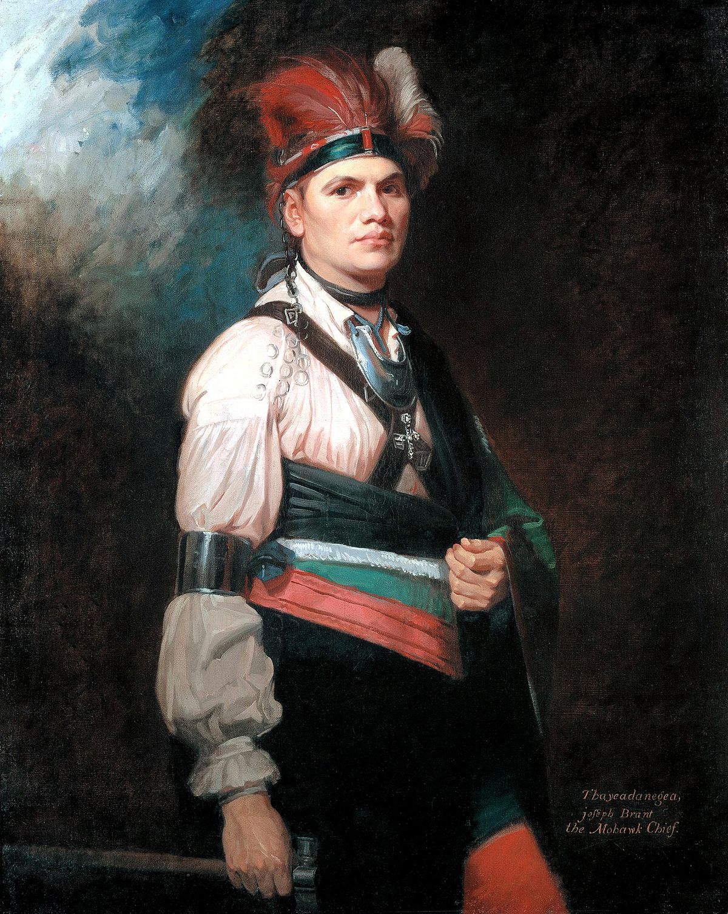
Joseph Brant
He earned his title of Mohawk Chief after his successful career in the "Seven Years War" between Great Britain and France.
He united many of the Iroquois tribes in the fight against the Americans and was very successful in battling against the American revolutionaries.
For their part in the war Brant and his people were given 270,000 hectares of Crown land north of Lake Erie.
Notes:
Brant felt betrayed when the 6 Nations people were not even mentioned in the Treaty of Paris of 1783 which officially ended the American Revolutionary War.

Slide 20
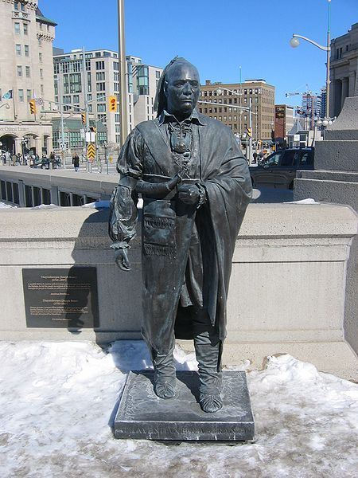
Taken for Branted
While the land seemed like a gift it was actually a way for the British to relocate Brant and his people so they wouldn’t pose a threat to further land claims.
By 1828, only 1/3 of the land remained in the hands of the Six Nations, the rest had been lost to errors in the original and grants, encroaching settlers, and land sales and leases.
Heritage Minute

Slide 21
Questions
Why might a person declare that the Quebec Act of 1774 was one of the most important documents in North American history?
How did the American Revolution impact the Aboriginal population?
What can we learn from the image on the following page?
Notes:
Perhaps the most important consequence of the Quebec Act was the American War of Independence. To many settlers in the Thirteen Colonies, the Quebec Act was a very unpopular act and a demonstration of “British Authoritarianism.” It was famously one of the five “intolerable acts” passed by Britain in the lead-up to the revolution. The Quebec Act had shown how tyrannical and corrupt the Crown had become, with many feeling betrayed. It was their duty to “resist such sweeping attacks on their liberty.” It could be argued that this Act led to the creation of the United State of America.
Chief Brant and the Iroquois were given land but were essentially resettled into a fairly isolated area where they wouldn’t be a burden. They were continued to be seen as a potential threat by the British and treated as a footnote in their involvement in the American Revolutionary War, as seen by their omittance in the Paris Treaty of 1783.

Slide 22
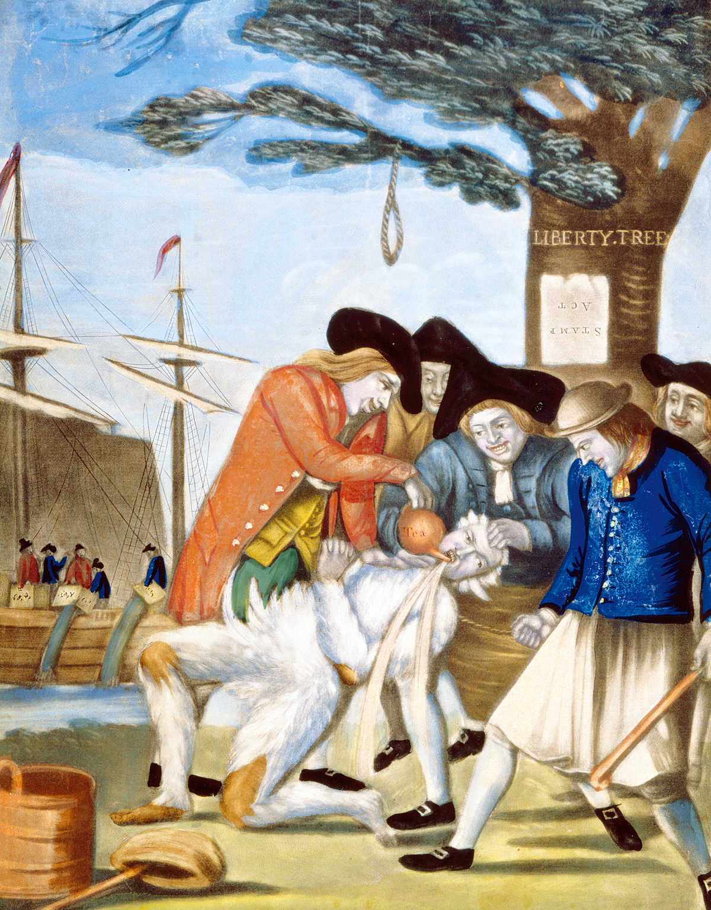
“Bostonians Paying the Excise Man” 1774 (British Print)
Notes:
In this depiction of the events, the artist portrays the Bostonians with menacing faces, violently pouring tea down Malcom’s throat. Items representing events from the daylong assault are compressed into one scene, including the tar and feathers, a club, and a noose hanging from the Liberty Tree. The Boston Tea Party, which occurred a month before the attack on Malcom, appears in the background, linking the two events for the British audience. The Stamp Act is also depicted upside down on the Liberty Tree, serving as a reminder of the Stamp Act protests of 1765. The British portray the Americans as violent and dangerous.

