Slide 1
Canadian Cultural Identity

Slide 2
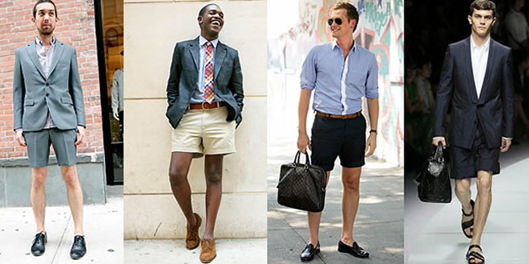
Before we get started on Canadian Identity…
What makes up your personal identity?
Consider, but not limited to, the following:
Where you live in NB
Your family’s ethnic origins
Your unique traditions and activities
Your religion
Your sense of style
Your personal values

Slide 3
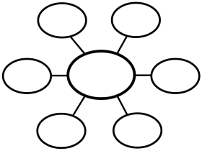
Personal Identity Activity
On the paper provided create a concept web with “Who am I?” in the centre. Write or draw ideas and thoughts about what makes up you personal identity. What makes you you?
Who am I?

Slide 4
Expectations for Concept Map
/5 Discuss family and friends
/5 culture (what is your heritage? (Irish, African Canadian, Scottish) Explain where your family originated from.
/5 Your family has developed traditions surrounding Christmas, Easter, Thanksgiving. Explain.
/5 Please add drawings surrounding your concept map and add some color.
Total:
20

Slide 6
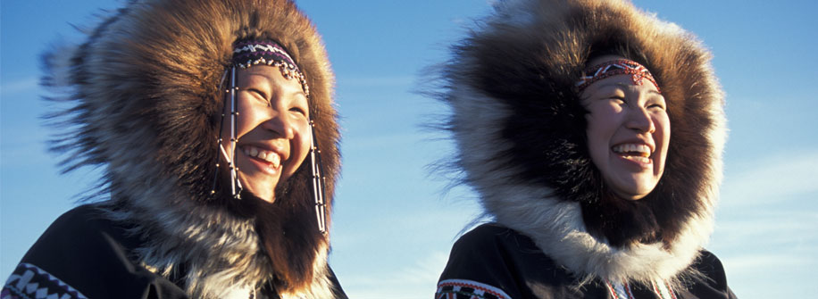
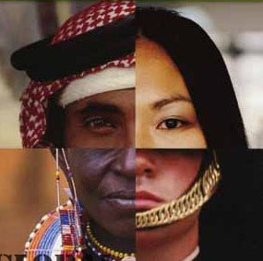
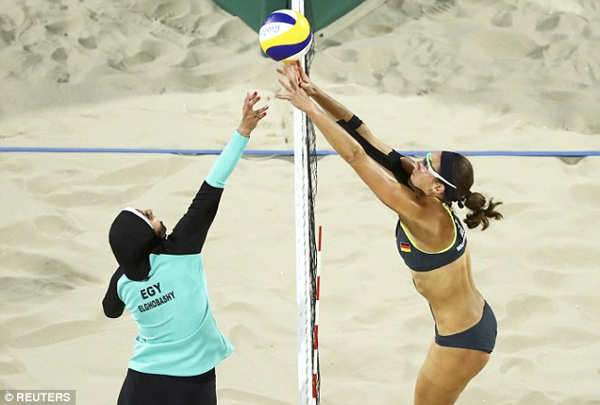
Class Discussion
Would your concept web be different if you lived somewhere else in Canada or the world?
Why?

Slide 7
Homework – Show and Tell
Your task tonight is to find an object that is meaningful to you and helps define who you are as an individual. Be prepared to bring it to class and share the meaningfulness of this object.

Slide 8
Canadian Identity
Now that we’ve discussed personal identity we will look at Canadian identity.
This is not as easy as it might seem at first, why might it be difficult to define Canadian identity?

Slide 9
Canadian Identity
Canada is such a vast county and its people are so diverse that finding Canadian identity can be quite difficult.
Let’s consider some factors that influence the concept of national identity:
geography/climate
Community/province/region
Regional history
Language/culture/ethnic background
Friends/leaders/politicians/heroes
Gov’t
Which of these factors have influenced you? Are there any other factors you would include?

Slide 10
Researching Canadian Identity
As we continue through lessons in Canadian Identity you will asked to research and discover how art, literature and music are influenced by Canadian identity.
One way that researches do their work is by developing a hypothesis. A hypothesis is an idea to be tested or a question to be answered.
Your goal is to think critically about why artists choose to express themselves as they do and draw your own conclusions.

