Slide 1
Canadian Geography

Slide 2
Prior Knowledge
Use the paper provided to draw Canada as accurately as possible. Be sure to label:
provincial/territorial boundaries
capitals cities
Atlantic Ocean, Pacific Ocean, Arctic Ocean & Hudson Bay
Be prepared to share your drawing with your classmates.

Slide 3
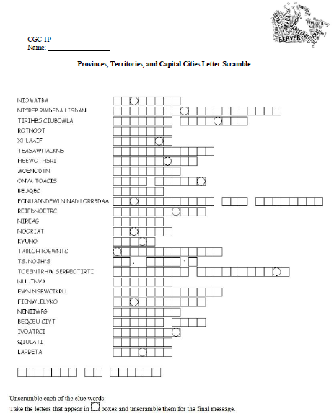
Accessing Prior Knowledge
Letter Scramble Worksheet

Slide 4
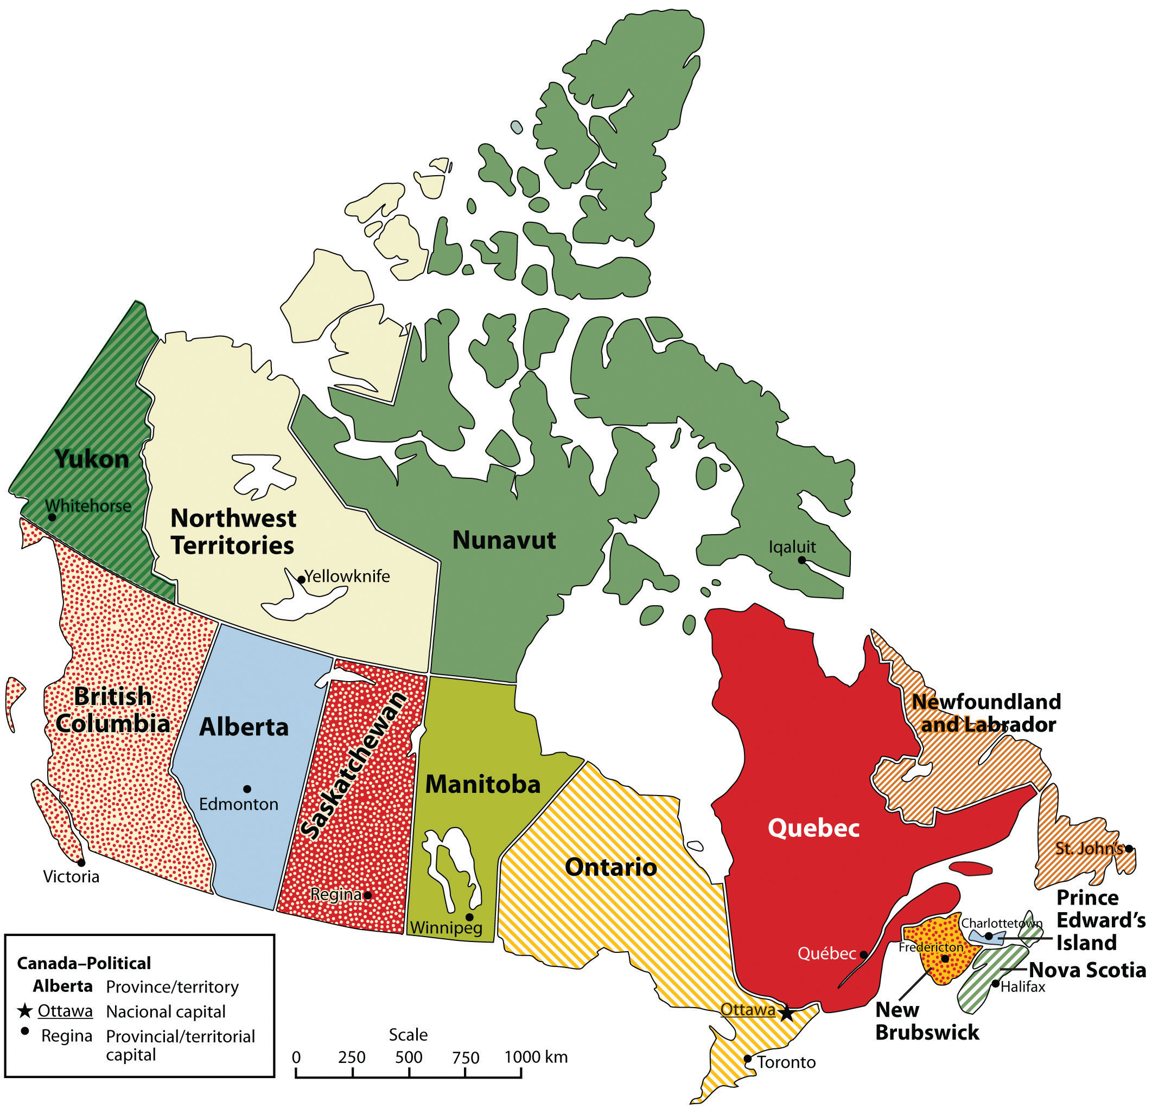
The Basics: Provinces and Capitals

Slide 5
Population Distribution & Density
Although Canada in one of the largest countries on the planet its population is relatively small.
Population Distribution describes where people choose to live in a particular country. Population Density describes the average number of people occupying an area.
What factors do you think influence a persons decision to live in a particular area?

Slide 6
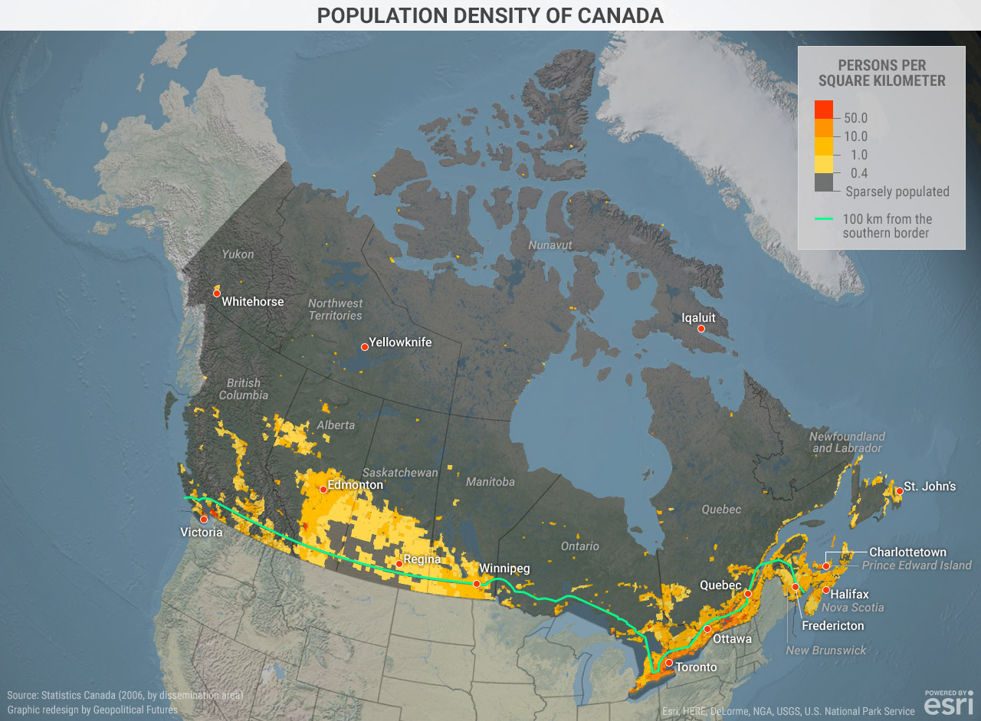

Slide 7
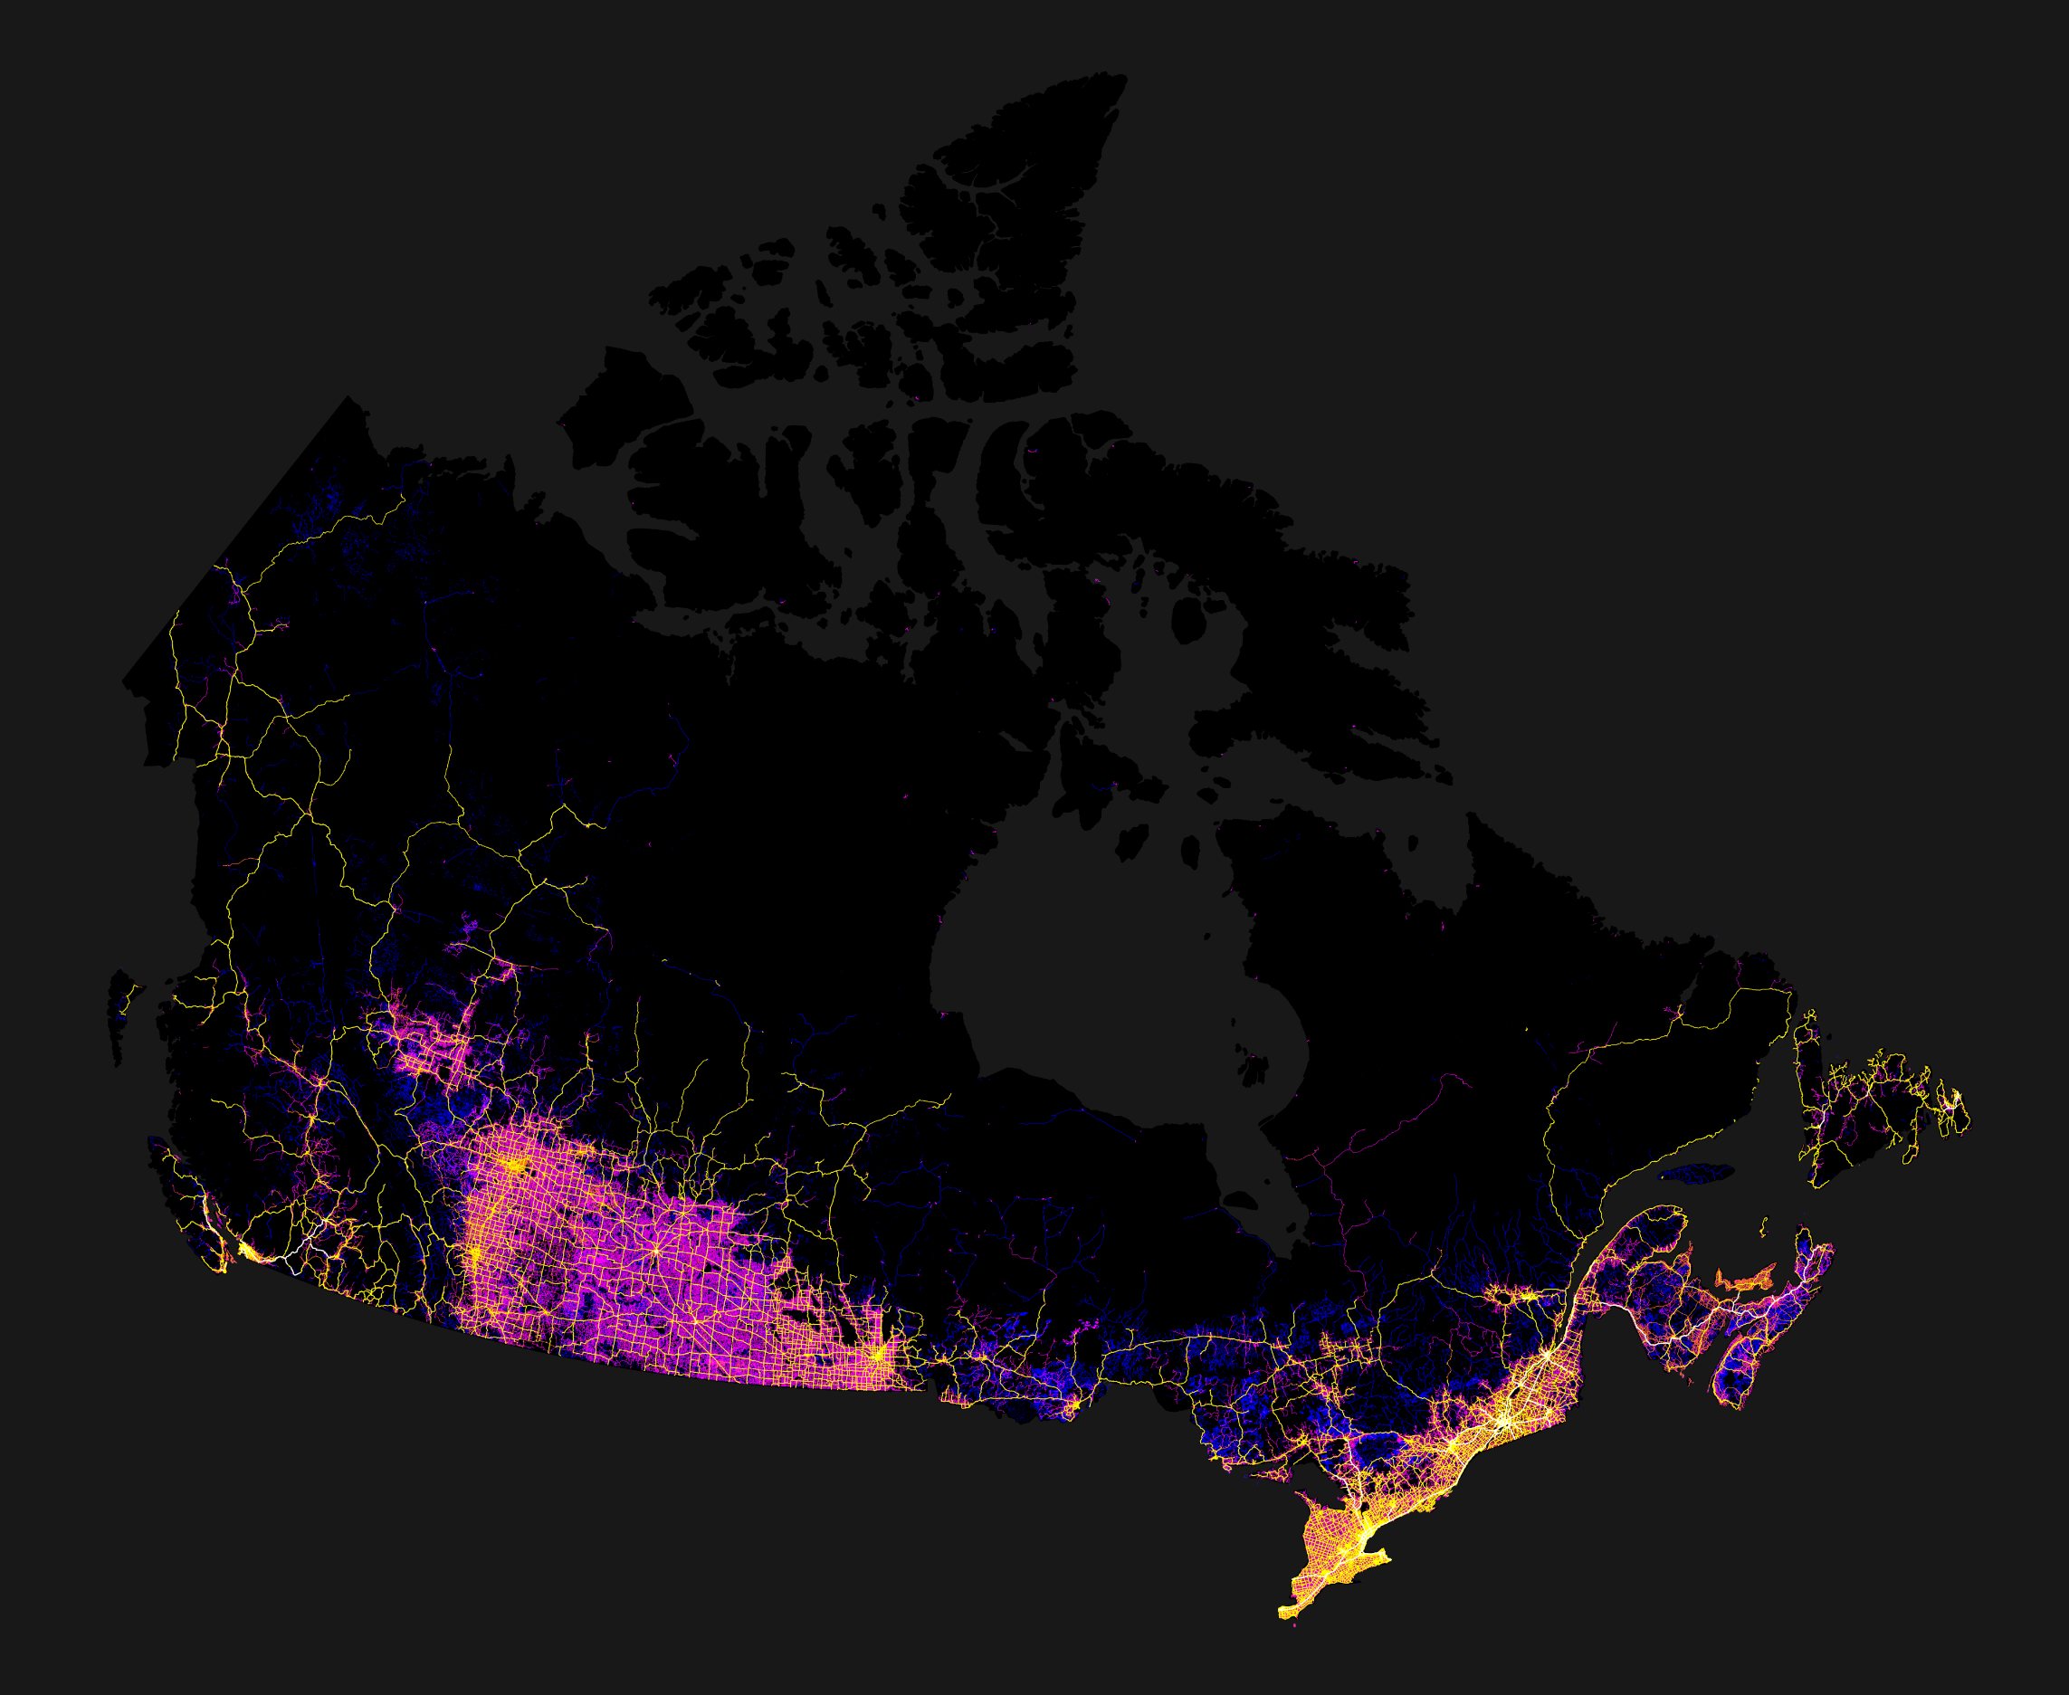
Canada Mapped by Roads

Slide 8
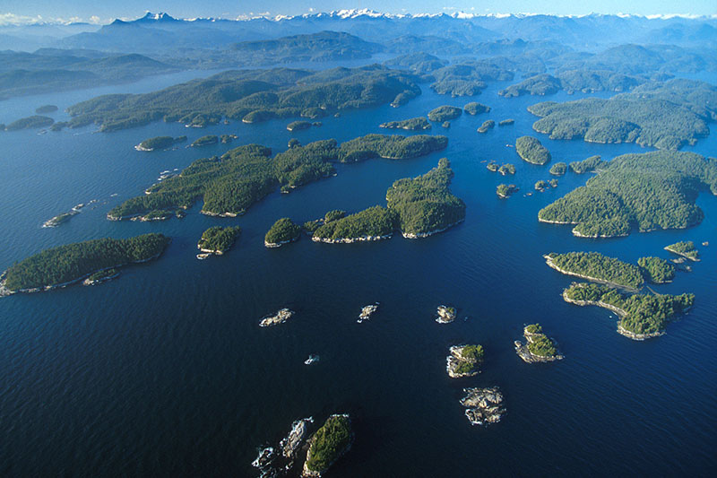
Canadian Population Distribution
Canadian pop. distribution is often referred to as an archipelago effect because the populations are scattered in small pockets or people.
Vancouver Island archipelago

Slide 9
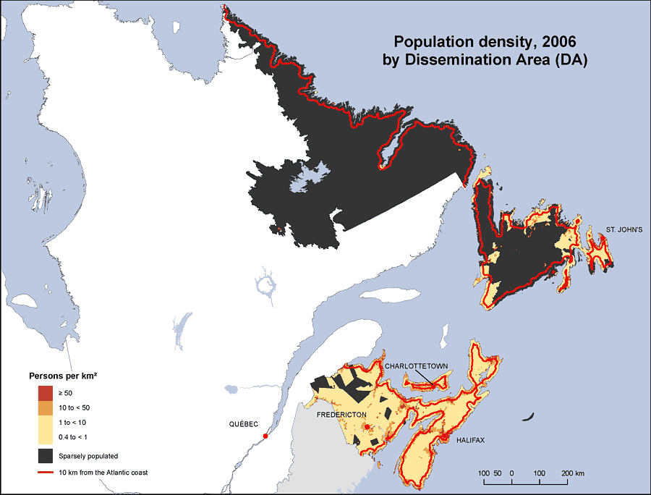
Population Density – Atlantic Canada

Slide 10
Canada Compared
Let’s compare Canada’s Population Density to the rest of the world…
But first: Out of 244 countries and territories, where do you think Canada ranks in terms of pop. density?
Pop. Density link

Slide 11
Zombie Apocalypse!
If we were to experience a zombie apocalypse what would you have to consider for survival?
Where would you choose to rebuild your community?

Slide 12
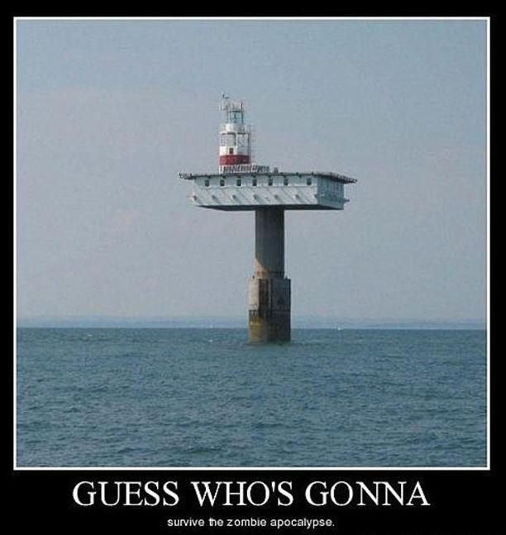
Is this enough?

Slide 13
Site and Situation
When people look at reasons why some communities develop faster and larger than other they look at two different factors: site factors and situation factors.
Site Factors are the features of the physical landscape, such as fertile soil(farming), abundant trees(logging and housing), plentiful fish(food) or the presence of minerals(mining).
Situation Factors relate to the site’s relationship to other places. This relationship can be economic, related to trade, markets or transportation. Politics can also play a role in the development of a community.

Slide 14
Key Reasons for Locating Settlements
Purpose | Site | Advantages
Transportation | Bridge Confluence Head of Navigation | Good location for a bridge over a river. Where two or more rivers come together. This is convenient for travelling and trade. Where changing traveling method is necessary
Defense | Island/Peninsula Sheltered Harbour | Water acts like a moat for protection and also a good place for surveillance. Protection form other people and weather.
Access to Resources | Resource | Minerals, forests, fish and water power

Slide 15
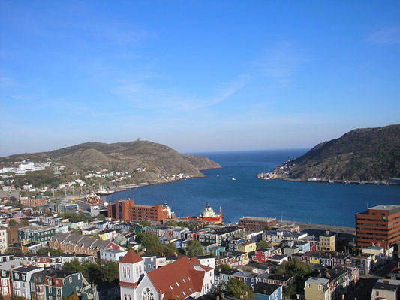
What site and situation factors promoted the establishment and growth of St. John’s, NF?

Slide 16
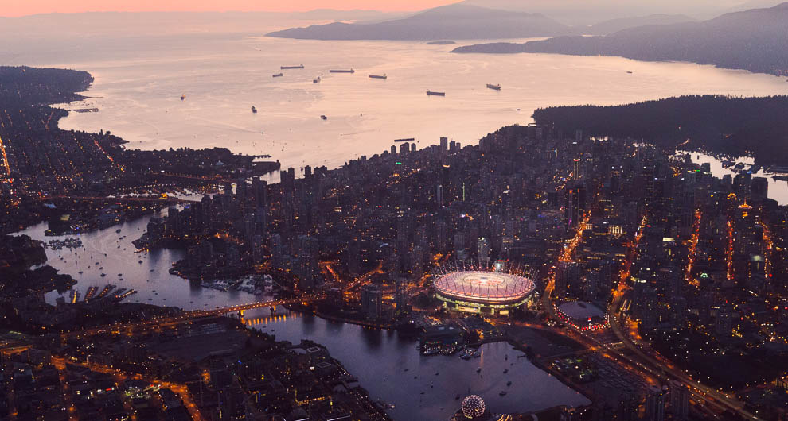
What site and situation factors promoted the establishment and growth of Vancouver, BC?

Slide 17
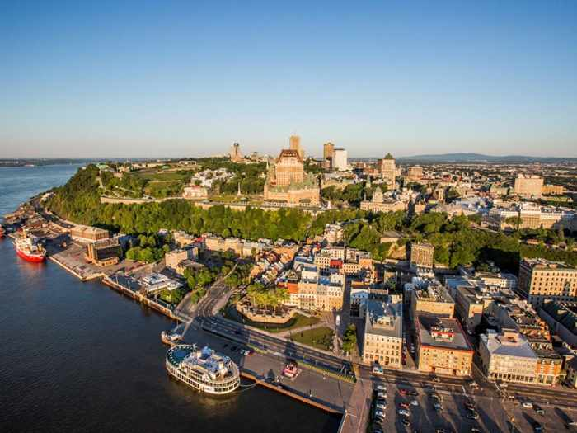
What site and situation factors promoted the establishment and growth of Quebec City, QU?

Slide 18
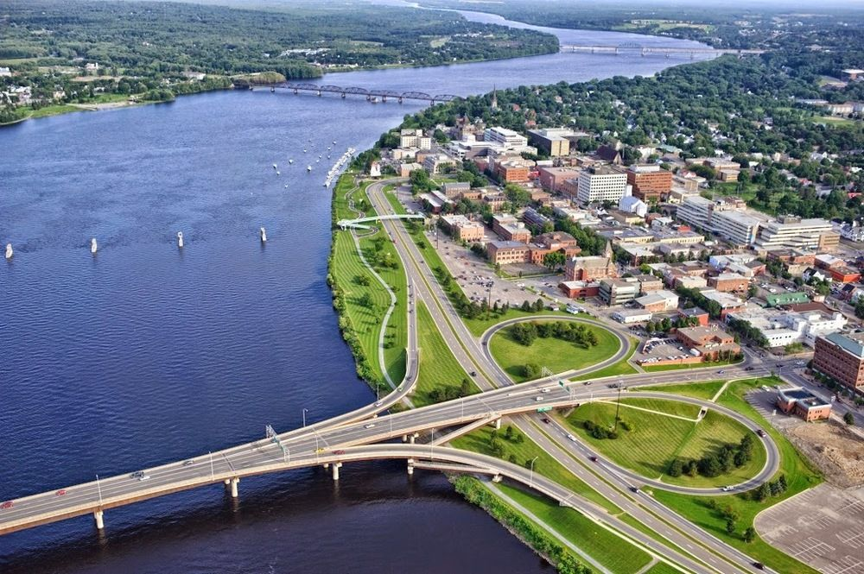
Fredericton?
What makes Fredericton a good spot for a settlement?
Fredericton – Google Maps

