Slide 1
Electrostatics

Slide 2
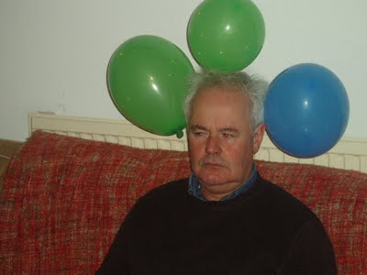
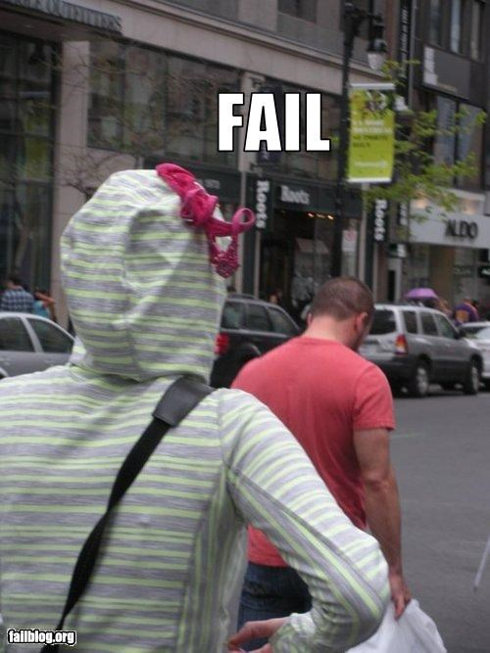
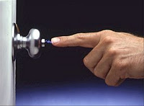
Prior Knowledge
How have you experienced the effects of static electricity?

Slide 3
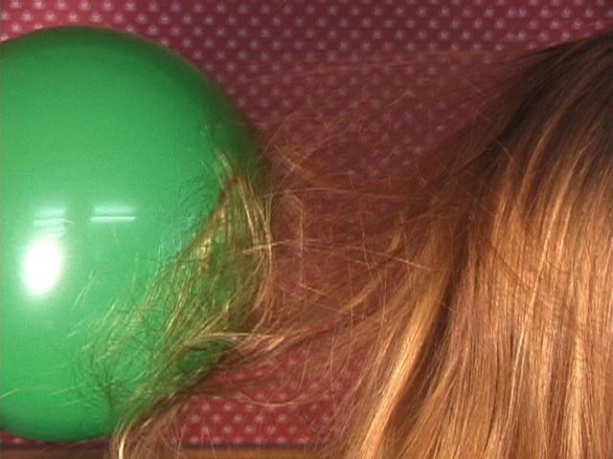
Electrical Nature of Matter
Incredible as it may seem the act of rubbing a balloon against your hair doesn’t create electrical charges. They were already there!
The fact is that all matter, which contains atoms, always contain electrical charges. The act of moving the charges from their normal position causes the “electricity”.

Slide 4
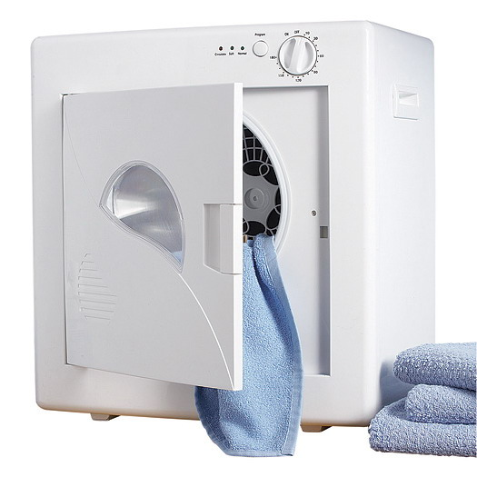
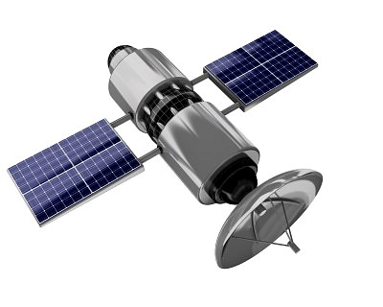
Inside of a dryer, your clothes rub against one another and become charged.
On many common substances the charge remains “STATIC”, in other words, the charge stays where the rubbing occurred. This has come to be known as static electricity.
Satellite that get hit with cosmic debris also gain electrical charges that can last for many months.

Slide 5
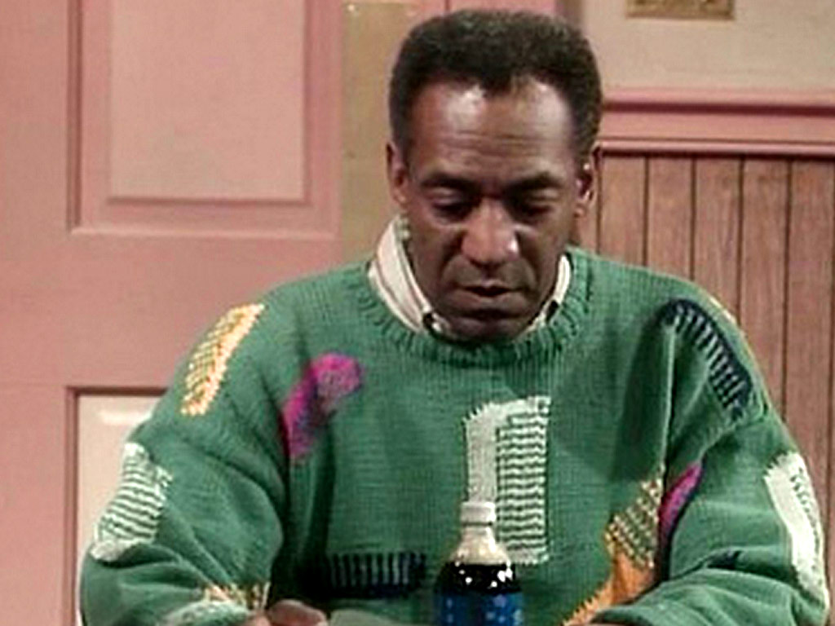
Electric Charge
A plastic comb and a woolen sweater are both electrically uncharged(neutral). When the comb is rubbed against the sweater they both become electrically charged.
This charged comb can now attract an uncharged piece of paper.

Slide 6
Positive and Negative
There are two kinds of electrical charge: negative and positive.
When two neutral substances rub together, one substance becomes negatively charged and the other becomes positively charged.
With the comb/sweater example the comb become negatively charged while the sweater becomes positively charged, both can now attract most neutral objects, including liquids and gases.

Slide 7
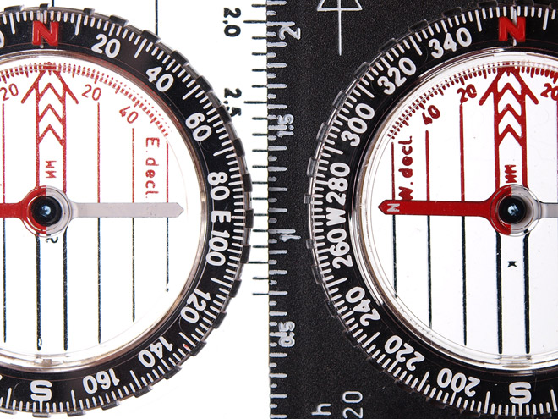
Law of Electrical Charges
Two objects with like charges, whether positive or negative, always repel one another and opposite charged objects attract one another.
This consistent behavior is known as the law of electrical charges. This law states: like charges repel one another, and unlike charges attract one another.

Slide 8
To determine whether an object is charged and, if it is charged, whether the charge is positive or negative, you must observe the object being repelled by an object with a known charge.
Charged objects will attract both neutral objects and objects with opposite charges.
On the other hand, charged objects will only repel objects with like charges.
?
- -
- -
- -
?
- -
- -
- -
attract
repel

Slide 9
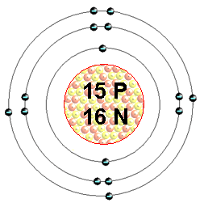
The Model for the Electrical Nature of Matter
Scientists believe that all matter is made up of atoms containing particles that possess electric charges.
Two scientists developed a model to help us visualize these particles; Rutherford and Bohr.
The following list of ideas helps us predict how charged objects will behave as well as explain the effects of electrical charges.

Slide 10
Electrical Nature of Matter
All matter is made up of particles called atoms.
At the centre of each atom is a nucleus, with two kinds of particles: the positively charged proton and the uncharged neutron. Protons do not move from the nucleus when an atom becomes charged.
A cloud of negatively charged particles called electrons surrounds the nucleus. When atoms become charged, only the electrons move from atom to atom.
Like charges repel each other; unlike charges attract each other.

Slide 11
Some elements have a weaker attraction for its electrons than others and the electrons are able to move freely from atom to atom. A good example is copper. Sulfur has electrons that are strongly bonded to its atom.
A single atom is always electrically neutral.
If an atom gains an extra electron, the net charge on the atom is negative and it is called a negative ion. If an atom loses an electron, the net charge on the atom is positive and it is called a positive ion.

Slide 12
Class Work
Answer the following:
Why is the term “static” electricity used? Describe a situation involving static electricity to explain your answer.
A photocopier sometimes takes in several papers at once, often causing a paper jam. Why does this happen? What would you suggest to correct this problem?
Draw a diagram that explains how electrical charges attract and repel objects. Be creative but stay realistic and true.

