Slide 1
First Arrivals
Aboriginal Peoples of Canada, 1000 BCE-1600 CE

Slide 2
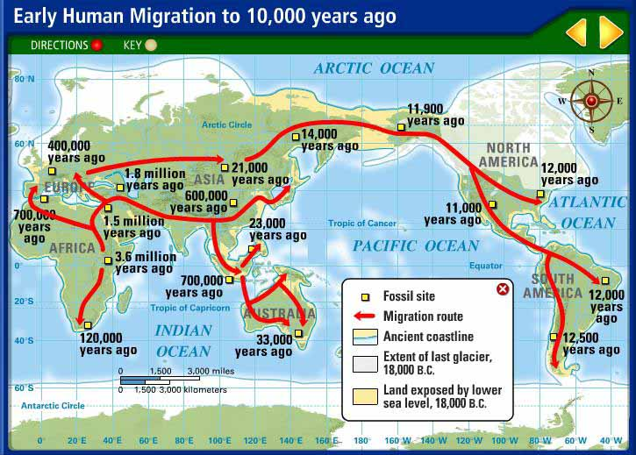
Notes:
Homo sapiens, the first modern humans, evolved from their early hominid predecessors between 200,000 and 300,000 years ago. They developed a capacity for language about 50,000 years ago.
The first modern humans began moving outside of Africa starting about 70,000-100,000 years ago.
Humans are the only known species to have successfully populated, adapted to, and significantly altered a wide variety of land regions across the world, resulting in profound historical and environmental impacts.

Slide 3
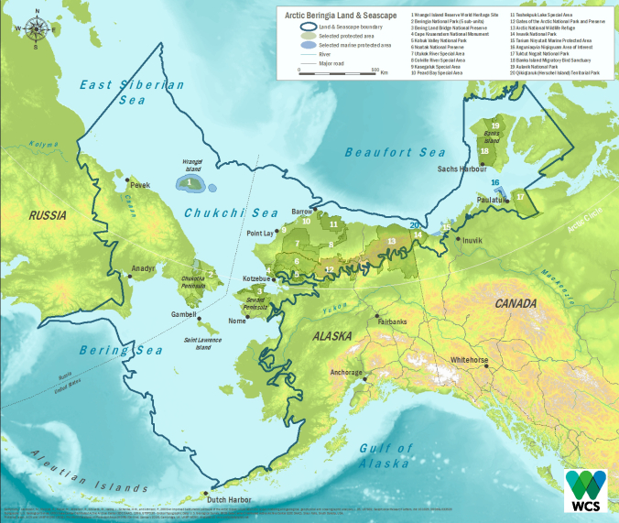
Theories of Origins and Arrival
80,000 – 12,000 BCE years ago nearly all of Canada was covered by a km of glacial ice.
This massive ice mass reduced sea levels by 125 meters leaving a 1000 km plain in what is the present day Bering Sea.
Known as Beringia.
Notes:
Last Glacial period lasted from roughly 115000 – 11700 years ago.

Slide 5
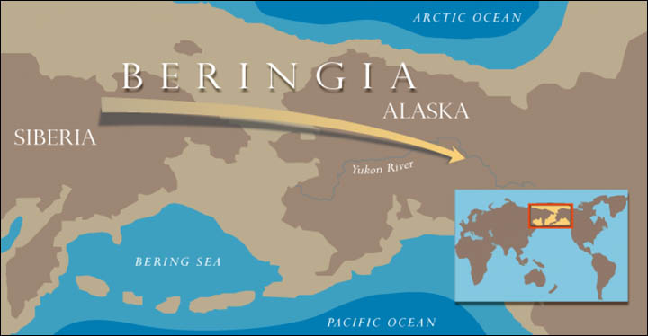
Notes:
This dry “corridor” allowed Paleolithic hunters to pursue large herbivores across the gap into modern day North America. Remember back to Ancient Medieval history when you learned about the origins of early man in Africa and Mesopotamia.

Slide 6
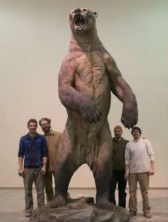
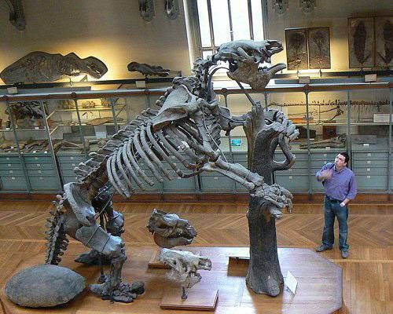
Paleolithic hunters hunted giant beavers, ground sloths, camels and bison across this corridor between the continents.
Notes:
Short Nose Bears were one of the many predators that early human migrants had to deal with and were a challenge to survival in N. America.
Wooly Mammoths lived during this time period and there were pockets of isolated mammoths living up until 4000 years ago.

Slide 7
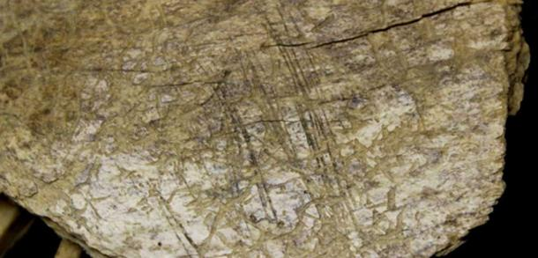
Migration
The movement of these early hunters is thought to have taken thousands of years.
Oldest evidence shows material dating back 24,000 years but recently (2004) new evidence has dated back to 50,000 years.
Some of the artifacts show similar characteristics to those found in northeast Asia.

Slide 8
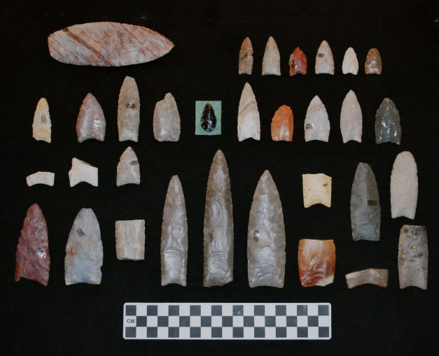
Blue Fish Caves
Three caves in northern Yukon contain some of the earliest evidence of human occupation. The Bluefish Caves contain the oldest undisturbed archaeological evidence in Canada.
It is now possible to suggest that Bluefish Caves were sporadically and discontinuously used by small hunting groups or parties between 25 000 and 12 000 years ago.
Notes:
The bones of mammoths, horses, bison, caribou, sheep, saiga antelope, bear, lion and many other mammals, as well as birds and fish. Many of the bones of the larger animals exhibit butchering marks made by stone tools as well as, on a few mammoth bones, attributes indicative of a percussion/bone flaking technology.

Slide 9
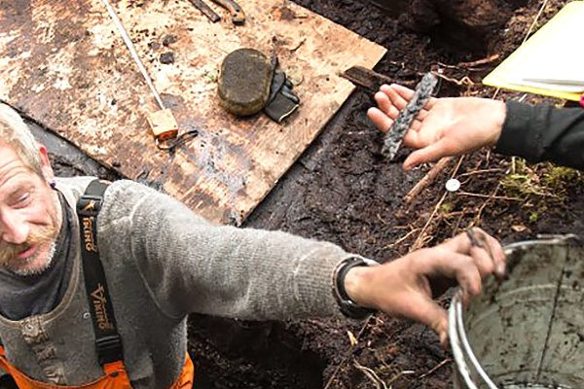
Rare evidence
Why would it be challenging to find artifacts in Canada?
It is difficult to discover artifacts here in Canada as our climate does not sustain organic material for very long. The acidity of our soil and the moisture levels as well as the variety of weather tend to degrade artifacts at a quicker pace compared to places such as Egypt and around the Mediterranean.
link

Slide 10
Differing Views
Exactly how and when these Paleolithic peoples reached North America is still highly speculative.
Some archeologists reject the idea of crossing the Bering Straight during dry times but suggest that early man crossed on frozen ice or in boats.
Keep in mind that the straight is only 90 km across and you can see land on any clear day. Ancestors of the present-day Inuit have been crossing for more than a thousand years.

Slide 11
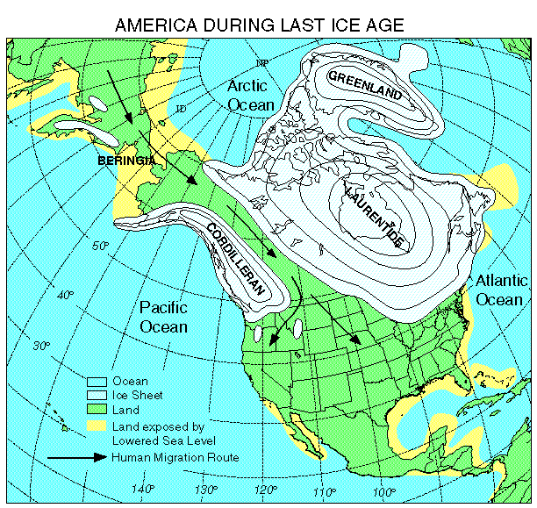
Cont…
Archaeologists also disagree about how these hunters travelled south.
The Traditional View
An ice-free corridor on the eastern side of the Rocky Mnts, between the Cordilleran glacier and the huge Laurentide glacier provided a route but critics think that this path was inhospitable.
No evidence has been found to support this view.

Slide 12
Your Thoughts
If historians acknowledge the existence of the corridor between the ice sheets, but argue it was a hostile environment for human survival, how did Paleo. peoples populate North America?

Slide 13
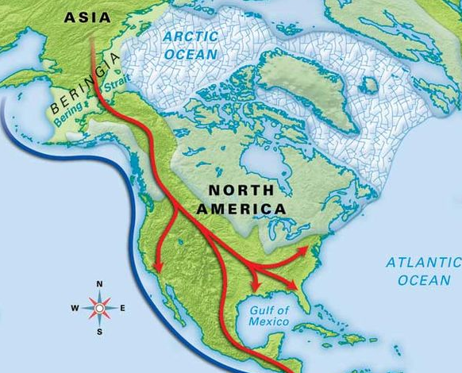
The Coastal Route Theory
An alternative theory to the “ice-free corridor” is that these early hunters moved along the western coastline in some sort of water craft, fishing, collecting shellfish and hunting sea creatures.
They eventually would have continued to move south below the ice fields and moved inland. These Paleolithic peoples would have followed the herds east, south and north as the ice caps retreated.
Notes:
Unfortunately, the coastline then is now submerged and any evidence has long been destroyed or at least lost to us today.

Slide 14
New Information – Argument against Beringia
Notes:
The study is the latest to effectively rule out a once widely held view that the first humans to reach North America walked across a land bridge that once connected Alaska and Siberia, and then wandered south through an ice-free corridor that opened up between the continent’s two major ice sheets at the end of the last ice age about 13,000 years ago. Most scientists now favour the idea of a Pacific coastal route that allowed the first Americans to skirt around the glaciers well before the corridor was open.

Slide 15
Thoughts
Could both of these theories work together? Are they exclusive or would both seem believable?
If both of these theories were true, what could it explain?
What did these Paleolithic people have to master in order to survive?
Notes:
3. Control fire, tailored clothing social organization, cooperation, understanding of the environment, hunting techniques, how to store food for longer periods of time, technology for creating tools and weapons…

Slide 16
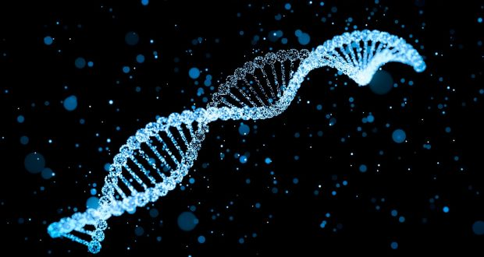
DNA and Migration Theories
Some perplexing information has made the Beringia theory even more difficult to defend.
Based on recent DNA studies it is known that there are 5 Aboriginal DNA lineages.
4 of the 5 have an affiliation with Asian origins – only the Ojibwa (Anishinabe) people do not have the affiliation.
Notes:
This lineage does appear in Europeans. This does not prove that the Ojibwa have European ancestry, it just casts doubt on the Beringia theory.

Slide 17
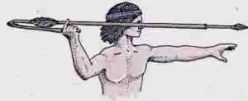
Evidence
When we look at other archaeological sites around North America we see similarities that suggest that these early Paleolithic people had spread out around the continent around 10,000 BCE.
Near Clovis, New Mexico, we see evidence of stone tools and a weighted throwing device that resemble similar items found in Southwestern Ontario. This device is called an Atlatl.

Slide 18
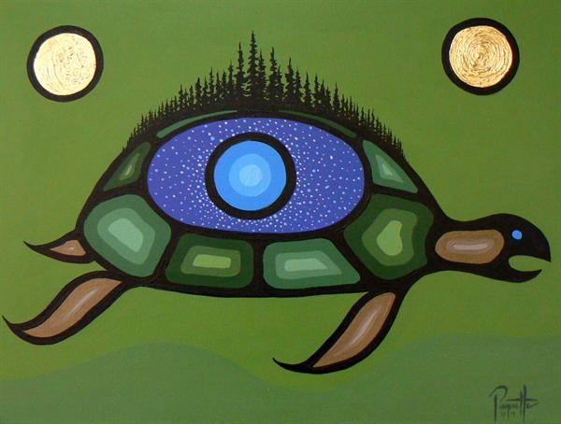
We Were Always Here Theory
Every Canadian Aboriginal group has a creation story.
For many Aboriginal people, stories told by elders have more credibility that the theories of archaeologists.
The Legend of Weesakayjack
Another Mi’kmaq creation story can be found on page 9 of the text book.
Notes:
The purpose of this presentation is not to present the merits of one form of evidence over another (aboriginal vs archaeologists) but to recognize and present them as part of the challenge of knowing the ancestral roots of Canadians better.
The interesting thing about the Mi’qmac story is that the oldest human remains east of the Rockies can be found on the coast of Labrador. This story echoes the geological description of the beginning and end of an ice age: shifting winters, slow growth of glaciers, and the dramatic swing between hot and cold over thousands of years.

Slide 19
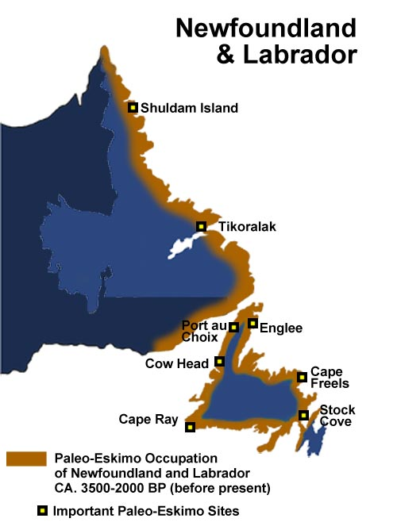
The People of Atlantic Canada: Archaic Period (6000-1000 BCE)
Between 10,000 – 8,000 years ago the wold of the Paleo people experienced drastic climate changes and disappearing species.
Paleo Peoples were faced to make changes to meet these new challenges.
This new era, with its changed environment, is referred to as the Archaic Period.
Notes:
The main change was a shift in scenery as these peoples moved east where they discovered the seal, an easy prey that fed these people for al least 6000 years.

Slide 20
People relocated to various locations, adjusting differently, creating cultural differences. What they had in common was their reliance on similar resources.
These difference and similarities are based on analysis of archaeological evidence and what they thought and believed can only be hypothesized.
Notes:
The difference can be understood by looking at the geographical locations these early people lived in as well as the animals they encountered. It is clear that these people have changed and adapted into a much more complex group compared to the early paleo people.

Slide 21
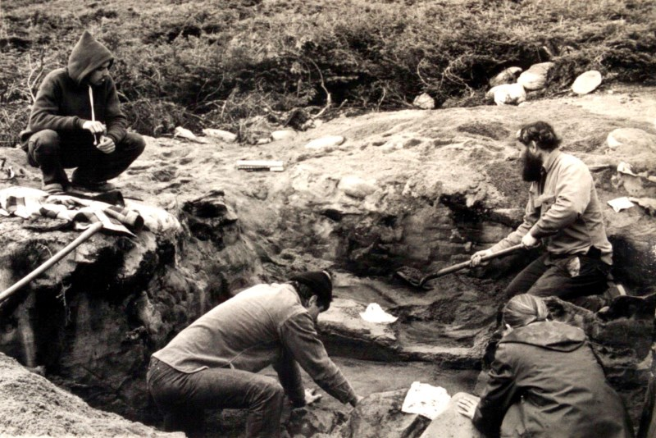
Radio-Carbon Dating
In 1973, two archaeologists began working on a site in southern Labrador that gave us a remarkable new view into an incredible find.
When listening to the recount of the find think about what we can learn from what they found.
Pg 11-12
Video link -------------→
Notes:
At 7500 years old, it is one of the oldest known complex burial sites in the world.

Slide 22
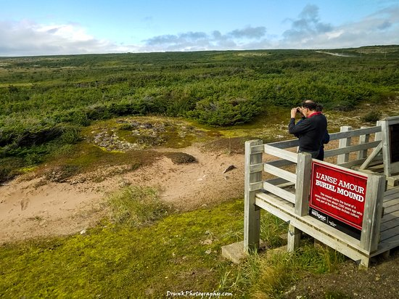
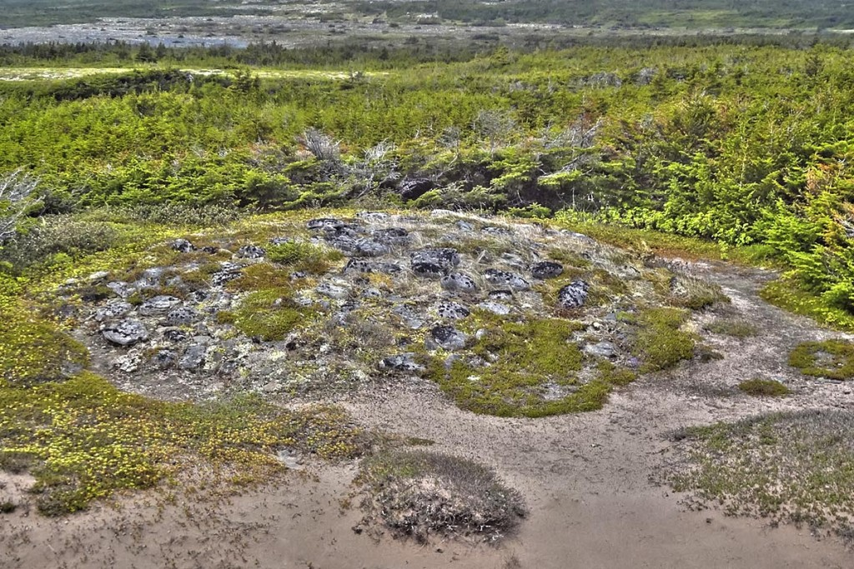
L’Anse-Amour

Slide 23
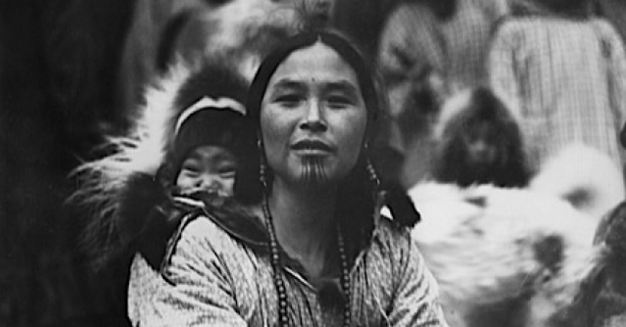
These Archaic people of the Atlantic later developed local variation of their culture and regional identities.
They became the Innu, Beothuk, Mi’kmaq, Wuastukwiuk, Passamaquoddy, Penobscot and Abenaki.

Slide 24
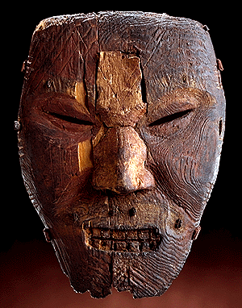
The People of the Artic (2000-0 BCE)
Quick Reading Activity:
Two distict groups emerged in the Artic: the Paleo-Eskimo and the Dorset. Read pages 13-17 to discover the fate of these two groups.
Notes:
The two life-sized masks were carved from driftwood and painted; they originally had fur moustaches and eyebrows attached with pegs. Shamans probably wore the masks in rituals for curing the sick, controlling the weather, or influencing the hunt.
The Dorset people disappeared about five hundred years ago, probably at the hands of the invading Inuit. Our only knowledge of them comes from the frozen remains of their camps and the carvings that allow us a rare glimpse into the artistic and spiritual life of an extinct people.

Slide 25
Methods of Historical Inquiry

