Slide 1
Properties of Matter

Slide 2
Matter
Matter is anything that has mass and takes up space. See excerpt from Bill Bryson
Everything around you is made of matter.
Can matter change? If yes, how?

Slide 4
Properties of Matter
A Property is a characteristic used to describe something.
There are two types of properties we will learn about – physical properties and chemical properties.

Slide 5
Physical Properties of Matter
A Physical Property is a characteristic of a substance that can be observed and used to describe it.
Physical Properties describe a substance as is. It does not involve the substance changing what it is.
Some examples:
Color – red, yellow…
Texture – rough, smooth….
Taste – sour, salty. sweet….

Slide 6
List some physical properties from the image below:

Slide 7
Sample Responses
Color – Brown
Smell – like coffee
Texture – smooth
Size – small

Slide 8
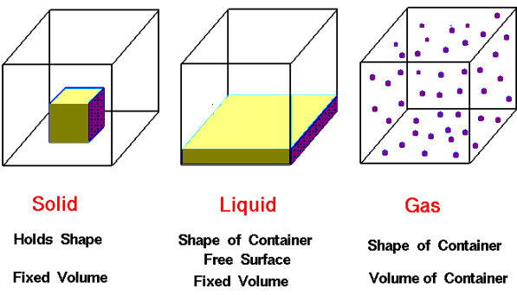
Other Physical Properties of Matter
1. State: solid, liquid or gas – usually given for the substance at room temperature

Slide 9
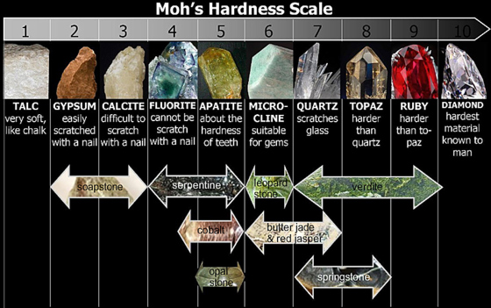
Hardness: the measure of the resistance of a solid to being scratched or dented
A harder
material will
scratch or
dent a softer
one

Slide 10
Mohs Scale of Hardness

Slide 11
Malleability: The ability of a substance to be hammered or bent into different shapes.
Examples:
Aluminum foil and Gold are malleable.
Glass is not malleable.
The opposite of malleable is brittle (shatters when hammered instead of flattening out)

Slide 12
Malleability

Slide 13
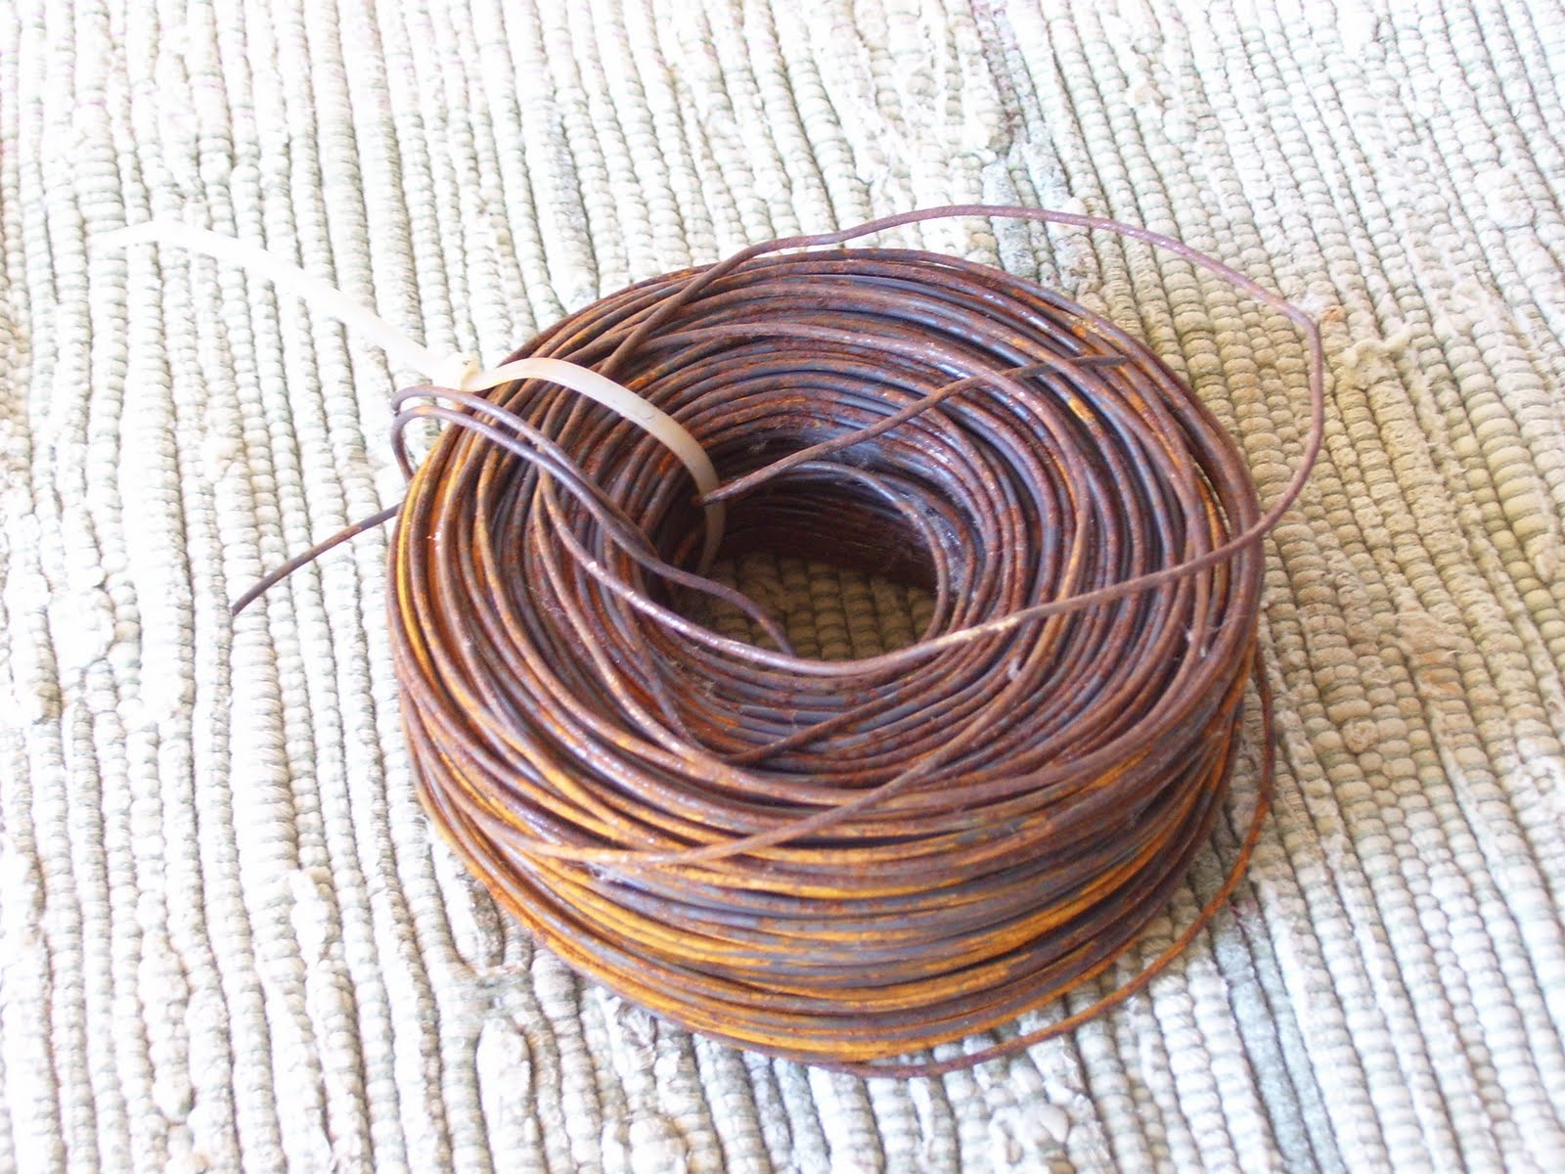
Ductility: The ability of a substance to be pulled out into wires
Copper is ductile

Slide 14
Melting and Boiling Point: The temperature at which substances change state.
Melting point of water (change from solid to liquid) is 0°C
Boiling point of water (change from liquid to vapour) is 100°C

Slide 15
Melting
Boiling

Slide 16
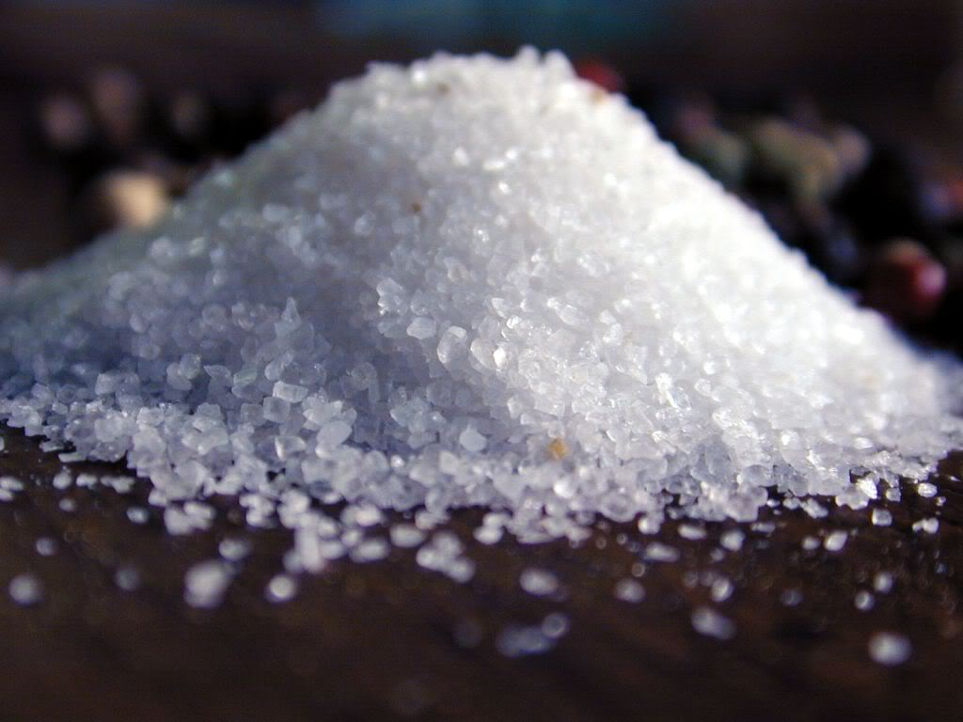
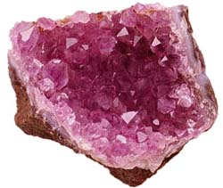
Crystal Form: A solid form in which you can see a definite structure of cubes or blocks with a regular pattern
Example: salt quartz

Slide 17
Solubility: The ability of a substance to dissolve in a substance such as water.
Salt is soluble in water
Pepper is insoluble in water (insoluble means not soluble)

Slide 18
Sugar Dissolves in Hot Coffee

Slide 19
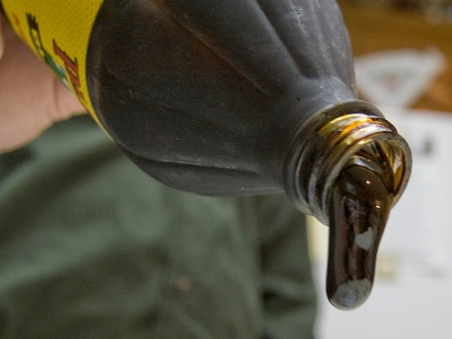
Viscosity: refers to how easily a liquid flows
The thicker the liquid – the more viscous it is
Molasses is more
viscous that water

Slide 20
Density: The amount of matter per unit volume of that matter
Measured in g/cm³
The density of water is 1.0 g/cm³

Slide 21
Anything that is less dense than water will float in water. Anything that is more dense than water will sink in water.

Slide 23
Chemical Properties of Matter
Chemical Properties describe the behavior of a substance as it becomes a new substance.
Combustibility: (or flammability), is the ability of a substance to burn.
Combustion is the reaction of a substance with oxygen to produce water vapour, carbon dioxide and energy.
Wood and gasoline are flammable/combustible
Water is not flammable/combustible

Slide 25
Reaction with Acid: when exposed to acid, will the substance react with it?
When magnesium reacts with acid it produces bubbles and eventually disappears.
When gold is exposed to acid, we see no change.
Geologists use acid to test samples of rock for specific minerals.

Slide 26
Magnesium reacts with acid to produce hydrogen gas bubbles

Slide 27
Another Way to Classify Matter
Matter can also be classified as Metals and Nonmetals
Mixtures of metals are called Alloys and can make metals more versatile and useful.
Alloys are used for a variety of things and are created for specific uses. Examples are airplane parts, braces for teeth, and cooking pots.

