Slide 1
The Early Years of French Settlements
1603 - 1663

Slide 2
The World of New France
For at least 100 years prior to Samuel de Champlain's settlement, French had been fishing off the coast of Eastern Canada and trading for furs with Aboriginal Peoples.
When Champlain arrived the St. Lawrence River was bustling with activity. More than 500 ships from a half dozen European nations were fishing its waters.
Notes:
While there seemed to be an abundance of activity in this new world, it still was a seasonal, transitional population: none of the settlements were occupied year-round.

Slide 3
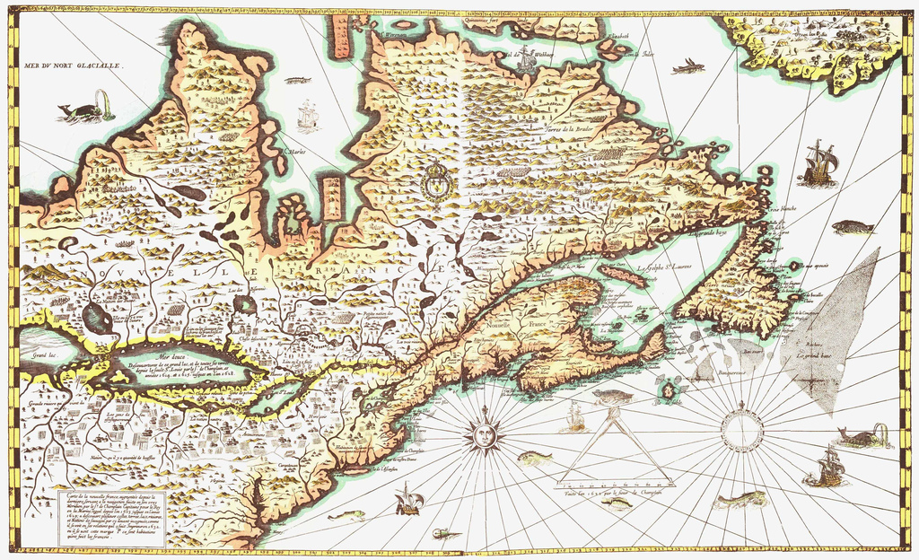
The St. Lawrence River
A shift in perspective
Notes:
While this river originally served as a fishing and whaling destination, under Champlain it was transformed into something more: a fur-trading artery and a “highway” into the heart of the continent.
Remember that this new world was originally an opportunity for expanding colonial power but also an opportunity to expand economic power.

Slide 4
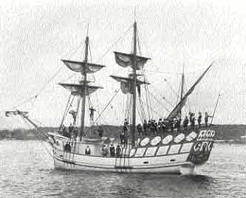
Samuel De Champlain
From 1601 to 1603, he was a geographer for King Henry IV, and then joined François Gravé Du Pont's expedition to Canada in 1603. The group sailed up the St. Lawrence and Saguenay rivers and explored the Gaspé Peninsula, ultimately arriving in Montreal.
Notes:
Although Champlain had no official role or title on the expedition, he proved his mettle by making uncanny predictions about the network of lakes and other geographic features of the region.

Slide 5
Champlain never Quits
Given his usefulness on Du Pont's voyage, the following year Champlain was chosen to be geographer on an expedition to Acadia led by Lieutenant-General Pierre Du Gua de Monts.
They landed in May on the southeast coast of what is now Nova Scotia and Champlain was asked to choose a location for a temporary settlement.

Slide 6
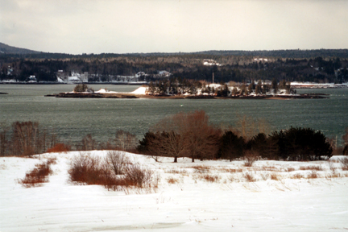
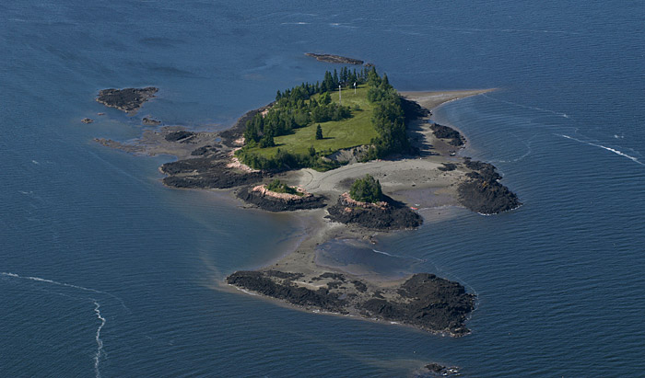
Poor Decisions
He explored the Bay of Fundy and St. John River area before selecting a small island in the St. Croix River. The team built a fort and spent the winter there. It didn’t go well.
Notes:
Beautiful in the summer, despair in the winter.
The year that De Monts and Champlain spent on St. Croix had one of the worst winters in a hundred years. Snow started falling in early October and didn’t stop. 36 o the 80 colonists died that winter…on to Port Royal in modern day Annapolis Royal in NS.

Slide 7
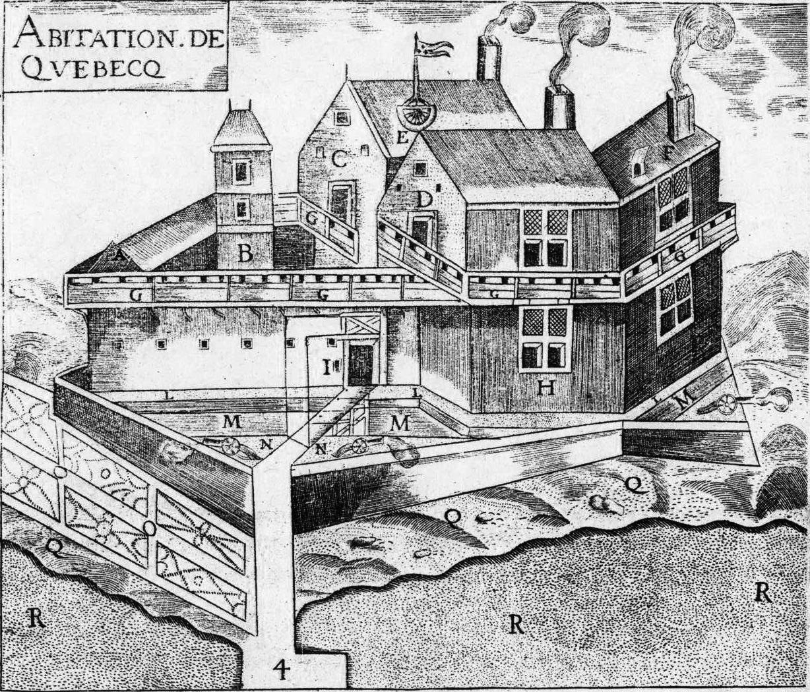
Quebec City
In 1608, Champlain was named lieutenant to de Monts, and they set off on another expedition up the St. Lawrence. In June 1608, they constructed a fort in what is now Quebec City. Quebec would soon become the hub for French fur trading. The following summer, Champlain fought the first major battle against the Iroquois, cementing a hostile relationship that would last for more than a century.
Notes:
This battle with the Iroquois was due to Champlain attempts to befriend the Montagnais native with whom he had traded for furs. Champlain’s involvement in this and other raids against the Iroquois made him lifelong enemies, especially with the Mohawk.
Keep in mind that Cartier wad been upriver 70 years earlier but tribal warfare left the region a no-mans-land which made claiming it so much easier for Champlain and de Monts.

Slide 8
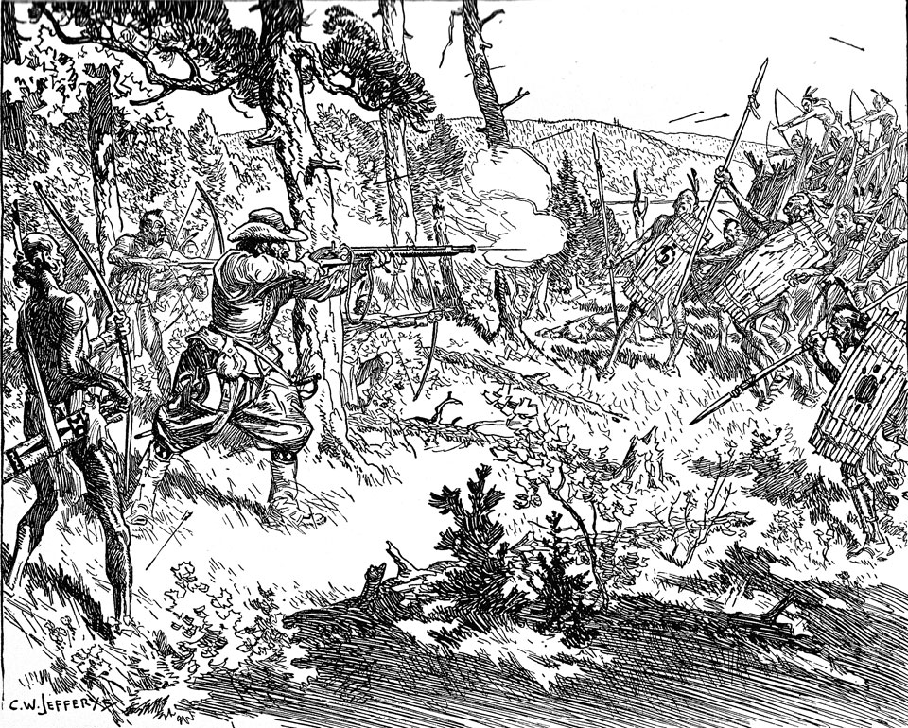
Notes:
The Battle of Ticonderoga Point, south of Quebec, 1609. This battle, according to some historians, was the first time that European weapons were used on the Iroquois.

Slide 9
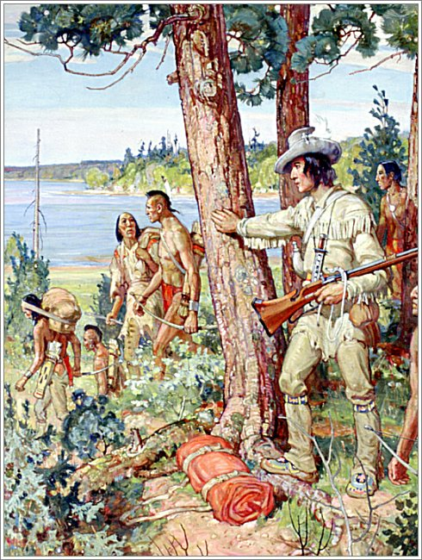
A Tale of two Settlers
During the early days of New France settlers fell into two types of categories: the “coureur de bois” and the habitant, or the forest vs the farm.
These “coureur de bois” were the “runners of the woods” who hunted for pelts to sell and trade with the local native population.
The habitants came here to settle down, clear land and plant crops.
Notes:
Etienne Brule was the original coureur de bois, he had been here 5 years before Champlain and spent 20 years living among and trading with the Huron…until they apparently assassinated him when a trade deal went wrong.
Louis Hebert, a former Acadian colonist, was asked by Champlain to move to New France. His move to New France ushered in a shift from Canada being a fur trading post to a colony of farming communities.

Slide 10
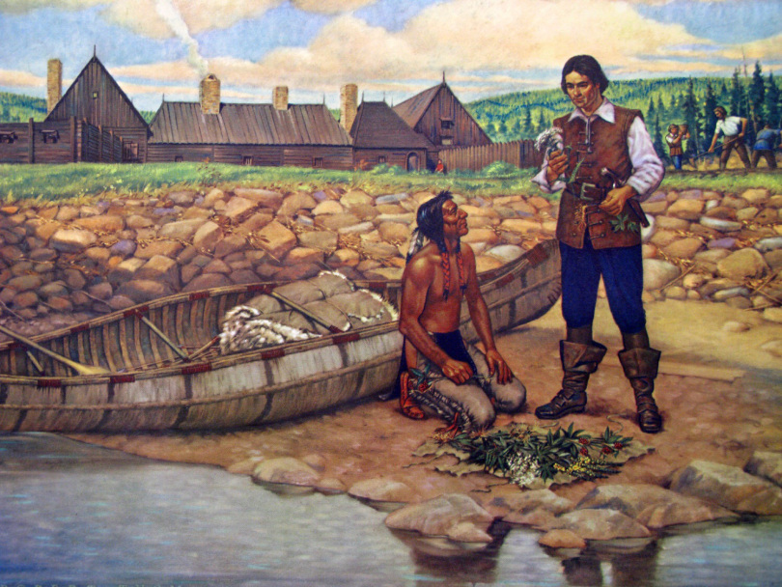
Louis Hebert
Notes:
Louis Hebert was a pharmacist/herbalist back in France before he packed up his family and moved to New France in 1617.

Slide 11
Side note

Slide 12
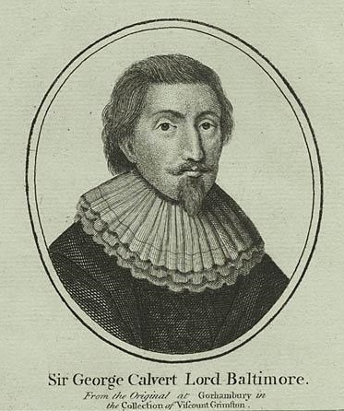
Sir George Calvert (Lord Baltimore) Governor of Province of Avalon, 1627-1629
“I have sent [my family] home after much sufferance in this wofull country, where with one intolerable winter were we almost undone. It is not to be expressed with my pen what wee have endured.”
Notes:
David Kirke, privateer/pirate became the first governor of Newfoundland and chased away Lord Baltimore’s old colonial supporters.

Slide 13
Back to the Early Years in New France…

Slide 14
Company of One Hundred and the battle for Souls and Wealth
Champlain felt that just trading with “the savages” wouldn't be enough to bring about civilization. To remedy this he called on the Recollet friars to come to New France as missionaries.
Converting the Natives, he declared, would “cement their commercial ties with the French as well as save them from eternal hell-fire in the next world.”
The Jesuits would come 10 years later with a renewed vigour to convert and save.
Notes:
The Récollets came to New France in 1615 and were present at various times in Acadia, Newfoundland and Québec. Missionaries and preachers, they were known for their simple and austere life; however, in 1763 British authorities forbade them to receive novices, and thus the order disappeared in 1848 when the last Canadian Récollet died in Montréal. Récollets returned to Trois-Rivières, Qué, in 1888 but they were united in 1897 with other branches to form the order known today as the Friars Minor (or Franciscans).

Slide 15
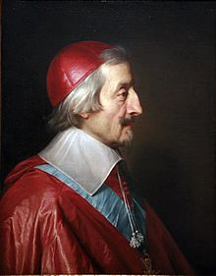
Tensions Rise
Tensions rose between the French Protestant traders (Huguenots) and the Catholic missionaries. The missionaries appealed to Cardinal Richelieu back in France who canceled the trade monopoly in 1627 and introduced the Company of One Hundred Associates.
It didn’t work out for long…

Slide 16
Notable historic Figure
The unsung father of Acadia?

Slide 17
Back in Acadia 1610
- Mi’kmaq Chief Membertou (left in charge of Port Royal) did a great job keeping the colony successful. - Mi'kmaq were attributed to the success of Acadia -- they supported the French and didn’t start conflict with the Acadians. - Membertou set the tone for cooperation and friendship. - Claimed he was over 100 years old and present when Cartier arrived 70 years prior. - Converted to Catholicism - On his death bed: urged his people to maintain alliance and friendship
Notes:
Port Royal was abandoned in 1607 when de Monts’ trading monopoly was revoked.

Slide 18
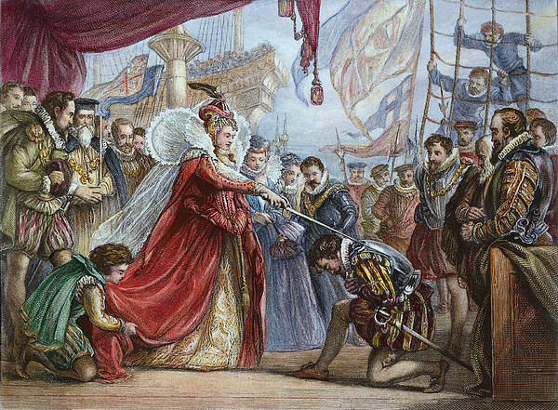
Pirates or Privateers – a fine line
What’s the difference?
Both plundered the seas and robbed ships of their bounty.
Privateers were “licensed pirates” who worked under a charter from the King/Queen.

Slide 19
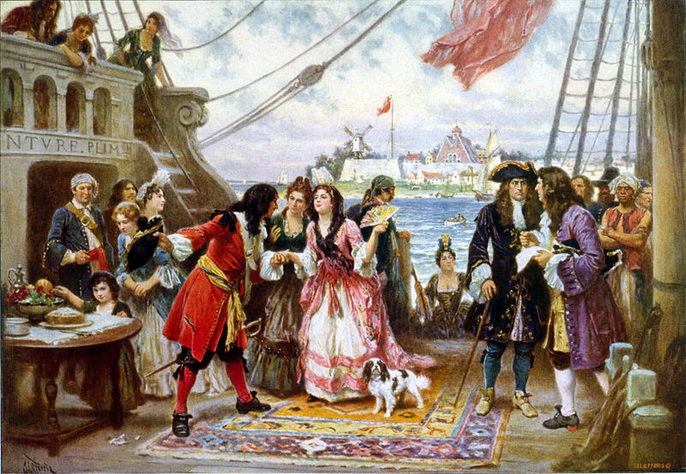
Captain Kidd
Notes:
William Kidd, also Captain William Kidd or simply Captain Kidd (c.1654 – 23 May 1701) was a Scottish sailor who was tried and executed for piracy after returning from a voyage to the Indian Ocean. Some modern historians deem his piratical reputation unjust as he looted a ship belonging to the powerful British East India Company.
Legend has it that his treasure, with which he bartered for his life, is buried at Oak Island in NS.

Slide 20
The kirke Brothers
This group of 5 brothers were privateers but many historians from Quebec think of them more as pirates.
They earned this reputation in 1628 when they captured Quebec after terrorizing the Acadians as they travelled up the St. Lawrence.
They conquered Tadoussac and demanded that Champlain surrender as he was cut off in Quebec.
Notes:
The Kirke brothers had luck on their side as they captured 18 of the 20 ships belonging to the Company of One Hundred Associated that had just been restocked with supplies and colonists, 600 of whom were taken prisoner.

Slide 21
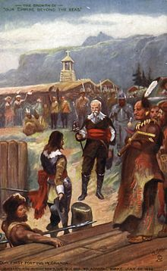
Cruel but Effective
The Kirkes made a fortune and left Quebec to a winter without the much needed supplies from France.
When they returned in the summer Champlain had no choice but to surrender, he was taken back to England as a prisoner.
New France was done for…or was it?
Notes:
For 4 years New France and Acadia remained under the control of the Kirke brothers until King Charles in England gave back the French colonies in exchange for a lump sum payment – he was broke at the time. New France was resurrected!
Sir David Kirke (c. 1597–1654) (a.k.a. David Ker) was an adventurer, colonizer and governor for the king of England. He is best known for his successful capture of New France in 1629 during the Thirty Years' War and his subsequent governorship of lands in Newfoundland. A favourite of Charles I of England, the fall of the Crown during the English Civil War led to Kirke's downfall. It is believed he died in prison.

Slide 22
Death of Champlain
Champlain arrived back in Quebec in 1633 to find the colony stripped bare by the Kirkes.
He attempted to build the colony back up and even founded another post at Trois-Rivieres in1634 but his dream of a great inland colony along the St Lawrence had yet to be fulfilled.
He died on Christmas Day 1635, an exhausted man.
Notes:
At the time of his death, fewer then 200 people were living in New France. So much work and effort with so little to show for it.

Slide 23
Questions
How did Champlain and the European presence forever alter warfare between the Aboriginal groups?
The early explorers described the seasons in this “New World”, how had these early experiences shaped Canadian culture and Identity?

