Slide 1
The First World War
Its Impact on Canadian Society

Slide 2
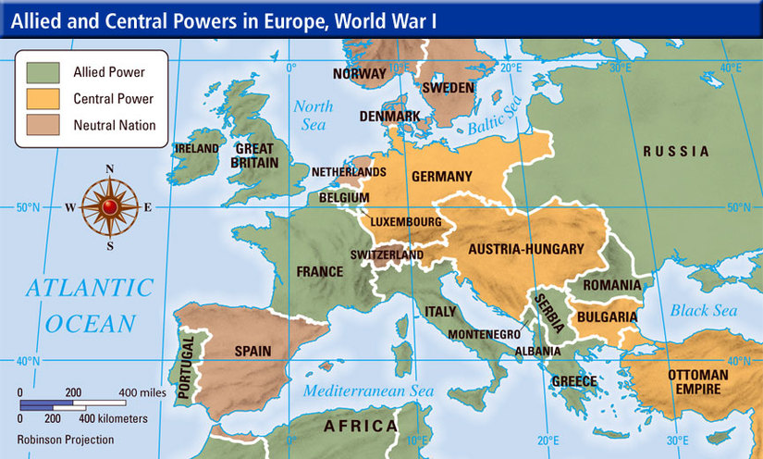
The Details
The “Great War” originated in Europe but expanded to include the Middle East, Africa and into Asia.
Starting in 1914 it lasted a grueling 4 year and ended on Nov. 11, 1918.

Slide 3
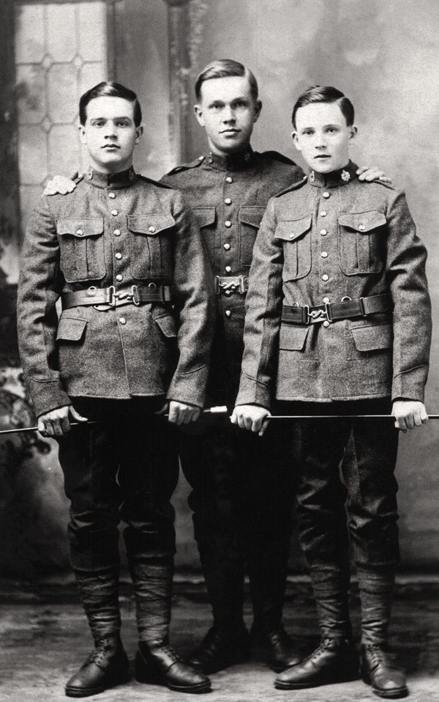
Shocking Statistics
The population of Canada was around 8 million.
620 000 Canadians served in the war.
66 000 were killed.
170 000 were injured.

Slide 4
Around 50% of men from ages 16-30 served in the war.
10% of those that served were killed.

Slide 5
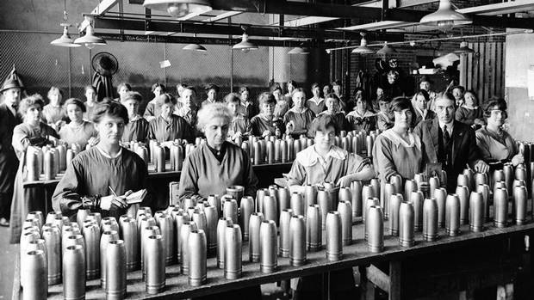
Because the War was overseas…
Industry
Canadian factories were not in danger of being destroyed.
Canadians were able to build millions of bombs and guns each week.

Slide 6
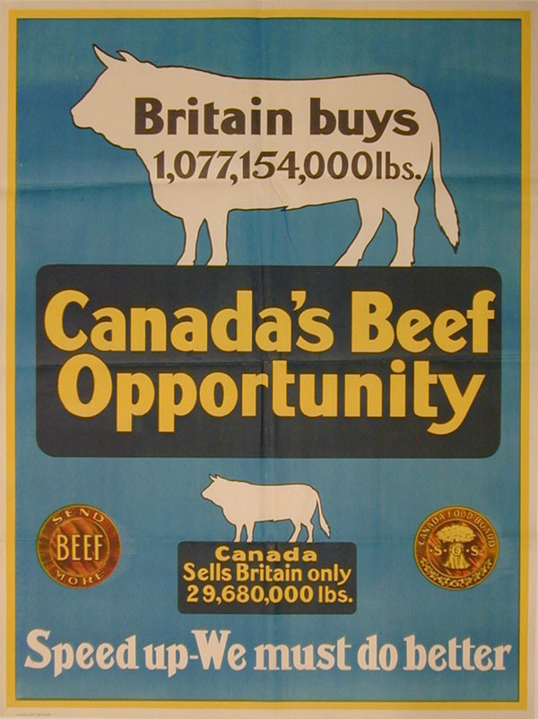
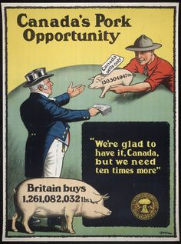
Canada at War
Agriculture
Canada has lots of open space.
Farms were not in danger from the war.
Plenty of extra food could be made, sold and shipped to coutries at war.
Notes:
During the war the demand for food for the war effort drove the economy and provided plenty of opportunity for farmers and manufacturers to sell goods at a inflated price.

Slide 7
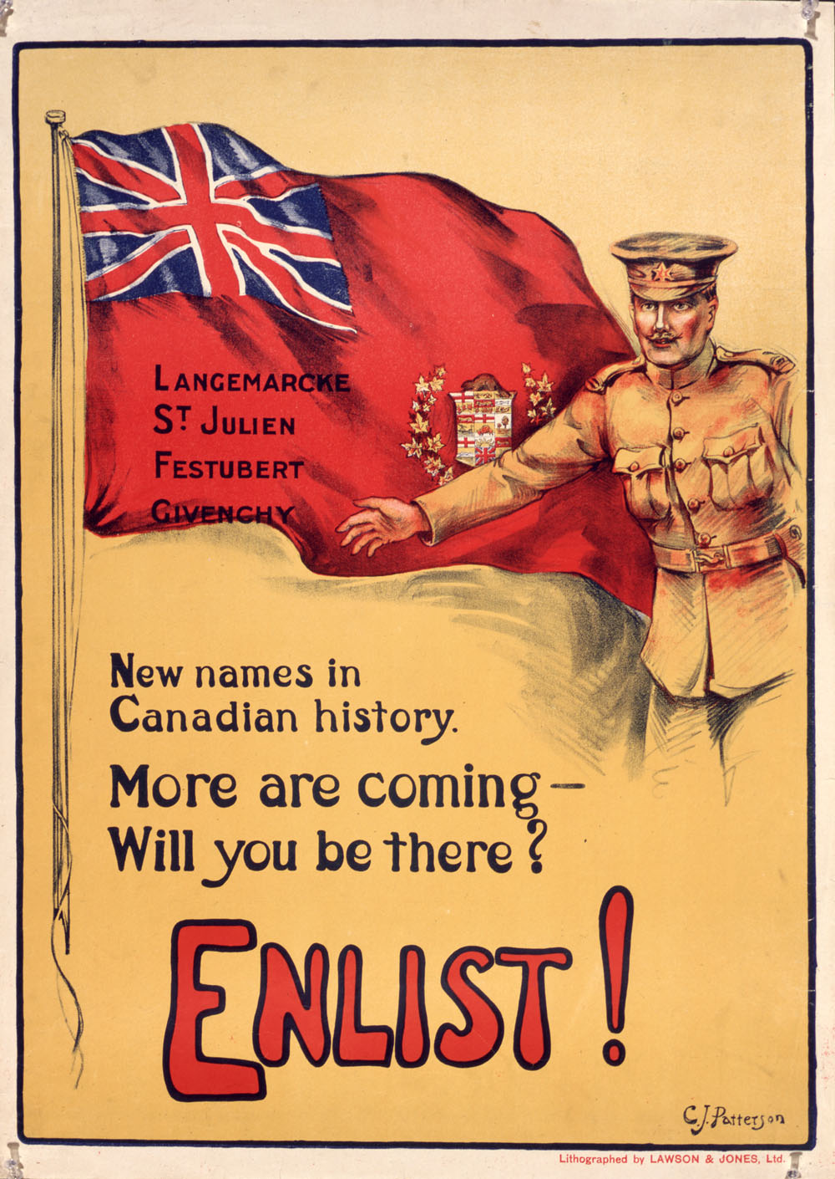
A National Effort
To start, Canadians with British origins played the largest role.
By the end of the war, Canadians of all backgrounds took part.
Canada joined the war as a British subject. Canada ended the war as an individual signature on the Treaty of Versaille.

Slide 8
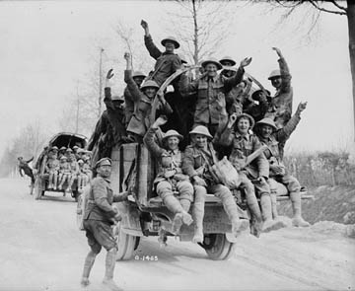
The War is Over!
After the war, Canadian soldiers returned to life in Canada.
Life was difficult for returned soldiers, especially those that were injured. Why?
Notes:
After the war ended so did the demand for Canadian products, which created a slump in the Canadian economy. The Prairies and the Maritimes felt it the hardest as the price for wheat and fish dropped.
In addition, the war created a temporary spike in the cost for goods and services, after the war ended the prices remained high while wages for workers were lowered. To make matters worse many returning soldiers couldn’t find employment and therefore struggled to provide for themselves and their families.

Slide 9
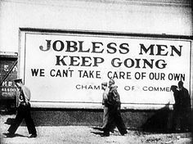
What if…?
How would you feel if you had served overseas during the war and upon your return you couldn’t find a job and found yourself without any trade or skill that was needed for a career?

Slide 10
Cause and Consequences - Activity
ACTION → RESULT
1ST EVENT → 2ND EVENT
NOTHING HAPPENS IN ISOLATION!
__________________________ → ________________________

Slide 11
Consequences of WWI in Canadian History
BLUE OPTION
Use the list of “causes” from the WWI overview and match the with possible “consequences” on Canadian history.
GREEN OPTION
Use the list of “causes” provided from the WWI overview and predict possible consequences.
PINK OPTION
Use your notes in order to predict cause and consequence from WWI

