Slide 1
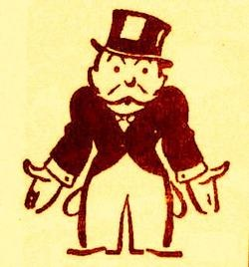
The Great Depression & The Dirty Thirties
1929-1939

Slide 2
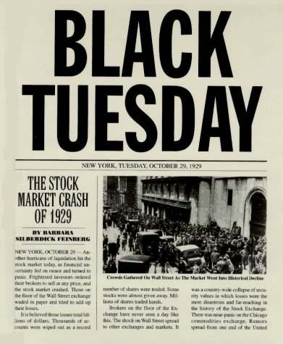
The end of the good times – Stock Market Crash
As the 1920s ended so did the prosperity and good times.
On October 29th, 1929, a date known as “Black Tuesday” the New York Stock Market crashed.
Because Canada and the USA are so closely connected economically and socially, we too felt the crash in a major way.

Slide 3
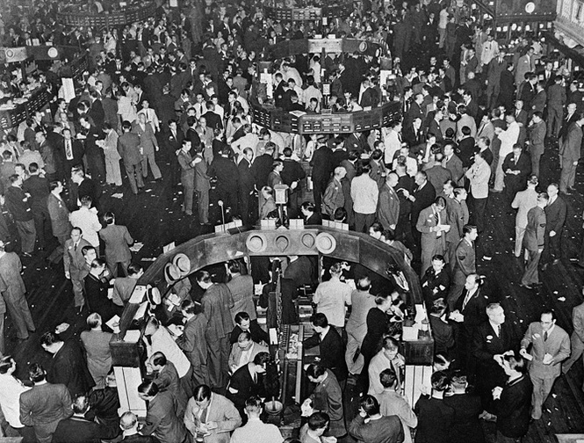
What is a Stock Market?
The stock market is an everyday term we use to talk about a place where stocks and bonds are "traded" – meaning bought and sold. For many people, that is the first thing that comes to mind for investing. The goal is to buy the stock, hold it for a time, and then sell the stock for more than you paid for it.

Slide 4
A deeper Understanding
Video – Stock Market for Dummies

Slide 5
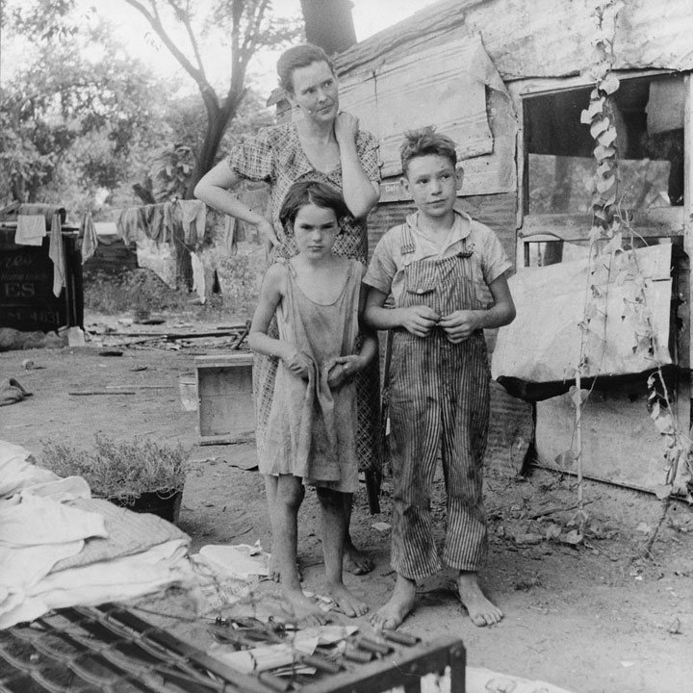
Just a piece of the puzzle
While the stock market crash did seem to play a large role in the onset of the Great Depression it wasn’t the only factor that led to this deep, longest-lasting economic downturn in the history of the Western industrialized world.

Slide 6
Prior Knowledge
What have we learned about so far that may have played a factor in this crash?
Debt and Credit
False Expectations of Investing
Increased Production and the Struggle for Demand to Keep Up

Slide 7
Debt and Credit
In the 1920s, there was a rapid growth in bank credit and loans in the US. Encouraged by the strength of the economy, people felt the stock market was a sure bet. Some consumers borrowed to buy shares. Firms took out more loans for expansion.
As we had learned people were used to spending and borrowing and spending and borrowing and….

Slide 8
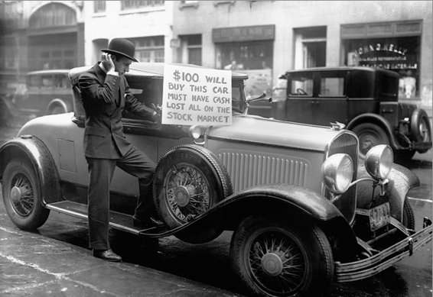
How does this man feel about selling his car? Why?

Slide 9
False Expectations of Investing
A lot of the stock market crash can be blamed on high and false expectations. In the years leading up to 1929, the stock market offered the potential for making huge gains in wealth. It was the new gold rush with relatively no risk.
People bought shares with the expectations of making more money. As share prices rose, people started to borrow money to invest in the stock market as they were convinced that it was a good investment.

Slide 10
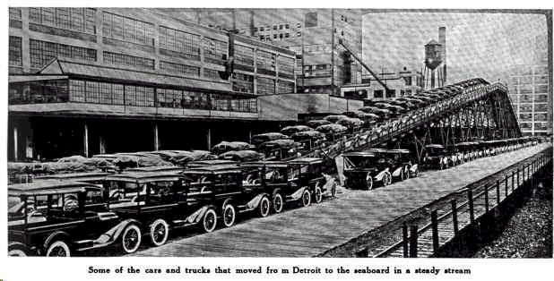
Too much of a good thing
The 1920s saw great strides in production techniques, especially in industries like automobiles. The production line enable great increases in production. However, demand for buying expensive cars and consumer goods were struggling to keep up. Therefore, towards the end of the 1920s many firms were struggling to sell all their production.

Slide 11
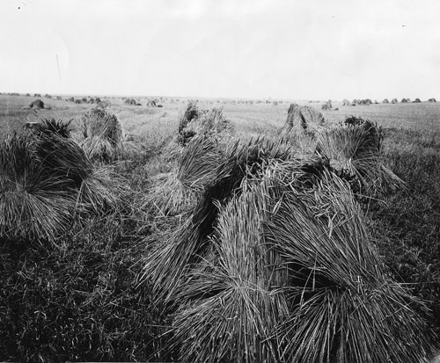
Increased Production and the Struggle for Demand to Keep Up
The agricultural sector was struggling to maintain profitability. Many small farmers were driven out of business because they could not compete with larger farms. Better technology was increasing supply, but demand for food was not increasing at the same rate. Therefore, prices fell and farmers incomes dropped and many struggled to remain profitable.
Surpluses of goods piled up in warehouses and farmers continued to grow wheat even when the demand peaked in 1927. ($1.03 > $0.29)
Notes:
Farmers had hoped that the stockpile of wheat would pay off when prices rose but by 1928-29 it was clear that the global economy was not going to rebound.

Slide 12
The Stock Market Crash of 1929
On October 29, 1929, Black Tuesday hit Wall Street as investors traded some 16 million shares on the New York Stock Exchange in a single day. Billions of dollars were lost, wiping out thousands of investors.
Investors were frantically trying to sell their shares as soon as possible so they wouldn’t lose all of their money but as the fear spread it was too late for many and market continued to plummet.

Slide 13
Canada and the USA and the world
With our close trading ties Canada and the USA both suffered from this economic collapse. As the American economy slowed so did their interest in Canadian imports. American companies began to pull out of Canada and branch plants closed down. Thousands and thousands of people lost their jobs and this again multiplied the problems that Canada faced.
By 1932, international trade dropped by 50% from its heights in the 1920s and many countries increased tariffs on imports.

Slide 14
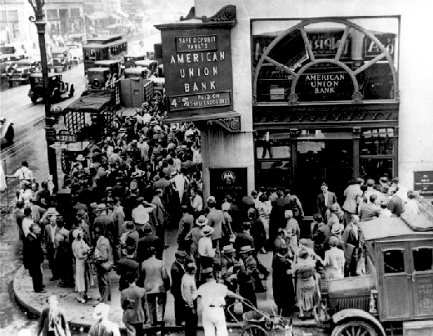
The Banks and other Businesses
Financial institutions were not safe from the economic crisis, and although Canada wasn’t hit as hard as the USA we still experienced great losses. People’s saving accounts were lost as banks went out of business.
Companies that managed to stay open were forced to lay off workers in order to stay afloat. This increased unemployment further compounded the problems faced by banks because unemployed workers couldn’t pay off their debt.

Slide 15
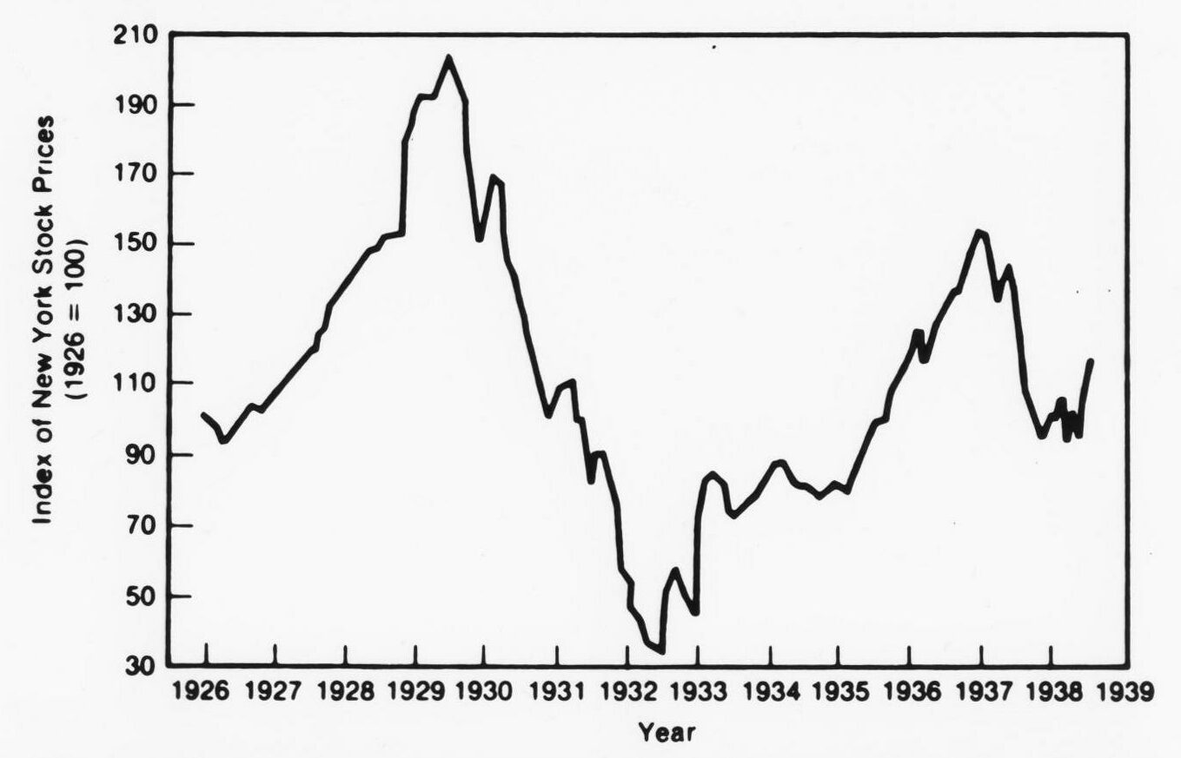

Slide 16
The Great Depression in Canada
The worldwide Great Depression of the early 1930s was a social and economic shock that left millions of Canadians unemployed, hungry and often homeless.
Few countries were affected as severely as Canada during what became known as the Dirty Thirties, due to Canada’s heavy dependence on raw material and farm exports, combined with a crippling Prairies drought.

Slide 17
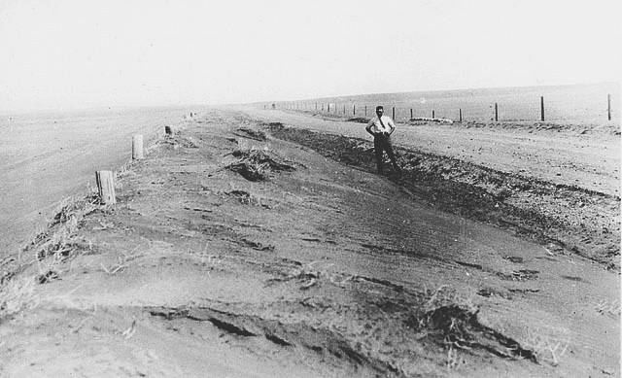
Prairie Drought in Saskatchewan in the late 1920s

Slide 18
Writing Activity
Using the knowledge about the “Roaring 20s” and the “Dirty 30s” write about the Historical Significance of knowing about this time period. Also, write about examples of Cause and Consequences of “Black Tuesday”.
This mini-assignment will be able to used as evidence of your understanding.

Slide 19
Unemployment Numbers
By 1933, 30% of the labour force was out of work. The unemployment in Canada reached an average of 32% in many cities and in Windsor, Ont. it reached a whopping 50%.
The Maritime provinces reached up to 60% unemployment.
By 1932 one in five Canadians had become dependent upon government relief for survival. The unemployment rate would remain above 12% until the start of the Second World War in 1939.
Germany’s unemployment numbers went from 650,000 in 1928 to 6,100,000 in 1933.

Slide 20
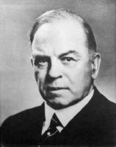
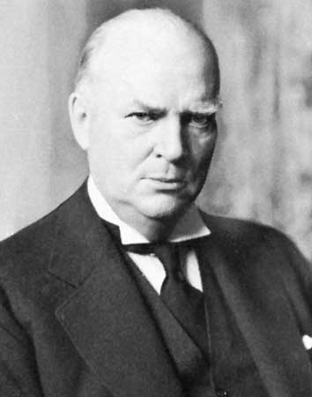
Effects of the Great Depression
In 1929, Liberal William Lyon Mackenzie King was the prime minister of Canada. He and thousands of other Canadians thought the Depression was a temporary set back that would end quickly, they were wrong.
In 1930 King and his Liberal party lost the federal election to Conservative leader R.B. Bennett.

Slide 21
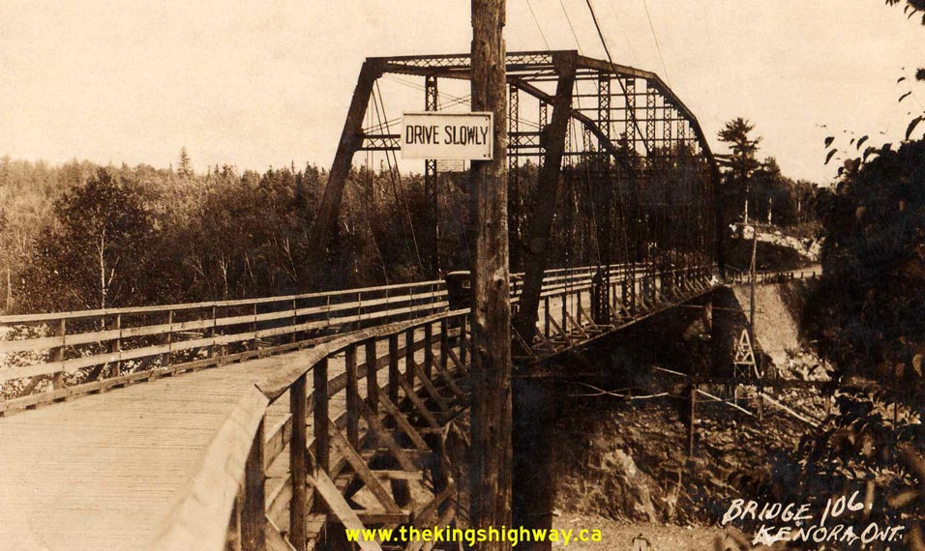
Failing Economic policies
During his campaign Bennett had promised to take action to stop the downward economic spiral. Bennett’s government gave $20 million in aid to the provinces. This money was used for public relief (welfare) and public works projects.
These projects included building roads and bridges and other activities that were designed to get people back to work.
Notes:
During the 1930s, the unemployed received uneven treatment across Canada. Married men or men with families were favoured over single men and women when relief or relief work was distributed. Many cities established residence requirements to keep out job seekers from other provinces or towns.
To help spur an economic recovery, the federal government increased its spending on relief, subsidies and work camps, among other things. This resulted in a ballooning national debt.

Slide 22
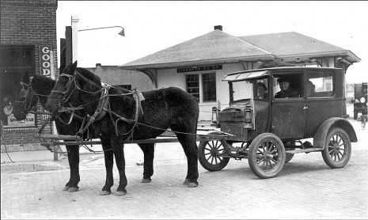
The “Bennett Buggy” was a term used in Canada during the Great Depression to describe a car which had its engine and windows taken out and was pulled by a horse.

Slide 23
While the make-work projects seem to help some people Bennett wasn’t able to negotiate better tariffs with the US and Britain.
Bennett then attempted to balance the financial budget as was done in the past when times were tough but that didn’t help as conditions got worse.
Some economists believe that if Bennett has spent more money he could have helped Canada recover quickly. Why would they think this?

Slide 24
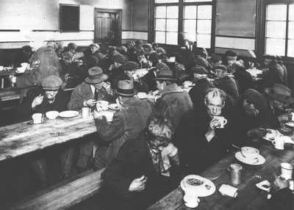
Social Concerns
Unemployment ruined lives during the Great Depression. Unskilled workers, labourers, small-business owners, farmers, and young people found it nearly impossible to find work.
Lives worsened for the already disadvantaged such as the poor, working women, First Nations, and visible minorities. These groups experienced discrimination when looking for work, and many lost the jobs they already had.

Slide 25
Hard Times
Luxuries and “extras” vanished except for the wealthy.
For many, essential vanished and many people were homeless and hungry. Malnutrition and diet-related diseases such as scurvy became all too common.
Keep in mind that in the 30s there was no government assistance programs like medicare, employment insurance or child tax credits.

Slide 26
Pogey
Those how lost jobs had to suffer the embarrassment of asking for public relief, also known as “the dole” or “pogey.” This was the last option for many and was humiliating for many who had ran out of options.
Those who had to seek pogey had to give up drinking alcohol as well as their driver’s license and relief camps were set up to house young men in this desperate time. Many of the homeless became hobos and “rode the rails” looking for work across Canada.

Slide 27
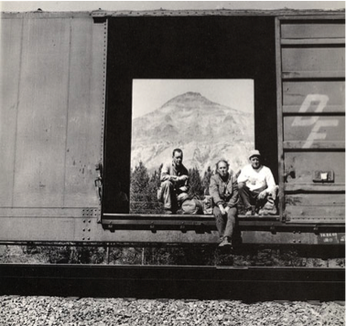
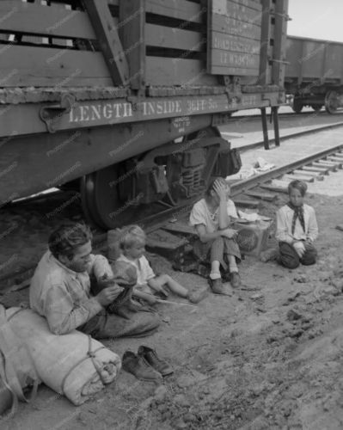
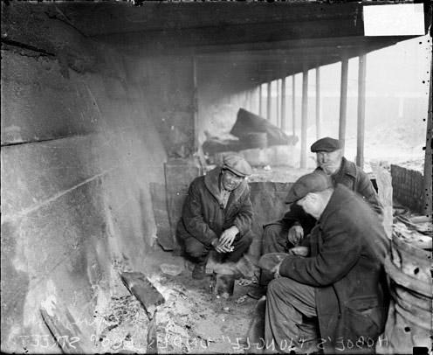
“Riding the Rails”
How do you think these hobos were treated in the communities they traveled to?

Slide 28
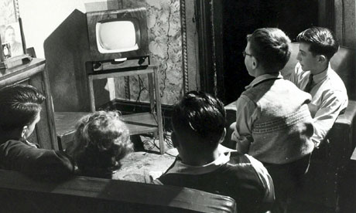
Political Changes
While the Great Depression has a considerable impact on Canadian society in the 30s it also brought people together. The radio served as a means to connect individuals and to escape the hard times. For those who could afford it, TV also helped people forget about the troubling financial downturn.

Slide 29
Political Changes – mini Assignment
With the financial crisis many Canadians were losing faith in the traditional political parties. As a result new political parties formed with ideas about how to fix the crisis. These new parties were quite popular in Western Canada.
Prepare a small summary on your assigned political party and create a campaign poster that focuses on Canadian Identity seen through the eyes of your party.
Notes:
To assist your group with what to include in your presentation answer questions 1 and 2 in the Review and Reflect section found on page 102.

