Slide 1
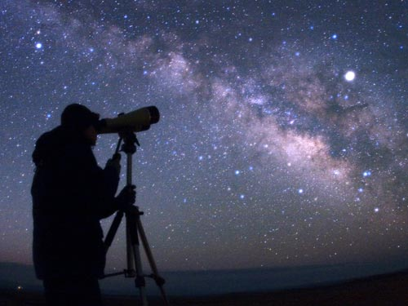
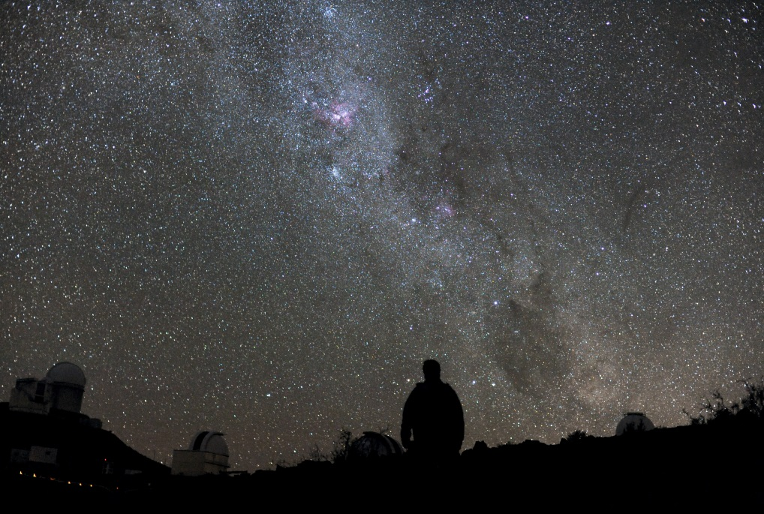
The night sky

Slide 2
What do you see?
Chances are, at some point you have looked up during a clear night and noticed patterns and changes.
Humans have for many years speculated at what was above us.
This is the study of astronomy – what is beyond Earth.
The first would likely be the most numerous object we see – stars.

Slide 3
Answer on loose-leaf:
When you look up at the night sky, you see stars. What do you think these stars ARE?
Why do the stars glow?
Why should we know about space? Or, if you disagree, why shouldn’t we?

Slide 4
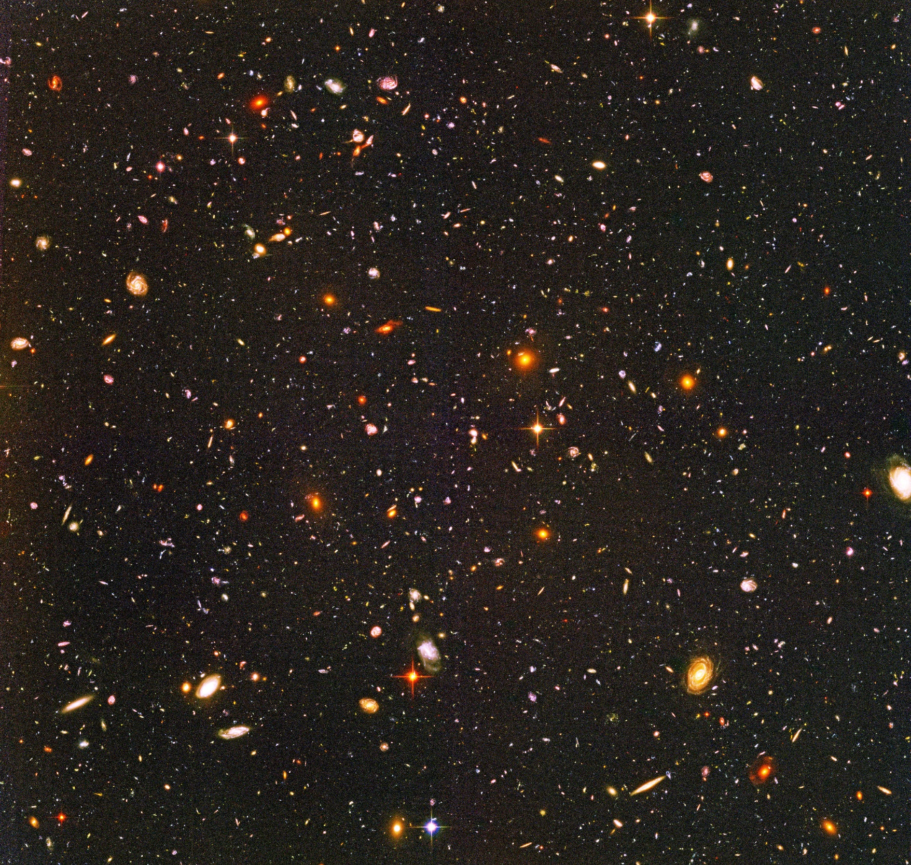
This picture contains approximately 3000 galaxies looking outward from our own
There are over 100 Billion stars in our galaxy, The Milky Way
There are approximately 150 billion galaxies in the universe
http://asd.gsfc.nasa.gov/

Slide 5
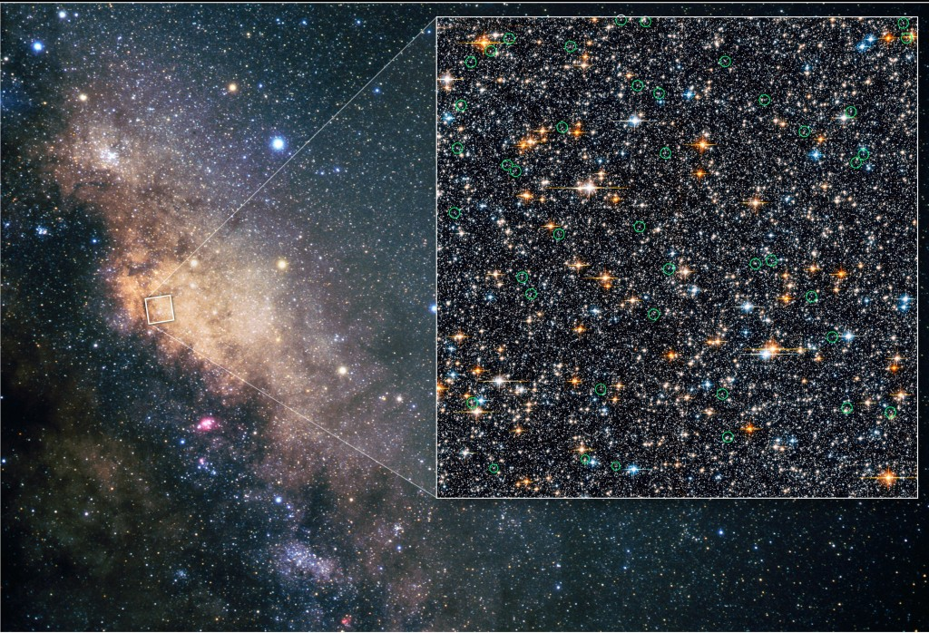
http://asd.gsfc.nasa.gov/

Slide 6
Constellations
Even before the advent of telescopes, humans took note of star formations and have been influenced by them.
As we often do, some claimed through patterns they could see objects or people “hidden” there.
These objects are what’s known as constellations.
They aren’t necessarily found in the same area of space, but the light reaches us around the same part of the sky, they just appear to be close together.

Slide 7
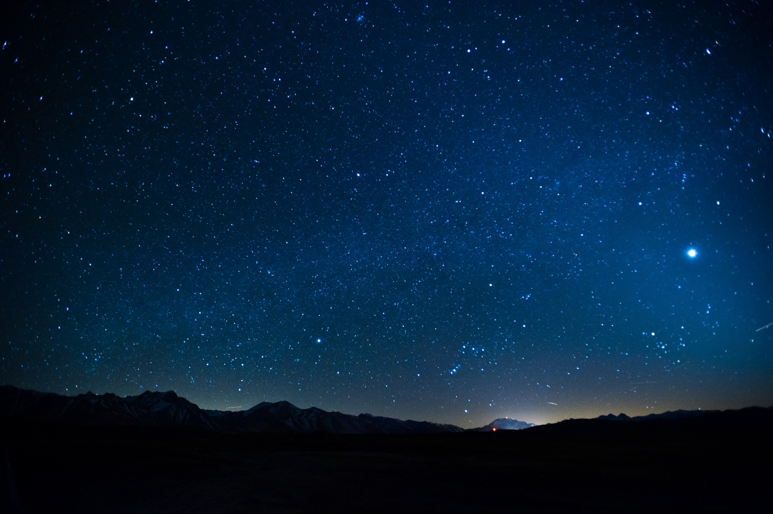
http://asd.gsfc.nasa.gov/

Slide 8
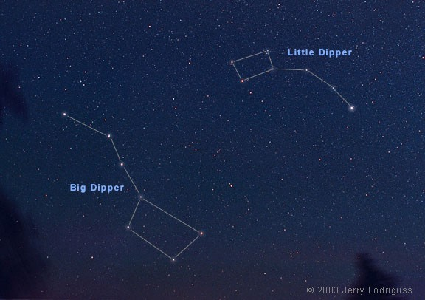
Big and little dipper

Slide 9
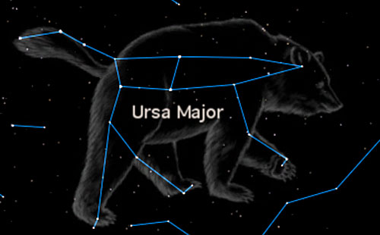

Slide 10
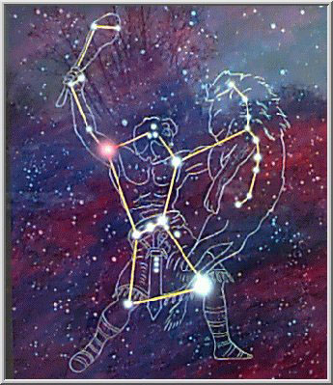
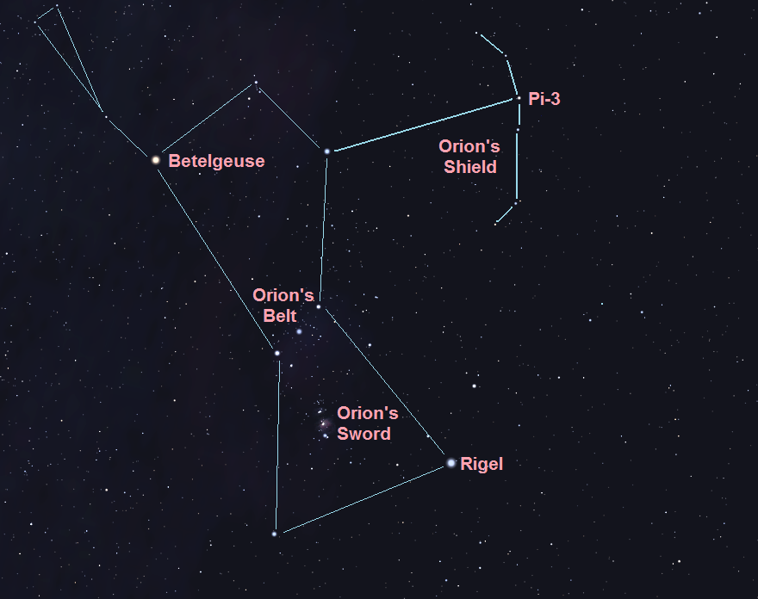
orion

Slide 11
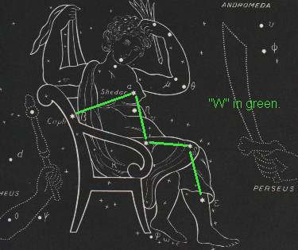
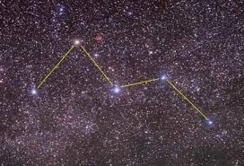
Cassiopeia

Slide 12
The patterns we see here on Earth may not be the same you would see if you were standing on another planet far away.
Plus, their location in the sky changes over the evening and over the seasons.
AB time lapse
More night sky time lapse
AB from ISS
Nonetheless, constellations have been used as direction-finders by many travelers, especially at sea.

Slide 13
Objects in our solar system
In addition to the stars we can also see some of the planets that revolve around our sun.
The most prominent object in the night sky would be the moon.
Though the moon revolves around our planet, and the other planets revolve around the sun, they are all non-luminous.
This means they do not produce their own visible light.

Slide 14
The only luminous objects in the sky are stars.
They produce their own light.
These includes our nearest star, the sun.
Our star is fairly young, and quite small compared to others.
Star Size Comparison
We can only see other objects because light from our sun illuminates them.
Nonluminous objects (planets, moons) tend to revolve around luminous ones(stars).

Slide 15
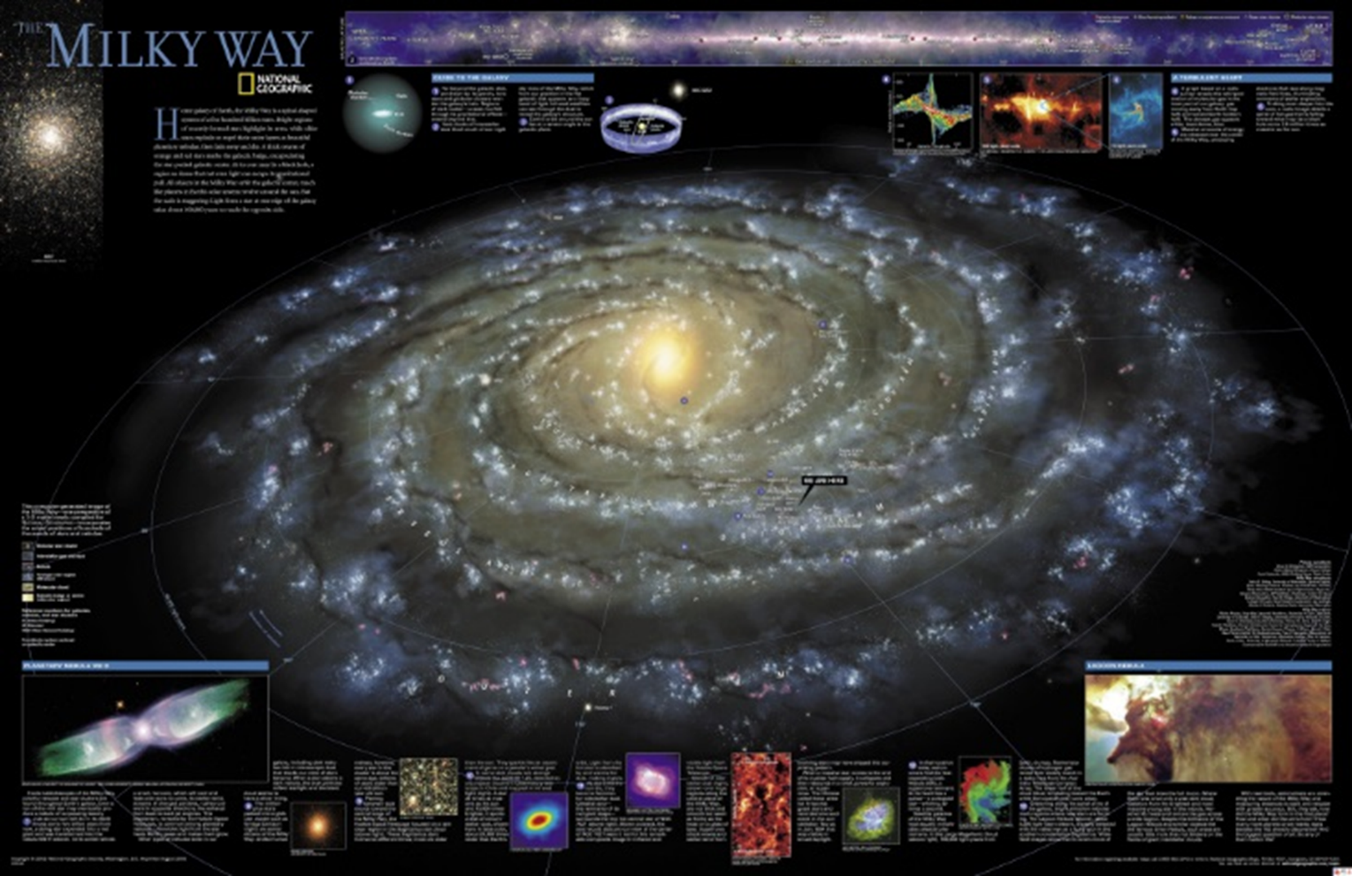
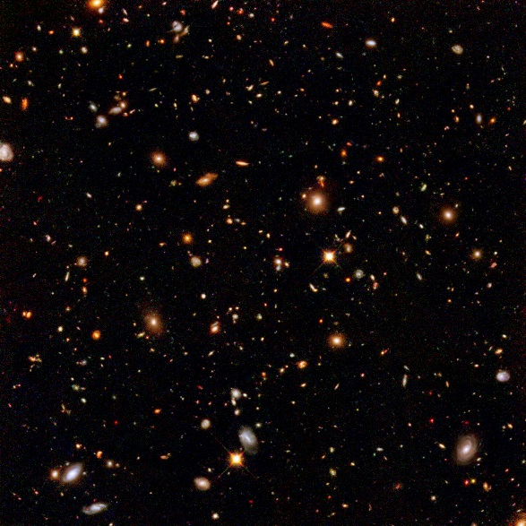
The other side of the galaxy is 100,000 light years away (It would take 100,000 years travelling at the speed of light to get there).
Speed of light is 300 000km/s. At this speed you could go around the Earth 7 times in 1 second.

Slide 16
Planets appear to move through constellations that are made up of stars

Slide 17
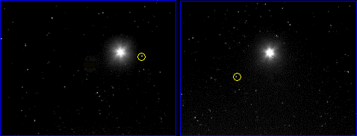
Planets appear to move through constellations that are made up of stars as the planets are closer and wander through the nights sky unlike stars that travel with constellations.
Mars

Slide 18
Types of motion
Why did it appear to many people as though the night sky was moving?
Years ago, we believed it was because the universe revolved around us.
This was because of one of two types of motion our planet exhibits
Rotation – a spin of an object around its axis
Revolution – a rotation around a larger object (an orbit)

Slide 19
Rotation
One complete spin takes 24 hours, meaning we are spinning at 1670 km/h
Our concept of one day is based on this length of time.
The Earth’s axis is tilted 23.45°
Without this, we wouldn’t have seasons.

Slide 20
Revolution
Think of this as one trip around the sun.
We are orbiting this star at just under 30 km/s
Many think it takes 365 days to complete the trip
The exact time is 365.2422 days
So, we actually add one day every four years
How do you think we “correct” this?
Rotation and revolution

Slide 21
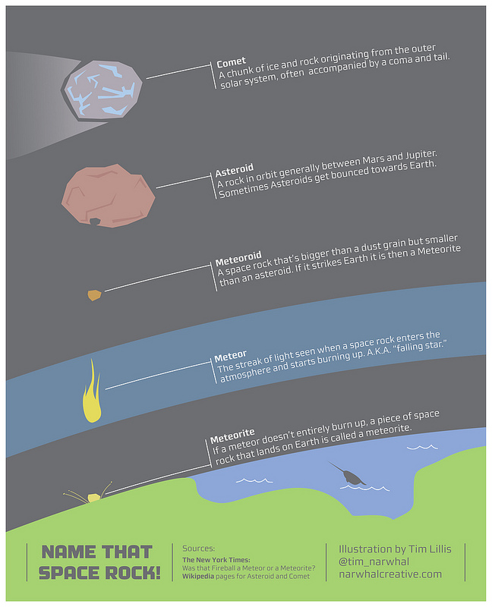

Slide 22
Questions
Complete questions 3, 4 and 6 on page 402.

