Slide 1
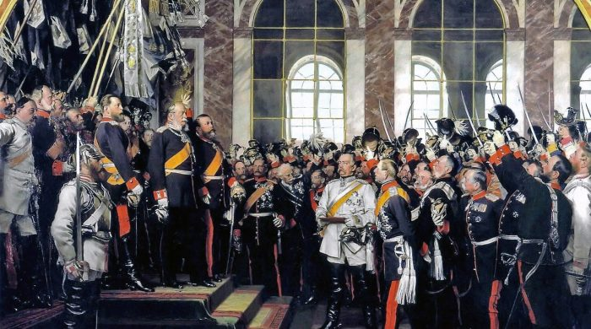
German Unification
How did nationalism influence the unification of Germany

Slide 2
Brief History
By the 1800s the Germany we know today consisted of 39 independent states
The largest was Prussia
These states shared the same culture and industry brought them closer together
Most Countries in Europe did not want a unified Germany (too powerful)

Slide 3
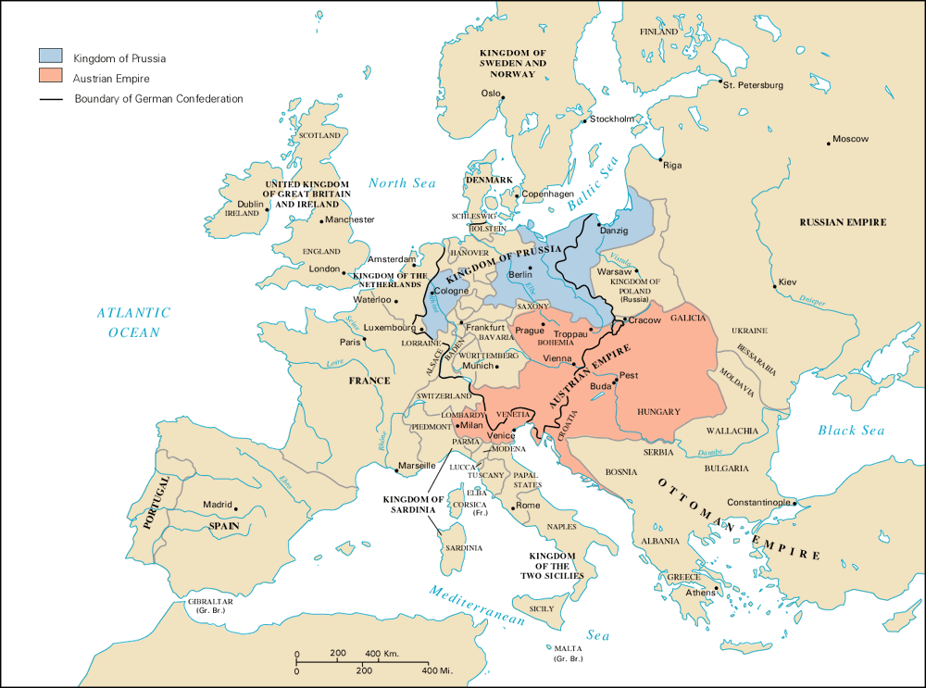

Slide 4
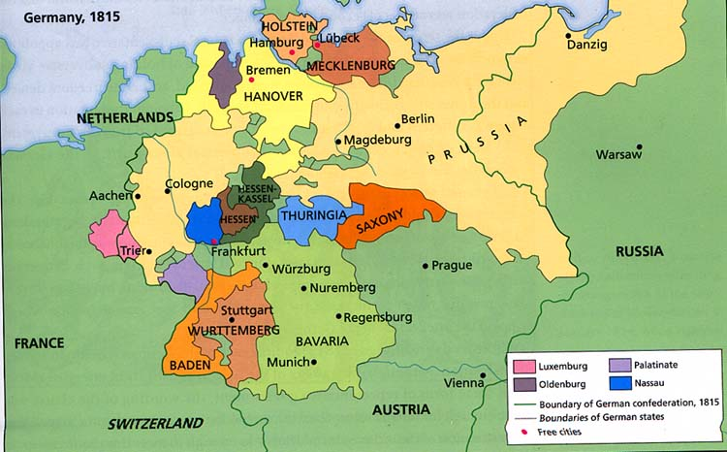

Slide 5
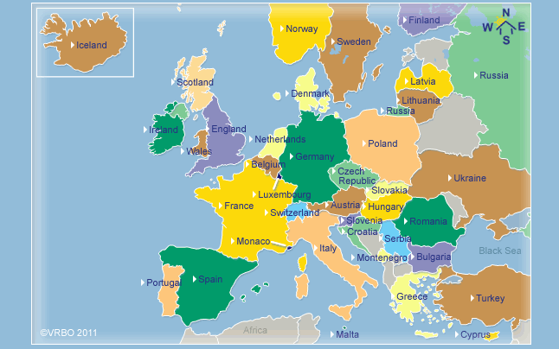

Slide 6
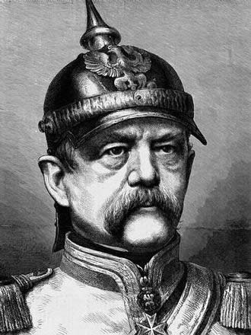
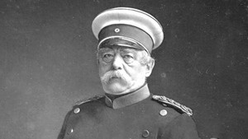
Leader of German Unification
Otto von Bismarck
Prime Minister of Prussia
Builds up Prussian military
Authoritarian

Slide 7
Bismarck's Beliefs
Wanted strong government & army to unify Germany
Embraced Realpolitik (politics of reality) = right of a country to pursue its self-interest by any means, including war.

Slide 8
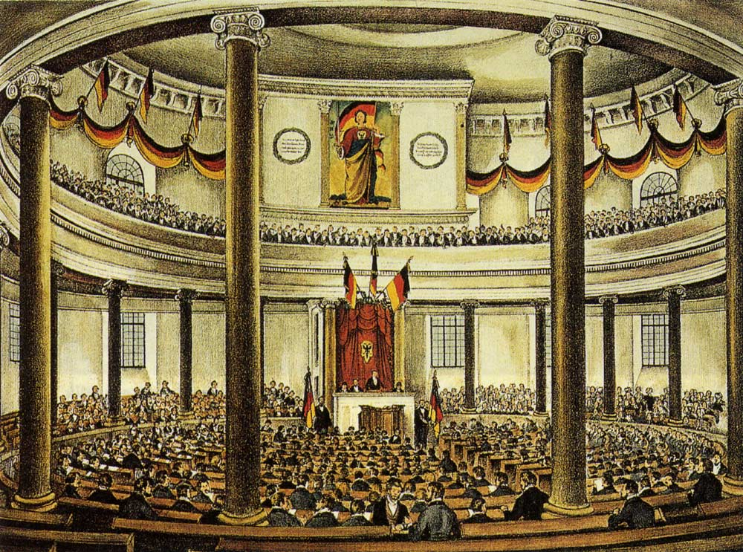
Frankfurt Assembly - 1848
Call for German Unification
Prussia wanted to unify the German States
Notes:
A preliminary parliament met in Frankfurt am Main in March 1848 at the instigation of liberal leaders from all the German states (including Austria), and it called for the election of a national assembly.
The Frankfurt National Assembly spent much time debating various plans for a unified Germany, but it also had to decide on immediate practical problems, such as the nature of the executive power and Germany’s territorial extent.
The Frankfurt National Assembly was finally able to adopt a proposed constitution for Germany on March 28, 1849. This document provided for universal suffrage, parliamentary government, and a hereditary emperor. Germany was to have a unified monetary and customs system but would maintain the internal autonomy of the constituent German states.

Slide 9
Quotes by Bismarck
“The great questions of the day will not be settled by speeches and majority decisions but by blood and iron.”
“The less people know about how sausages and laws are made, the better they’ll sleep at night.”
“Some damned foolish thing in the Balkans will provoke the next war.”
Notes:
In his speech, Bismarck claimed that the international policy of a modern state is built upon the willingness to fight — “Blut” (blood) — and the willingness to spend vast amounts of public treasure in creating giant armies — “Eisen” (iron).
"The great questions of the time will not be resolved by speeches and majority decisions ... but by iron and blood," the minister president of the Kingdom of Prussia said. Nine years later — after the expenditure of plenty of blood and iron — Bismarck became the first chancellor of the new German Empire.
Less than two years after the speech, in 1864, Bismarck maneuvered Prussia and Austria into fighting an aggressive war against Denmark. The war was quickly won by the two larger nations, both of which gained additional territory.
In 1866 Bismarck instigated an aggressive war by Prussia against its erstwhile ally Austria, which was defeated in a mere seven weeks. Bismarck’s terms drove Austrian influence out of northern Germany, leaving Prussia with effective hegemony.
In 1871 Bismarck tricked France into a war against Prussia that resulted in a crushing Prussian victory and the addition of all the smaller German states around the Rhine into the new German Empire. This empire included a large number of smaller German states that had been quite happy to remain independent but that felt pressured and helpless after the collapse of France.
The series of wars did not happen by accident. They were part of Bismarck's calculated plan of power politics, aggression, and annexation. The realpolitik Bismarck defined in his famous “Blood and Iron” nine years earlier had given birth to the German Empire.

Slide 10
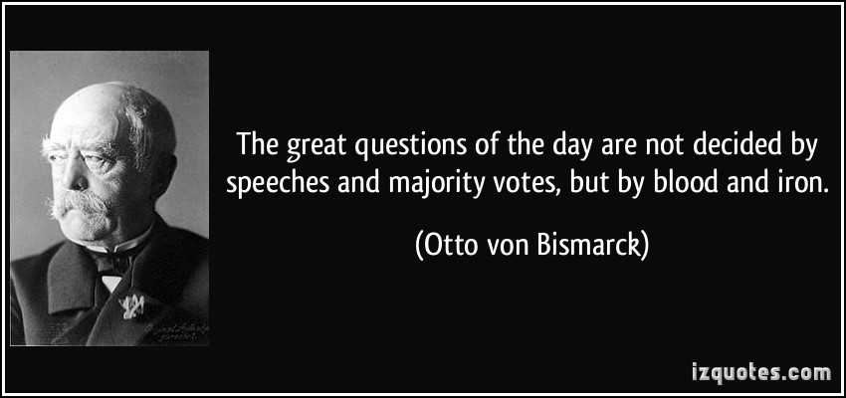
Letter to Austria - 1856
There will be a war with Austria in the near future.
The way the war will be fought will be with “Blood (War) & Iron (Industrialization).”
Notes:
Otto von Bismarck: Letter to Minister von Manteuffel, 1856
Because of the policy of Vienna [the Congress of Vienna, 1815], Germany is clearly too small for us both [Prussia and Austria]; as long as an honorable arrangement concerning the influence of each in Germany cannot be concluded and carried out, we will both plough the same disputed acre, and Austria will remain the only state to whom we can permanently lose or from whom we can permanently gain. . . .I wish only to express my conviction that, in the not too distant future, we shall have to fight for our existence against Austria and that it is not within our power to avoid that, since the course of events in Germany has no other solution.

Slide 11
Bismarck’s Plan
Bismarck will use nationalism and war to unify and bring Germany together.

Slide 12
Step 1: Nationalism
Nationalism – loyalty and devotion to your nation.
German states share the same culture but no actual country.
Bismarck wants to use nationalism to unify the German states.
He will obtain nationalism through war.

Slide 13
Step 2: Austro-Prussian War
Bismarck stirs up a border dispute with Austria who declares war.
Prussia wins war in 7 weeks. (Seven Weeks War)
Austria gave German territory to Prussia.
Causes a boost in nationalism in smaller German states.

Slide 14
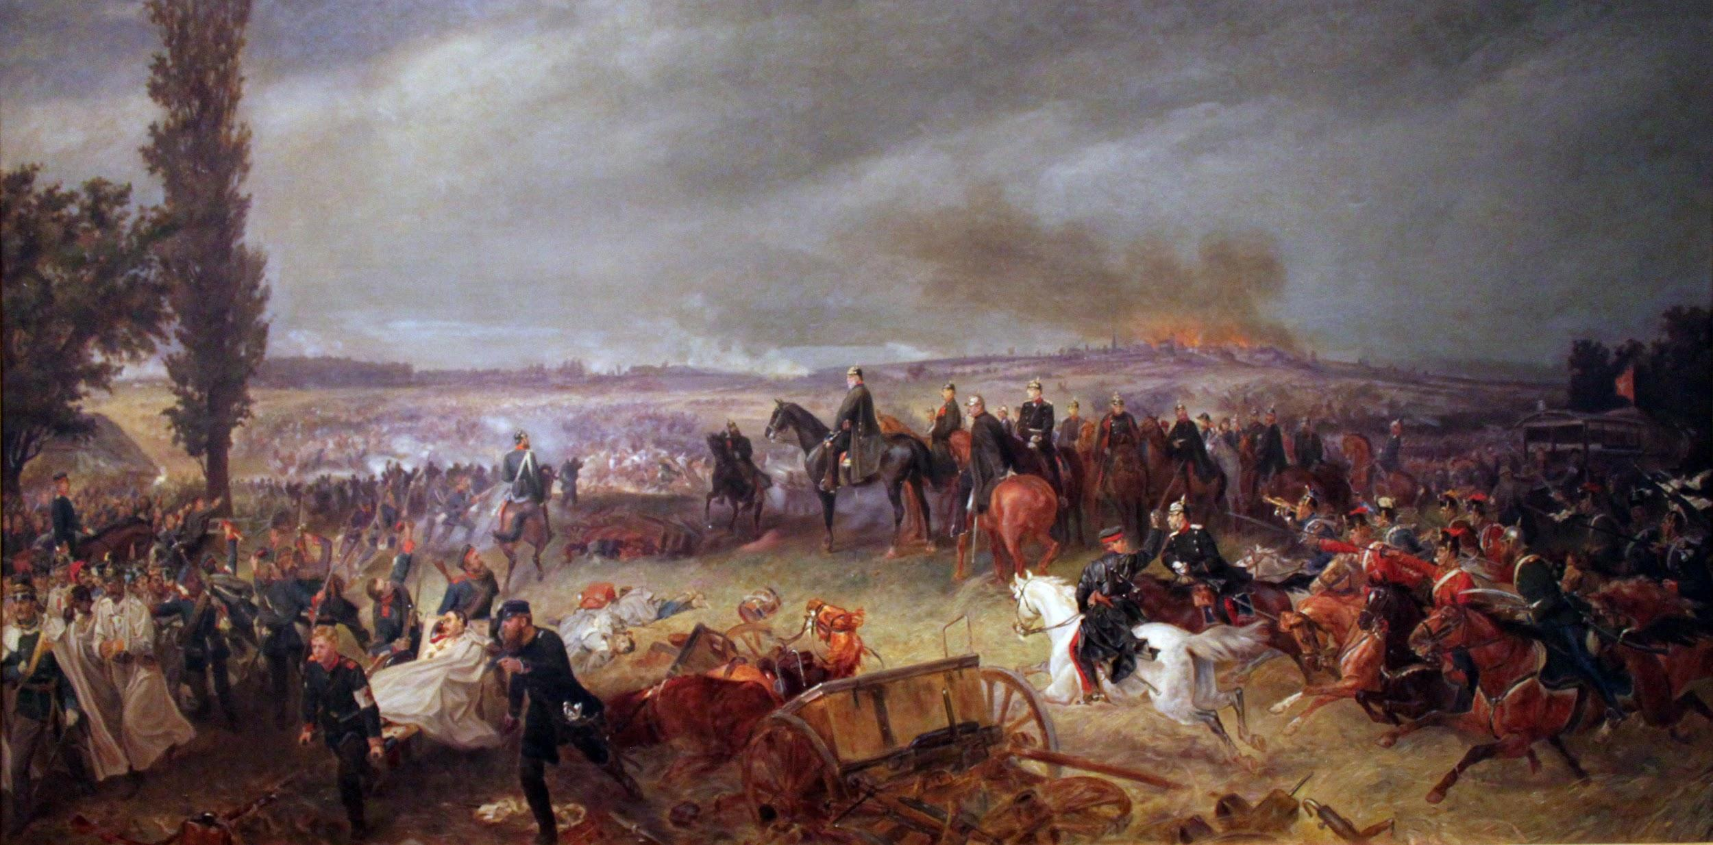
Austro-Prussian War - 1866
Prussia fought the war with Austria for power.
Self-Determination
War lasted 7 weeks
Notes:
Seven Weeks’ War, also called Austro-Prussian War, (1866), war between Prussia on the one side and Austria, Bavaria, Saxony, Hanover, and certain minor German states on the other. It ended in a Prussian victory, which meant the exclusion of Austria from Germany. The issue was decided in Bohemia, where the principal Prussian armies met the main Austrian forces and the Saxon army, most decisively at the Battle of Königgrätz.

Slide 15
Bismark on Austria - 1866
Do not want Austria to desire revenge against Germany.
Self-Determination
Notes:
Otto von Bismarck: 1866
We had to avoid wounding Austria too severely; we had to avoid leaving behind in her any unnecessary bitterness of feeling or desire for revenge; we ought rather to reserve the possibility of becoming friends again with our adversary of the moment, and in any case to regard the Austrian state as a piece on the European chessboard. If Austria were severely injured, she would become the ally of France and of every other opponent of ours; she would even sacrifice her anti-Russian interests for the sake of revenge on Prussia. . . .The acquisition of provinces like Austria Silesia and portions of Bohemia could not strengthen the Prussian state; it would not lead to an amalgamation of German Austria with Prussia, and Vienna could not be governed from Berlin as a mere dependency. . . .Austria's conflict and rivalry with us was no more culpable than ours with her; our task was the establishment or foundation of German national unity under the leadership of the King of Prussia.

Slide 16
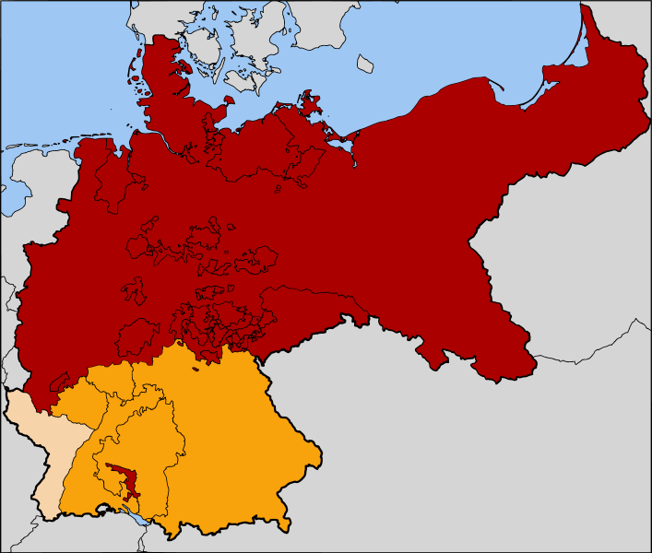
North German Confederation
Notes:
Prussia’s victory in the war enabled it to organize the North German Confederation.

Slide 17
Step 3: Franco-Prussian War
Felt that a war and victory over France would lead to more nationalism and the rest joining.
Due to political issues and Bismarck tampering with a letter, France declares war on German Confederation.

Slide 18
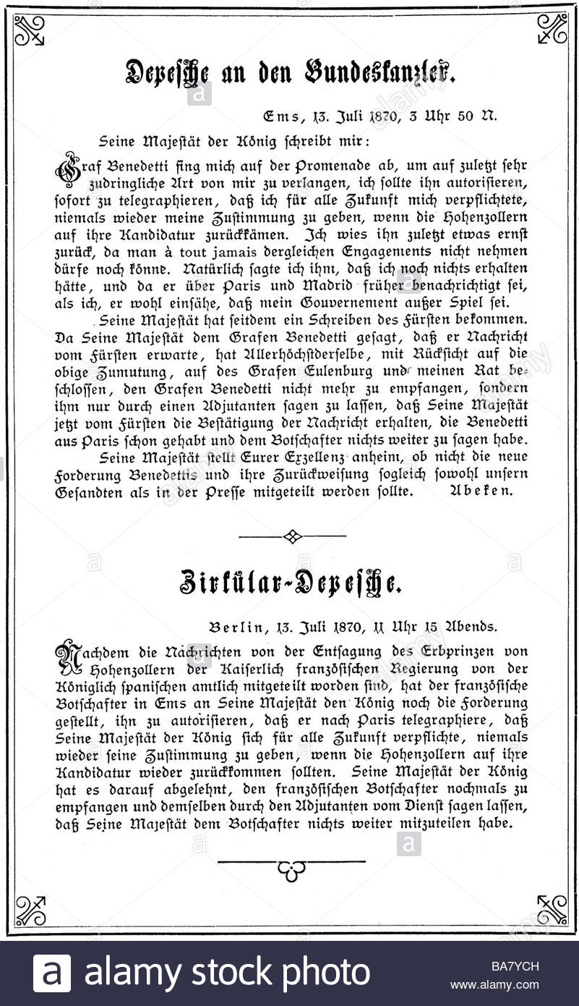
Franco-Prussian War - 1870
Bismarck changed text in a letter that insulted the Franch.
EMS Dispatch was published in France on Bastille Day.
France declared war.
North & South unite.
Final stage of unification
Notes:
Ems telegram, report of an encounter between King William I of Prussia and the French ambassador; the telegram was sent from Ems (Bad Ems) in the Prussian Rhineland on July 13, 1870, to the Prussian chancellor, Otto von Bismarck. Its publication in a version edited by Bismarck so as to purposely offend the French government precipitated the Franco-German War.
Early in July, the candidacy of Prince Leopold of Hohenzollern-Sigmaringen, a relative of the Prussian king, for the Spanish throne had alarmed the French, who feared that the extension of Prussian influence into Spain would threaten France. Leopold’s candidacy was withdrawn on July 12; the following day, the French ambassador to Prussia, Count Vincent Benedetti, approached King William at Ems to request an assurance that no member of his family would again be a candidate for the Spanish throne. The king politely refused Benedetti’s demand, and their discussion ended.
A telegram describing the incident was sent to Bismarck. Bismarck’s edited version, which he published the next day, omitted the courtesies in the two men’s exchange and instead made it seem that each man had insulted the other. This touched off an intensified demand for war in Paris and Berlin, and France declared war on July 19. The incident provided the excuse for a trial of strength that was sought by both France and Prussia, but because of Bismarck’s dishonest editing of the Ems telegram, it was France that was the first to declare war. This circumstance helped enlist the southern German states to Prussia’s side in the ensuing war, which resulted in the unification of all the German states (except Austria) into modern Germany.

Slide 19
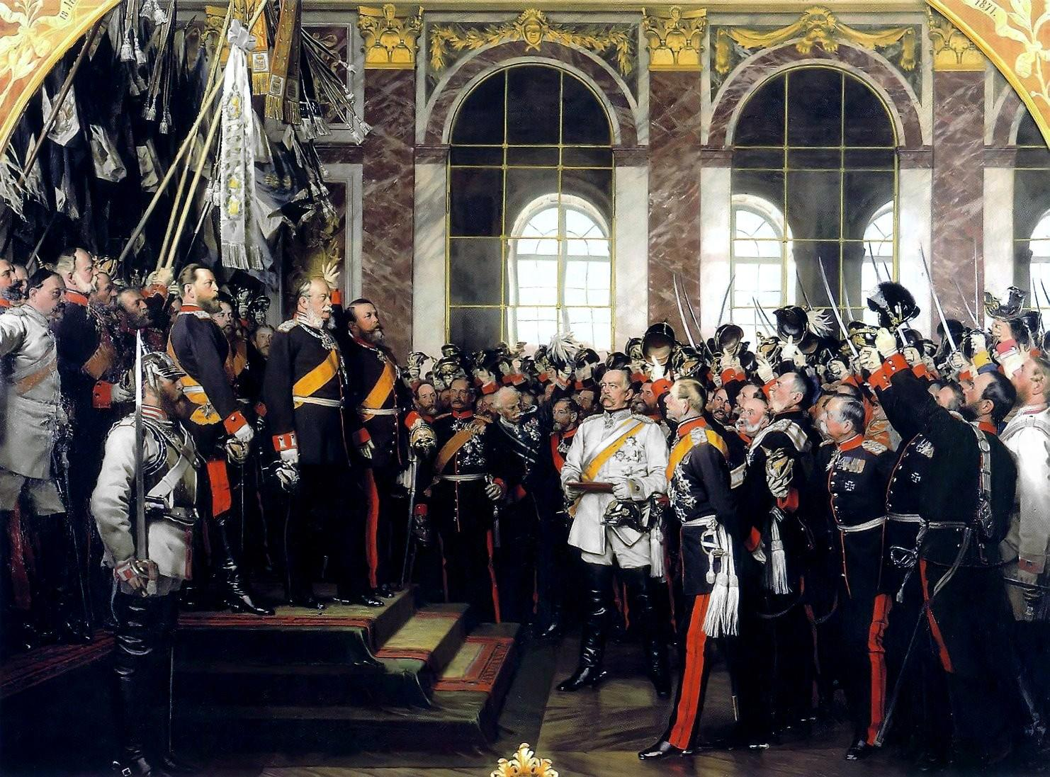
Proclamation - 1871
New leader of Germany Kaiser William I.
Germany is united.
Seeds for World War I planted.

Slide 20
Outcome
Germany is unified in 1871
Bismarck becomes Chancellor of Germany
Now, major powers in Europe are Britain, France, Austria, Russia, and Germany.

Slide 21
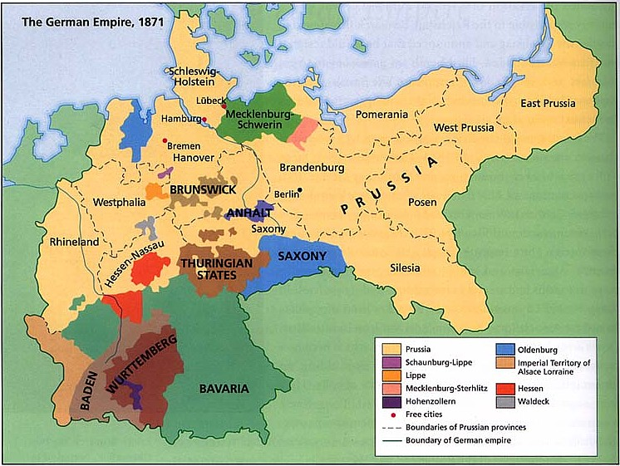

Slide 22
