Slide 1
Artists Reflect Canadian Identity Historic Overview

Slide 2
Consider This…
When viewing Canadian artwork it is important to consider the many factors that influence the art itself.
Some of the influencing factors include: geography, socioeconomic status, ethnic background, and when the art was created.

Slide 3
When viewing art…
What do you see?
Who is in the artwork? What are they doing?
Where was the painting painted? Or the photo taken?
Why was the art created?
What emotions are invoked?
Did the artist emphasize or omit anything from the image to convey a certain message?

Slide 4
Ask yourself…
How are people dressed? What can we learn from that?
What facial expressions do you see?
How are people interacting?
What technology is being used? What are the buildings/structures like?
What geographic features are present and what is there influence?
How would you feel if you were in that photo/painting?

Slide 5
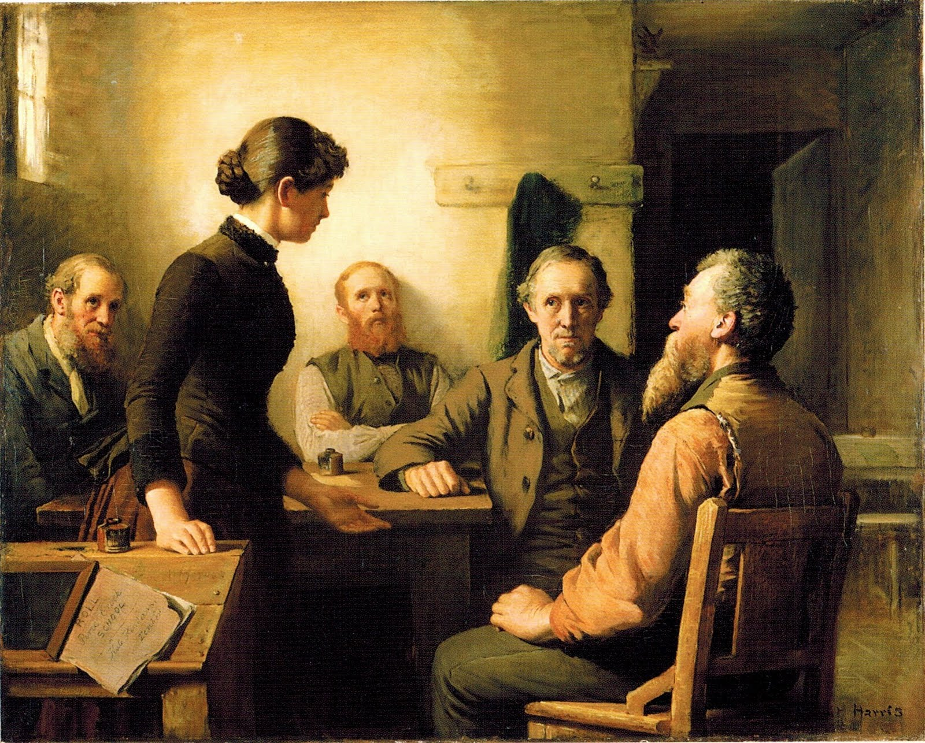
Ask you questions…
Robert Harris,
A Meeting of the School Trustees,
1885

Slide 6
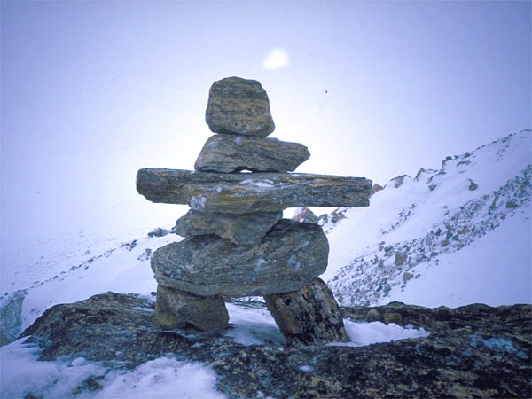
Canadian Artists from First Nations and Inuit
Inuksuk - is a symbol of the Canadian Arctic. It is a stone structure built to resemble a human. They were used as messages for other travellers, for marking good hunting and fishing spots, and for showing where supplies of food were stored.
The Inukshuk – YouTube
Inukshuk History
Arctic Inukshuk Landscape

Slide 7
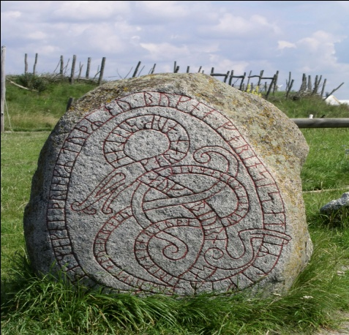
Petroglyphs
Ojibwa rock carvings, or petroglyphs are known to the Anishinabe people as “the rocks that teach,” were found in 1954 at the east end of Stony Lake, Ont. They were carved between 600 and 1200 years ago. The symbols and figures of turtles, snakes, birds, and humans tell of spiritual beliefs.
Petroglyphs stolen from sacred Calif. American Indian site - CBS News

Slide 8
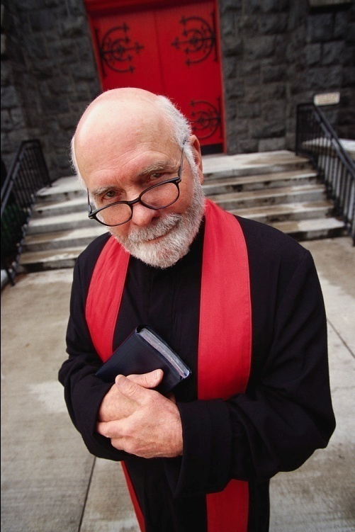
New France
Many of the earliest works of art in New France in the 1500’s and 1600’s were religious works, painted by priests who went out to the colony specifically to paint. They decorated churches and used their art to inform the people of Christianity.

Slide 9
British North America
In British North America, wealthy citizens often paid artists to paint portraits of their families or themselves.
Some of the military officers who came to British North America in the 1700s had been trained to do topographic drawings –drawings that showed landscape features such as hills or lakes

Slide 10
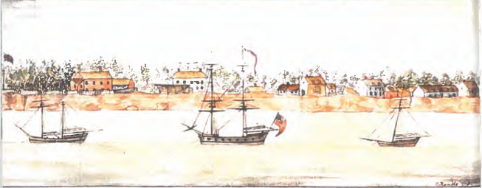
Charlottetown on the Island of St. John, c. 1778
Notes:
Why does the artist use a horizontal format?
What do you notice about the strip of land that runs across the picture?

Slide 11
The topographers also drew the things they saw in their everyday life. This kind of painting is often called documentary painting because it provides a record of the times.
Many scenes and events in Atlantic Canada were painted this way.

Slide 12
Canada’s Natural Beauty
Canada’s natural beauty has always been a subject for artists. Many paintings include images of rivers, lakes, and oceans as well as the people who used them for work and play.

Slide 13
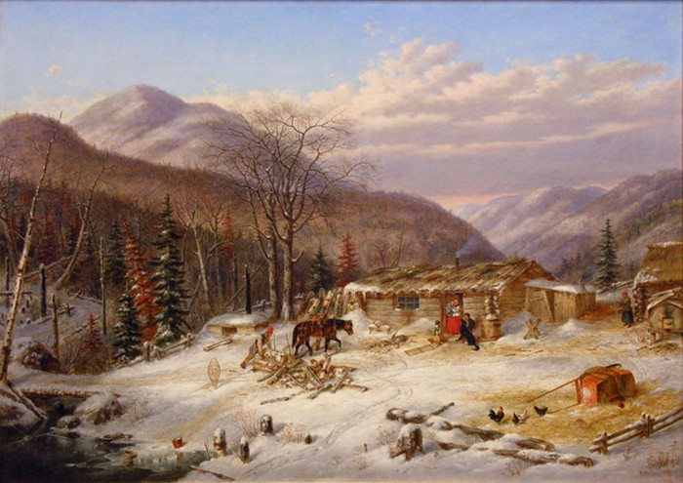
New People, New Paintings
As more and more immigrants arrived in the 1800s, new artists appeared, adding to the diversity in Canadian art. One famous painter Cornelius Krieghoff, painted landscapes and people in the European style which told a story through painting.

Slide 14
Canadian Artists
Many Canadian artists have captured the Canadian experience and identity and have gained international recognition.
Shirley Bear
Alex Colville
Tom Thomson
Emily Carr
Emily and Christopher Pratt
Group Of Seven:
Lawren Harris,
J.E.H. MacDonald,
Arthur Lismer,
Frederick Varley,
Frank Johnston,
Franklin Carmichael
A.Y. Jackson

Slide 15
Art Viewing
Text Book pg 5-9

Slide 16
Identity in Art Assignment/Project

Slide 17
Canadian Literature
Canadian literature covers all literary (books) genres (fictional/historical fiction) as writers tell stories, recount events, persuade, report, and describe.
One of the purposes of writing is to tell stories. Writing that tells a story is called narrative writing. Its main purpose is to involve the reader in an experience, either factual or fictional.

Slide 18
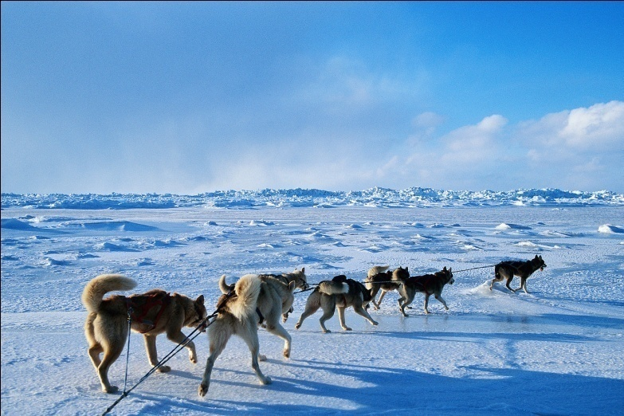
Modern Storytelling
Northwest Passage by Stan Rogers.
Stan Rogers was a musician and a modern balladeer.
An interesting story in Canada’s history Rogers wrote about was Sir John Franklin’s 1845 expedition to the Arctic to find the Northwest Passage. The expedition perished when its ships became frozen in the ice.
Notes:
Franklin's lost expedition was a British voyage of Arctic exploration led by Captain Sir John Franklin that departed England in 1845 aboard two ships, HMS Erebus and HMS Terror. A Royal Navy officer and experienced explorer, Franklin had served on three previous Arctic expeditions, the latter two as commanding officer. His fourth and last, undertaken when he was 59, was meant to traverse the last unnavigated section of the Northwest Passage. After a few early fatalities, the two ships became icebound in Victoria Strait near King William Island in the Canadian Arctic. The entire expedition, 129 men including Franklin, was lost.^{[2]}

Slide 19
Many Canadian authors have created stories that record our diverse past.
Famous Canadian authors include:
Farley Mowat
Margaret Atwood
Alice Munro
Susanna Moodie
Lucy Maude Montgomery
Pierre Berton

Slide 20



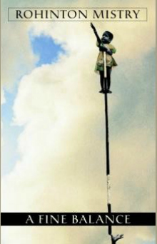
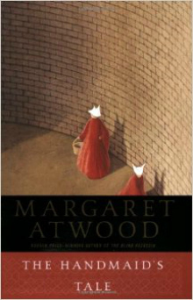
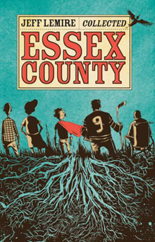

Top 100 Novels that Make You Proud to Be a Canadian

Slide 21
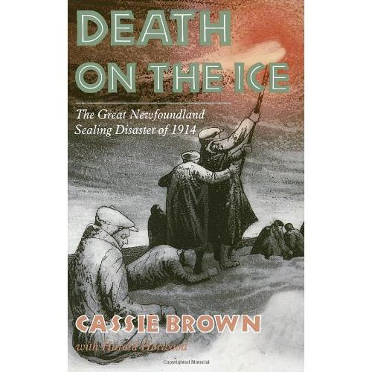
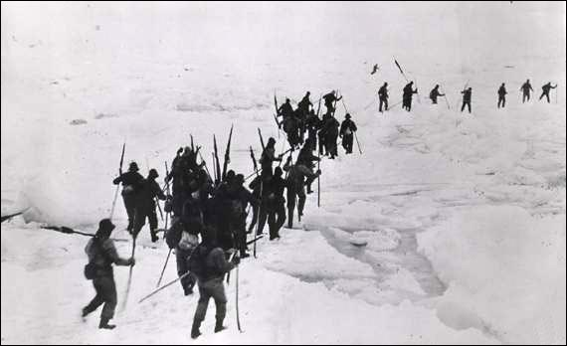
Death on the Ice

Slide 22
CanLit
Canadian literature covers all literary genres as writers tell stories, write poems and recount events that add to Canadian Identity.
If you had a story to tell about your Canadian experience, what would it be? Why?

Slide 23
The CRTC
As far back at the 1920s Canadian artists felt that they struggled to find success when they were competing with larger countries with many more artists, especially musicians.
In 1958 the federal govt. passed the Broadcasting Act which created the Board of Broadcasting Governors to ensure that the Canadian airways were “basically Canadian in content and character”.

Slide 24

The CRTC
The BBG quickly expanded to include television.
The BBG was replaced in 1968 with the CRTC and a an name change in 1979 to Canadian Radio-Telecommunication Commission.
This commission was designed to protect and promote Canadian culture and offer entertainment from a “Canadian point of view”.

Slide 25









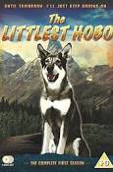
The CRTC
The CRTC made sure that radio and television stations devote a specific amount of time each day to Canadian content and performances.

Slide 26
Journal – Reflections: Min 500 words or 2 page handwritten
Some people question if Canada has an identity. What do you think? Explain
What has surprised or interested you in this first unit on Canadian Identity?
What is the biggest threat to Canadian Identity? Explain.
Do you feel that the CRTC should require radio and TV stations to give airtime to Canadian content? Explain your answer fully.

