Slide 1
Canadian Landforms

Slide 2
Regions
As we have discussed previously, Canada is a large country with a large variety of geographical characteristics.
Due to its geographic diversity many geographers divide Canada into regions to better understand its impact on climate and population.
What are some of the geographic characteristics of the Fredericton area?
Notes:
Regions are separated by common characteristics or combinations of characteristics.

Slide 3
Geographic Characteristics
Geographers classify landform regions based on a combination of characteristics:
Age of rock
Type of rock
Relief
Gradient
Process that has shaped the rock
Notes:
Relief is the difference in elevation (or height) between parts of the Earth's surface, usually in a given area.

Slide 4
It is difficult to limit the number of Canadian landform region. However, there is a general agreement about the eight major regions:
The Canadian Shield
Appalachian Mountain
Western Cordillera
Innuitian Mountains
Arctic Lowlands
Interior Planes
Great Lakes/St. Lawrence Lowlands
Hudson Bay Lowlands

Slide 5
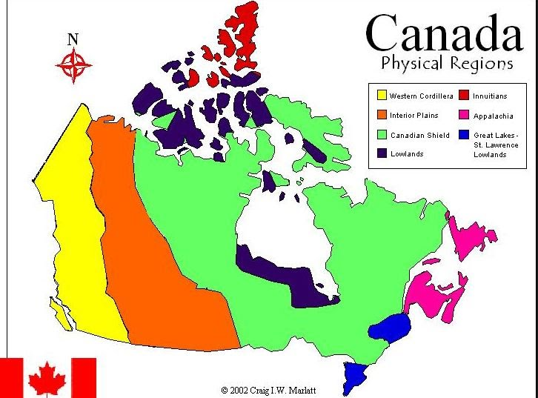
Use the bank map provided to show these regions. Be sure to use color or some other way to distinguish between each of the regions.
Notes:
While there are many different maps of landform regions this one will best suit our needs.

Slide 6
The Canadian Shield
The Shield is composed of ancient rocks, including some that are among the oldest rocks on Earth (possibly more than 4 billion years old). The construction of the Shield involved the collision and build-up of a large number of tectonic plates beginning more than 3 billion years ago.
Most of the shield has thin, acidic soils called podzols which are good for coniferous forest but not good for farming.
The Canadian shield is the largest geographic regions which covers much of Central Canada, including Saskatchewan, Manitoba, Ontario, Quebec, Labrador, Northwest Territories, and Nunavut.
Notes:
Podzols - an infertile acidic soil having an ashlike subsurface layer (from which minerals have been leached) and a lower dark stratum, occurring typically under temperate coniferous woodland.
The Shield covers a total area of 4.8 million square kilometres, and almost two thirds of Ontario.
Some of these rocks are even over 2 billion years old, making the rocks of the Canadian Shield the oldest rocks in North America. The rocks are igneous (including granites, diorites and basalts) and metamorphic (including schists and marbles).

Slide 7
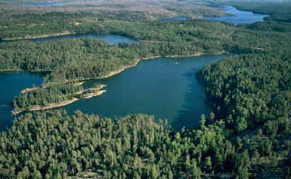
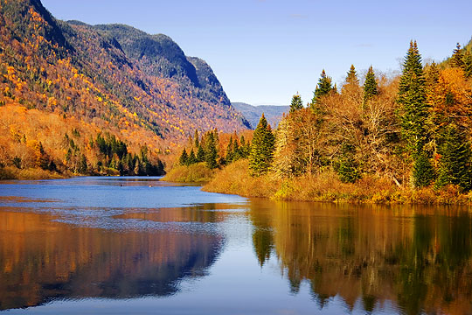
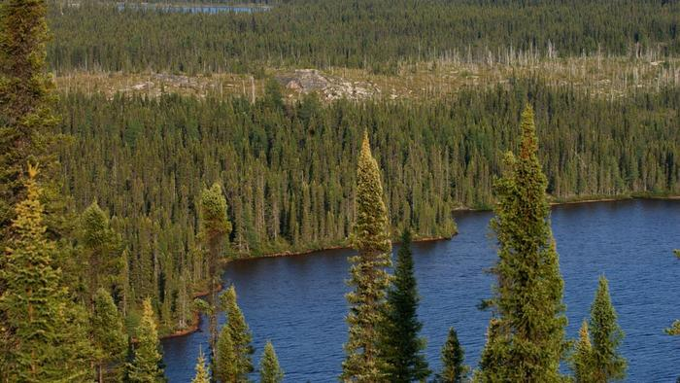
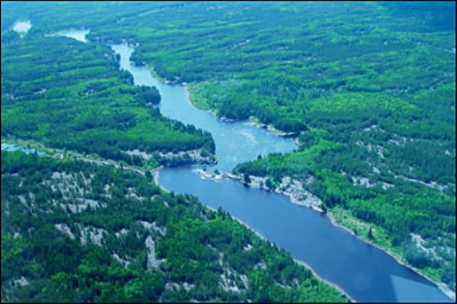
Notes:
The Shield has helped shape Canada's cultural history — the navigable waterways carved into the area during glaciations dictated settlement across its expanse by both Native and European settlers. The Hudson Bay, an extremely important body of water in Canada's early history, was created by depression in the Canadian Shield from continental ice sheets. The Shield is also a source for many important minerals including iron, nickel, copper, zinc, uranium, gold and silver, and has influenced the economy in Canada.

Slide 8
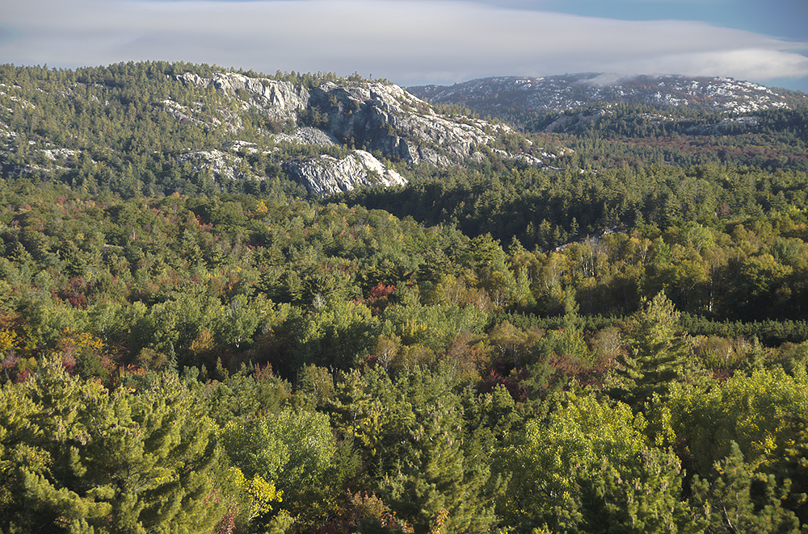

Slide 9
Appalachian Mountains
Located on the eastern coast of Canada lies the Appalachian mountain region. This region includes New Brunswick, Nova Scotia, Newfoundland, Quebec, and PEI.
Once higher than the Rockies, these uplands formed 500 million years ago. Over time, weathering eroded the peaks. Except for Prince Edward Island’s fertile fields, the interior is a land of rounded hills and narrow river valleys.
Notes:
When you look at this region it compares to the western region of Canada.
Geological evidence indicates that the island of Newfoundland contains remnants of the destruction by subduction(the sideways and downward movement of the edge of a plate of the earth's crust into the mantle beneath another plate) of an entire ocean. The Avalon Peninsula, in the east, represents a sliver of a continent that formerly lay somewhere between Britain and Africa. In Gros Morne National Park it is possible to see where a fragment of the Earth’s oceanic crust and mantle was pushed up over the ancient continental margin during the subduction process.

Slide 10
Appalachian Mountains
This landform region is heavily forested with both coniferous and deciduous trees, even though the soil these trees grow in is unproductive mountain soil.
Soil nearby rivers tend to be much richer than the majority of the other soil in the region, which makes the vegetation in these areas a lot healthier.
Notes:
The main economic activity that takes place in the Appalachian mountains is mining. Mining is important to this landform region because it produces money, many jobs, and resources. However, due to the coal mining that used to take place, a significant environmental impact took place, which was the large amounts of pollution. This pollution is damaging vegetation, bodies of water, and wildlife and this results in huge negative impacts on ecosystems.

Slide 11
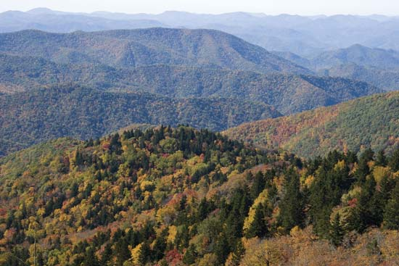
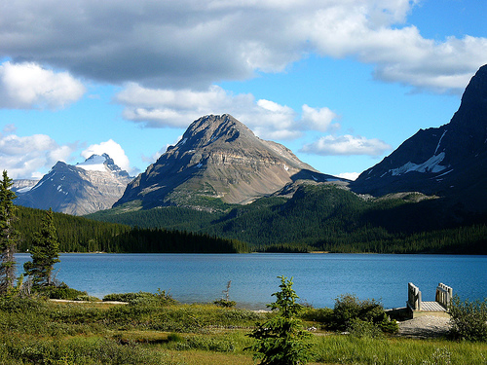
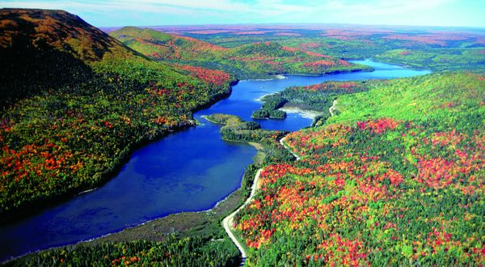
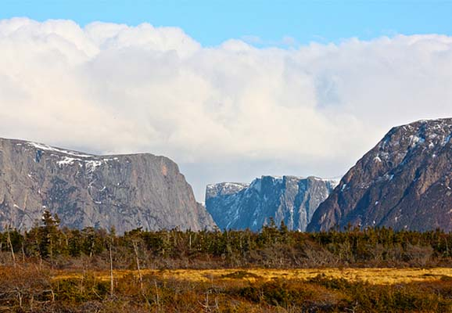

Slide 12
