Slide 1
Importance of Cell Division

Slide 2
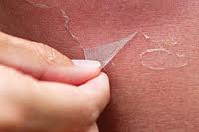
Think about the last time you had a sun burn and your skin peeled off.
What if new skin cells didn’t replace the dead skin that flaked off?
What if every cut, scrape, blemish or scratch you’ve ever had didn’t heal?

Slide 3
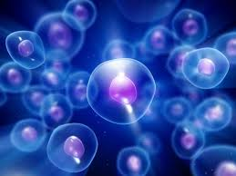
Skin cells, and other cells in your body, come from preexisting cells that are constantly being replaced by cell division.
Our bodies shed millions and millions of cells every minute and we produce billions of new cells everyday. If we didn’t replace the dead cells our bodies would gradually shrink and eventually die.

Slide 4
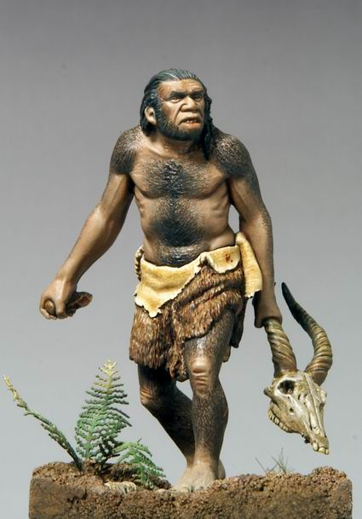
Many Cells
Remember that we are made up of trillions of cells!
How big is a trillion? Well, if you were to count from one to a trillion….it would take you…31,546 years.

Slide 5
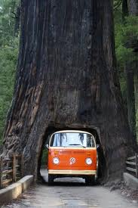
Both Animals and Plants
Both plants and animals have to produce and replace cells in order to survive and grow.
The cells in your body are different from the cells that we you when you were born. Trees experience this same cycle.
The oldest living cells in a 300-year-old redwood tree are only about 30 years old. The inner part of the tree is actually made of dead cells.

Slide 6
Growth
The most obvious function of cell division is to increase the number of cells and, in turn, increase the size of the organism.
Living organisms depend on cell division, in fact, we begin our lives as a fertilized egg that undergoes cell division to become who we are today.
All multicellular organisms rely on cell division to grow.

Slide 7
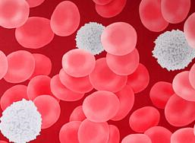
Did You Know?
In the human body, red blood cells live about 120 days, white blood cells can last between 1 day to 10 years; and platelets, the cells that help in helping blood to clot, only lasts 6 days.

Slide 8
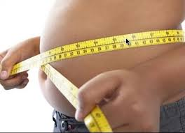
Why Divide?
Cells have to divide instead of just getting larger because the cell membranes cannot keep up with the growth of the organelles of the cell.
Also, if cells got larger than the organelles would be further away from the nucleus, this would slow down the communication between the cell parts and reduce the healthiness of the cells.

Slide 9
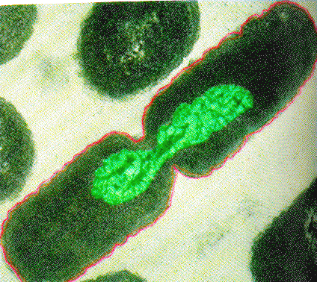
Reproduction of Organisms
Cell division is essential to continuing life on the planet and the continuation of the species.
This is especially true for unicellular organisms, like bacteria. For bacteria, cell division creates two new organisms from a single organism.

Slide 10
Unanswered Questions
Although we know a lot about biology there is still many questions to which we do not know the answers;
How do cells know when to divide?
Why does an egg divide so rapidly after fertilization?
Why do brain cells rarely divide in adult while red blood cells divide at an incredible rate?

Slide 11
Questions to Consider
Provide evidence(2 examples) that suggests that not all cells in your body divide at the same rate.
In the past, doctors used to transfuse blood from young people into the elderly. This was thought to provide the elderly with more energy. Do you think this would work? Support your answer.
Why would scientists was to get mature nerve cells to divide?

