Slide 1
Charging and Discharging Objects
9.3, 9.4, 9.8, 9.7

Slide 2
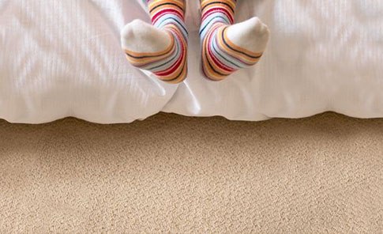
What rooms in your house and school seem to produce the worst shocks from static electricity?
What can you do to minimize or eliminate the problem?
This effect occurs only when electric charges shift from their normal neutral position and is transferred from one object to another.
There are three ways in which objects become electrically charged: by friction, by contact, and by induction.

Slide 3
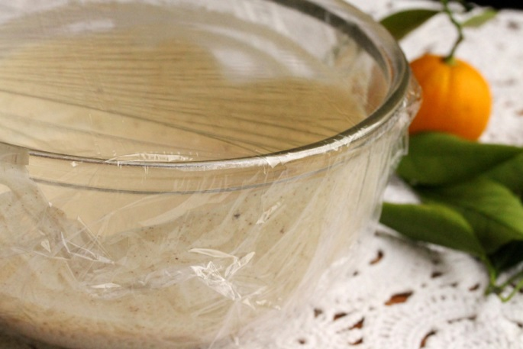
Charging By Friction
When plastic wrap is stretched and shaped to the sides of a bowl, static charges are produced that cause it to stick to the bowl. This happens because electric charges can be transferred by a rubbing action or friction.
Charging by friction causes many of the effects produced by static electricity. In your dryer at home the clothing is tumbling and rubbing up against each other. When you walk across a carpeted floor your socks are rubbing the carpet making both the carpet and your socks charged.

Slide 4
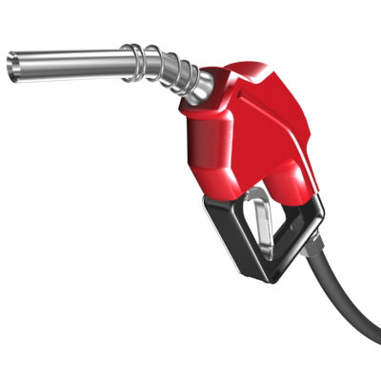
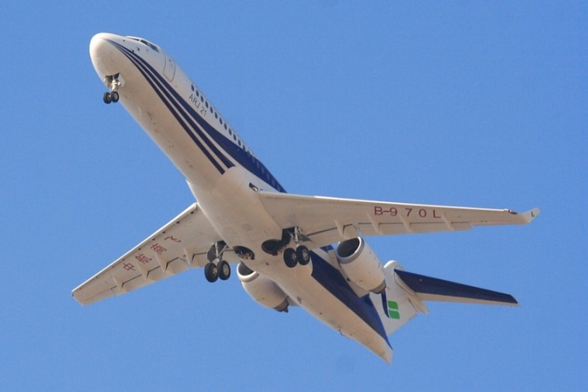
Friction
Sometimes creating an electrical charge can happen in a less obvious way.
For example pumping gasoline through a hose at a gas station and when dry air rushes over the body of a car or an airplane, both can produce an electrical charge that can shock you if you were to touch the vehicle.

Slide 5
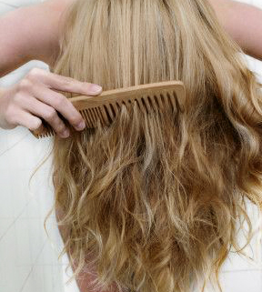
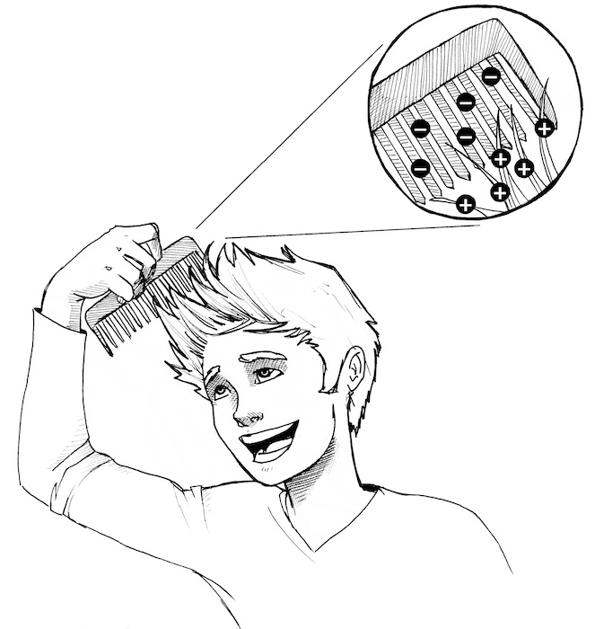
Combing your hair means rubbing the comb through your hair which causes the comb to become negatively charged and the hair becomes positively charged.
This occurs because the positively charged nuclei of the molecules in the comb attract electrons, including electrons in your hair molecules, much more strongly than the nuclei of the hair molecules.

Slide 6
Just touching the hair with the comb allows the electrons to transfer but the rubbing allows more molecules to come in contact an in turn more electrons are transferred.

Slide 7
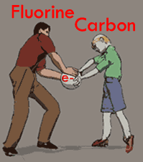
Charging by friction occurs because the positively charged nuclei of one of the objects attracts the electrons(-) from the other object.
Remember, some types of matter have a stronger hold on their electrons than other types of matter.
The Electrostatic Series is useful for determining the type of electric charge produced on each substance when any two substances are rubbed together.

Slide 8
Electrostatic Series

Slide 9
Class Task
1. Draw a series of diagrams and explain, in terms of the electrical model for matter how objects become charged by friction.
2. What two factors affect the amount of static charge produced when you rub two different substances together? Explain why.
3. Predict what will happen when acetate is rubbed with fur. What about when rubber is rubbed with cotton. Explain your answers.
Sometimes at night if you move your feet around quickly against the sheets you can observe an interesting phenomenon. Explain what is happening.

Slide 10
Charging By Conduction (Contact)
The touching of any kind of matter (solid, liquid, or gas) can transfer a charge. There doesn’t need to be rubbing or friction for a transfer to occur.
In charging by contact, one object is already charged and the other may or may not be.
Did you know?
The rubbing produced by sliding across your car seat may charge you to an electric potential of 15000V. That energy is transferred to the ground when you step out of the car and the small shock you may receive is too small to be dangerous

Slide 11
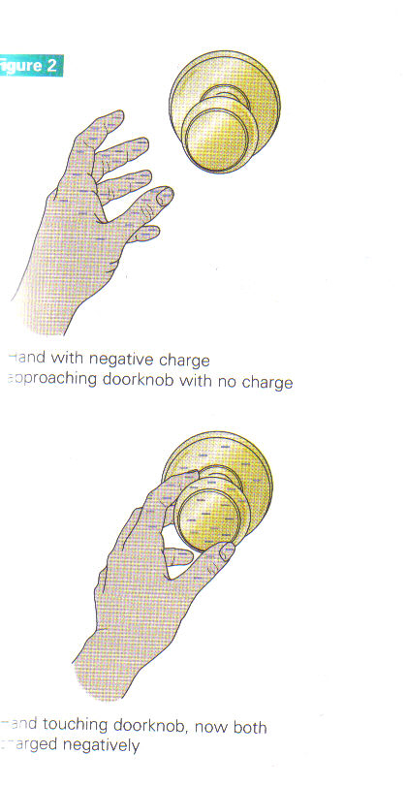
For example, after you walk on a carpet your body may be negatively charged. The door knob is usually uncharged.
Your body transfers the electric charge with the doorknob on “contact”.
Actually, your hand does not even get to touch the doorknob before the charge begins to transfer in the form of a spark.

Slide 12
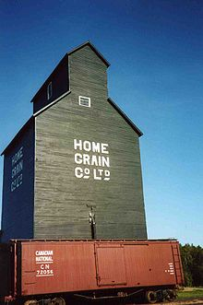
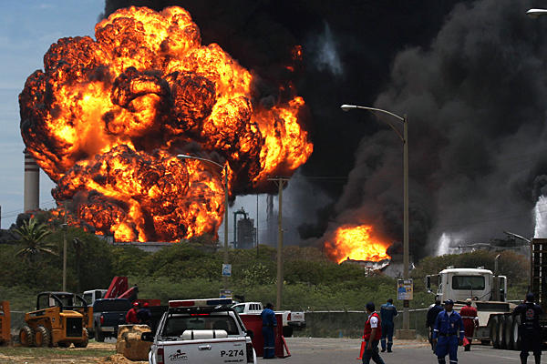
Transferring Electrons on Contact
A single spark produced by a transferred charge can be quite dangerous. Using safety precautions, such as shoes and gloves, are required in many occupations.
Oil refineries, grain elevators, coal mines and hospital operating rooms are all example of places where people have to wear special gear to prevent the transfer of electrons from charged objects.

Slide 13
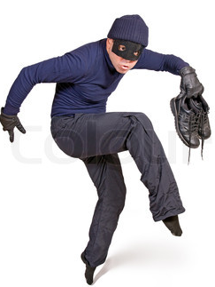
Transferring a charge by friction is difficult to avoid. Even if you are neutrally charged and carefully walk through a carpeted room, many electrical charges are transferred by the contact of your socks and the carpet fibers.

Slide 14
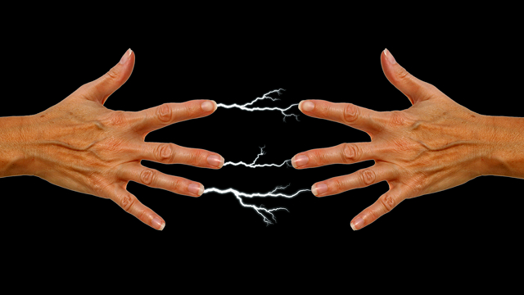
The shock you receive when touching the doorknob is actually electrons that jump across the air gap between your hand and the door knob, like a miniature lighting strike!

Slide 15
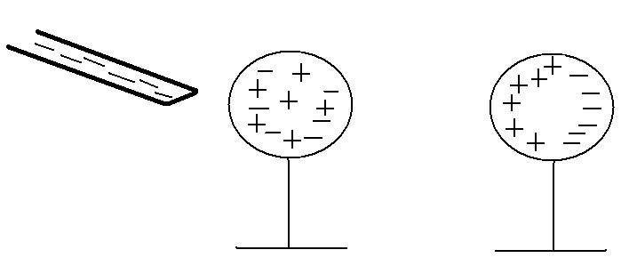
Charging By Induction
A neutral object becomes charged without direct contact with a charged object

Slide 16
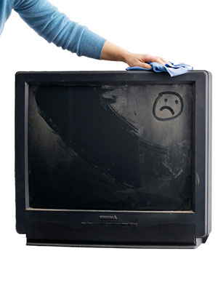
In the case of the uncharged dust particle and the television screen, the charged tv screen causes (or induces) the electrons to shift in the dust particle
This shifting means that the side of
the dust particle facing the screen is
now positive and attracted to the
electrons on the tv screen.

Slide 17
Discharging Electrically Charged Objects
An object is said to be discharged or neutralized if it has all of the excess electric charges removed.
All matter wants to reach a neutral state (and be neither positive nor negative) by losing its excess charge.

Slide 18
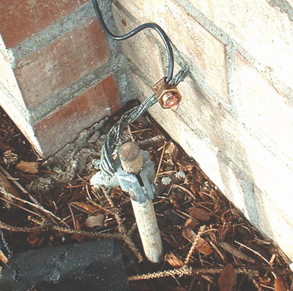
Methods for Discharging Charged Objects - GROUNDING
By connecting an object to a conductor wire, we are sending the extra charges into the ground.
This charge is then shared with the entire planet.

Slide 19
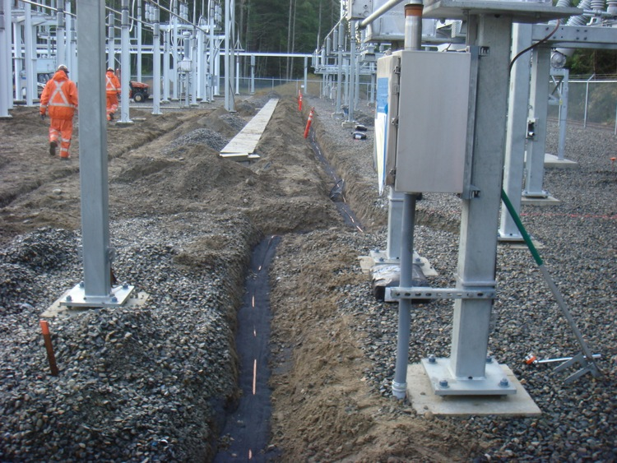
Grounding and Discharging
Example: Gas flowing through a hose at the gas station could build up charge as it flows. The hose and pump are carefully connected to the ground using a wire which is connected to a metal rod buried underground. This conducts any charges that build up safely away from the gasoline.

Slide 20
Gas Pump Fire

Slide 21
DISCHARGE AT A POINT
In some cases a grounding wire is not practical (ie airplanes)
The surface of the airplane is smooth and rounded and any charges that build up will remain indefinitely
Airplanes will use pointed rods called “static wicks” on their wings and tails for discharging any accumulated charges
Static wicks are pointed at the tip so that as electrons build up on the wick they will be repelled into the air.

Slide 22
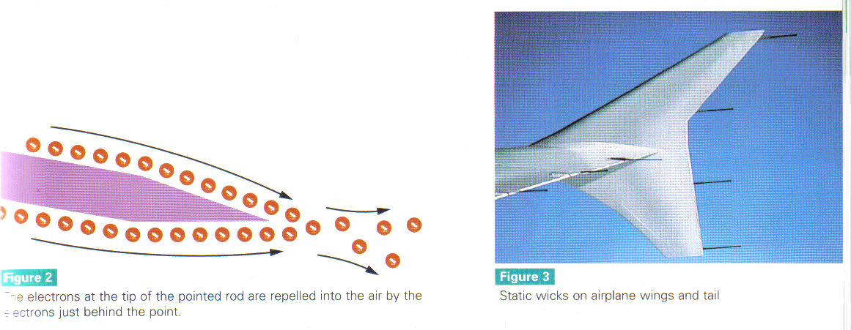
How a Static Wick Works

Slide 23
Other Ways to Discharge Objects
Exposure to humid air
- Charge is absorbed by water molecules.
Exposure to light
- Photon bombardment dislodges electrons.
Exposure to radioactivity
- Electrons neutralized or repelled by charged particles.

