Slide 1
Aboriginal Peoples of Canada: Early Times Iroquoian Peoples, Algonquian Peoples and Peoples of the Forest and Sub-Arctic

Slide 2
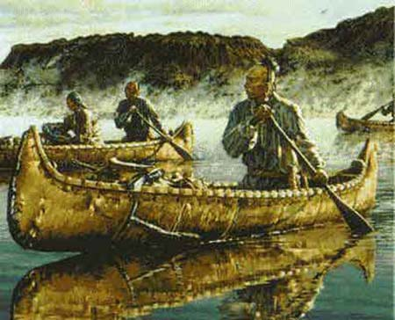
Haudenosaunee (Iroquois)
The Iroquois were members of the League of the Five Nations or Haudenosaunee (People of the Longhouse).
These early aboriginals lived along the St. Lawrence River and throughout Eastern Ontario.
The Iroquois people consisted of the Huron, the Neutral and the Petun or tobacco.
The Cherokee, also Iroquois, are the people from whom the Canadian Iroquoians likely separated from around 4000 years ago.
Notes:
The names Huron came from Wendat, the French called these natives Huron. The Neutral, also a given name, was earned because they didn’t choose sides during warfare and the Petun or tobacco got their names from…growing tobacco.

Slide 3
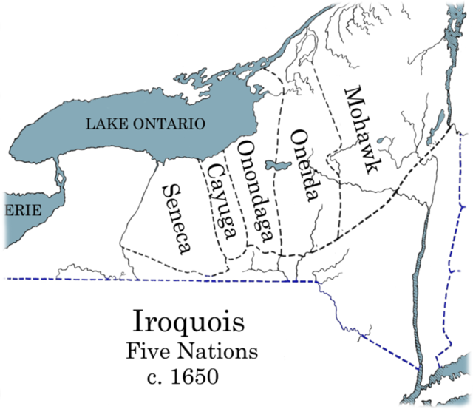

Slide 4
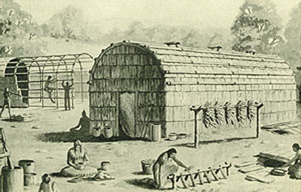
Daily Lives and Activities
These Iroquoians were hunters and farmers. The didn’t domestic animals only grew crops.
They practiced sash and burn agriculture to free up land to plant crops that consisted of the “Three Sisters”: corn, beans and squash.
Houses were clustered in villages of 1500 or more inhabitants and dated back to before 800 CE.

Slide 5
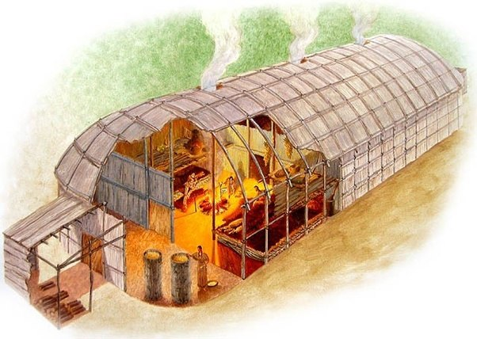
Longhouse
The largest longhouse built by the Haudenosaunee was 500 feet long - most were about 100 feet long. They had barrel-vaulted roofs, and were constructed with timber and bark sheathing. Sleeping platforms line the sides.

Slide 6
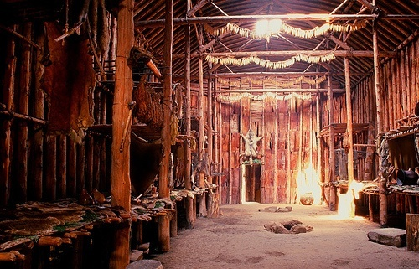
Here's an interior of a reconstructed longhouse

Slide 7
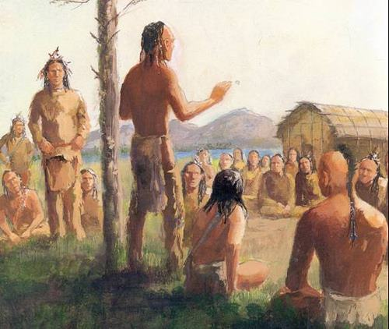
The Great Peace – pre-European contact
In an effort to end the incessant warfare between the various nations of the Iroquois, the “prophet” Dekanawidah brought the Iroquois tribes together and as a symbol of their unity the long house was chosen.
The five nations were the Mohawks, Oneidas, Onondagas, Cayugas, Senecas and in the eighteenth century the Tuscaroras joined.
Notes:
Oral history dates the forming of the league in 1451 as it corresponds to a solar eclipse that same year.
This confederacy is still in place today and is recognized across North America.

Slide 8
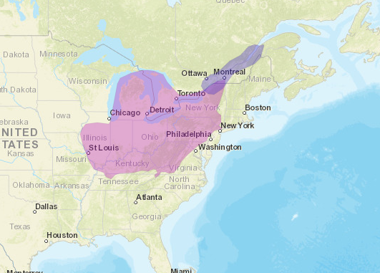
Modern Day Confederacy

Slide 9
Video Links
Heritage Minute
We are the Haudenonsaunee

Slide 10
Brief Historical Summary
Archeological evidence places Haudenosaunee in the area around present-day New York state by approximately 500 to 600 CE, and possibly as far back as 4000 BCE.
Their distinctive culture seems to have developed by about 1000 CE.
Estimates vary widely as to the founding date of the Haudenosaunee Confederacy, with many claiming a date in the mid-16th century. However, in 1997, researchers Barbara A. Mann and Jerry L. Fields proposed a founding date of 31 August 1142. They arrived at this by consulting the full oral tradition, archaeology, historical record, and even astronomical and mathematical calculations.

Slide 11
Influence and Importance
The Iroquois were one of the most powerful and influential Indian nations in America and played an instrumental role in the development of New France, the English colonies and the final resolution of the French-English struggle.
When Cartier arrived in the early 1500's, the Iroquois occupied the St Lawrence river valley and were the natives that he met. When Champlain returned in 1608 the Algonquin had replace the Iroquois along the St Lawrence river.

Slide 12
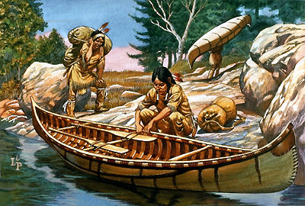
The Algonquian

Slide 13
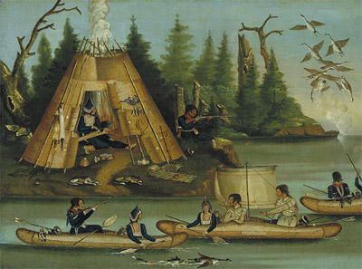
The Algonquin
The Algonquin are Aboriginal peoples in Canada, whose home communities are located in western Québec and adjacent Ontario, but range over a much larger area.
While the Algonquin people include many different groups we will focus on the Mi’kmaq.

Slide 14
The Mi’kmaq
These are the most easterly aboriginal people of Canada and are often referred to the People of the Dawn, the Maliseet, Passamaquoddy, Penobscot, and the Abenaki.
These peoples share a common Algonkian language origin and a similar lifestyle that involved a seasonal coastal-inland migration pattern.
Traditionally they believed that everything had a spark of life that should be respected. This spark of life can be compared to the idea of a soul.

Slide 15
Mi’kmaq Creation Story
Pg 37

Slide 16
Politics
Mi’kmaq territory was divided into seven districts, each governed by a chief or sagamore. A Grand Chief presided over a Great Council, which is usually held in Cape Breton.
The district chief not only conferred in council but also appropriated hunting territories to families often based on the size of each family.
The chiefs were often picked based on their generous nature; many chiefs gave away personal possessions as a way to cultivate affection and respect.

Slide 17
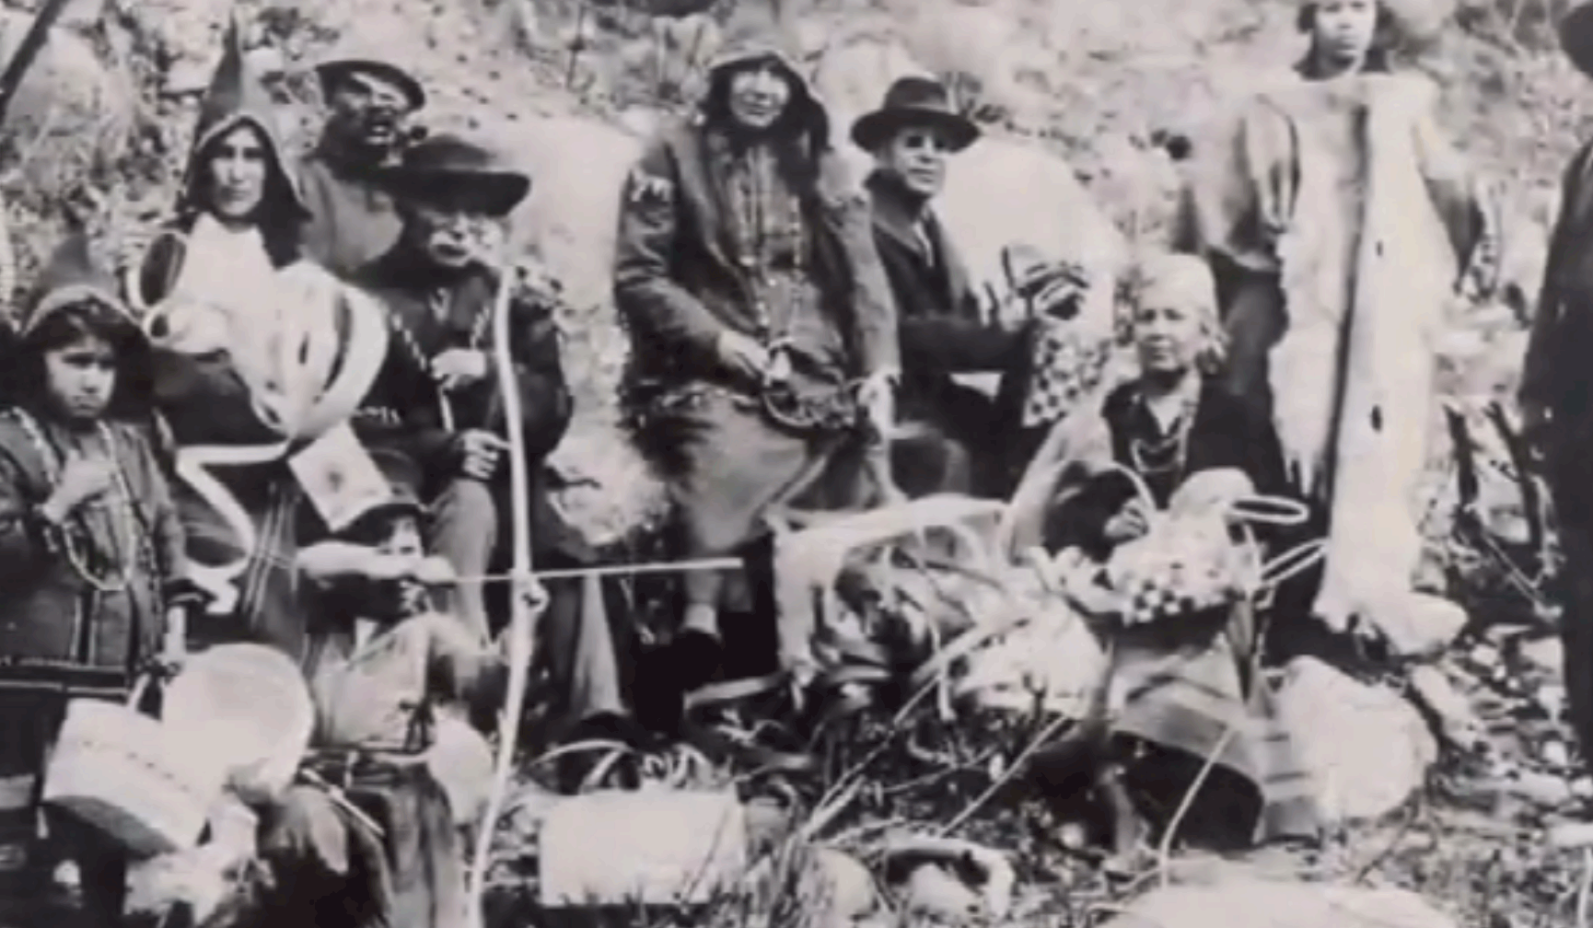
Notes:
On June 24, 1610, Grand Chief Henri Membertou, a chief of the Mi’kmaq people from 1550 to 1611, along with 20 members of his family, was baptized by French Jesuit missionaries. Beyond embracing the Christian faith and forging an alliance with the French, Grand Chief Membertou helped set Canadian history along a path marked by welcome and acceptance.

Slide 18
Mi’kmaq Society
Historically everyday work was divided by gender; men spent time hunting, fishing, preparing for war raids, and making and repairing equipment.
Early Mi’kmaq peoples constructed fish traps, bows and arrows, spears and clubs and even pipes. When winter came many men made snowshoe frames and worked on birchbark canoes.
Women maintained camps and were responsible for cleaning and preparing fresh kills to eat or to preserve it by drying or smoking it.

Slide 19
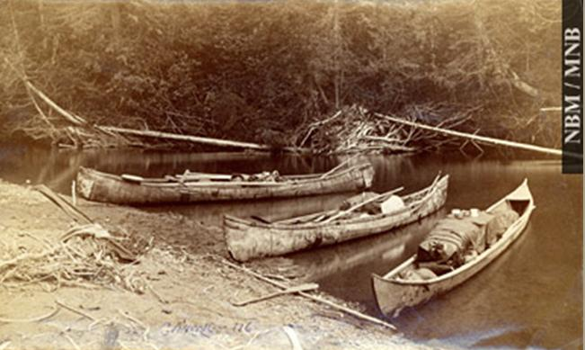
Birch Bark Canoes - Maliseet

Slide 20
Spoils of War
In addition to the men and women of these early Mi’maq tribes they also had slaves. Most male slaves were killed on the field of battle but some were brought back to be tortured or to complete menial chores. The women and children who were captured often joined families and were treated well.
If a slave attempted to flee they would be put to death.

Slide 21
Society
Family groups were often large as couples who “married” brought families together to live in a common community. This helped with hunting parties as well as caring for family members.
Mi’kmaq people were different than other Woodland people as they spent the majority of their time living off the sea, perhaps living in the Maritimes made it easier to reach a major body of water compare to other Algonkian people.

Slide 22
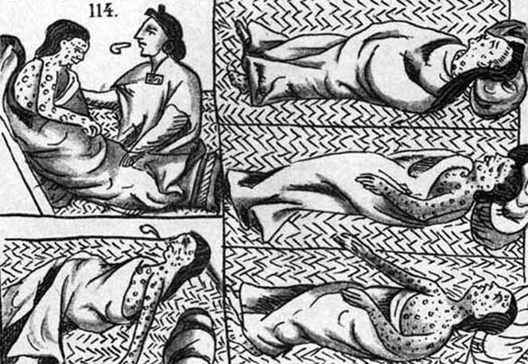
Fate
Prior to European contact the number of Mi’kmaq was estimated at around 35,000 but, tragically, the introduction of European diseases and warfare as well as the introduction to alcohol and other unhealthy foreign foods lead to a reduction to about 3000 people within a few generation of European contact.

Slide 23
Peoples of the Forest and Sub-Artic
Although known to history by a wide variety of names, the Northeastern Woodland peoples can be grouped into two language groups: the Cree and the Ojibwa (Anishinabe).
The Ojibwa dialect can be found mostly in central and southern Ontario while the Cree language can be found across northern Canada.

Slide 24
Survival
These peoples were hunters and gatherers and evidence shows that these people hunted: deer, moose, rabbit, beaver, otter, fox, wolf, racoon, and various types of birds and fish.
These Woodland aboriginals used bows and arrows to hunt and also made traps to catch prey.
In addition to live animals they also harvested fruit, nuts, roots and wild rice. Some of the more southern tribes cultivated squash, beans, and corn.

Slide 25
Today
The Cree and the Ojibwa(language groups) have the largest Aboriginal population in Canada with over 200,000 people. The Mi’kmaq and the Innu are also amongst the largest nations in Canada.

Slide 26
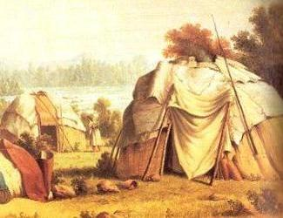
Shelter
The Woodland people also traded with neighbouring villages as they travelled from hunting range to hunting range.
They were a highly mobile people and therefore permanent structures were rare. They used tee-pee style huts that trapped warm air inside.
Wigwam

Slide 27
Discussions Questions
1. It is important to remember that these early societies were not always “static” and they should not be seen as stereotypes, What is meant by this statement.
2. How did the arrival of Europeans impact the native population in regards to their identity and traditional beliefs?

