Slide 1
Canadian Identity in Paintings
Artwork Assignment

Slide 2
Canadian Identity in Painting
Process
Take a close look at each of these paintings
Choose your three favourite paintings
Complete the exercise worksheet
Column 1:
Identify the painting, artist and year
Column 2:
Identify an aspect of Canadian Identity and explain WHY this is Canadian Identity
Provide one personal commentary (Do you like the painting? Why?)

Slide 3
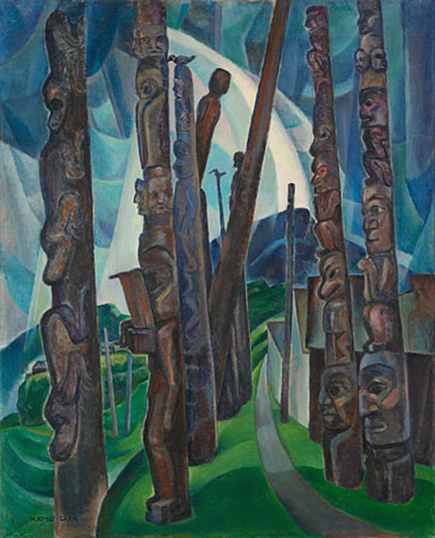
Emily Carr
Kitwancool
1928

Slide 4
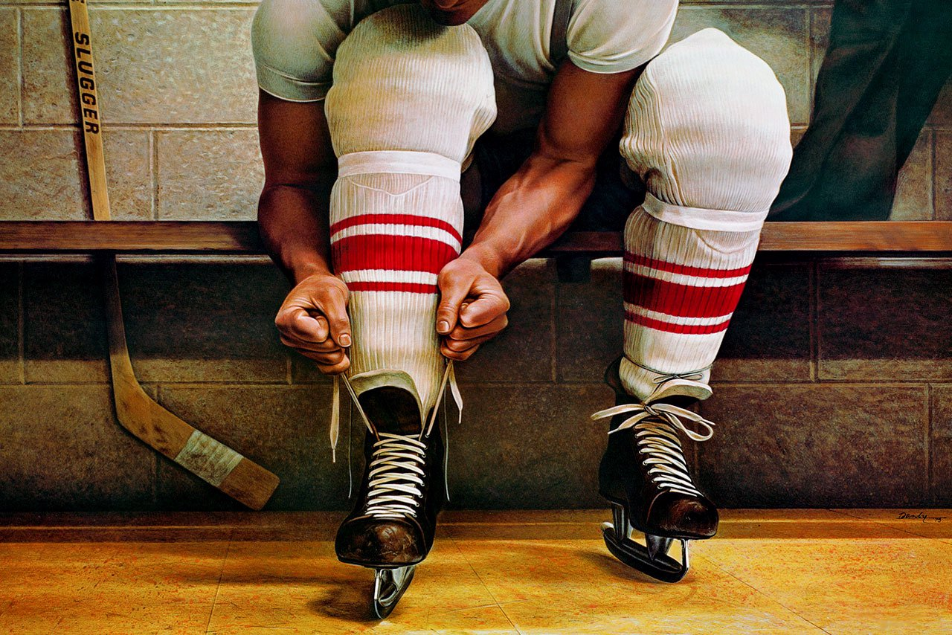
Ken Danby
Lacing Up
1973

Slide 5
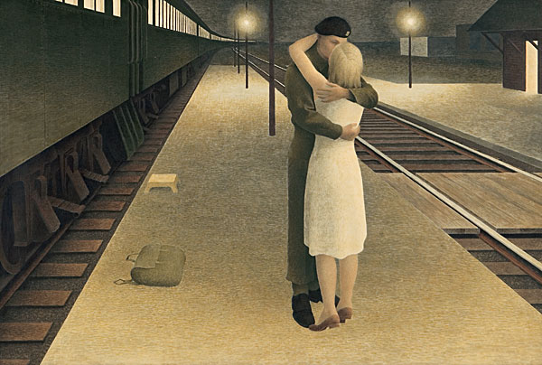
Alex Colville
Soldier and Girl at Station
1953

Slide 6
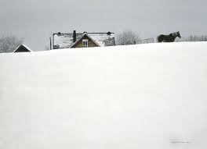
Robert Bateman
Winter Coat
1991

Slide 7
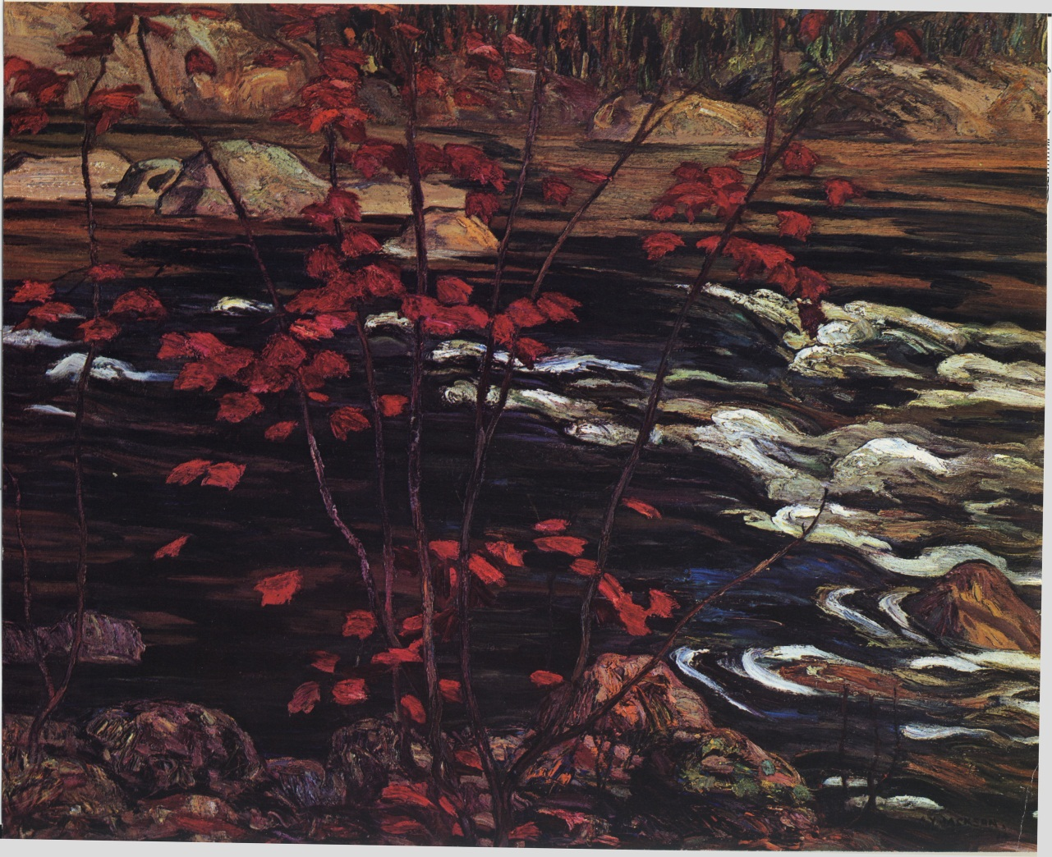
A.Y. Jackson
Red Maple
1914

Slide 8
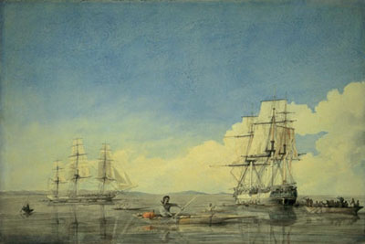
Robert Hood,
Hudson’s Bay Company, 1819

Slide 9
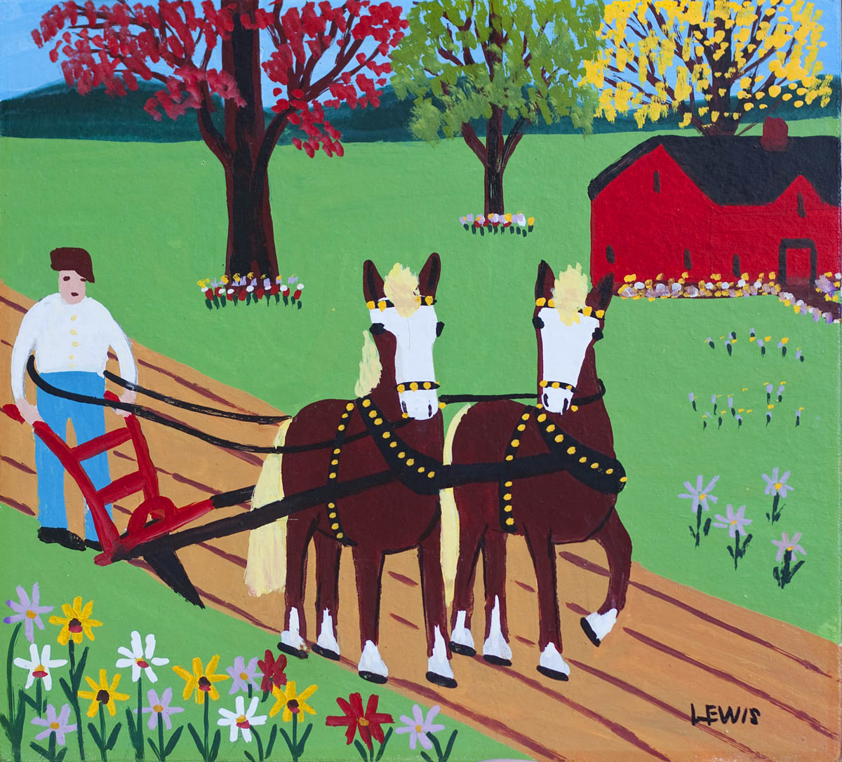
Maud Lewis
Spring Plowing
1958

