Slide 1
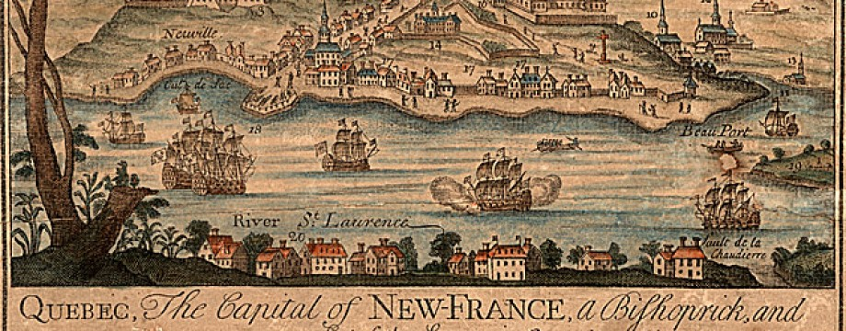
Life in New France

Slide 2
Feudalism: Canadien style
To a certain extent, New France had become a “little Paris.” It was pocket of French culture transplanted in the rich fertile soils of the St. Lawrence River valley.
Some anachronistic elements of Old France were preserved and kept alive in Canada long after their demise elsewhere.
Notes:
One such example is the distinct form of feudalism that took root in New France in the 1620s and would last for 200 year until 1854, long after the Fr. Revloution had wiped out these hereditary rights back in old France.

Slide 3
The Seigneurial System
This system of land ownership was devised by Cardinal Richelieu and strengthened by Jean Talon.
In it the crown granted land titles to certain individuals and institutions, usually soldiers, noblemen, or religious organizations, but – especially in Canada – they could also be wealthy or well-connected commoners.

Slide 4
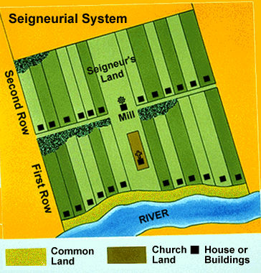
The seigneur, or “lord” owned land under the condition that he develop it. This usually involved building a manor, a mill, or even a fortress.
Notes:
Access to water was essential for this system to work as most plots of land had to have farms that were used to feed the owners and people who worked there.

Slide 5
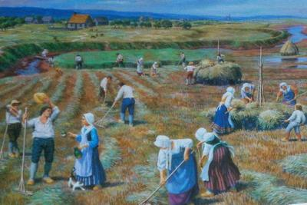
The Habs and the Hab nots
To achieve this condition many seigneurs bought in labourers who lived on his land and worked it. These tenants, known as habitants in Canada, did not fully own the land but could pass it down to their children.
The habitants paid a lease and had certain obligations to the lords of the estates, such as giving him a portion of their harvest.
Notes:
Official term for habitants is censitaire.
The relationship between the habitants and the lords never escalated as it had in Europe simply because the lords were forced to live on the land(many did not), usually working along side the habitants.

Slide 6
Question to Ponder
Was this seigneurial system bad for New France? Did it hold the colony back? Or did it encourage growth?
Notes:
In Angelo-American colonies, where individual initiative was rewarded, expansion occurred at a staggering rate. Bringing a class-conscious system into the new world seemed an odd thing to do as the New World was supposed to be an opportunity for prosperity, a new start and a change from the old ways.

Slide 7
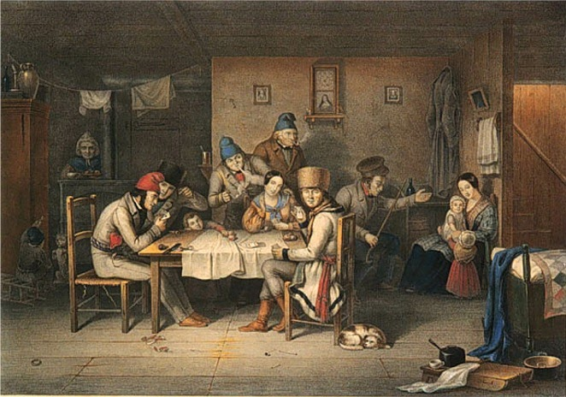
Independence
Despite this simple feudal system a new identity had started to form by the 1700s. The Canadiens emerged and citizens no longer saw themselves as Europeans or French.
These new Canadiens were not peasants but more independent and experienced far more freedoms then their European counterparts.
These Canadiens ate better, had healthier lifestyles and had larger families.
Notes:
Many officials from France often complained that the habitants of Canada were “too proud”.

Slide 8
Slavery in New France
Slaves were bought and sold in Canada for over 200 years, both under French and British rule.
The clergy were among the largest slaveholders but Catholic convents and hospitals run by nuns owned both black and native slaves.
Code Noire – the proper treatment of slaves "If a Black tries to escape, we cut off his ears and we brand a fleur-de-lis on his shoulder with a hot iron. If he tries to escape a second time, we cut the hamstrings on the back of his legs. If he is so bold as to try it again, it's death"
Notes:
Merchants and the upper class also participated in the slave trade.
If you doubted that Canadians were better then their American counterparts when it came to slavery just consider the passage from the Code Noire of New France.

Slide 9
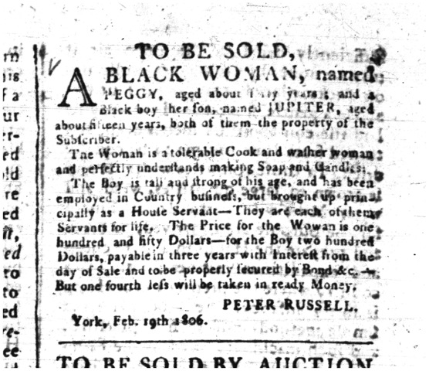
Slavery advertisement from Upper Canada Gazette, 10 February 1806.

Slide 10
Announcement of sale of slaves appeared in the Quebec Gazette May 12, 1785.

Slide 11
Aboriginal Peoples and the Conquest
After the defeat of the French by the British at the Plains of Abraham and in Montreal it was felt as a “bitter blow” to French Canadiens but to the Aboriginal population it was devastating.
The Aboriginal population lost the bargaining position between the French and the English; they lost the distribution gifts that were heavily relied on and the new settlers encroached farther into their lands.
Notes:
The aboriginals of Canada often would play one colonial power against the other in an attempt to get the best deal for trading alliances. With the French gone they no longer had a bargaining tool and they lost their strategic position.
British Commander-in-Chief Jeffery Amherst thought that the “distribution gifts” were no better than bribery. There gifts were originally agreed upon for allowing the French and English settlers to live on Aboriginal lands. The movements of these gifts(namely guns and ammo) ceased and the aboriginal population had relied on theses gifts or generations, they were in dire straights.

Slide 12
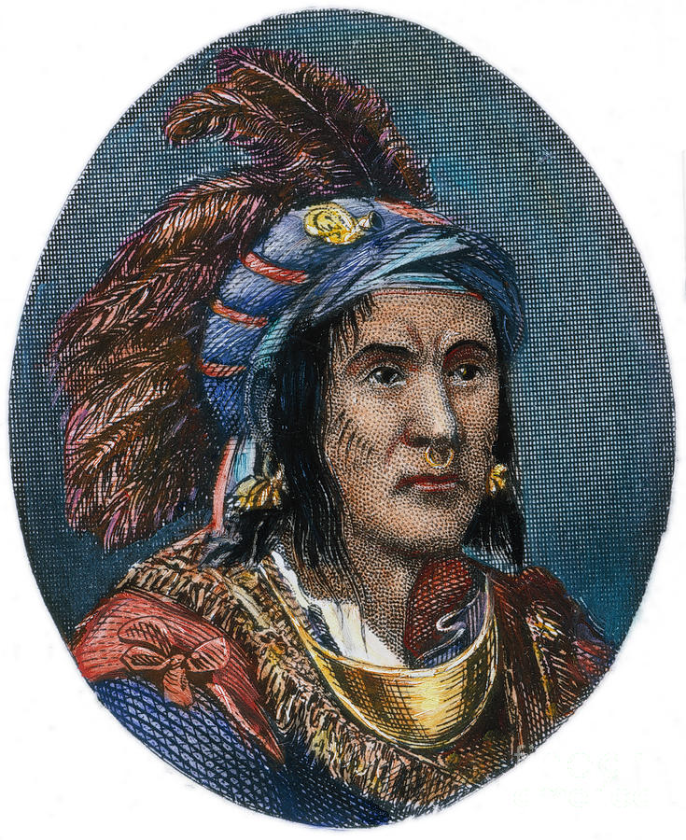
Pontiac, the War Chief
Pontiac, an Ottawa (Odawa)war chief, had fought as an ally with the French in Montreal. He saw the suffering of his people after the British victory and attempted to unite the 7 Tribes in an attempt to fight the English and drive them out of their land.
Notes:
Pontiac had attempted to broker a deal with the British after the conquest but was not successful. He meet with The Grand Council of the Huron, Odawa, and the Potawatomi people and expressed his concern about how the British laughed at the death of their people .

Slide 13
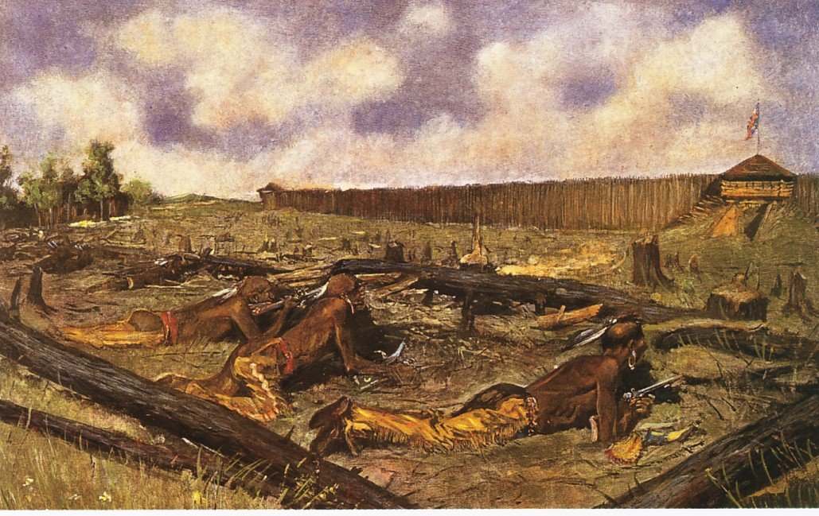
Chief Pontiac
In 1763, under the encouragement from remaining French settlers, the Aboriginals began attacking British outposts and forts. Pontiac and the Seven Nations Confederacy failed to take Fort Detroit but managed to capture 9 British forts and took control of the regions north and west of the thirteen colonies.
Notes:
Homes and farms were destroyed and many settlers were killed. Over 2000 settlers were massacred and 400 soldiers were killed.

Slide 14
British Response
Amherst was outraged and looked at any opportunity to exterminate the Aboriginals, even looking at biological warfare.
Amherst instructed that blankets infected with smallpox be cut up and placed in small tin boxes only to be open when delegates returned to their outposts and among their own people.
Notes:
Pontiac warned his people about the threat of letting a white man into their midst. He knew of smallpox, and other maladies that would decimate the aboriginal populations.

Slide 15
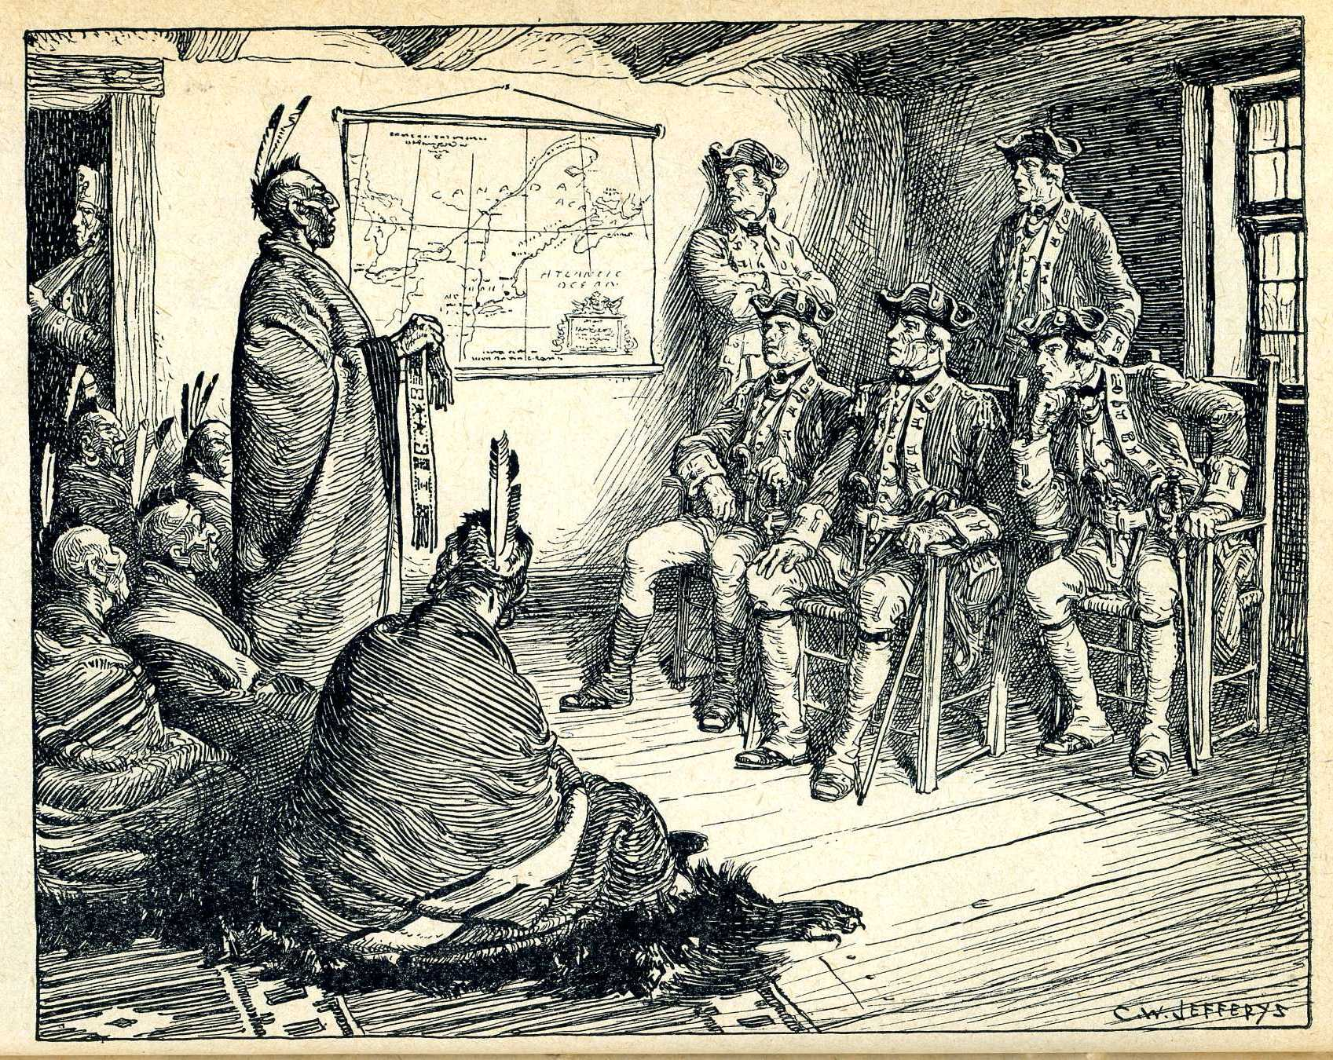
Death of Pontiac
Pontiac signed a peace treaty with the English in 1765 in which he stated again that the French surrender did not mean that Aboriginal lands had been surrendered.
By 1766 Pontiac’s influence dwindled and he was later assassinated by a rival tribesman after he was bribed by an English trader.

Slide 16
The Royal Proclamation
Primary Document analysis
Read page 180 – 182 of the text book and answer question 2 on page 182. Also, I encourage you to look further into the Royal Proclamation to learn what impact it had on Canada.

