Slide 1
Physical and Chemical Changes
1.7

Slide 2
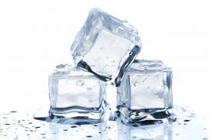
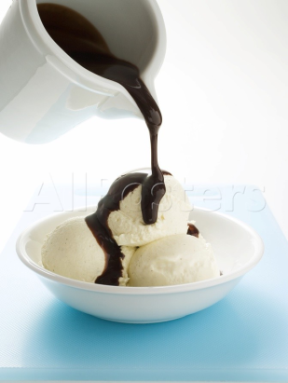
Physical Changes
Physical Change: the substance involved remains the same, even though it may change state or form.
Examples:
Dissolving – stirring a spoonful of sugar in water
Melting –an ice cube melts
Freezing – dripping warm chocolate onto ice cream hardens
Most physical changes are easy to reverse (but not all!)

Slide 3
Physical Changes Video

Slide 4
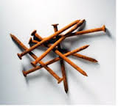
Chemical Changes
Chemical Change: The original substance is changed into one or more different substances that have different properties.
Examples:
Burning – a campfire
Cooking - baking a cake, frying an egg
Rusting - old truck, nail left on the ground
Chemical changes are very difficult to reverse.

Slide 5
Clues that a Chemical Change has Occurred
A new substance has formed
A new color appears
Energy (heat or light) is given off
Bubbles of gas are given off (new substance being formed)
A precipitate (a solid material formed inside a solution) forms
The change is difficult to reverse

Slide 6
Sample Chemical Changes (Always involve the production of a new substance)
Ex. 1: H₂ + O₂ → H₂O (water)
gas gas liquid
Reactants: Left side Products: Right side
Ex. 2:
C + O₂ → CO₂ (carbon dioxide)
Ex. 3:
C + H₂ + O₂ → C₆H₁₂O₆ (sugar)
Ex. 4:
C + H₂ → C₃H₈ (Propane)

Slide 7
Chemical Changes Video

Slide 8
Determine whether each of the following images represents a physical change or a chemical change

Slide 9
Burning

Slide 10
Melting

Slide 11
Sharpening Your Pencil

Slide 12
Cooking Breakfast

Slide 13
Cutting an apple?

Slide 14
Fireworks

Slide 15
Assignment
Worksheets
Read Pages 28 – 30 of the textbook and answer questions 1 -4
Challenge Question
Identify physical and chemical changes that are useful to us. Provide three example of how these changes are needed or beneficial.

Slide 16
Explain how a physical change differs from a chemical change.
Chemical changes involve production of a new substance with new properties. No new substances are produced in physical changes.

Slide 17
2. a) Garbage rotting
chemical
b) Cutting up carrots
physical
c) A silver spoon turning black
chemical
d) Making tea from tea leaves
physical
e) Bleaching a stain
chemical
f) Boiling an egg
chemical

Slide 18
Question 3 and 4
3. Changes occur more quickly at high temperatures. Putting candles together tends to concentrate heat more and the candles will be at a higher temperature.
4. Evaporation, mixing, and condensation are physical changes.
Combustion, catalytic conversion and rusting are chemical changes

