Slide 1
The Rise of Totalitarianism

Slide 2
“The aim of totalitarian education has never been to instill convictions but to destroy the capacity to form any.”
- Hannah Arendt
Think about what this means… and the implications for society.
Notes:
Arendt viewed the growth of totalitarianism as the outcome of the disintegration of the traditional nation-state. She argued that totalitarian regimes, through their pursuit of raw political power and their neglect of material or utilitarian considerations, had revolutionized the social structure and made contemporary politics nearly impossible to predict.
Conviction - a firmly held belief or opinion.

Slide 3
“Totalitarianism is never content to rule by external means, namely, through the state and a machinery of violence; thanks to its peculiar ideology and the role assigned to it in this apparatus of coercion, totalitarianism has discovered a mean of dominating and terrorizing human being from within.”
- Hannah Arendt The Origins of Totalitarianism, 1951

Slide 4
1984 – George Orwell, 1949
“Then the face of Big Brother faded away again and instead the three slogans of the Party stood out in bold capitals:
WAR IS PEACE
FREEDOM IS SLAVERY
IGNORANCE IS STRENGTH”

Slide 5
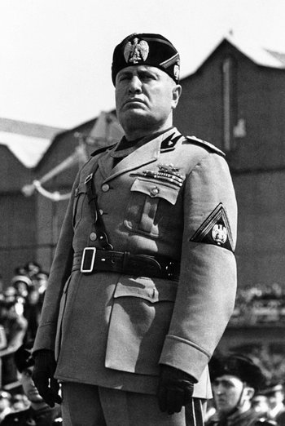
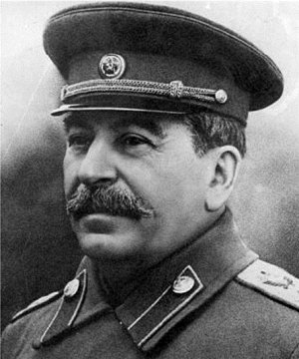
All for Naught?
After WW1 democracy in Europe was under serious threat as a new type of absolute power began to rise. Mussolini’s Italian fascist state and the Russian totalitarian rule under Stalin were a direct challenge toward the democratic governments of England and France. Spain too attempted to hold on to old roots of authoritarianism with the elites maintaining a hold on governmental control.
It appeared that the triumph of democracy in Europe in 1919 was to be a short lived victory as many European states adopted dictatorial regimes.

Slide 6
the Rise of the Dictators
The new form of dictatorship was the modern totalitarian state where the government aims to control the political, economic, social, intellectual, and cultural lives of its citizens.
The goal of these new regimes was not just to demand passive obedience but to conquer the minds and hearts of their subjects.
Q. How would such a government succeed in taking over its people with such success?
Notes:
Winning hearts and minds is a concept occasionally expressed in the resolution of war, insurgency, and other conflicts, in which one side seeks to prevail not by the use of superior force, but by making emotional or intellectual appeals to sway supporters of the other side.
Have you ever been so engaged and excited about something that you were nearly out of control? Or have been so invested in a game, sporting event, performance, or whatever that you couldn’t stop thinking about it? This is the goal of these states; to get you so invested and convinced that you would be willing to do anything for their cause?

Slide 7
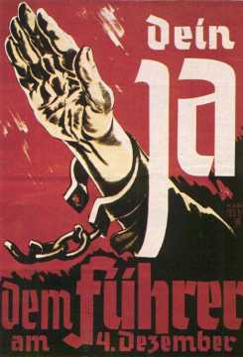
Hearts and Minds
To convince the population to “buy in” to this new governmental system mass propaganda techniques are necessary.
These techniques when paired with “high-speed” modern communication seemed to give these new totalitarianism regimes an unprecedented ability to impose their wishes on their citizens.
What does this poster mean? What images do you see?

Slide 8
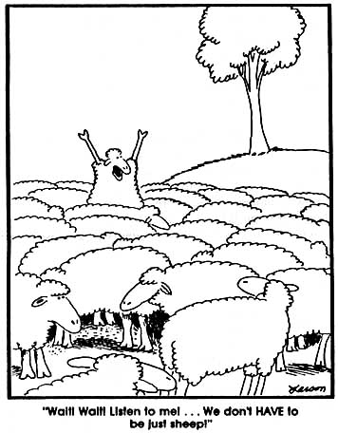
What do the other sheep think of the lone dissenter?
Do they even understand what he is getting at?
If the sheep are convinced that this is the life they have and it’s the best they’ll ever have will they ever try to change?
Plato’s Allegory of the Cave
Notes:
The allegory of all allegories, Plato's Allegory of the Cave is not the rosiest take on the reality of human existence. You might even call it downright bleak: it envisions the world as a dark cave, human beings as trapped prisoners, and all of our experiences as nothing but shadows on a wall. "See human beings as though they were in an underground cave-like dwelling," instructs Socrates, "with its entrance, a long one, open to the light across the whole width of the cave" (514a).
Imagine a cave with a small tunnel of light leading out and hundreds of human beings tied up so that they can't move—they just stare straight ahead all day long (creepy, we know). But they do get a little entertainment: there's a rockin' shadow-puppet show projected on the wall in front of them with a fire burning in the back for light. Since this show is all these poor people can see, they think it's the best, most awesome reality ever. They chat about it, gossip, call people names... you know, the usual.
So that's how life goes down in the cave until one day, one of the prisoners manages to break free and begins to figure out what's going on. It takes a while for his eyes to adjust, but gradually, he sees that there is a much brighter speck of light at the end of another tunnel. So out he goes... and wow, you can imagine how amazing and beautiful the real world looks to him compared to that two-dimensional, dark cave he's spent all his life in.
Feeling sorry for all his fellow prisoners, the freed prisoner goes back down and explains to everyone that they're all trapped in this massive cave, and everything they think is real is an illusion. Guess what? They think he's nuts. He keeps trying to convince them, and he's finally able to persuade a few... but the rest choose to remain where they are.

Slide 9
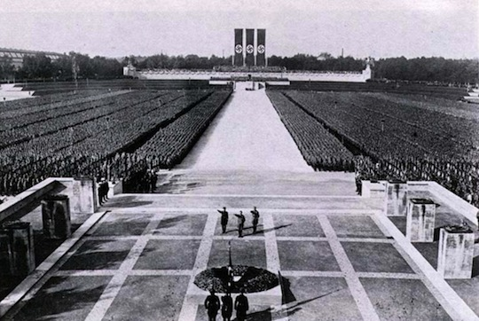
Notes:
What if this one guy, this “sheep”, stood out and exclaimed: “whoa, whoa, what a minute, this doesn’t seem right”. What do you think would happen? Or would it even happen? Why?

Slide 10
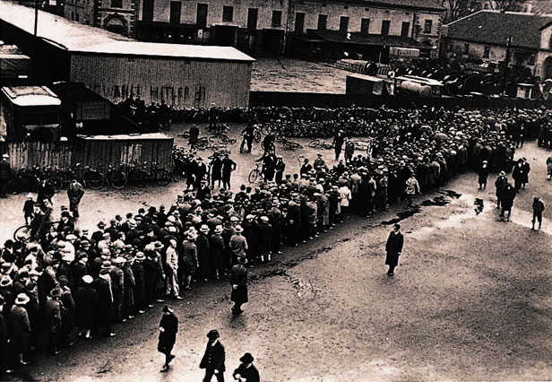
Politics and the Economy
Another factor that influenced the rise of the totalitarian state is the Great Depression.
This economic crisis left millions unemployed and millions more staving and homeless.
The downtrodden turned to forms of government that promised change and simple solutions in return for dictatorial power…for the benefit of the people of course.
Notes:
Communist leaders and followers of the Marxist ideals of socialism predicted this capitalist collapse and many people knew they had suspected this was going to happen for many years…it appeared that their predictions were coming true.
In many countries democracy seemed to be on the defensive as it appears that the capitalist system was what led to this economic crisis.
People turned to Marxism, Nazism or fascism for answers to economic problems.

Slide 11
The Fascists in Italy
Like other European countries, Italy experienced financial disasters after WW1. Worker strikes and talk of Socialist revolution were spreading across the country and the middle class feared a communist takeover like what happened in Russia.
From this civil unrest rose another key figure in the rise of the totalitarian state: Benito Mussolini.
Mussolini began his political career as a Socialist but in 1919 he started a new political group called the Fascio di Combattimento, or League of Combat.
Notes:
Mussolini had taught and served in the military before his political career. From 1912 to 1914 he edited the Italian Socialist Party’s official newspaper. He supported going to war in 1914 and that angered many of the Socialists and they revoked his membership. In 1915 when Italy entered WW1 he joined the military until he was discharged in 1917 after being wounded. He started the Fascio di Combattimento two years later.

Slide 12
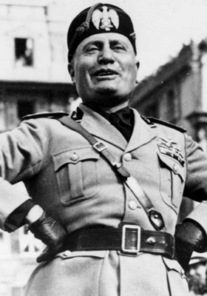
Fascism
Thomas Hobbes felt the same way
AS a political philosophy, fascism glorifies the state above the individual by emphasizing the need for a strong central government led by a dictatorial ruler.
A fascist state controls the people and stifles any opposition.
Many in Italy had been unhappy that they didn’t receive more land after WW1 and Mussolini used his nationalist ideals to convince thousands of Italians to join his Fascist Party.
Notes:
Mussolini continues to gain support and in 1922 he threatens to march on Rome and Victor Emmanuel II, King of Italy, makes him Prime Minister.

Slide 13
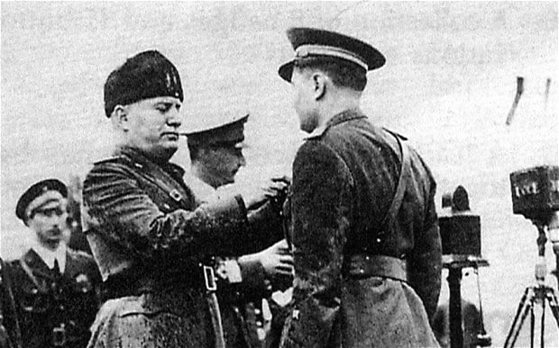
Mussolini becomes “Il Duce”
Mussolini sets up a Fascist dictatorship and quickly introduces new laws that make it illegal to criticize the Catholic Church, the monarchy, or the state.
Police were given unrestricted authority to arrest and jail anyone for political or non-political crimes.
In 1926 the Fascists outlawed all other political parties and established a secret police called the OVRA.
Notes:
Il Duce means “The Leader”
The OVRA watched citizens’ political activity and enforced govt policies. The Italian Fascists also tried to exercise control over all forms of mass media, including radio, film and newspapers.

Slide 14
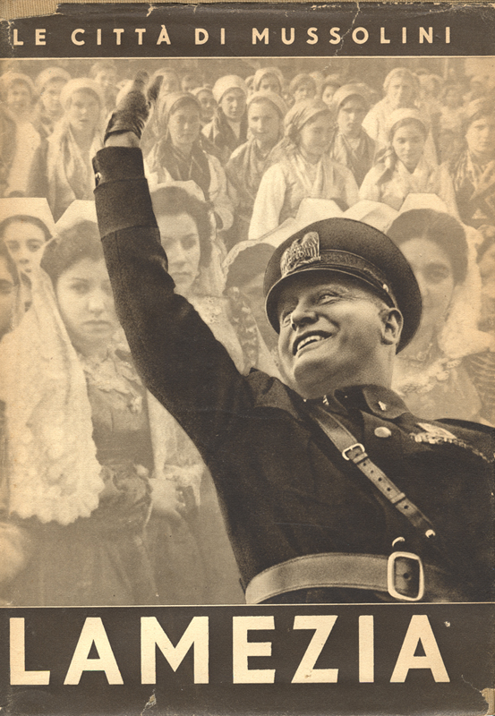
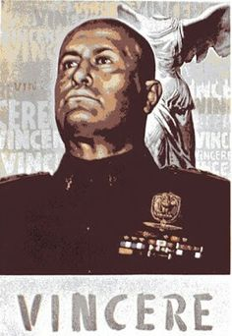
Notes:
Many of Mussolinis’ propaganda posters consisted of simple slogans like. “Mussolini Is Always Right”

Slide 15
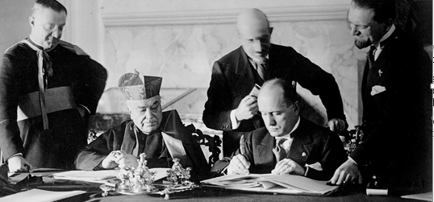
The Fascist State
By 1939 Fascist youth groups included around 66% of the population between 8 and 18. These groups were often focused on military values and activities.
While these values were the focus the Fascists did not achieve total control over its population. Many traditional values persisted and they hung on to some of the older power structures of Italy, including keeping Victor Emmanuel II as King.
Mussolini also recognized the sovereign independence of Vatican City and therefore the Catholic Church encouraged Italians to support the Fascist regime.
Notes:
Mussolini looked to create a nation filled with fit, disciplined and war-loving citizens.
Mussolini’s Fascist party never did manage to get total control over the Italian people like Hitler managed in Germany.

Slide 16
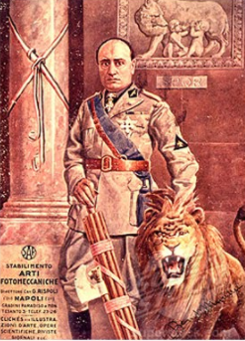
Image Analysis
What do you notice about this image?
“Anti-individualistic, the Fascist conception of life stresses the importance of the State and accepts the individual only in so far as his interests coincide with those of the State…War alone keys up all human energies to their maximum tension and sets the seal of nobility on those peoples who have the courage to face it.”
-Benito Mussolini, The Doctrine of Fascism, 1932
What does this quote tell you about the role of the individual in a Fascist state?
Notes:
Romulus and Remus in the background – they were the twins who built Rome…also Romulus killed his brother after a fight. This ties Mussolini’s Fascist state to the grandeur of the Roman Empire.
Mussolini is holding a Fasces which is a bound bundle of wooden rods, sometimes including an axe with its blade emerging. This became the symbol of Fascism in Italy. The fasces had its origin in the Etruscan civilization and was passed on to ancient Rome, where it symbolized a magistrate's power and jurisdiction.
Individuals are only important in relation to their contribution to the state.

Slide 17
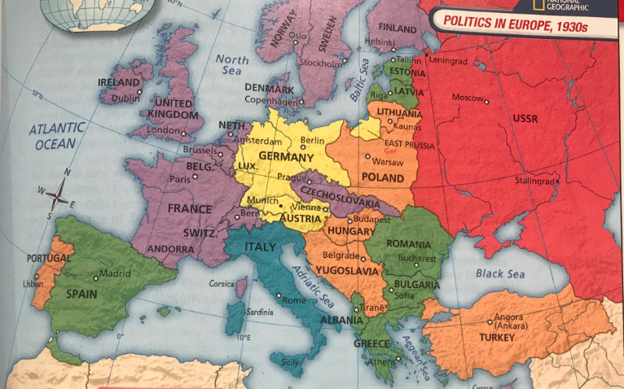
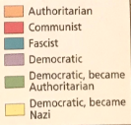
Notes:
The state of politics in Europe in the 1930s – it was a challenging time for democracy.
Q. Which countries switched from Democratic to another form of govt in the 1930s? – Albania, Austria, Bulgaria, Estonia, Latvia, Romania, and Spain
Q. Why was Czechoslovakia's location a problem for Democracy? – surrounded by fascists, authoritarian, or Communist govts.

Slide 18
The New Era in the USSR
Lenin’s New Economic Policy, Murder Industrialization, Murder, Stalin, Murder, Five-Years Plan, Murder, Collectivization,….
Rise of Joseph Stalin video

Slide 19
Eastern Europe
It seemed that after WW1 many European nations would adopt democratic governments. Austria, Poland, Czechoslovakia, Yugoslavia, Romania, Bulgaria, and Hungary all adopted parliamentary systems but soon most of these systems were replaced by authoritarian regimes.
These states had little tradition of political democracy and that made adopting a new system challenging.
In addition to unfamiliarity with democratic systems many of these states were rural and agrarian. Most of the peasants were illiterate and often had conflicts with the wealthy because of ethnic divides.
Notes:
Powerful landowners, the churches and some of the members of the middle class feared land reforms, communist upheaval and ethnic conflict. These countries looked to authoritarian governments to maintain the old system. Only Czechoslovakia, which had a large middle class, a liberal tradition and a strong industrial base, maintained its political democracy.

Slide 20
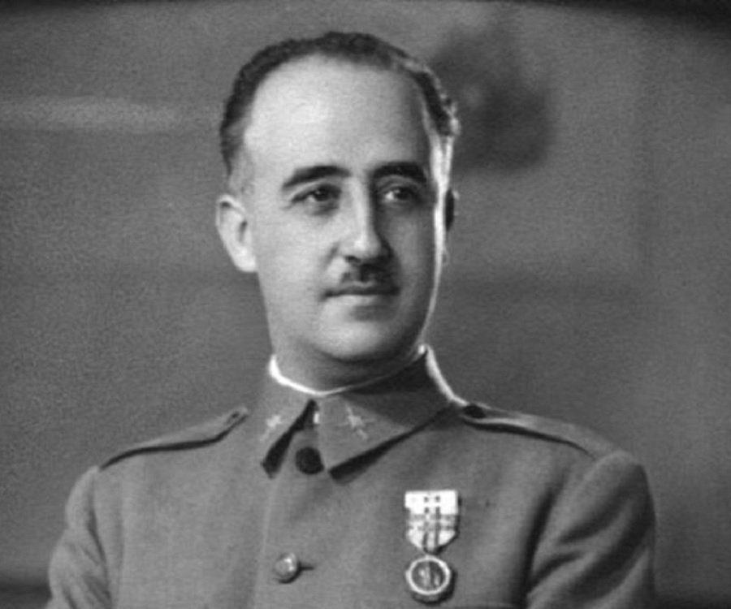
Spain
Democracy failed to survive in Spain as well as rival political parties and rivalries between the personalities of these parties tore Spain apart. The Spanish Republic only lasted 5 years.
Francisco Franco, a successful military personality, rose to power and became Europe’s youngest general. He led a revolt in 1936 and started a bloody civil war.
Italy and Germany sent aid to Franco during this civil war and used this opportunity to test out new weapons and revived air force.
Franco established a dictatorship in 1939 after he captured Madrid.
Notes:
Franco favoured large landowners, successful businesspeople, and the Catholic clergy. His rule was seen as authoritarian rather than totalitarian because he did not try to control all aspects of people’s lives.
The Italians and Germans used planes armed with machine guns and bombs during their experiment in Spain.

Slide 21
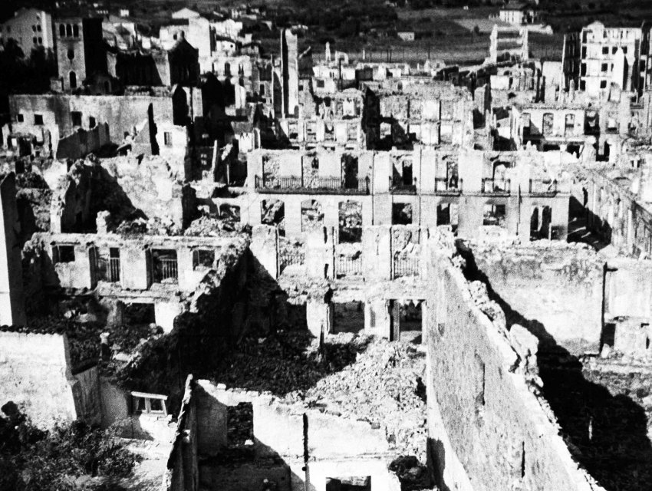
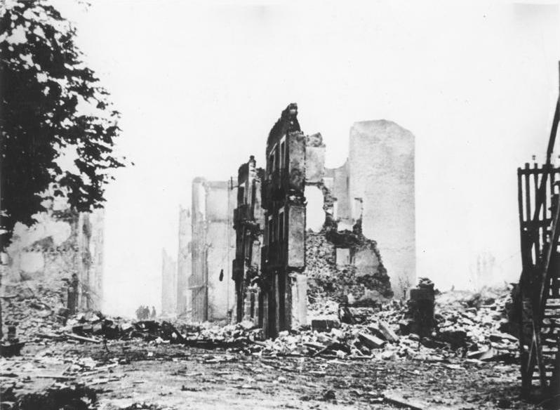
The Bombing of Guernica
Notes:
Nazi and Italian planes attacked for over 3 hours, dropping bombs and strafing people trying to escape. An estimated 1600 people were killed. The bombing destroyed 80% of the town's buildings.
Noel Monks was a correspondent covering the civil war in Spain for the "London Daily Express." He was the first reporter to arrive on the scene after the bombing. We join his story as he and other reporters drive along a dusty Spanish road:
...I was the first correspondent to reach Guernica, and was immediately pressed into service by some Basque soldiers collecting charred bodies that the flames had passed over. Some of the soldiers were sobbing like children. There were flames and-smoke and grit, and the smell of burning human flesh was nauseating. Houses were collapsing into the inferno.
In the Plaza, surrounded almost by a wall of fire, were about a hundred refugees. They were wailing and weeping and rocking to and fro. One middle-aged man spoke English. He told me: 'At four, before the-market closed, many aeroplanes came. They dropped bombs. Some came low and shot bullets into the streets. Father Aroriategui was wonderful. He prayed with the people in the Plaza while the bombs fell.'..
...The only things left standing were a church, a sacred Tree, symbol of the Basque people, and, just outside the town, a small munitions factory. There hadn't been a single anti-aircraft gun in the town. It had been mainly a fire raid.
...A sight that haunted me for weeks was the charred bodies of several women and children huddled together in what had been the cellar of a house. It had been a refugio."

Slide 22
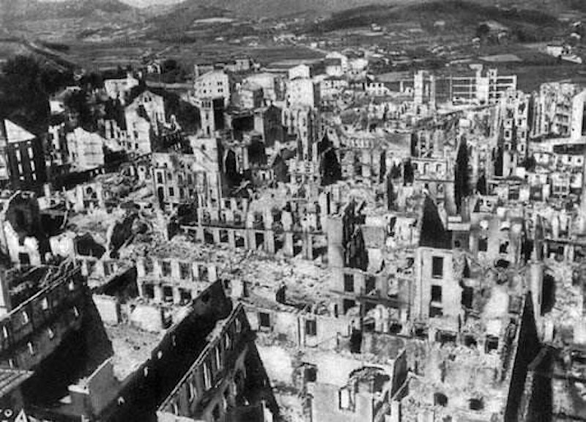
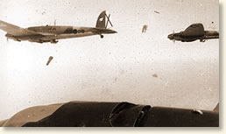
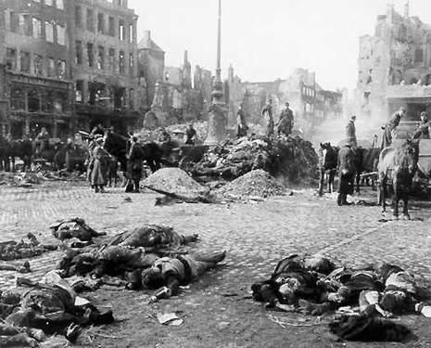
Notes:
The attack was ordered by General Franco to break the spirit and resistance of the Basque people, who opposed Franco's forces and supported the Republican cause.
The bombing of this city served no military purpose. Hitler had actually conducted a test to determine what effect a targeted bombing would have on civilians.

Slide 23
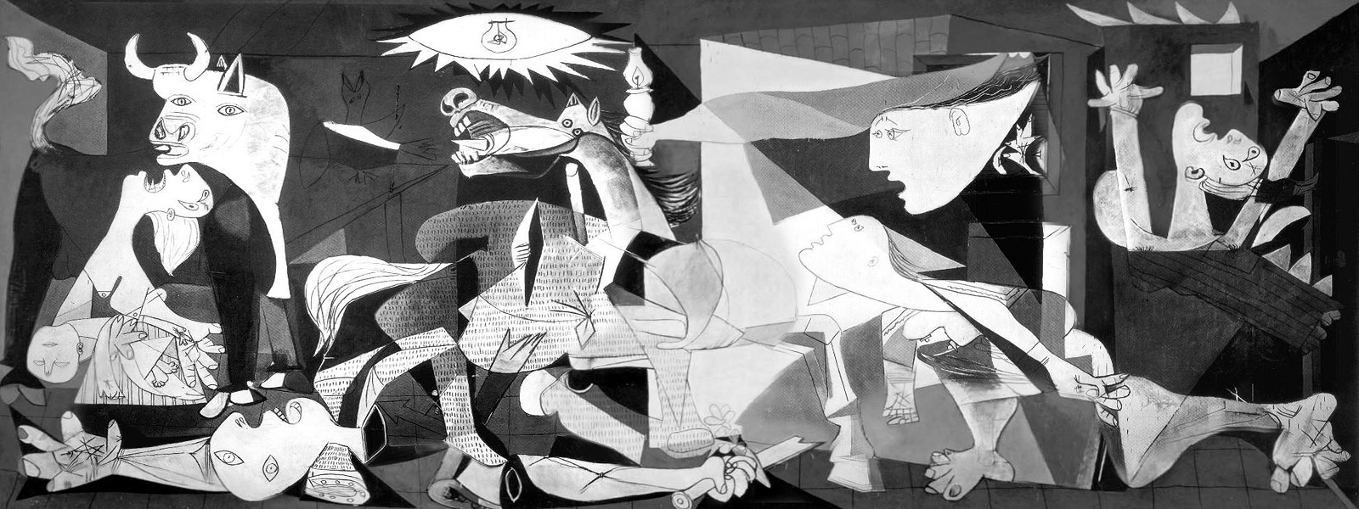
The Destruction of Guernica
Notes:
This famous Picasso mural created for the 1937 World’s Fair in Paris depicted Picasso’s feelings toward the destruction of the Spanish city of Guernica by German bombers in 1937.
Picasso spoke about this image: “[In Guernica] I clearly express my loathing for the military caste that has plunged Spain into a sea of suffering and death.”
Historians consider this piece of art as one of the most important works of social protest in the history of art. Its huge: 25 feet x 11 feet.

Slide 24
Questions
What effect did new war technology have in the battle of Guernica?
What one word describes your response to Picasso’s Guernica? What feelings does Picasso create with his mural?
Notes:
Bombs and machine guns fire from airplanes killed many people and completely destroyed a city.
A. Frightening, horrifying…. Body parts everywhere, suffering faces, stark background…

