Slide 1
What would remain in 10,000 years?
Video “life after people”
From 1:14:19 ☺

Slide 2
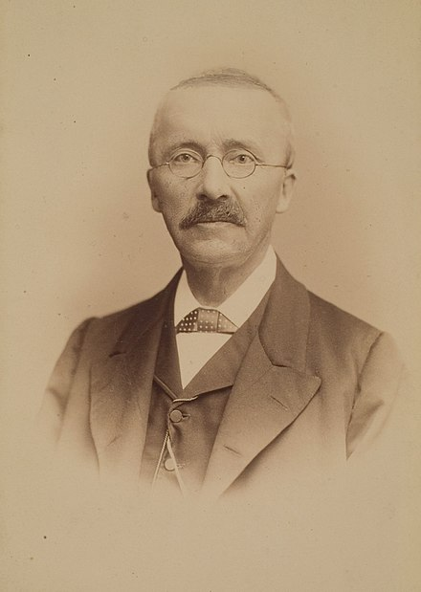
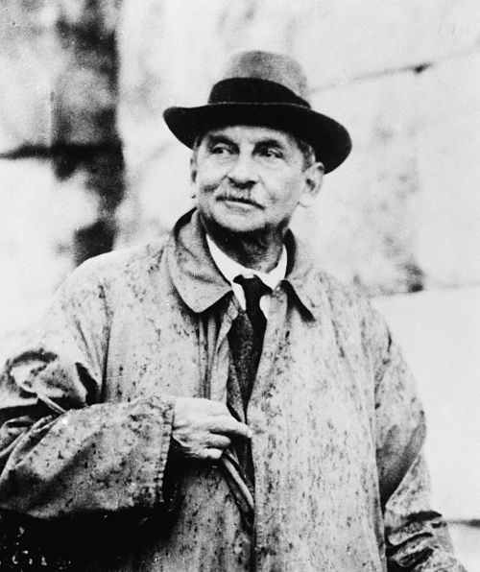
Ancient Greece
Mycenae Civilization
Heinrich Schliemann
1822 –1890
Minoan
Civilization
Sir
Arthur Evans
1851-1941
Notes:
We only knew there is ancient Greece. And people thought Mycenae and Minoan civilizations are just stories. Then Schliemann found Mycenae. Big Celebration!
Evans wanted to do the same thing with Minoan, and he found it.
We gonna start with, of course, the oldest one we know. So Minoan first.

Slide 3
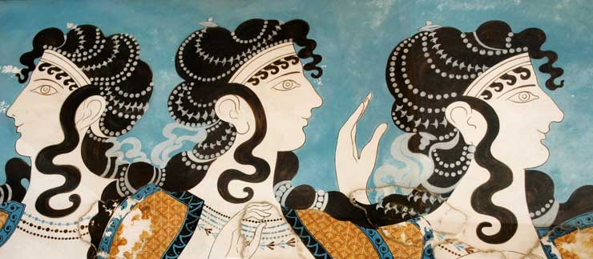
The Minoans
Early Greek Civilization

Slide 4
Story Time
https://www.youtube.com/watch?v=_fVRJXECkhY
Notes:
Tell the story of Theseus and the labyrinth and the Minotaur

Slide 5
Sir
Arthur Evans
1851-1941

Slide 6
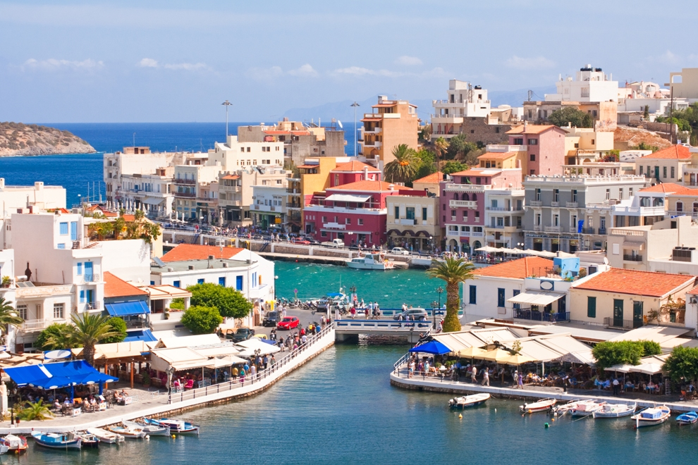
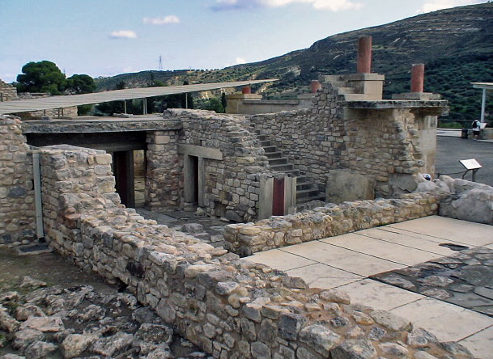
Minoan civilization remains
Crete island today

Slide 7
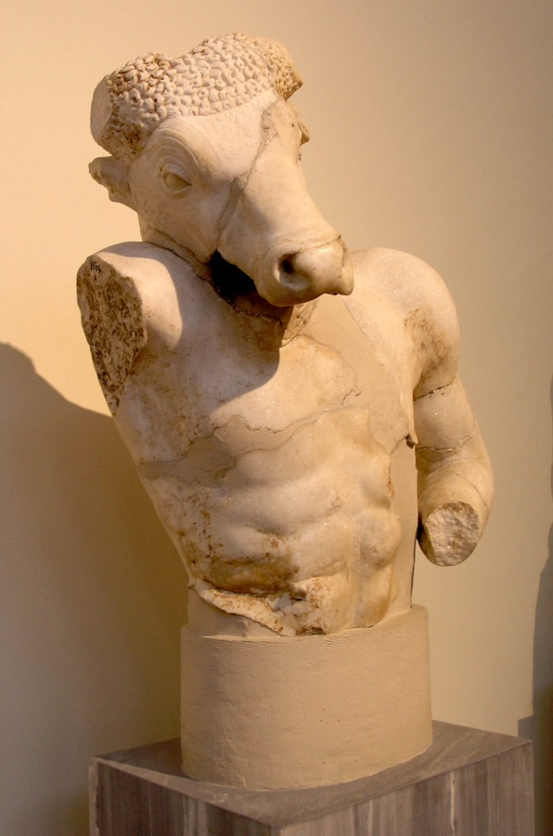
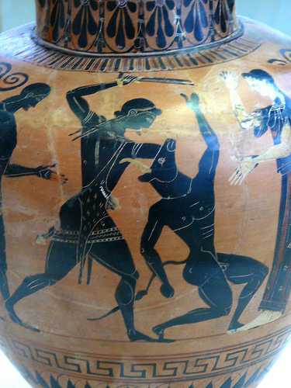
.

Slide 8
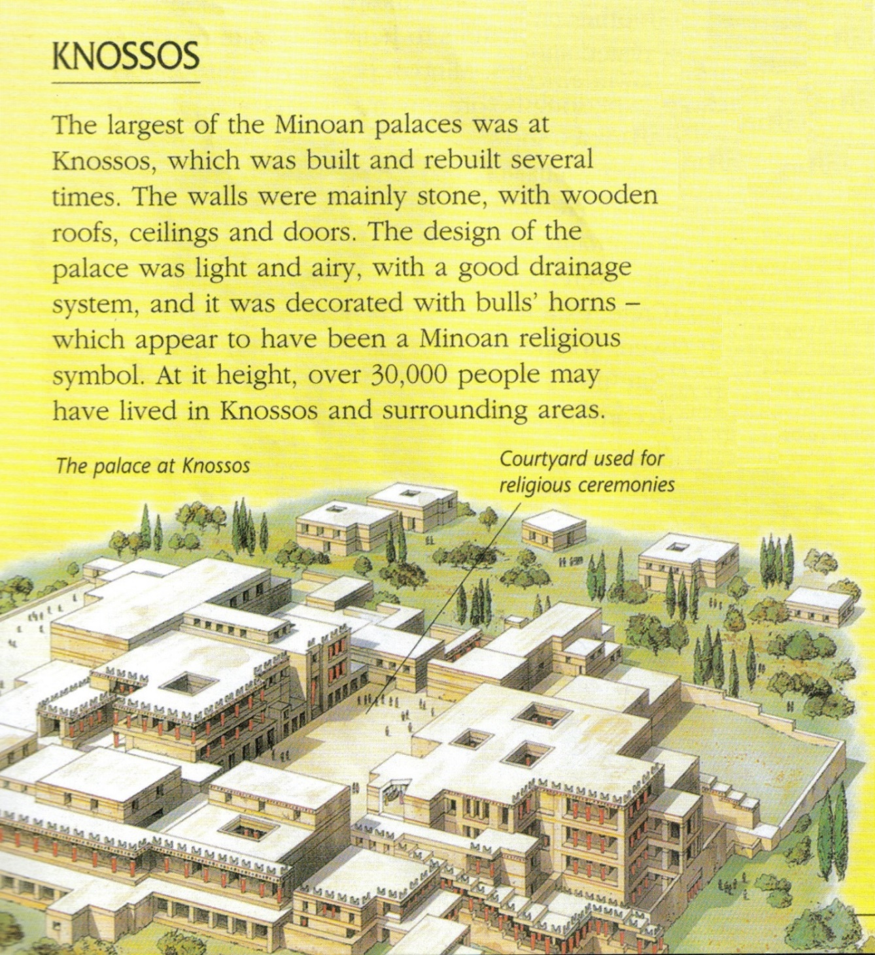
Notes:
The palace at Knossos was the royal seat of the kings. This elaborate palace was exquisitely decorated with vases, ivory figurines, and jewelry.

Slide 9
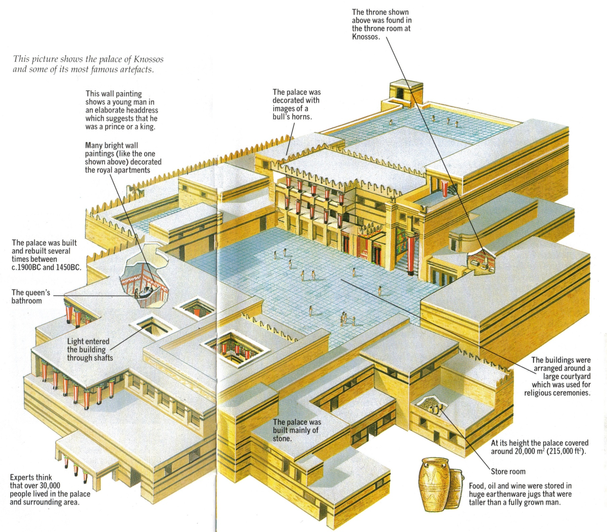

Slide 10
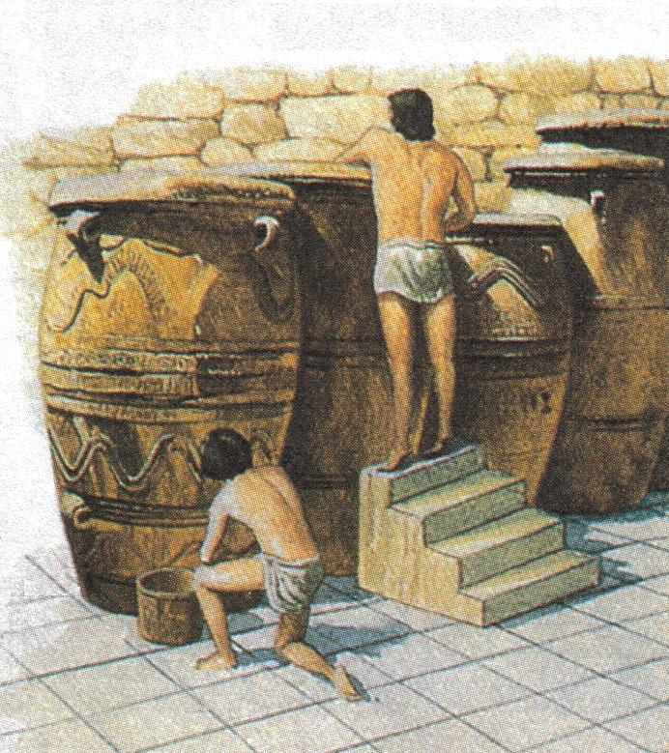
Minoan Storeroom
Notes:
The palaces fulfilled a plethora of functions: they served as centres of government, administrative offices, shrines, workshops, and storage spaces (e.g., for grain).

Slide 11
Bull heads are common in Minoan

Slide 13
Don’t do it at home

Slide 15
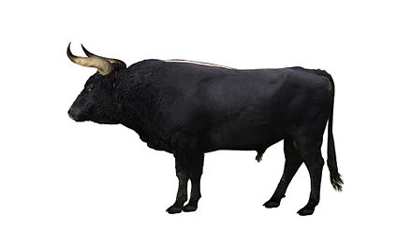
Life restoration of an aurochs bull found in Braunschweig, Germany
Mounted skeleton of a bull found in Vig, Denmark, National Museum of Denmark
Notes:
The kind of bull they were playing with are most likely to be extinct. And even back then, the bulls are at least half wild. People were trying to tame them, inter breed them with other breeds, to get tamer ones.
So, you see, fighting with bulls and leaping on bulls are not completely pointless.

Slide 16
Greeks didn’t think they were Greeks.

Slide 17
Modern Findings of who they are and where from
The oldest evidence of preceramic Neolithic farming community remains on Crete are that date to approximately 7000 BC
A 2013 DNA study of bone samples from a Minoan ossuary, dated to 4,400–3,700 years ago, showed that the ancient Minoan DNA was most similar to populations from western and northern Europe. The population showed particular genetic affinities with Bronze Age populations from Scandinavia and France.

Slide 18
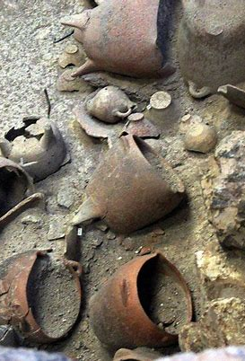
Bronze Age civilization
Appeared around 2800 BCE (and lasted for 12 centuries until ~1500 BCE)
The Bronze Age was a time in early human history when people first began to use tools made of bronze.
People make it by melting copper and tin together to make it harder.
Notes:
The Bronze Age was a time in early human history when people first began to use tools made of bronze. Bronze is a hard, yellowish alloy, or mixture of metals. People make it by melting copper and tin together. The Bronze Age began in some places about 5,000 years ago. It began later in other places. Learning how to use bronze led to advances in many areas of human life.

Slide 19
Relying on timber resources
While the island appears today completely deforested, in ancient times timber was one of the natural resources that was commercially exploited and exported to nearby Egypt, Syria, Cyprus, the Aegean Islands and the Greek mainland.
Several localities on the island developed into centers of commerce and handwork in the late 3000 BC. This enabled the upper classes to continuously practice leadership activities and to expand their influence.
It is likely that the original hierarchies of the local elites were replaced by monarchist power structures – a precondition for the creation of the great palaces.

Slide 20
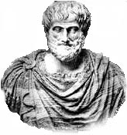
What we have learned about them is through their architecture, art and cultural artifacts.
They spoke a language and wrote scripts that historians cannot understand(Linear A).
Notes:
The archaeologist Sir Arthur Evans was first alerted to the possible presence of an ancient civilization on Crete by surviving carved seal stones worn as charms by native Cretans in the early 20th century CE. Excavating at Knossos from 1900 to 1905 CE, Evans discovered extensive ruins which confirmed the ancient accounts, both literary and mythological, of a sophisticated Cretan culture and possible site of the legendary labyrinth and palace of King Minos. It was Evans who coined the term Minoan in reference to this legendary Bronze Age King.
Historians had uncovered two clay tablets, Linear A and Linear B, B has been decoded while A remains a mystery, it is assumed that B had replaced an earlier written language.

Slide 21
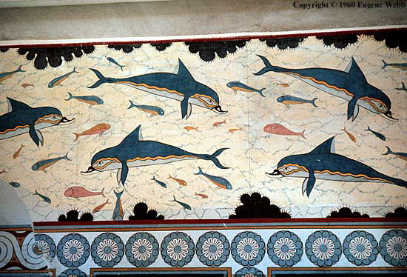
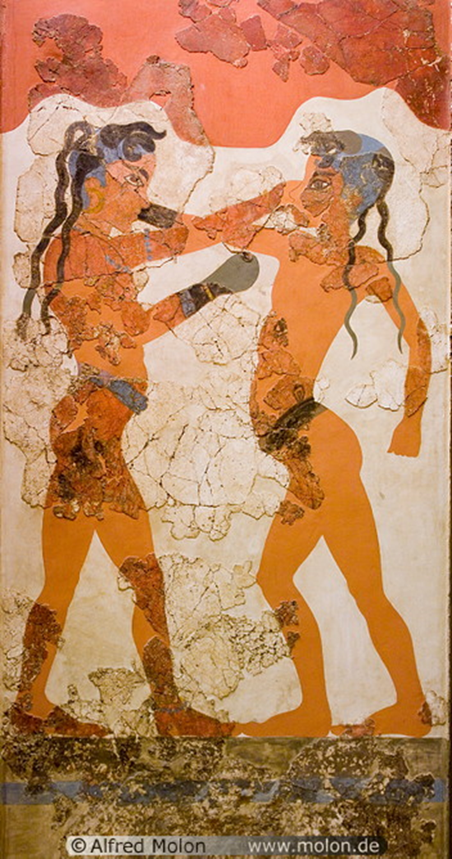
They were a peaceful people as their frescos (wall paintings) do not show battle scenes.

Slide 22
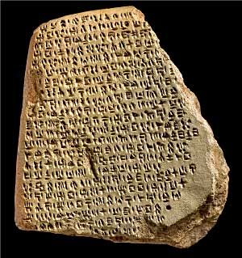
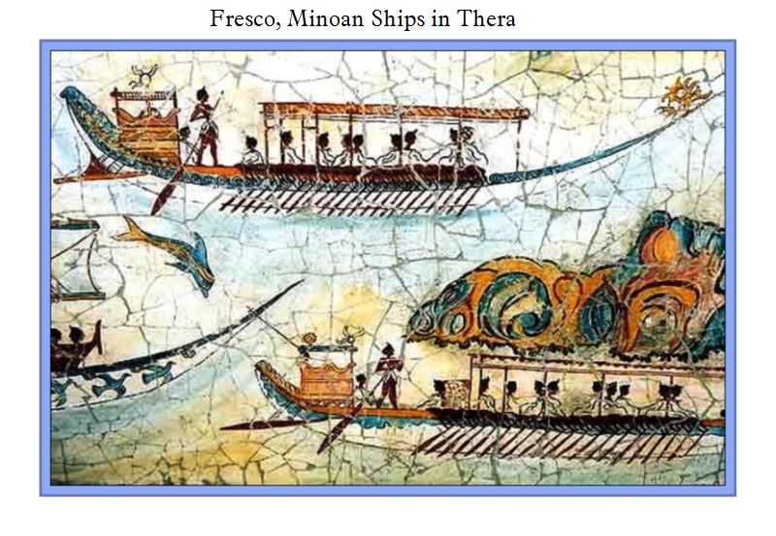
The Minoans were:
Linear A
great merchants
kept very accurate records
And they visited Egypt and
Mesopotamia

Slide 23
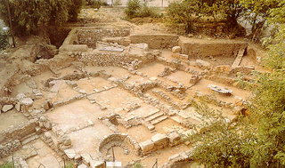
Cities and Communities
Did not have walls around them.
Knossos – largest city on island of Crete
Palace: 250 rooms; 3 – 5 floors; running water; flushing toilets…
Plumbing system - first of its kind.
Notes:
The Minoan cities were connected with stone-paved roads, formed from blocks cut with bronze saws. Streets were drained and water and sewer facilities were available to the upper class, through clay pipes.
Minoan buildings often had flat tiled roofs; plaster, wood, or flagstone floors, and stood two to three stories high. Typically the lower walls were constructed of stone and rubble, and the upper walls of mudbrick. Ceiling timbers held up the roofs.

Slide 24
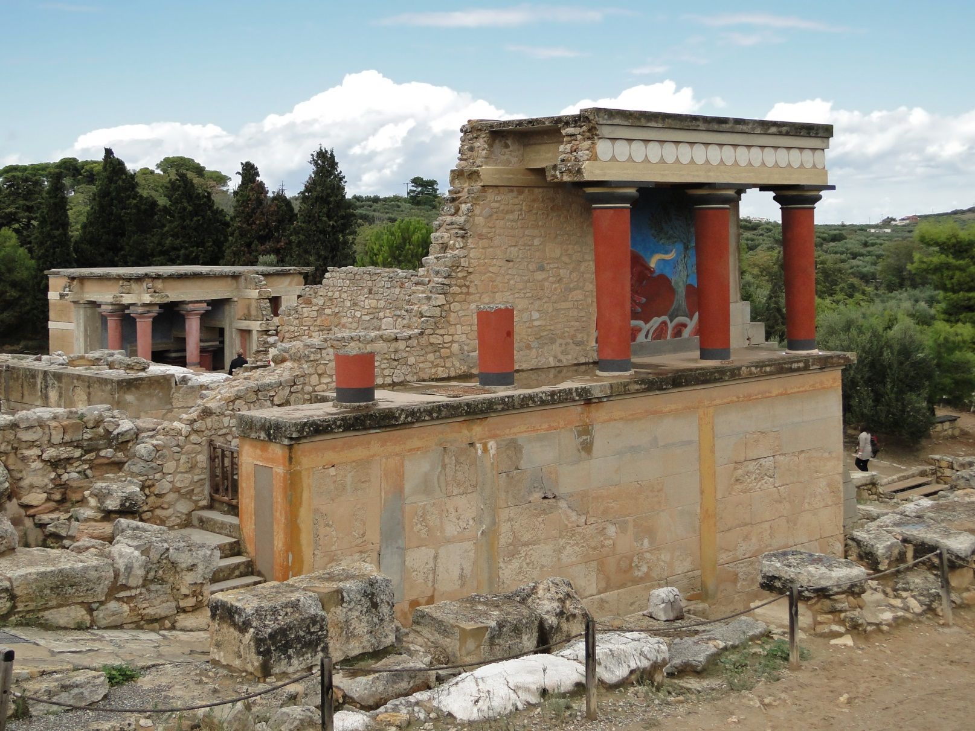
Knossos - Video

Slide 25
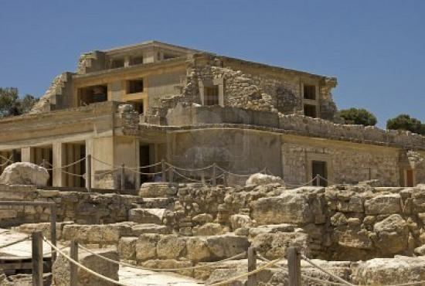
3D Reconstruction - Video

Slide 26
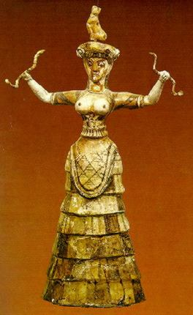
Religion
Mostly female goddesses and priests.
Rituals included sporting events such as “Bull-Leaping”.
The Minoans were addicted to sports as seen by their art.
Popular sports were boxing and bull-leaping.
Notes:
Although there is some evidence of male gods, depictions of Minoan goddesses vastly outnumber depictions of anything that could be considered a Minoan god.^{[73]} While some of these depictions of women may be images of worshippers and priestesses officiating at religious ceremonies, as opposed to deities, several goddesses appear to be portrayed. These include a Mother Goddess of fertility, a Mistress of the Animals, a protectress of cities, the household, the harvest, and the underworld, and more. They are often represented by serpents, birds, poppies, and a somewhat vague shape of an animal upon the head.

Slide 27
Disappearance
Minoan civilization suffered a suddenly and catastrophic collapse around 1450 BCE.
Speculations of their destruction include:
An earthquake
Volcano eruption on a nearby island of Thera that caused a tidal wave.
Conquered and destroyed by the Mycenaean people from inland Greece.
Notes:
This volcanic eruption was also linked to the disappearance of the fabled continent of Atlantis. Thera is the present day island of Santorini.
The common belief that Minoan society was destroyed by the Myceneans is due to the influx of mainland greek art and other materials.
So, not really because of Theseus, or Poseidon. Although in Homer’s stories, it is because Poseidon was mad. Who is the father of Theseus again?

Slide 28
