Slide 1
The Road to War
Imperialism, Nationalism, and Alliances

Slide 2
Curricular Goal
3.2.1 Students should be able to express how power is typically exercised on a continuum and that the exercise of power can have both intended and unintended consequences.

Slide 3
Consider These Questions…
When is the last time you stood up for a friend who was getting picked on or criticized?
Are friendships(alliances) important in life?
What benefits do friendships provide?
Can people go though life with no connections and alliances? What may happen to individuals who remain solitary and isolated?
Notes:
Liberals set 15-day limit on solitary confinement of federal prisoners ... Atlantic Canadahas highest use of solitary confinement

Slide 4
Historical Perspective
Leading up to the outbreak of WW1 European rivalries over colonies and trade grew and intensified as powerful nations and empires vied for global dominance.
During this age of nationalism and imperialism the great powers of Europe found themselves divided between two loose alliances.
Germany, Austria-Hungary, and Italy formed the Triple Alliance in 1882.
France, Great Britain and Russia created the Triple Entente in 1907.
Notes:
Imperialism - a policy of extending a country's power and influence through diplomacy or military force.
Germany, Austria-Hungary and Italy formed the Triple Alliance. In 1882, they signed a document that promised they would give each other military support in case of a war. The Alliance agreement stated it was 'essentially defensive and conservative' with the aim of stopping anyone who 'might threaten' the three nations.
The alliance formed between Germany and Austria-Hungary had strong ethnic ties. Germany and Austria-Hungary shared borders and (in many regions) the German language, as well as a desire to add to their territories. Austria-Hungary specifically wanted the Balkans.
Italy wanted more territory in parts of Greece, Turkey and the Balkans. It also wanted protection from attacks from its northern neighbour, France. Finally, Italy still disputed land with Austria-Hungary. An alliance could turn out to be more effective in negotiating this land back, and stop Austria from taking any more land in a war. However, Italy still did not entirely trust Austria-Hungary, so made a secret treaty with France after the joining the Triple Alliance.
A conflict involving any one of the Triple Alliance countries could, by the terms of the treaty, bring in the other two. Rather than acting as a deterrent, the Treaty could be used as a bullying tactic. If a small nation was threatened by one of the Triple Alliance, the Triple Entente would have to ignore the situation or face a major conflict with Germany, Austria-Hungary and Italy combined.

Slide 5
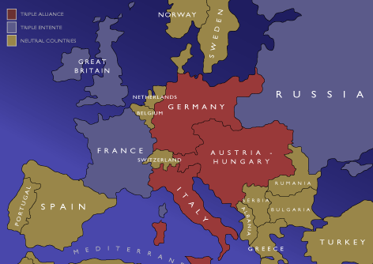
Notes:
In the early 20th century the Balkans (Albania, Serbia, Romania, Bulgaria and Greece) were a hotbed of crises that was fueled by Nationalism in an attempt to seek independence.

Slide 6
In 1853 the Crimean War broke out as a result of Russia was expanding into the Danube region – Romania today. This was under Ottoman (Turkish) control. Therefore, Turkey and Russia went to war in 1853, and the following year Britain and France – fearful of Russian expansion – became involved. Britain and France did not like to see Russia pushing down into the Danube region. They feared Russia would continue pushing down, and eventually come into British India through Afghanistan.
Time Travel – 50 Years into the Past
Notes:
50 years earlier, in 1853, the Russians had gone to war with the Ottoman Empire in what is known as the Crimean War. Russia was interested in controlling a warm water port and controlling the Balkans would allow Russia exactly that, an access to the Mediterranean through the Dardanelles.
Long story short: Russia lost as both France and Britain joined the Ottomans against Russia as they feared the Russians would become too powerful with these disputed territories under its control. Russia lost 500,000 men and gained economic troubles and didn’t secure any rights to Moldovia and Walachia which is now known as Romania.
Florence Nightingale heard about the poor medical conditions in the Crimea region, and went there as a civilian to help. She became a big news story. The Crimean War was arguably the first media-driven war as this was the first war in which you saw letters being sent home, and many of them were published in newspapers.

Slide 7
This Crimean conflict resulted in the further destruction of the Concert of Europe. The breakdown of the Concert of Europe is our main concern as this system of alliances between Britain, Austria, Russia, Prussia, and France kept any major conflicts from engulfing Europe since the defeat of Napoleon in 1815.
Breakdown Of The Concert of Europe
Notes:
Austria didn’t come to the aid of Russia during this Crimean War as they also had interests in the Balkan region and that further weakened the loose alliances that kept the Concert together.
Russia was humiliated and withdrew from European affairs for the next 20 years.
This conflict opened the door to German unification as well as Italian unification,

Slide 8
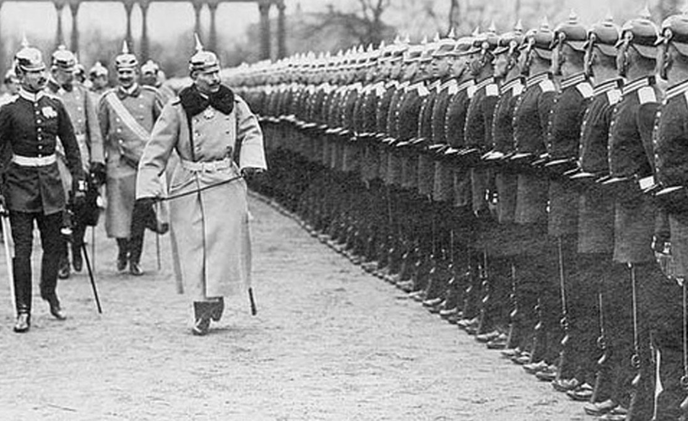
Militarism
The Industrial Revolution played an important role in the events of World War 1.
As countries industrialized they introduced new methods of warfare.
Shipbuilding and the use of iron, steel and chemicals made war even more deadly.

Slide 9
Growing Fear
Militarism is the aggressive preparation for war.
Many of the military leaders of these powerful nations had begun to draft up vast and complex plans to quickly mobilize large numbers of troops and supplied in the possible event of large scale conflicts.
The growing fear of possible war led many countries to rely on strong militaries rather than strong political leaders that could avoid war.

Slide 10
Size Matters
Nations had begun to increase the size of their armies and navies even since the French Revolution which made tensions rise even more.
What happened during the French Revolution that caused this paradigm shift with creating armies?
Prior to 1914 many Western countries established conscription and as a result armies doubled in size between 1890 and 1914.
Notes:
Conscription or drafting, is the compulsory enlistment of people in a national service, most often a military service.
The size of armies for many years was relatively small, usually made up of private soldiers. All of this changed after the French Revolution. When the Third Estate toppled the Monarchy in France in the 1790s many countries sent their militaries to stop the revolution, in response the National Convention introduces the Levee en Masse. This decree changed the face of armies forever as armies now were to be made up of citizens of countries. Napoleon would continue this practice and that is one o the reasons why he dominated Europe in 1803–1815. It wasn’t until other nations followed suit and allowed more citizens to join the military and receive training.

Slide 11
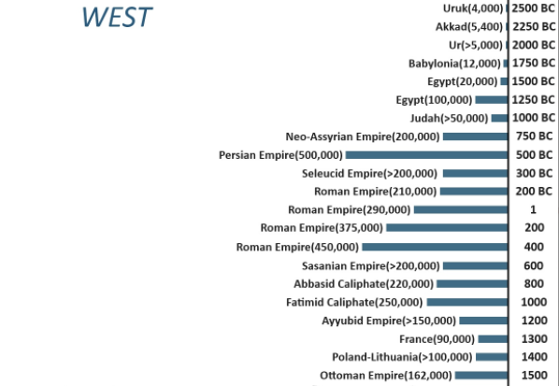
Military Superpowers Throughout History

Slide 12
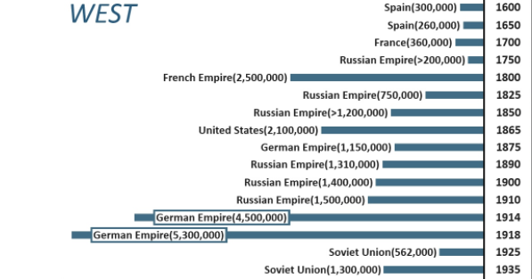
Military Superpowers Throughout History

Slide 13
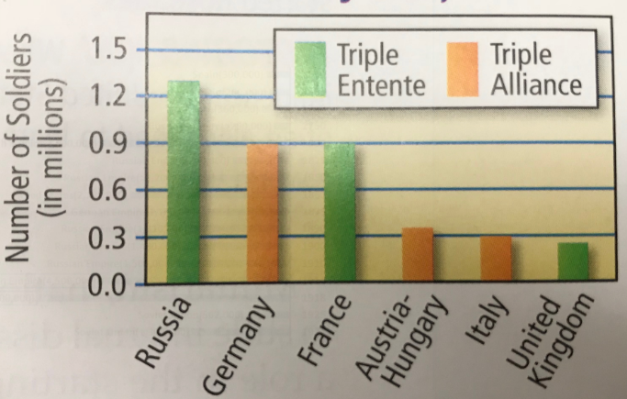
Estimated Army Size, 1914

Slide 14
Back to Sarajevo

Slide 15
The Ultimatum and Mobilization
Nearly a month after the assassination of Franz Ferdinand, Austria-Hungary issues an ultimatum to the Serbian govt.
The demands set out by this July 23rd ultimatum were meant to lead to war as no nation could meet its demands, especially within the 48 hour window that was set out with the demands.
On July 28th, Austria-Hungary declares war on Serbia.
Notes:
According to the terms of the ultimatum delivered on July 23, the Serbian government would have to accept an Austro-Hungarian inquiry into the assassination, notwithstanding its claim that it was already conducting its own internal investigation. Serbia was also to suppress all anti-Austrian propaganda and to take steps to root out and eliminate terrorist organizations within its borders—one such organization, the Black Hand, was believed to have aided and abetted the archduke’s killer, Gavrilo Princip, and his cohorts, providing weapons and safe passage from Belgrade to Sarajevo. The Dual Monarchy demanded an answer to the note within 48 hours

Slide 16
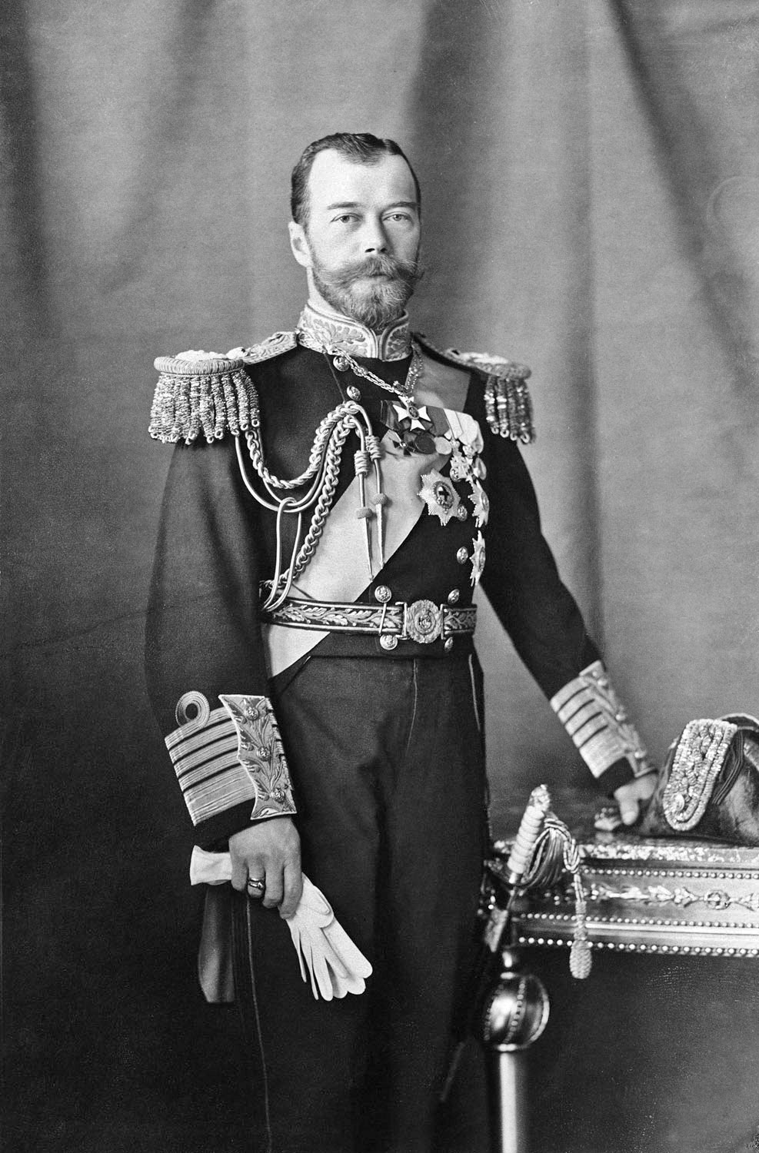
Russia Mobilizes
Russia was determined to assist Serbia’s cause.
On July 28th, Czar Nicolas II ordered a partial mobilization of the Russian army against Austria-Hungary.
Mobilization is the process of assembling troops and supplies for war.
In 1914, mobilization was considered an act of war.
Notes:
Nicholas II’s advisers and leaders of the army immediately informed the czar that partial mobilization was a bad idea as it opened them up to retaliation, the following day he fully mobilizes his army to which Germany recognizes as an act of war.
Nicholas II was the last tsar of Russia under Romanov rule. His poor handling of Bloody Sunday and Russia’s role in World War I led to his abdication and execution.
At the beginning of World War I, Russia’s armies performed poorly. In response, Nicholas II appointed himself commander-in-chief, so he could take direct control of the military from Grand Duke Nicholas, against the advice of his ministers.
In his absence, the empress grew increasingly withdrawn and ever more dependent on Rasputin, who heavily influenced her political view on matters at home.

Slide 17
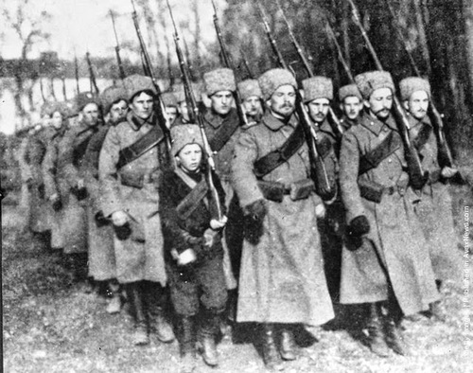
The Ticking Timebomb
When Russia mobilizes it sets in motion evens that impact all the loose alliances that existed in Europe left over from the Concert of Europe.
Germany warns Russia against taking action, they ignore and Germany has no choice but to declare war on Russia.
Notes:
Russian mobilization was the first moment an outside power turns on their so-called doomsday device.
When Russia steps in all the other countries then feel the need to join in.

Slide 18
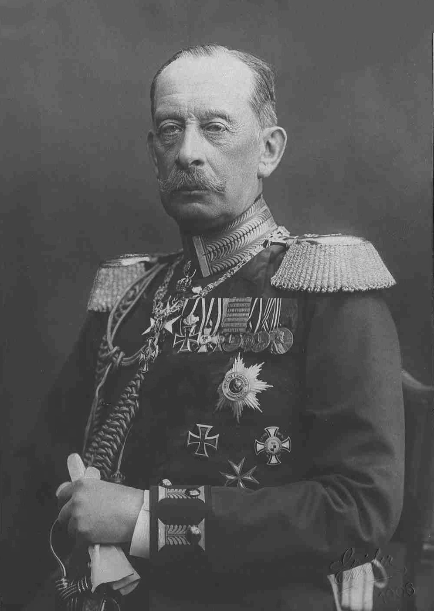
The Schlieffen Plan
When Russia steps in the clock begins to tick for Germany, they have a plan that allows for just around 950 hours to set their tactics in motion to ensure they can destroy France. France was seen as their biggest threat.
The plan called for a two-front war with France and Russia.
Notes:
Where does France come into the equation? In 1894 Russia and France entered an military alliance which ensured that France would be entering the war as well. Prior to Germany’s actions they approached the French and asked if they were going to join in, they responded that they will be forced to follow the agreements set in place with Russia in 1894. Germany offers them an out as long as they hand over the keys to all the French forts on their shared fortified border, it was impossible for France to do this.
Time now becomes the most important factor, the politician didn’t have enough time to prevent this upcoming war, the military now dictated everything and how the events were going to unfold. Britain had attempted to hold a peace conference on the 26th of July but it was already too late, Russia had already started the clock.

Slide 19
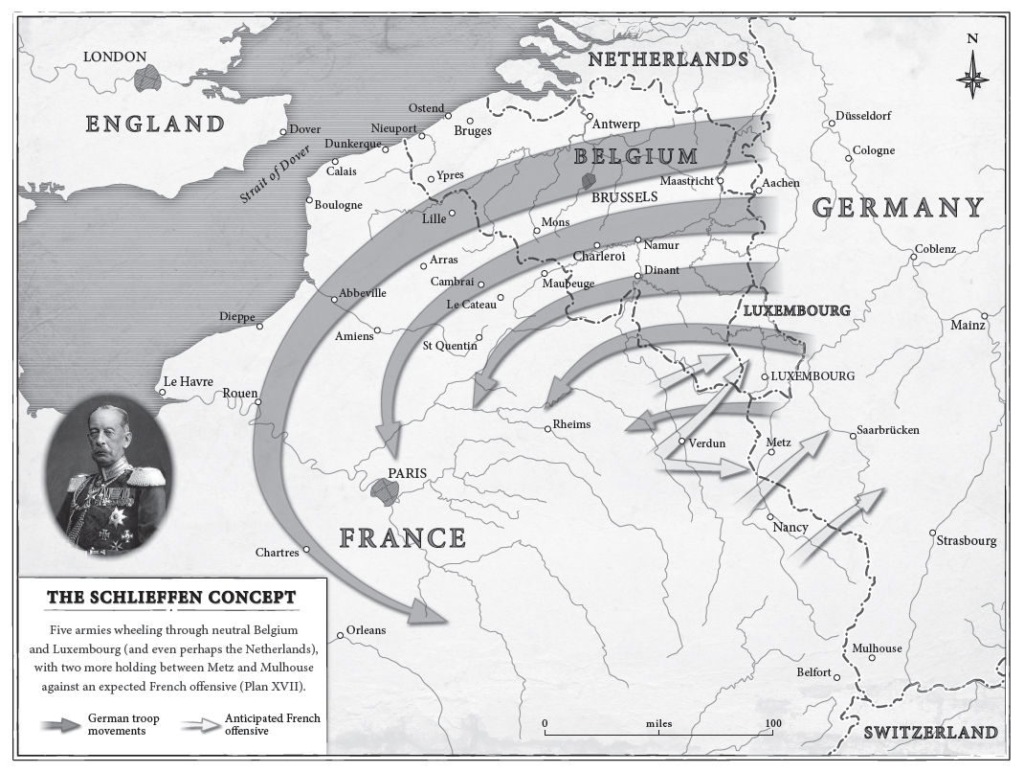
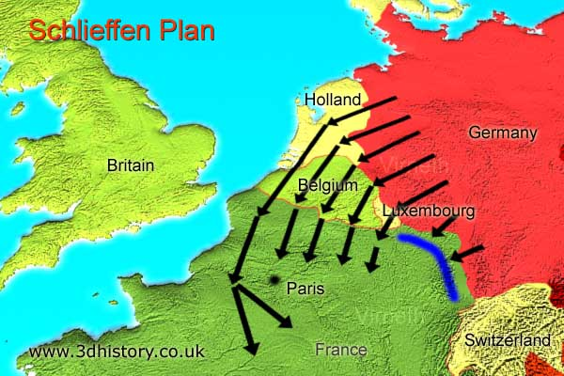
Notes:
What do you notice about this plan?

Slide 20
The Conflict Broadens – Aug 3
When France communicates its intentions, Germany has no choice but to declare war against them as well, which was included in the Schlieffen Plan anyway.
During the same time Germany also issues an ultimatum to Belgium demanding that German troops be allowed to pass through Belgian territory.
Ultimatum
Notes:
The attack through Belgium was perhaps the largest mistakes in German Military history as this action would ultimately get Britain involved in the War. Britain was allied with Belgium for over 70 years.
The Belgians and French have a heavily fortifications along their borders that had been built between 1888 and 1891 following the Franco-Prussian War(1870-1871)

Slide 21
Belgium Ultimatum
"If the Belgian army," the Secretary of State replied, "allows us to pass freely, without destroying the railways, without blowing up the bridges and tunnels, and if it retires on Antwerp without attempting to defend Liege, we promise not only to respect the independence of Belgium, the lives and property of the inhabitants, but also to indemnify you for the loss incurred.“
How would you respond to this demand?
Notes:
Belgium responded by…destroying railways, blowing up bridges and tunnels and mobilized their tiny army in preparation for an invasion.

Slide 22
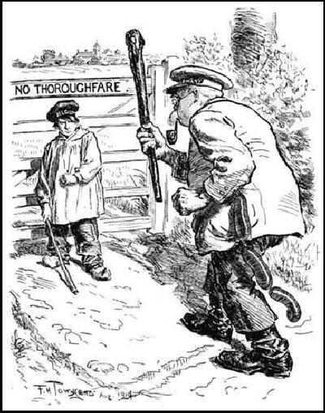
PR Nightmare
Germany decision to invade France through Belgium was a PR nightmare.
Great Britain, just two days earlier, had been committed to neutrality until Germany decided to enter Belgium. This changed everything for the British, as now the Germans were seen as the instigators and the aggressors in the lead up to the upcoming war.
Notes:
The German’s now became evil as Germany essentially invaded an innocent bystander, no other major European power had done something this heinous.

Slide 23
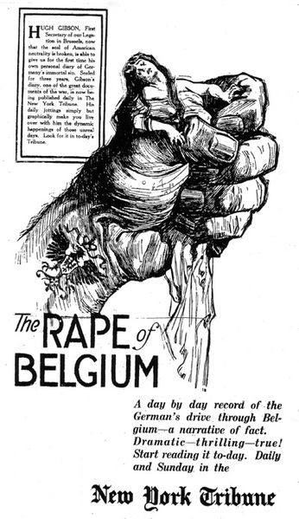
Propaganda Activity
In small groups analyse the propaganda posters available and prepare to share your analysis with the class.
Plan and create your own propaganda poster.
12 marks!
Effort, neatness, clear message, accuracy of info

