Slide 1
The Roaring 20s

Slide 2
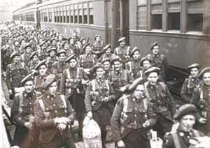
The Lead-Up
Remember that prior to the 1920s Canada struggled through a post WW1 slump where international demand for Canadian good fell and the cost of purchasing items remained high.
Returning soldiers found difficulty seeking employment and without a war many factories closed down.

Slide 3
Post WW1
While many families were happy to have their loved ones home from the war others struggles to aid those who were injured and many still had to deal with the loss of loved ones
Morally speaking, many Canadians wondered about what is ‘good” and what is “bad”, specially after experiencing so much death and destruction in Europe.
America had similar struggles but nowhere near what we felt in Canada as the USA were only involved in WW1 for a single year.

Slide 4
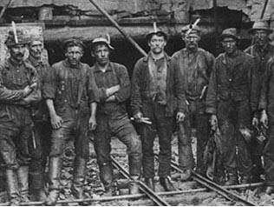
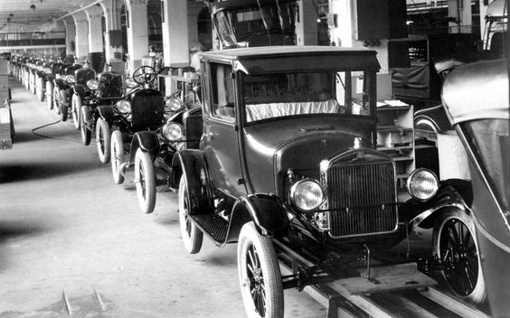
Some Hope - 1923
By the early 1920s some hope emerged as agriculture and mining increased. This was good for the Prairies(wheat), BC, Manitoba and Central Canada(mining).
Demand for pulp and paper in the US also helped boost the economy and car manufactures set up branch plants in Canada to avoid tariffs on importing goods to Canada.

Slide 5
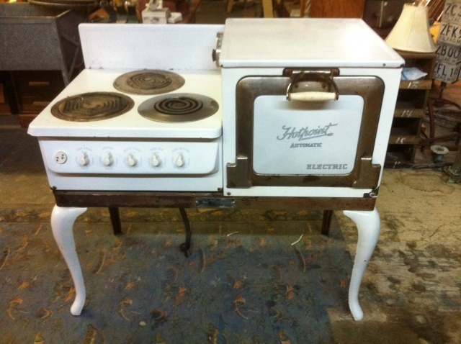
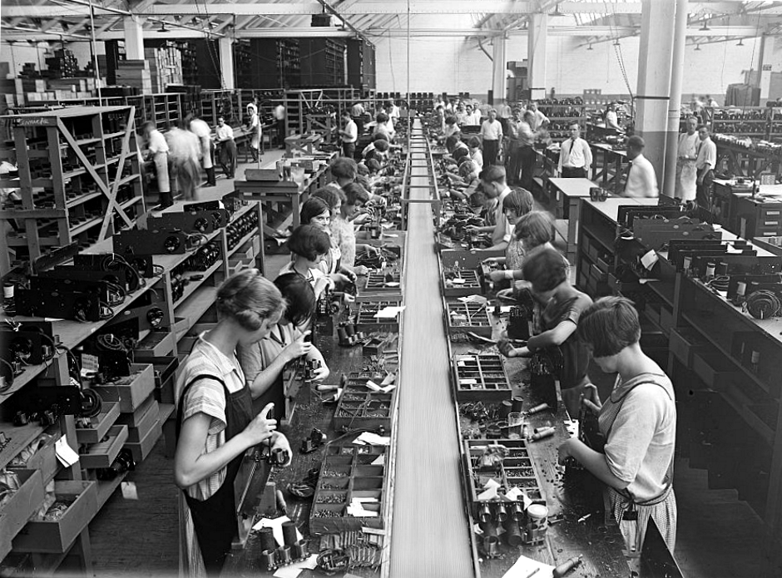
Good Times Ahead?
The introduction of the assembly line in factories greatly increased the number of products that could be made and new inventions, such as the electric range, improved the quality of life. It appeared that Canada has finally shaken off the post-WW1 slump…or at least some places in Canada did.

Slide 6
The Early Boom 1925-1929
During the mid to late 1920s many factories were redesigned to build new products and this created many new jobs.
The USA were rich from their experience in WW1 and they invested in and purchased goods from Canada.
People were now not as concerned about the struggle between what is “good” and ‘bad” and they started to loosen up and relax.
It was generally a happy time for Canadians as they were not scared anymore and the economy seemed to have rebounded for the post-war slump.

Slide 7
Reading Assignment and Questions
While some parts of Canada prospered some places, like the Maritimes and Newfoundland, continued to struggle.
Read the section titled “A Stalled Economy for Others” found on page 87-88 in your text book and answer question 1 and 3.
In addition to question 3 write about how a Maritime Union today may still be beneficial to the Atlantic provinces. You should research this…
http://www.macleans.ca/news/canada/an-unwelcome-proposal/
http://www.theglobeandmail.com/opinion/good-luck-with-that-maritime-union/article6010678/
http://www.cbc.ca/news/canada/new-brunswick/maritime-union-pitched-to-solve-financial-mess-1.1225731

