Slide 1
Insulators and Conductors
9.6

Slide 2
How would you feel if someone asked you to grab a live power line?
Knowledge of insulators and conductors allows us to approach these situations

Slide 3
Insulators
An insulator is a substance which slows the free movement of electrons from atom to atom. In fact, it resists the flow of electrons.
Think of the material that electrical wires are coated with. What is it?
These materials have a tendency to hold onto their electrons because they have a strong attraction with the electrons.

Slide 4
Since insulators do not allow the free movement of electrons, insulators can encourage the build up of static charge on the surface.
The build up will depend on the ability of each object to hold onto their electrons (Electrostatic Series) and the amount of rubbing.
Paint and wax are both insulators that can protect the car as it builds up a charge as air rushes over it while driving.

Slide 5
Although some insulators can cause static electricity problems they are very helpful because electrons cannot be conducted through electrical insulators. This protects us from electrical shocks.
Where would we find examples of everyday household insulators?

Slide 6
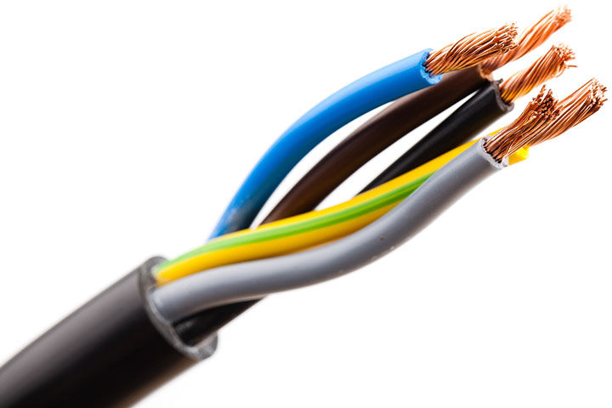
Conductors
A conductor is a substance in which electrons can move freely from one atom to another.
Now, think of the material that the actual wires are made of.

Slide 7
Static Electricity and Winter
The reason static electricity is worse in the winter is that the cold air is drier than the rest of the year and contains few water molecules.
Dry air is an insulator and does not easily pick up the charges from our body.
Therefore, any static charges that build up on our clothes and body tend to stay.

Slide 8
Common Insulators and Conductors
Good Conductor | Fair Conductor | Good insulator
Copper | Carbon | Fur
Gold | Human body | Rubber
Salt water | Earth/soil | Silk
aluminum | Acidic solutions | wood
Iron | Water vapour | Paper
mercury | nichrome | oil

Slide 9
Questions
In our safety unit, we tell students to avoid unplugging electrical equipment if their hands are wet. Why is that?
What material would you want your gloves to be made of if you were handling a live wire?
NB Power workers are told to remove any rings before working on the lines. Why do you think that is?

