Slide 1
Canadian Music

Slide 2
Canadian Musicians and Groups

Slide 3
Canadian Musicians and Bands -

Slide 4
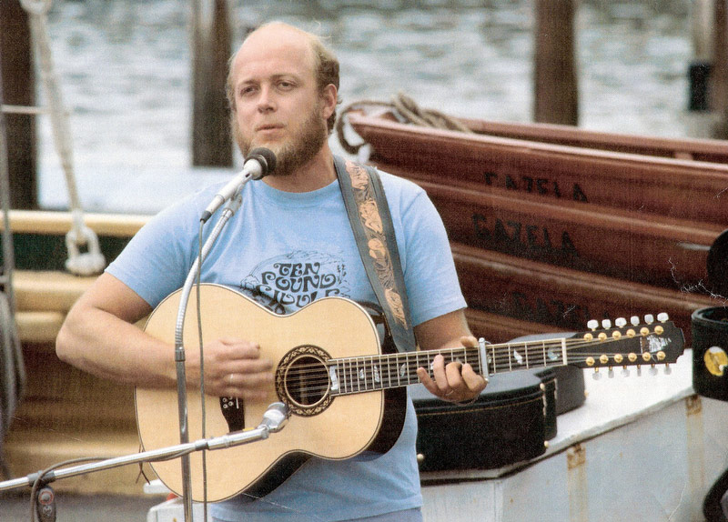
Stan Rogers
Rogers was noted for his rich, baritone voice and his finely crafted, traditional-sounding songs which were frequently inspired by Canadian history and the daily lives of working people, especially those from the fishing villages of the Maritime provinces and, later, the farms of the Canadian prairies and Great Lakes.
An interesting story in Canada’s history Rogers wrote about was Sir John Franklin’s 1845 expedition to the Arctic to find the Northwest Passage. The expedition perished when its ships became frozen in the ice.
In the News

Slide 5
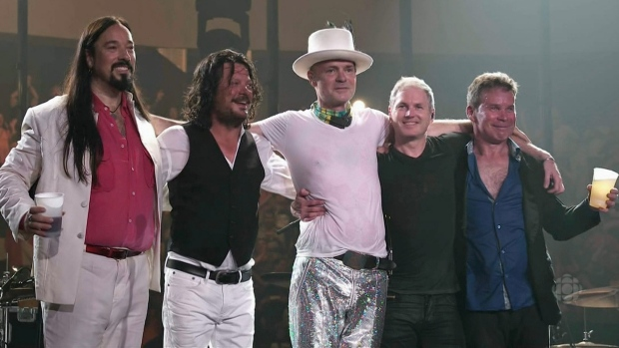
The Tragically Hip
In the News
In the News – Graphic Novel
The CBC's broadcast and livestreaming of The Tragically Hip: A National Celebration concert reached 11.7 million people on Saturday night, according to preliminary audience figures.

Slide 6
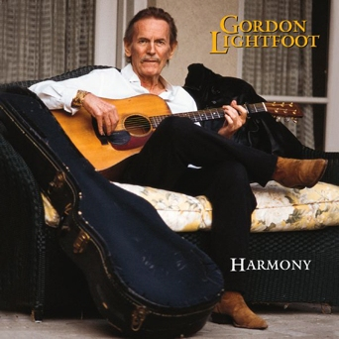
Gordon Lightfoot
Gordon Meredith Lightfoot, Jr. is a Canadian singer-songwriter who achieved international success in folk, folk-rock, and country music, and has been credited for helping define the folk-pop sound of the 1960s and 1970s.

Slide 7
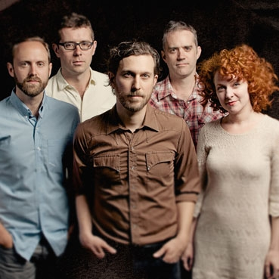
Great Lake Swimmers
Award winning band from Ontario that has represented Ont in a CBC contest to write songs about provinces.

Slide 8
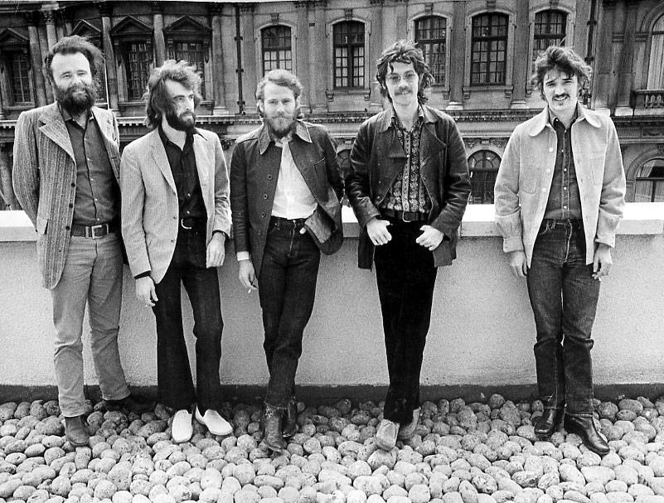
The Band
The members of the Band first came together as they joined rockabilly singer Ronnie Hawkins’s backing group, the Hawks, one by one between 1958 and 1963.
In 1964, they separated from Hawkins, after which they toured and released a few singles as Levon and the Hawks and the Canadian Squires. The next year, Bob Dylan hired them for his U.S. tour in 1965 and world tour in 1966. Following the 1966 tour, the group moved with Dylan to Saugerties, New York, where they made the informal 1967 recordings that became The Basement Tapes, which forged the basis for their 1968 debut album, Music from Big Pink.

Slide 9
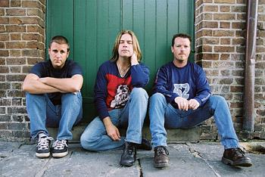
Great Big Sea
Great Big Sea was a Canadian folk rock band from Newfoundland and Labrador, best known for performing energetic rock interpretations of traditional Newfoundland folk songs including sea shanties, which draw from the island's 500-year-old Irish, Scottish, and Cornish heritage.

Slide 10
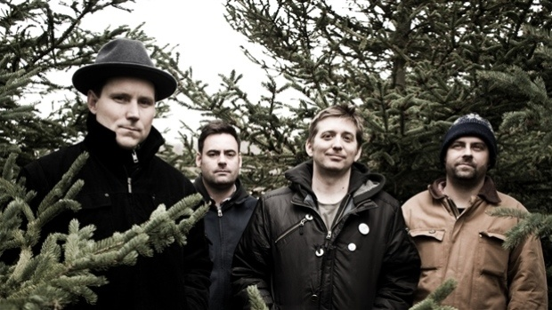
The Weakerthans
Award winning band based out of Winnipeg, Manitoba.

Slide 11
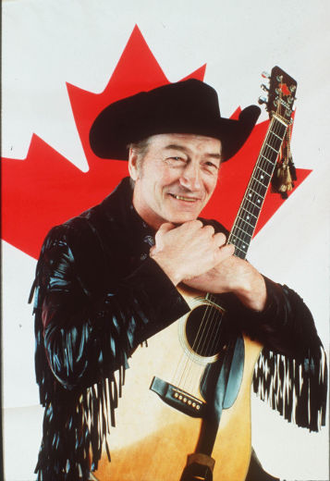
Stompin’ Tom Connors
Charles Thomas "Stompin' Tom" Connors, (February 9, 1936 – March 6, 2013) was a Canadian country and folk singer-songwriter. Focusing his career exclusively on his native Canada, Connors is credited with writing more than 300 songs and has released four dozen albums, with total sales of nearly 4 million copies.

