Slide 1
Cell Division

Slide 2
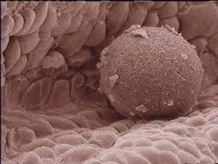
The trillion cells in your body all start as a single fertilized egg cell that divides and divides until it becomes you.

Slide 3
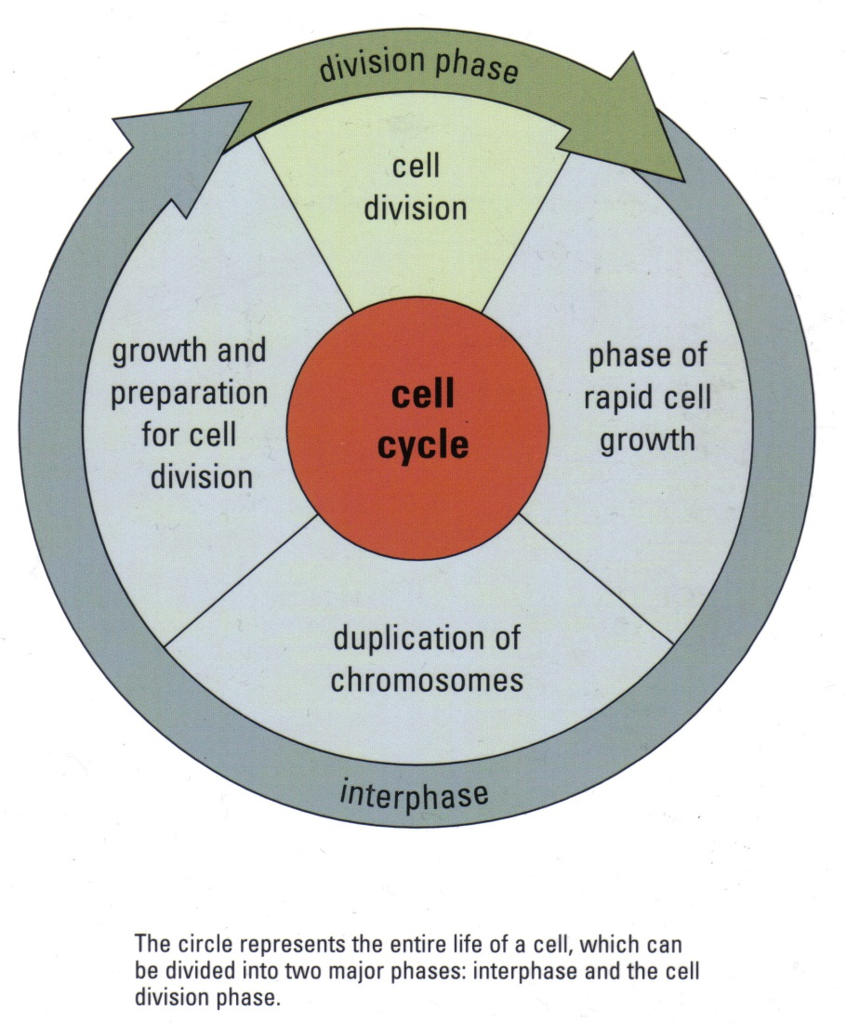
The Cell Cycle
Cells alternate between stages (phases) of dividing and not dividing. The sequence of events from one division to another is called the cell cycle.

Slide 4
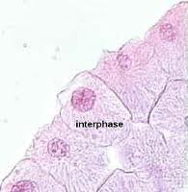
The cell cycle
The stage between cell divisions is called interphase.
During interphase the cell takes in nutrients and produces building materials, like proteins. These materials are used by the cell for energy, regrowth and repairing damage.
After a period of rapid growth the cell duplicates its chromosomes in preparation for division.

Slide 5
Question to ponder
Why do you think the duplication of the nuclear material is important during the cell cycle?
A normal human cell contain 46 chromosomes (23 pairs). After cell division, how many chromosomes would you expect to find in each of the daughter cells?

Slide 6
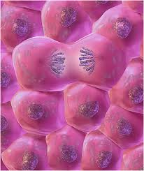
The Cell cycle
The duplication of the chromosomes is essential for the cell as the chromosomes contain genetic material which contains all the necessary information for all cell functions.
Each new cell has to contain the genetic material from the chromosomes for it to divide again after the next interphase.

Slide 7
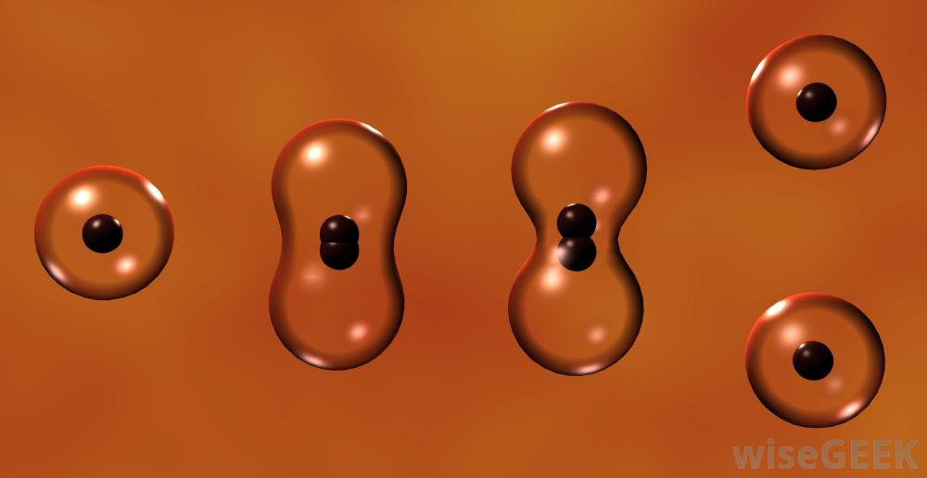
Mitosis and Cytokinesis
Cell division is very similar in most living creatures, from bacteria to human, our cells all undergo cell division where a mother cell divides into two identical daughter cells.

Slide 8
Basic Mitosis
Mitosis is the process of dividing nuclear (the nucleus) material.
During division the cells organelles and cytoplasm are shared by the newly created daughter cells.
The division of the cytoplasm and its contents happens in a process called cytokinesis.
Cytokinesis begins before mitosis is complete. In plant cells a new cell wall forms in the middle of the cell while animal cells tend to pinch in the middle to create the daughter cells.

Slide 9
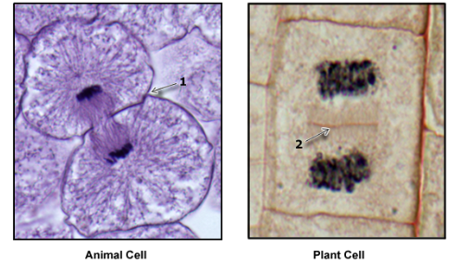
Cytokinesis

Slide 10
The Cycle continues
The processes of mitosis and cytokinesis result in the cell dividing and new cells find themselves smaller than the original mother cell.
The daughter cells enter the interphase where they gather nutrients and grow to become as large as their parent cells before them.
This process happens over and over again.

Slide 11
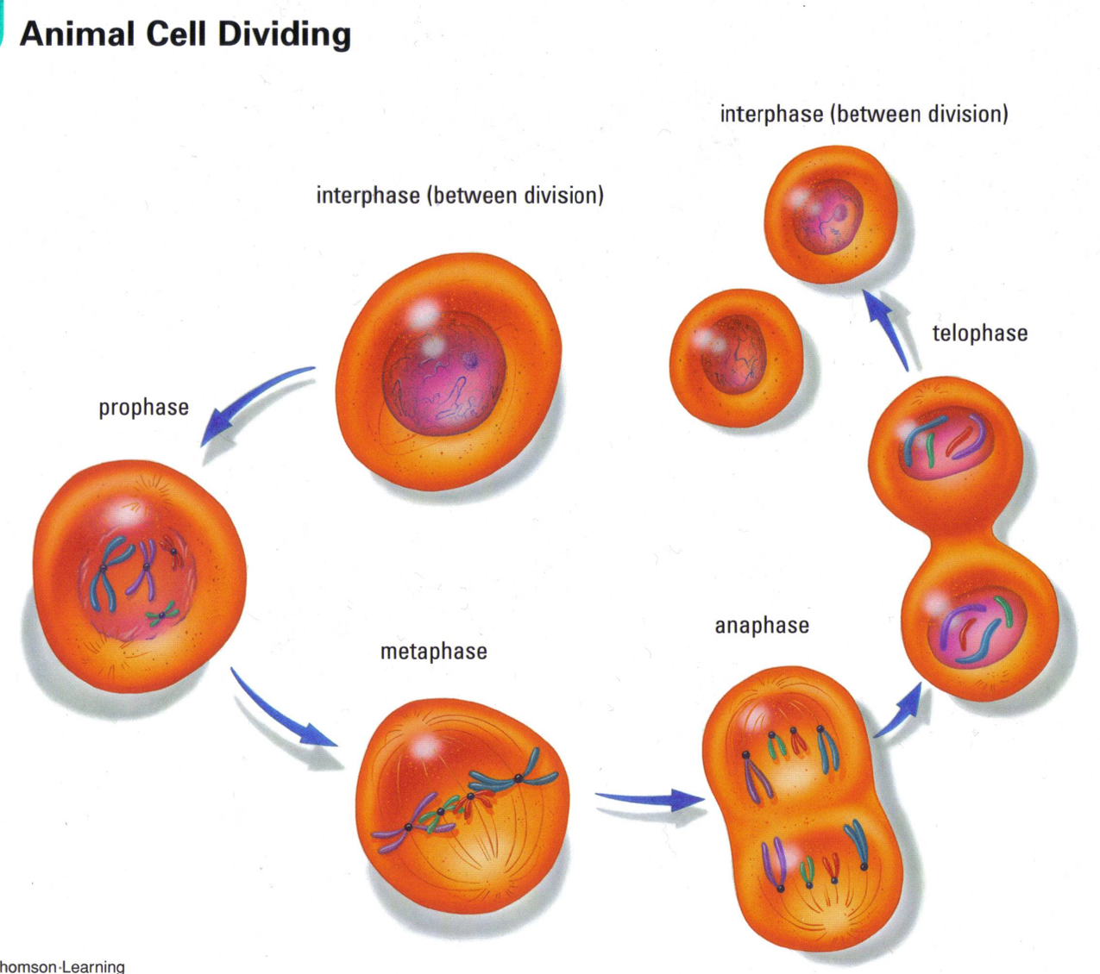

Slide 12
The phases of Mitosis
These phases are just a snapshot of the continuous cycle of cell division.
1. Interphase
2. Prophase
3. Metaphase
4. Anaphase
5. Telophase
6. Interphase (again)

Slide 13
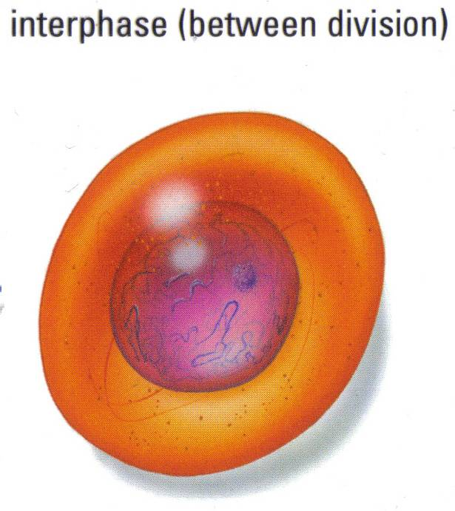
1. Interphase
Interphase involves cell growth and preparation for division by duplicating its genetic material.

Slide 14
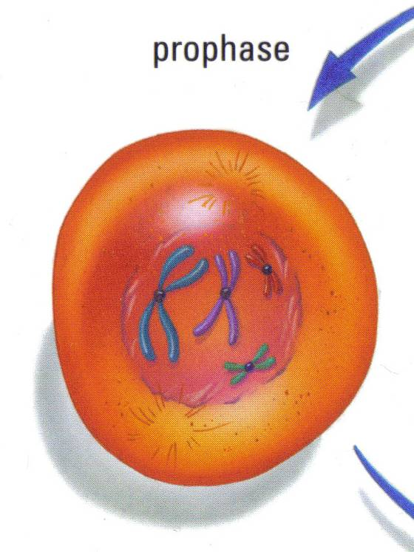
2. Prophase
The individual chromosomes, made up of two identical strands of genetic material, shorten and thicken. The nuclear membrane starts to dissolve.
The chromosomes can
be seen with a microscope!

Slide 15
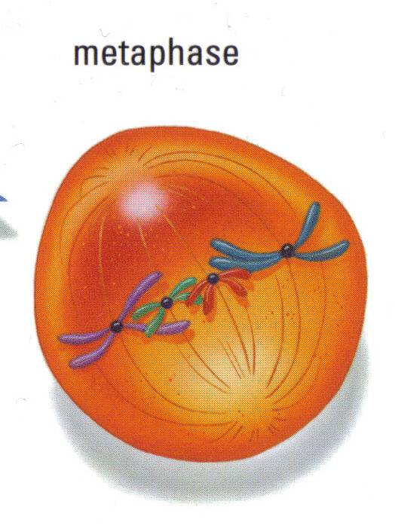
3. Metaphase
In metaphase, the double-stranded chromosomes line up in the middle of the cell. This ensures that each daughter cell will receive a copy of each chromosome.

Slide 16
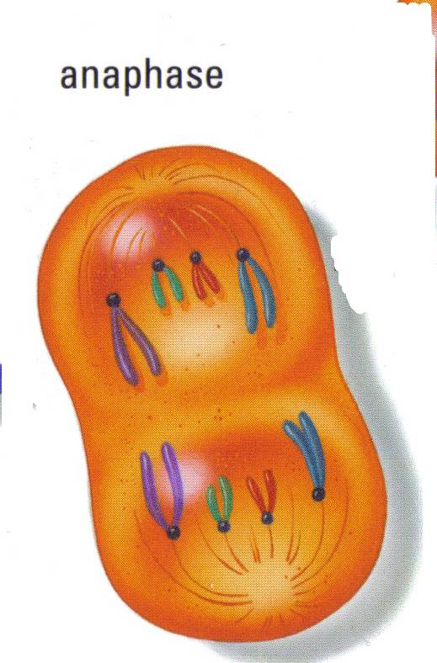
4. Anaphase
During anaphase, the chromosomes split and move to the opposite ends of the newly developing daughter cells. Each daughter cell should get a complete set of genetic material if the process happens correctly.

Slide 17
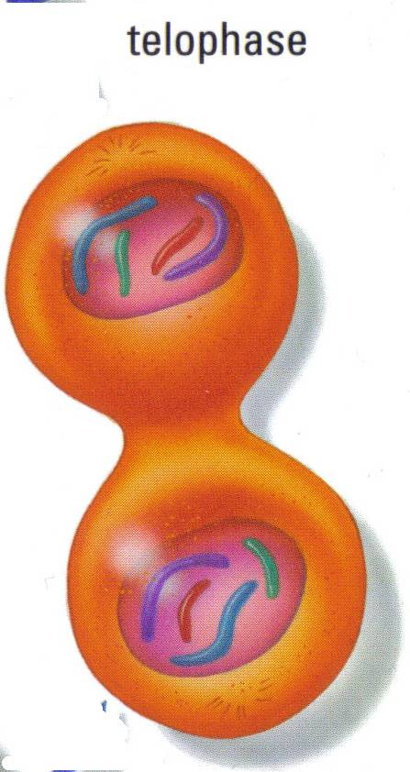
5. Telophase
The chromosomes move to the opposite ends of the developing daughter cells and a nuclear membrane begins to form around each set. Cytokinesis begins in this phase.
The chromosomes disperse and can no longer be seen.

Slide 18

6. Interphase
The daughter cells begin to grow and duplicate their genetic material again.

