Slide 1
Corrosion
1.9-1.10

Slide 2
What is corrosion?
Corrosion is the slow chemical change that occurs when a metal reacts with oxygen from the air.
This chemical reaction forms a new substance called an oxide.
Different kinds of corrosion:
Rusting
Aluminum corrosion
Silver tarnish

Slide 3
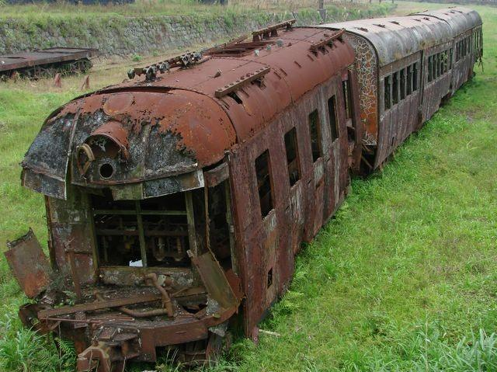
Rusting
Rusting is a chemical change that involves iron, oxygen from air and water, and salt or other minerals that may be dissolved in the water.
Fe + O₂ → Fe₂O₃
Where do we normally see rust?

Slide 4
Why Is Rusting a Problem?
Every year, millions of dollars of damage are caused to buildings, vehicles and other iron and steel products.
Rust is particularly damaging because of one of its physical properties. Rust is porous, absorbing water like a sponge.
When this happens layers flake off, leaving exposed metal to be attacked by oxygen.
This continues until the rust eats right through the metal.

Slide 5
What can we do to prevent rust?
One way is to paint it, so the oxygen cannot get to the metal.
Use alternate materials, such as plastics, instead of steel.
Also, the use of alloys of metals (mixtures) to provide a protective layer that prevents rusting.

Slide 6
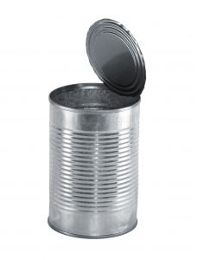
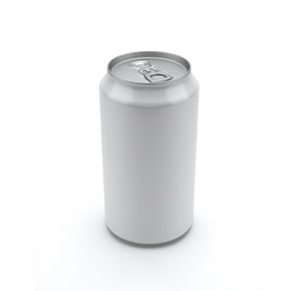
Interesting Fact
A common tin can can take roughly 100 years to degrade (rust) completely while an aluminum can takes about 400 years.

Slide 7
Questions
Corrosion of automobiles causes millions of dollars of damage every year. Which parts of the automobile corrode most? How can car owner’s reduce the effects of corrosion?
Make a list of products you have in your home that corrode:

Slide 8
FYI - Aluminum Corrosion
Aluminum has a chemical property similar to iron in that it reacts with oxygen to form an oxide.
The aluminum oxide that forms is strong and it is unaffected by water.
Al + 2 O → AlO₂

Slide 9
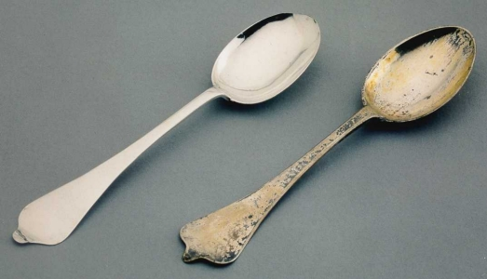
FYI - Silver Tarnish
Unlike iron and aluminum, silver does not react with oxygen but it does react with sulphur.
Sulphur is found in
Mustard
Eggs
Acid rain
Silver sulphide causes silver to develop a black coating.
The black layer is inconvenient but it can be removed by polishing the silver.

Slide 10
Combustion

Slide 11
Combustion
Combustion is a chemical reaction where a substance reacts rapidly with oxygen and releases energy.
The energy may be in the form of heat and light. The energy released from combustion is always greater than the amount of energy needed to get it started (exothermic).
Many substances can act as fuels because they burn readily.
Ex. Wood, diesel oil, and kerosene

Slide 12
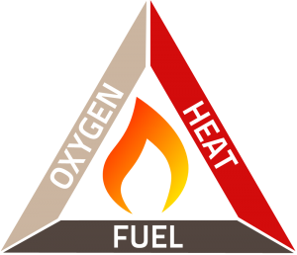
Fire Triangle
The fire triangle is a easy way to remember the three components of any combustion reaction. To stop the fire you need to remove one of the three components.

Slide 13
Fossil Fuels
Fossil fuels were formed from plants, animals, and micro-organisms that lived millions of years ago. The dead matters energy was sealed up in sediment.
Include: coal, oil, natural gas and gasoline.
Fossil fuels are made up of hydrocarbons, which are compounds that contain hydrogen and carbon.
When fossil fuels are burned:
Hydrocarbon + Oxygen → Carbon dioxide + water

Slide 15
Combustion and Air Pollution
Pollution would not be a huge problem if fossil fuels were made of pure hydrocarbons, unfortunately fossil fuels are normally mixtures of different substances.
The chemical action of combustion can be less efficient if there is not enough oxygen or heat.
Hydrocarbon + Not enough Oxygen → Carbon monoxide + water
Carbon Monoxide is a poisonous gas harmful to the environment.

Slide 16
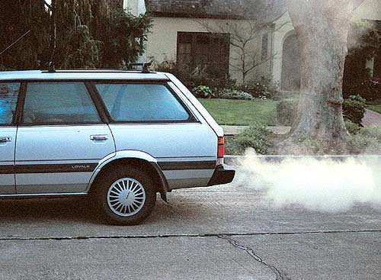
Car Combustion and Air Pollution
Car engines burn gas producing CO.
This increases the greenhouse effect.
This increased greenhouse effect causes global warming and produces other substances like carbon monoxide, smaller hydrocarbons, sulphur dioxides, and nitrogen oxide. All of these are dangerous to the environment, including people.

Slide 17
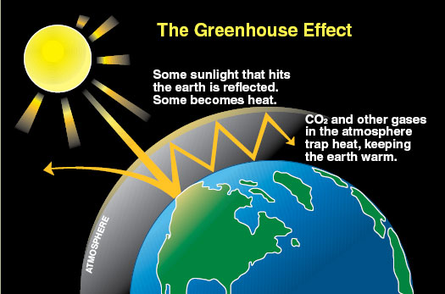
What is the Greenhouse Effect?
CO₂ in the atmosphere acts like the glass in a greenhouse, trapping in the heat.
This causes an increase in the Earth’s temperature.
Average Earth’s temperature is 15ºC

Slide 18
Classwork
Answer questions 1-5 on page 39
Chapter 1 Review Questions:
Answer questions pages 40-41:
3, 4, 5, 6, 7, 12, 13, 16
Bill Nye video – Chemical Reactions

Slide 19
Page 40 Answers
3.a) A physical property is any characteristic of a substance that does not depend on the effect of other substances. A chemical property describes how a substance will interact with another substance.
3.b) Wood is brown and burns. Baking soda is white and reacts with acid.

Slide 20
Page 40 Answers
4.a) reactants
b) products
c) chemical change
d) physical change
e) soluble
f) brittle

Slide 21
Page 40 Answers
5.a) A chemical change produces a new substance.
b) The formation of frost is a physical change.
c) A chemical change may produce a new substance called a “precipitate”.
d) A new colour may indicate a physical or chemical change.
e) Ability to react with acid is an example of a chemical property.

Slide 22
Page 40 Answers
5.f) No substances are safe to taste in the lab.
g) Malleability is a physical property.
h) A physical change is a change of state or form.
i) Corrosion is the reaction of a metal with oxygen in the air.
j) Goggles may be taken off if all students have finished their experiments and cleaned up.

Slide 23
Page 40 Answers
6. Five clues that indicate a chemical change are:
a colour change
formation of a gas
formation of a precipitate
an energy change
difficulty of reversing change.

Slide 24
Page 40 Answers
7. a) physical (change of state)
b) Phys. or chem. (soap dissolving grease)
c) Phys. or chem. (filament heating up)
d) chemical (dough changes into cake)
e) chemical (burning)
f) chemical (decay/decomposition)
g) physical (change of shape)
h) chemical (explosion)

Slide 25
Page 40 Answers
12. This is a physical change. Solid sulfur has melted to form a liquid.
13. The change is a physical change. The solid and liquid in these state changes have the same melting and freezing points.
16. Plastic and fiberglass tend to become more brittle and crack in the sunlight over periods of time. Plastics are replacing metals in everything from car body panels to cooking utensils for microwave ovens.

Slide 26
Bill Nye Video: Chemical Reactions Ch. 1 Quiz Tomorrow

