Slide 1
Early Revolutions

Slide 2
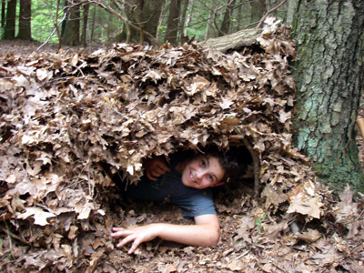
Thoughts – You & History
Picture yourself alone, in the woods, with nothing.
Could you live in the wild with only tools you made from the items that you can find around you?

Slide 3
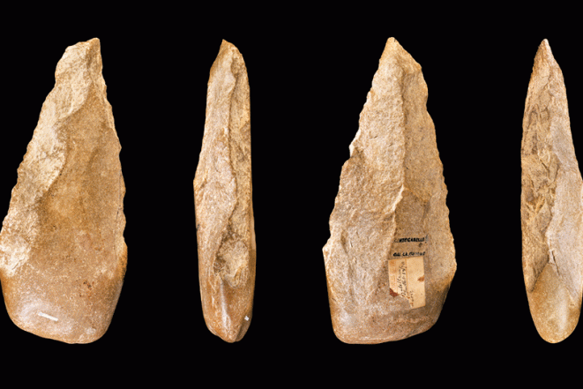
The Paleolithic Age
Approximately 2,500,000 – 10,000 BCE we, hominids, survived using simple tools created from stone and wood.
Paleolithic is Greek for “old stone” and this age is often called the Old Stone Age.

Slide 4
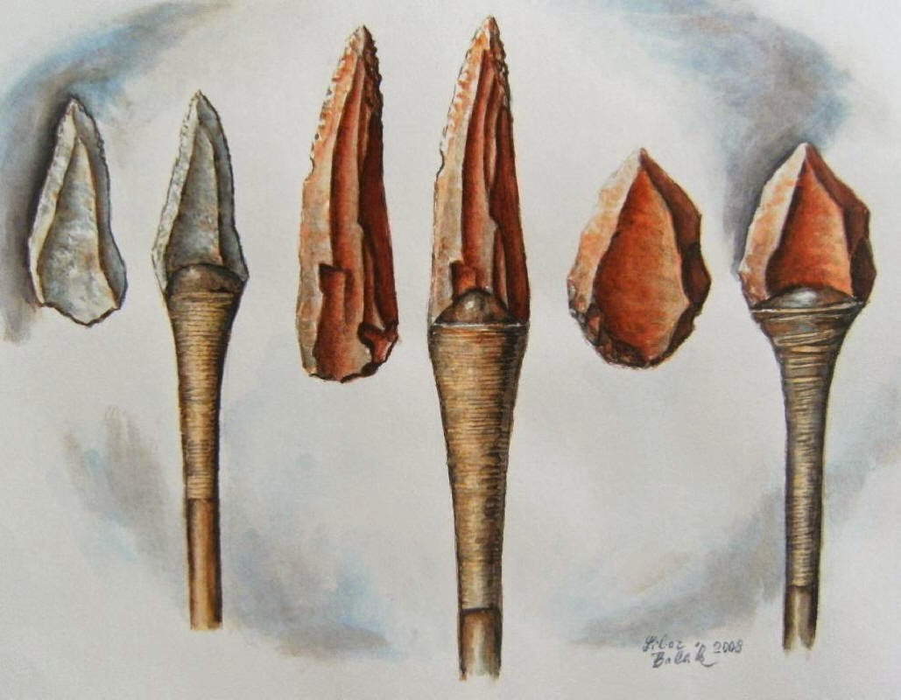
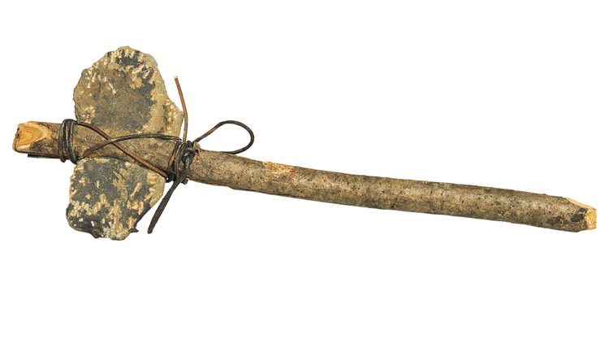
Life for the Paleolithic humans
Hunting and Gathering – a close relationship with the environment led to gathering nuts, berries, grains and green plants as well as hunting medium size game and fish and shellfish in coastal areas.
Primitive Technology
Tools – hand axes created from stones (ex. flint) and spears allowed hominids to kill larger animals. Bow and arrows came along later in the era as well as harpoons and fishhooks for coastal tribes.

Slide 5
Gender Roles
Roles for Men and Women – While it is hard to know for sure we can assume that because women bore and raised children they probably stayed closer to camp. Most historians believe that women were more responsible for gathering as well as teaching the younger children about what plants, roots, berries and nuts were safe.
As food was a constant need for survival men too had to play a role. It is believed that men had the responsibility to travel longer distances to hunt for animals.
It is likely that both men and woman made decisions about food and both genders played a vital role in the constant search for food. Both men and women had the task of teaching younger generations about survival.

Slide 6
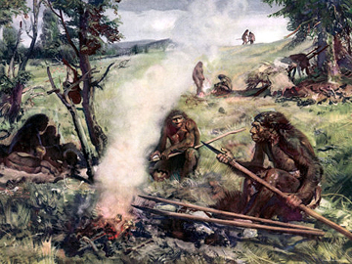
Adapting
Living accommodations were very primitive and adapting to changing seasons and climate forced early hominids to seek shelter in caves. Eventually newer structures were developed to allow some reprieve from the elements.
Animals skins were used as shelter and wood was used in many structures.
Fire was one “discovery” that allowed hominids to flourish and emigrate to new lands and climate. Evidence shows that some homo erectus used fire as long as 500,000 years ago.
Notes:
Fire was used for many things, including: warmth, keeping wild animals away, flush out hiding animals to be caught, socializing, and cooking.
Cooking food tasted better, lasted longer and was easier to digest. Cooking food was a very important moment for hominids – homo erectus.

Slide 7
Activity - Drawing
You choose: draw, as realistic as possible, a bull, horse or deer.

Slide 8
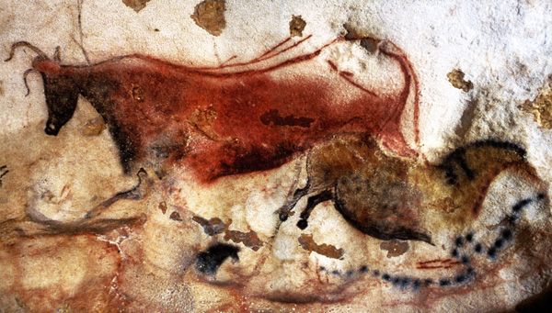
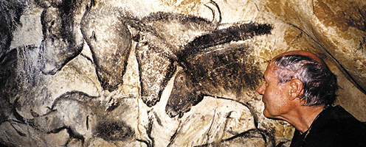
Creating Art
Art was as much a part of early humans as it is to us. In many places around Europe, caves were discovered that contained “painting” that despite deterioration depicted horses, bulls, stags and other animals.
Notes:
Many of these drawings were found in small difficult to navigate caves. The artists had to carry small “animal fat lamps” into caves and used reeds, sticks and fingers to create their masterpieces around 35,000 years ago.
It’s unclear as to why these painting were created, some believe it was for “luck” in future hunts, some believe that it could be for magical or religious reasons and some just suggest that it was merely pleasing to the eye.

Slide 9
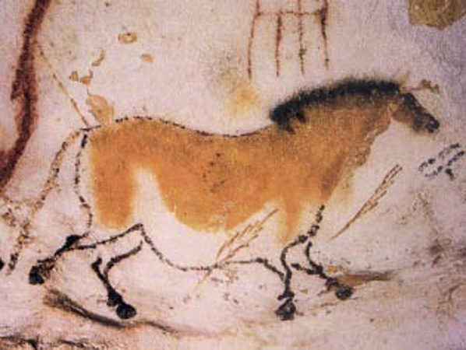
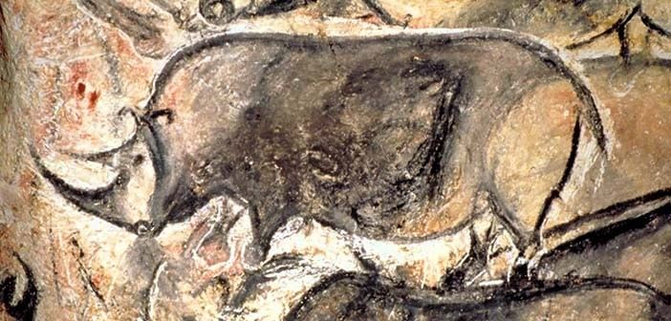
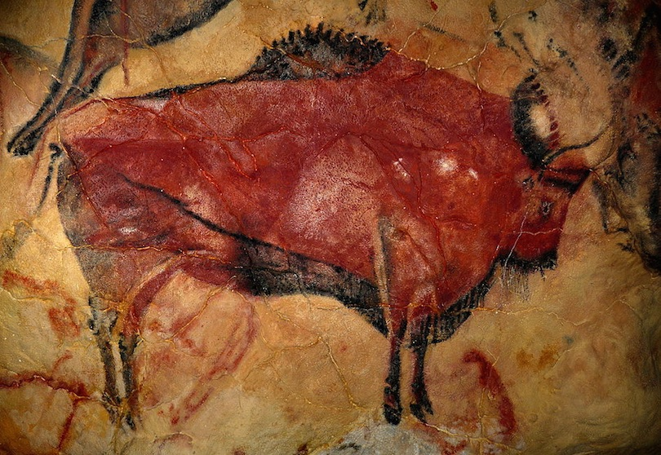
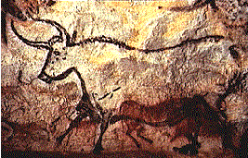

Slide 10
Questions – in your notebooks
Referring back to the previous slide, what do the paintings reveal about the relationship between early man and animals?
What are two important (significant) innovations of Paleolithic peoples?

Slide 11
The Neolithic Revolution
Agricultural Revolution

Slide 12
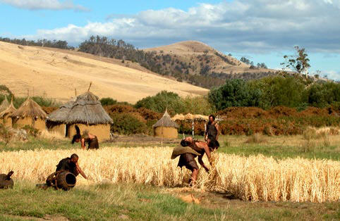
Agricultural Revolution
At the end of the last Ice Age, around 8000 BCE, the known world went through a revolution that lasted until 4000 BCE.
There was a shift in methods of survival, from hunting and gathering to the keeping of animals and the growing of food on a regular basis – what we call systematic agriculture.

Slide 13
Nomads no more
Domestication of animals allowed for a regular source of meat, milk and wool.
These domesticated animals helped with planting crops and allowed early humans to take control of their daily lives instead of having to spend countless hours finding food.
Historians believe that this revolution is the single most important development in human history.
This process, despite being called a revolution, was actually a gradual shift from older nomadic lifestyles to a stationary one.

Slide 14
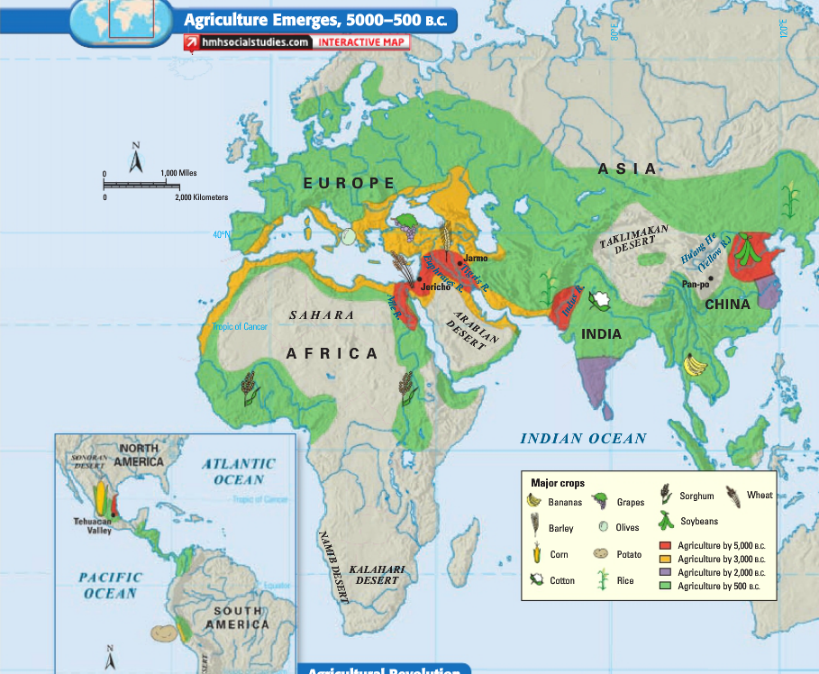

Slide 15
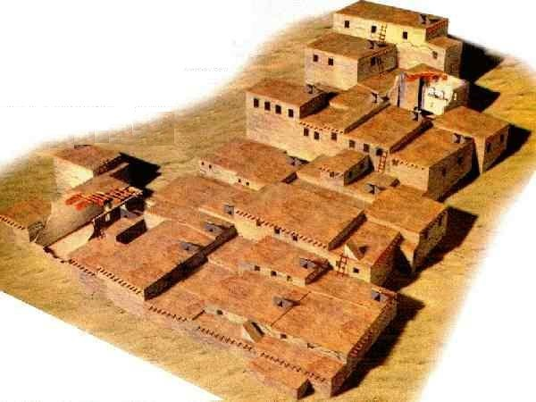
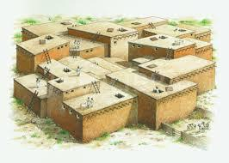
Birth of Villages
The shift towards growing crops and raising livestock gave way to the rise of permanent settlements and communities that were home to hundreds and even thousands of residents.
Catalhuyuks found in modern Turkey
Notes:
Catal Huyuk was a very large Neolithic proto-city settlement in southern Anatolia, which existed from approximately 7500 BC to 5700 BC, and flourished around 7000 BC.
Each house in Catal Huyuk has its own oven for the baking of bread. The walls and the floors of the houses are covered in plaster, renewed annually, and the walls in most houses are decorated with panels of red. Rush matting is used on the floors. The furniture is built in with brick platforms for sitting on, working on and sleeping on. Under these platforms the bones of the dead are buried, to remain part of the family.
Jericho is the oldest known city, it is dated back to 8000BCE.

Slide 16
Effects of Neolithic Villages
The rise of villages, due to the agricultural revolution, had a tremendous impact on people’s daily lives and gave birth to a barter system, labour specialization
Villagers saw the need for wall for protection and storage for goods. Storing excess products encouraged trade and trading encouraged people to learn crafts. This naturally led to the division of labour.
Artisans – skilled workers
Notes:
Artisans became more skilled and made more refined tools. These new tools improved hunting and farming as well as improvements in textiles and pottery.

Slide 17
Activity
Read Paleolithic to Neolithic – Descriptions of Daily Life and record findings in the chart provided.

