Slide 1
EGYPTIAN RELIGION
Gods and Goddesses
Beliefs and Practices
Death and the Afterlife

Slide 2
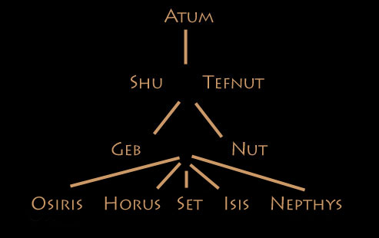
In the Beginning…
Much like any religion, the Egyptians had there very own creation story, or stories…
Notes:
Read pg 92 from the text: Prologue to the Present
There are a few creation stories that seem to conflict with one another and make studying Egyptian religion challenging. Despite this challenge we can learn a lot about Egyptian society and culture.

Slide 3
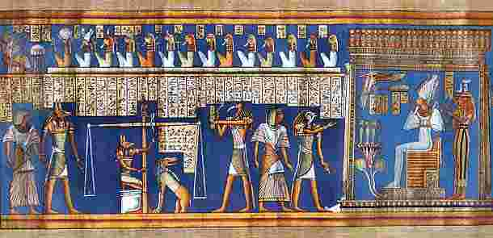
Gods and Goddesses
The ancient Egyptians believed that immortal beings influenced all aspects of nature and human activity.
As a result, they worshipped many different deities… more than 80 gods and goddesses. (polytheistic)
Notes:
Egyptians were often very open to welcoming new gods into their pantheon if newcomers to Egypt couldn’t find an already established god to suit their needs. Egyptians also allowed foreigners to worship their own God/Goddesses.

Slide 4
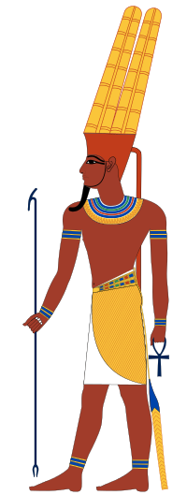
Amon-Re
Re, or Amon-Re was the chief god of the Egyptian pantheon.
He was relied upon for a good harvest.
He had a “mysterious” nature, Amon means “hidden”.
It was during the New Kingdom that Amon-Re became the principle god of Egypt.

Slide 5
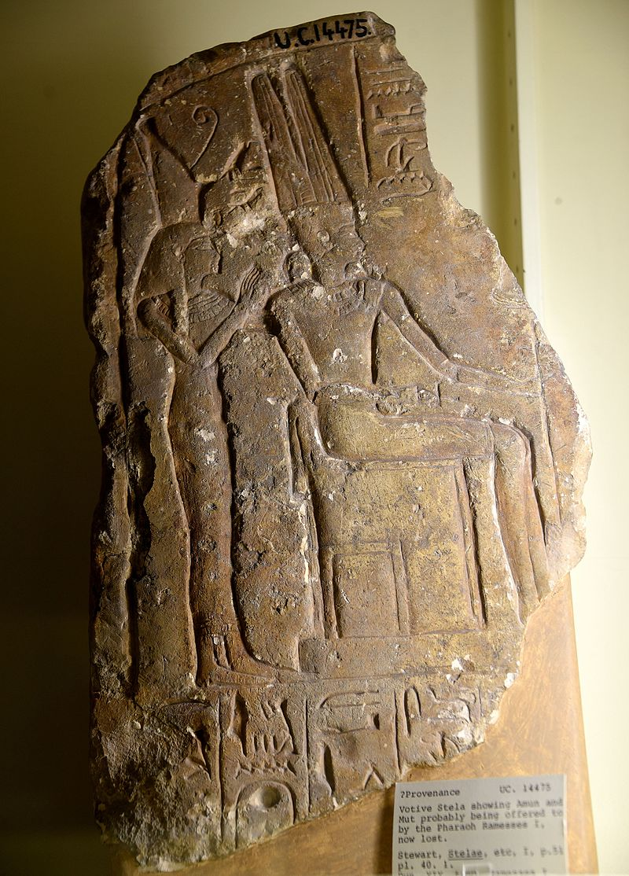
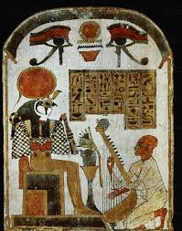
Amon-Re, the sun god and chief god of the Egyptian pantheon was a combination of Amon and Re, two independent sun and creator gods that were worshipped by tribes in early ancient Egypt.
Notes:
Amon-Re is actually a fusion of two “gods” Amun and Ra as after the rebellion of Thebes against the Hyksos, Amun acquired national importance, expressed in his fusion with the Sun god, Ra, as Amun-Ra or Amun-Re. As you can see understanding Egyptian theology is quite challenging.

Slide 6
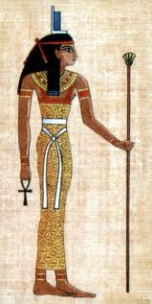
Isis
Isis was the goddess of female fertility and the protector of children.
Despite her association with being a mother and wife her chief aspect was that of a great magician, whose power surpassed that of all other deities.
Notes:
Isis was initially an obscure goddess who lacked her own dedicated temples, but she grew in importance as the dynastic age progressed, until she became one of the most important deities of ancient Egypt. Her cult subsequently spread throughout the Roman Empire, and Isis was worshipped from England to Afghanistan. She is still revered by pagans today. As mourner, she was a principal deity in rites connected with the dead; as magical healer, she cured the sick and brought the deceased to life; and as mother, she was a role model for all women.

Slide 7
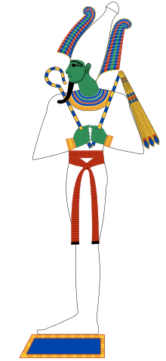
Osiris
Osiris- ruler of vegetation and the dead.
He is often depicted as a mummy.
He is often seen with green or black skin as it represents the fertile soil along the Nile river.
Notes:
Osiris one of the most important gods of ancient Egypt. The origin of Osiris is obscure; he was a local god of Busiris, in Lower Egypt, and may have been a personification of underworld fertility. By about 2400 bce, however, Osiris clearly played a double role: he was both a god of fertility and the embodiment of the dead and resurrected king. This dual role was in turn combined with the Egyptian concept of divine kingship: the king at death became Osiris, god of the underworld;

Slide 8
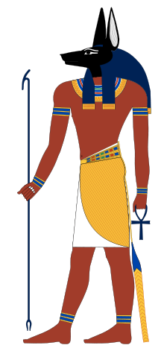
Anubis
Anubis was the guide of the afterlife.
He presided over the embalming rituals and heard praises on behalf of the dead.
Notes:
Anubis is the Egyptian god of mummification and the afterlife as well as the patron god of lost souls and the helpless. He is one of the oldest gods of Egypt, who most likely developed from the earlier (and much older) jackal god Wepwawet with whom he is often confused.
Anubis' image is seen on royal tombs from the First Dynasty of Egypt (c. 3150-2890 BCE) but it is certain he had already developed a cult following prior to this period in order to be invoked on the tomb's walls for protection.
His Black appearance symbolized the decay of the body as well as the fertile soil of the Nile River Valley which represented regeneration and life.

Slide 9
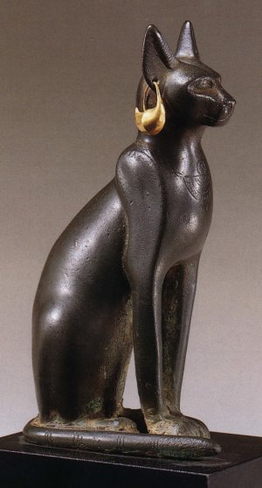
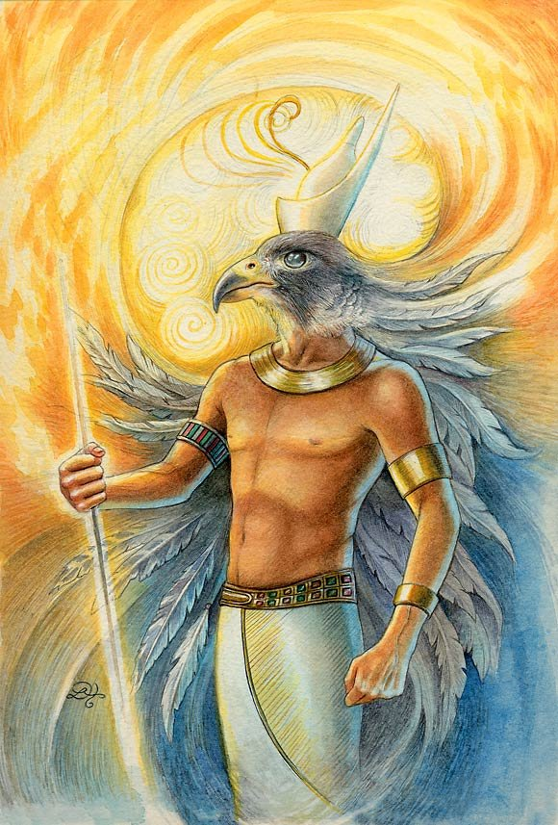
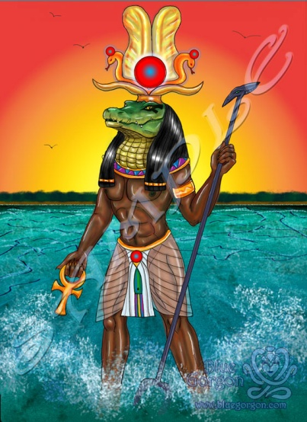
Association with Animals
Many deities were associated with animals.
They were pictured with human bodies and animal heads.
Dog/cat= loyalty
Crocodile/serpent= fear
Hawk/falcon= swiftness

Slide 10
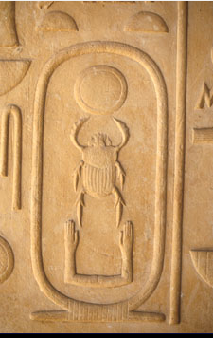
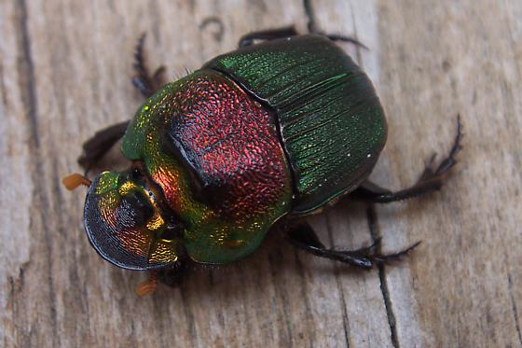
The Egyptians imagined a huge scarab beetle rolling the ball of the sun across the sky, which led to an association of the beetle with the sun god Ra.

Slide 11
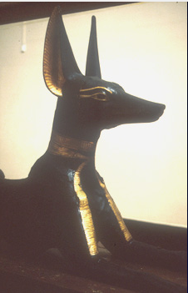
Jackals were often seen in the deserts close to the towns and villages, scavenging whatever food they could from their human neighbours. They were also often found in cemeteries, and for this reason jackals became associated with the dead - as represented by the god Anubis. This god was worshipped both as the guardian of cemeteries and as the god who presided over the embalming of the dead.

Slide 12
Notes:
How Anubis Became God of Embalming
The mythology of the story varies, but according to legend:
Osiris' brother (Seth), killed Osiris by luring him into a fancy coffin, sealing it shut, and pushing it into the Nile.
Osiris' wife and sister (Isis), retrieved Osiris’ body on the Phoenician coastline, but an angry Seth chopped up Osiris’ body and scattered it throughout Egypt.
Anubis, Isis and Nephthys, set about to find the pieces and were successful (except for Osiris’ phallus).
Another Egyptian God called Thoth, helped restore the body and Anubis wrapped Osiris in linen, the action of which bestowed on him the title, “He Who is in the Place of Embalming”.

Slide 13
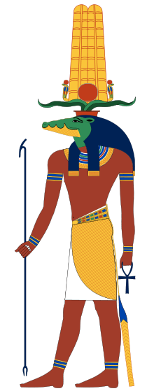
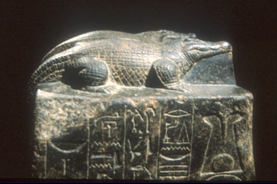
Crocodiles were a real danger to the Egyptians and, like other dangerous animals, were given divine status (in their case as the god Sobek) in the hope that in return they would not attack humans.
Notes:
Sobek was the god of the Nile

Slide 14
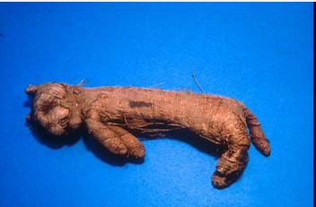
Cat Connection
Cats were kept to protect food stores from rats, mice and snakes, and were kept as pets. They are shown in paintings beneath their owners' chairs, or on their laps. Egyptian cats resembled modern tabby cats. The Egyptian name for cat is 'miw'.

Slide 15
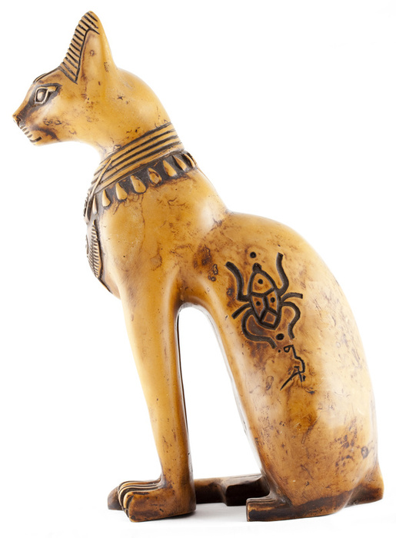
Cats also had a symbolic or religious meaning, as represented by the goddess Bastet, Goddess of Warfare, and in later periods of Egyptian history cat mummies were used as offerings to the gods.

Slide 16
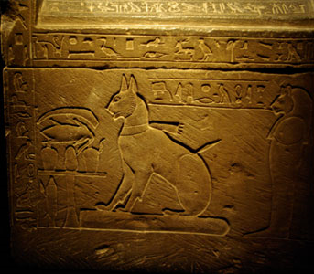

Slide 17
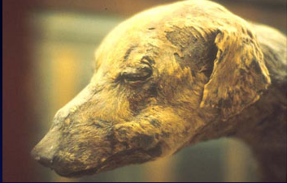
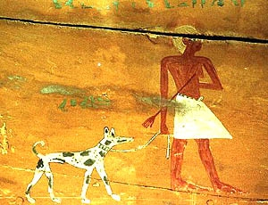
'Man's best friend' was considered not just as a family pet, but was also used for hunting, or for guard duty, from the earliest periods of Egyptian history.
Pet dogs were well looked after, given names such as 'Blackey' or 'Brave One', and often provided with elaborate leather collars.

Slide 19
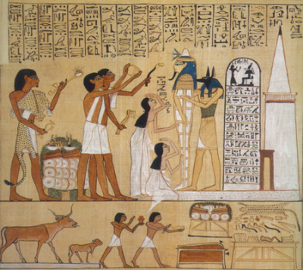
Death and the Afterlife
Egyptian burial practices were a way to ensure that the person who had died could continue to enjoy living in the afterlife.
For a person to pass on to the afterlife, it was believed that the body had to be preserved in a recognizable form.
Before mummification, the dry desert provided this as it removed moisture and prevented decay.

Slide 20
In-Class Assignment
Using the following video and page 97 from your text illustrate the key stages in the mummification process.
Video

