Slide 1
First Contact

Slide 2
Vikings
In 986 CE, Bjarni Herjolsson, while sailing to Greenland from Iceland, was blown off course by a storm and reported seeing land that was not Greenland.
Years later, another Viking, Leif Ericson, followed Herjolsson’s route and landed in modern day Newfoundland and called the region Vinland.
Leif’s stay was marked by both hostile confrontations with First Natives and peaceful trading with others.
His settlement at L’Anse Aux Meadows, was the first European settlement in North America.
Notes:
Ericson also named Labrador Markland, because of the abundance of trees.
Leif’s travels served as inspiration to later travelers as European’s went in search of the New World.

Slide 3
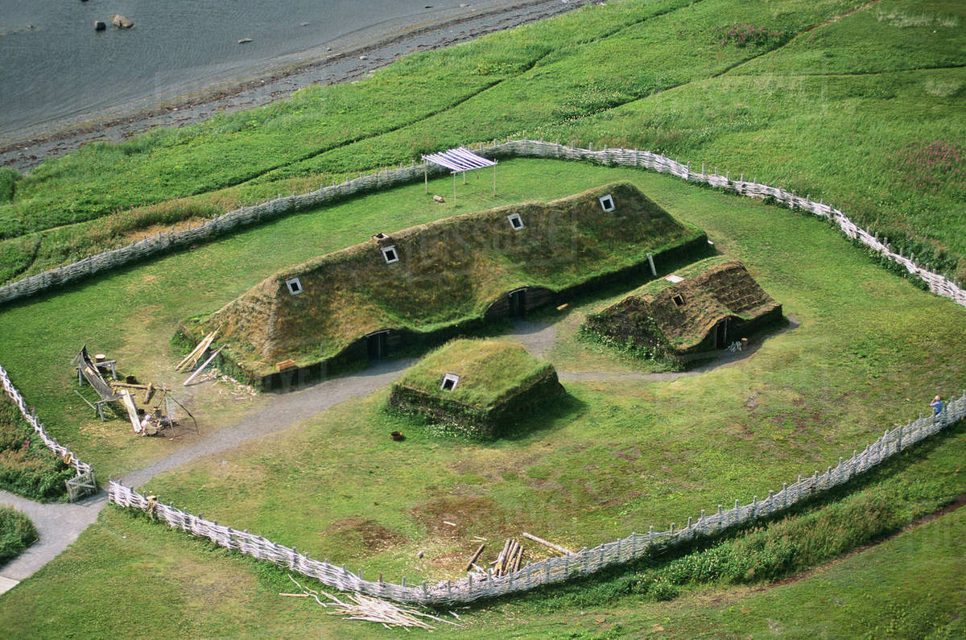
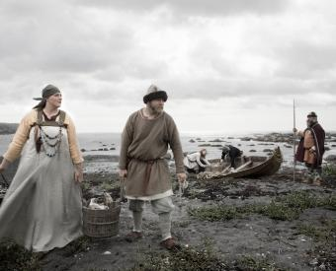
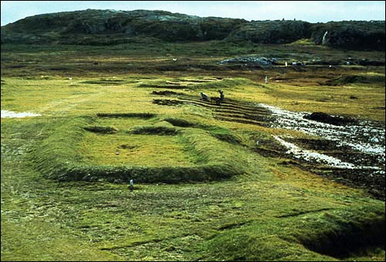
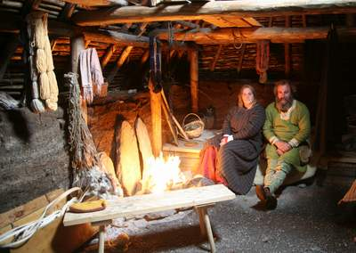
World Heritage Site – L’Anse aux Meadows
Notes:
L’Anse Aux Meadows was discovered by two Norwegians who retraced Leif Ericson’s voyage to Newfoundland. They unearthed 8 dwellings and hundreds of artifacts.

Slide 4
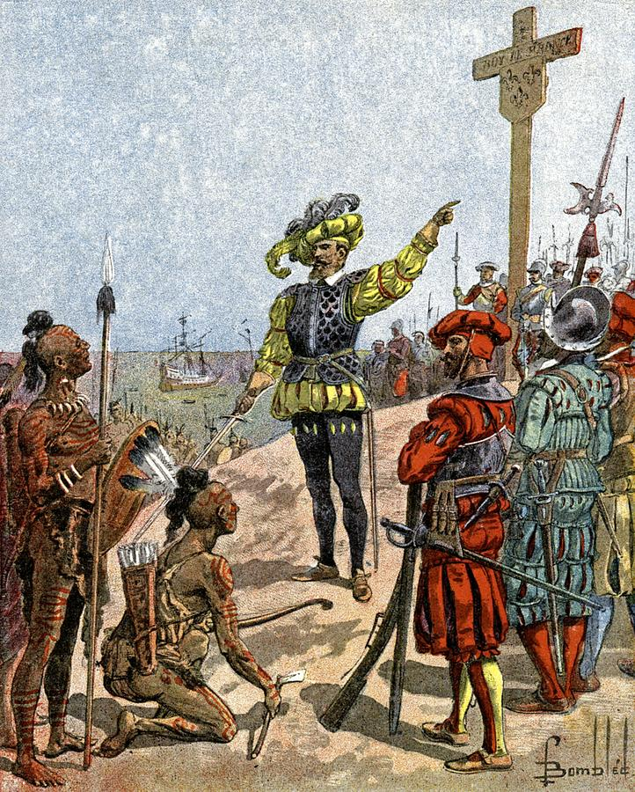
The Doctrine of Terra Nullius
European explorers approached the New World with the confident feeling of superiority of European cultures. They believed that the “New World” land belonged to no one( Terra Nullius).
They claimed the land for their home countries despite knowing that their were already people here.
Many European explorers believed that, because First Nations people were not Christian, the land couldn’t belong to them.
Notes:
How does this image depict the native populations? And how about Cartier and his men?

Slide 5
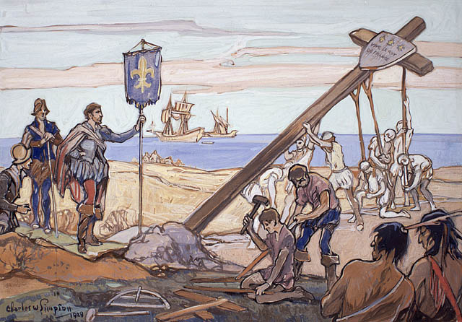
Mine!
Cartier claiming land for France in 1534 by erecting a giant cross.
How do you think this went over with the First Nation peoples?
Notes:
Cartier met with Haudenosaunee (Iroquois) leader Donnacona while travelling up the St. Lawrence River. The chief knew what was happening and Cartier had to resort to bribing and lying to Donnacona by insisting that the cross was a navigational marker. Cartier brought two of Donnacona’s sons back to France with him. Some argue it was kidnapping…

Slide 6
Giovanni Caboto – John Cabot
Because Constantinople was sacked by Muslims in 1453, many European countries were cut off from the east.
To remedy this problem many countries funded expeditions to seek a Northwest Passage to Asia.
England, after hearing about Columbus, hired Cabot to find this passage first and open up trade with the East again.

Slide 7
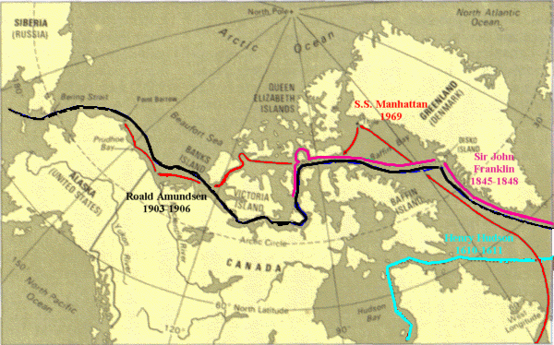
Notes:
The quest for the NW Passage often ended in disaster or failure.

Slide 8
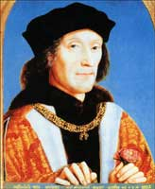
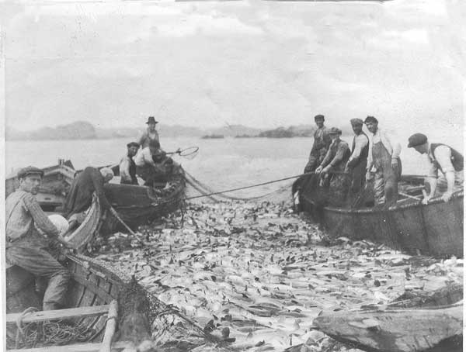
Cabot and New Founde Land
In 1497 Cabot and his crew of 18 arrived in Newfoundland aboard the Matthew. Upon his landing he erected a cross and a banner in the name of King Henry VII.
While Cabot didn’t find the Northwest Passage he did find something just as valuable…Cod.
Heritage Minute
Notes:
News of the abundance of fish spread quickly and soon other countries were sending boats to the Grand Banks to drop nets and return home with full loads of Cod fish.

Slide 9
Religion, Trade and Competition
As these early explorers returned to Europe with stories of “Indians”, many religious groups believed it was their God given duty to spread the Christian faith to this unknown cultures.
These groups, disregarding the culture and diverse spiritual traditions of the First Peoples, insisted on “helping” these people.

Slide 10
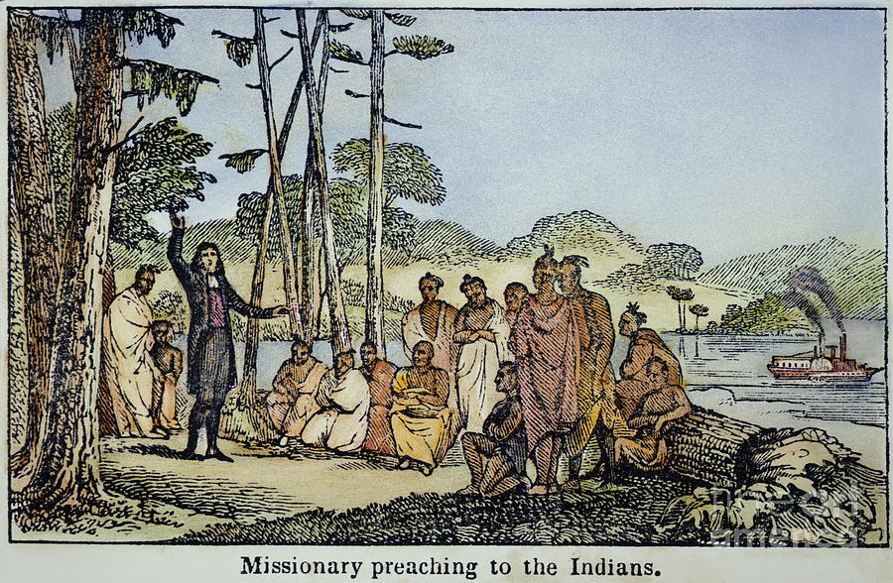

Slide 11
Trade and Money
In the early years of exploration many countries believed that finding new lands would lead to increase trade and, in turn, wealth.
North America served as an opportunity to exploit the land and resources to supply a steady stream of raw materials.
The raw materials would supply the manufacturing factories back in the home countries and new, permanent, settlements would act as an excellent market to sell finished goods.

Slide 12
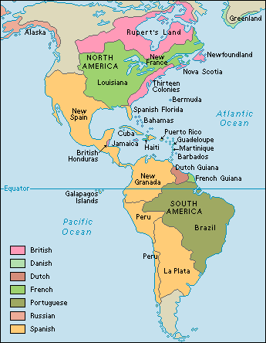
Competition – The Race is On!
Another way to increase the influence and power of the home countries is to claim and occupy new land.
Colonialism, the control and exploitation of a territory through settlement, increased in intensity during the 17th century.
Spain, Britain, France, and Portugal all claimed territories in the New World.

Slide 13
Reminder and Questions
These three reasons for colonialism – mercantilism, competition, and the desire to spread Christianity – changed the history of North America forever.
How may the doctrine of terra nullius have affected the behaviour of Europeans toward First Peoples?
Instead of “Age of Discovery” how else may this time period be remembered?

