Slide 1
Our Solar System

Slide 2
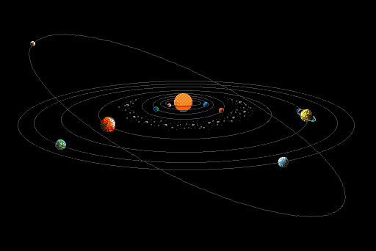
What is the Solar System
Our Solar System is made up of all the planets that orbit our Sun.
Besides planets, the Solar System also consists of celestial objects such as moons, comets, asteroids, minor planets, and dust and gas.

Slide 3
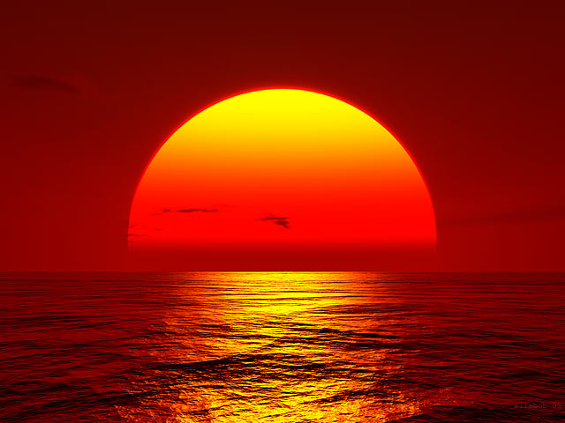
Everything in our Solar System orbits or revolves around the Sun. The Sun contains around 98% of all the material in the Solar System.
The larger an object is, the more gravity it has. Because the Sun is so large, its powerful gravity attracts all the other objects in the Solar System towards it.

Slide 4
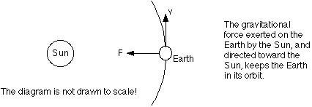
These objects, which are moving very rapidly, try to escape from the Sun, out into the emptiness of outer space.
These planets become trapped half-way as they become balanced between flying towards the Sun, and escaping into space, they spend eternity orbiting around their parent star.

Slide 5
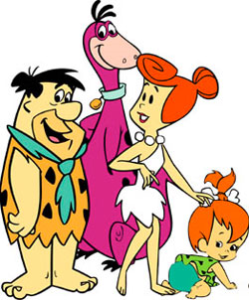
How Did the solar system Form?
This question is one that many people have fantasized over, and one that is difficult for scientists to understand. From what we know, the creation of our Solar System took place billions of years ago, long before people, dinosaurs and life had appeared on the planet.
Our own evolution is tied closely to the evolution of the Solar System. Thus, without understanding from where the Solar System came from, it is difficult to comprehend how mankind came to be.

Slide 6
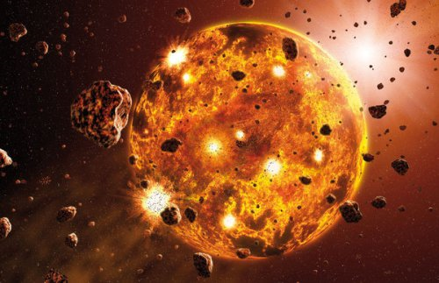
Birth of the Solar System
Scientists believe that the Solar System evolved from a giant cloud of dust and gas. This dust and gas was likely the remnants of a much older solar system that was destroyed when its sun exploded in a supernova and its bits now make up some of the planets and debris found in our solar system.

Slide 7
They believe that this dust and gas began to collapse under the weight of its own gravity. As it did so, the matter contained within this mass begin moving in a giant circle, much like the water in a drain moves around the center of the drain in a circle.
As the dust and debris continued to swirl toward the middle a protostar began to form which eventually grew to become the star we call the Sun.
At first the heat that it created was due to friction but as temperature hit 18 million degrees F, nuclear fusion kicked in. This was roughly 4.5 billion years ago.

Slide 8
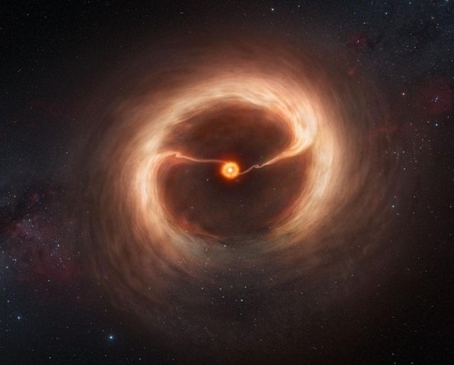

Slide 9
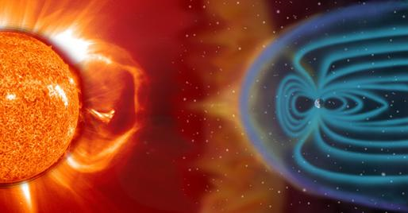
As the sun began to grow from swirling dust and gas so too did some of our planets. The giant gas planets of Jupiter, Saturn, Uranus and Neptune were created by spinning gas and dust.
The solar winds from the sun pushed much of the excess gas and debris away from the inner system and stunted the continued growth of the inner planets leaving only iron and rock behind.

Slide 10
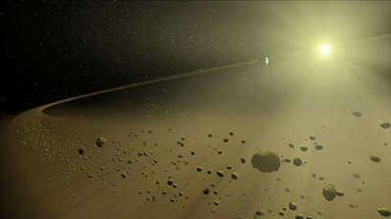
The remaining debris left in the inner system continued to circle the sun and eventually collided with each other and joined together. Over millions of years the chunks grew in size until they were large enough to have a gravity of their own and become planets.
In theory, microbes living on these floating chunks left over from the earlier supernova were responsible for life on our planet.

Slide 11
Over , millions of years(about 10 million), most of the matter in the solar system became concentrated in the gas giants and terrestrial planets.
The remaining matter makes up the asteroids, meteoroids and comets – the minor bodies.
Scientists study these minor bodies as their behaviors tend to give information about the early stages of the solar system.

Slide 12
Questions
Use the text book to answer questions #1,3,4 and 5 on page 473

