Slide 1
The Rise of Totalitarianism
Hitler and Nazi Germany

Slide 2
Introduction
Recovering from the humiliating loss of WW1 and from the Great Depression, Germans found extremist parties more attractive. Hitler’s Party promised to build a new Germany, and his new party’s propaganda appealed to the German sense of national honour. The new Germany that Hitler envisioned did not include any group the Nazis considered inferior, including Roma (Gypsies), people with disabilities, Poles, Soviet prisoners of war, and Afro-Germans, political dissidents, Jehovah’s Witnesses, homosexuals, and especially the Jews.

Slide 3
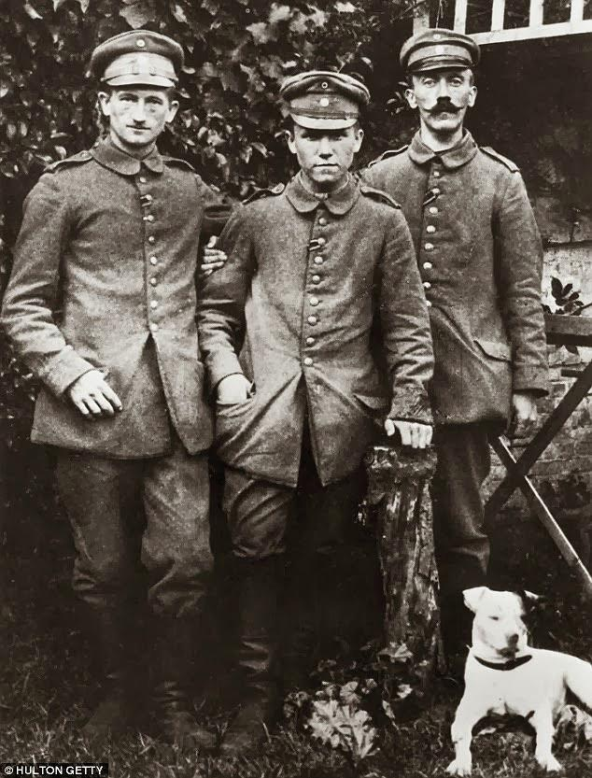
Hitler
Adolf Hitler was born in Austria on April 20, 1889. He failed out of school at 16 and left home to live in Vienna as an artist but was rejected by the academy.
Without a job and without any professional qualifications he ended up living in a hostel where he developed his basic social and political ideas.
“On the very first day there sat next to the bed that had been allotted to me a man who had nothing on except an old pair of trousers – Hitler. His old clothes were being cleaned of lice, since for days he had been wandering about without a roof and in a terribly neglected condition.”
Notes:
Quote is from a “tramp” in the hostel where Hitler stayed in 1909
For the next 4 years (1909-1913) survived by painting postcards and selling them in the street of Vienna. He quickly left Vienna to avoid joining the National Service and crossed the border to Munich, Germany.

Slide 4
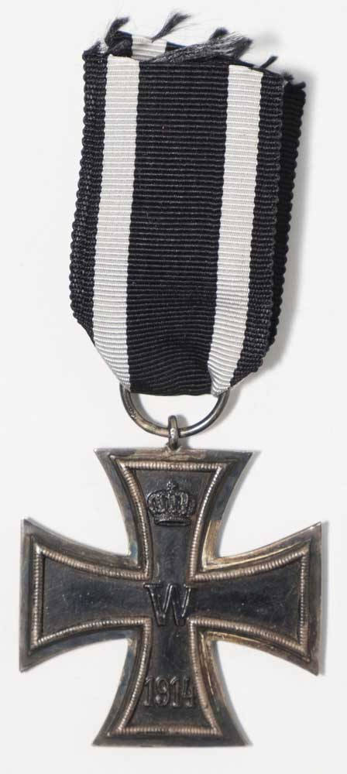
WW1
Hitler, while dodging the service during peacetime, joined the German Army at the outbreak of the First World War. He served in the army for 4 years where he won 6 medals for his bravery, including the Iron Cross, the highest award a German officer could win.
Hitler’s participation in the war ended in late 1918 when he was temporarily blinded by mustard gas in a British attack. It was while he was in hospital recovering when he learned of the German surrender.

Slide 5
Nationalsozialistische Deutsche Arbeiterpartei
In 1919 after the war had ended Hitler joined a small right-wing extreme nationalist party called the German Workers’ Party.
Within two years Hitler had taken control of the party and renamed it the Nationalist Socialist German Workers Party or Nazi for short.
Historian Z.A.B. Zeman, worked out that Hitler spoke at 228 vibrations/sec while most men poke at 200 vibrations/sec – this meant that “the onslaught on the eardrums of the audience was tremendous.” It was clear that Hitler was a gifted orator and could get his message across with relative ease.
What was his message...
Notes:
The German Workers’ Party had on 6 members and very little money for funding. Hitler joined this party as he liked their ideas and he had been spying on them as a V-Man, an army spy that was hired to investigate new political parties.

Slide 6
25 points – the highlights
1. We demand the union of all Germans to form a greater Germany…
2. We demand the abolition of the Peace Treaties of Versailles…
3. We demand land and territory for the maintenance of our people…
4. Only those who are our fellow countrymen can become citizens. Only those who have German blood, regardless of creed, can be our countrymen. Hence no Jew can be a countryman.
11. That all unearned income, and all income that does not arise from work, be abolished.
14. We demand profit-sharing in large industries.
15. We demand a generous increase in old-age pensions.
16. We demand the creation and maintenance of a sound middle-class…
25. We demand the creation of a strong central authority in the State…
COMMON GOOD BEFORE INDIVIDUAL GOOD
Notes:
Which of these points are nationalistic? Socialist?
What kinds of people would be attracted to the Nazi Party by these points?

Slide 7
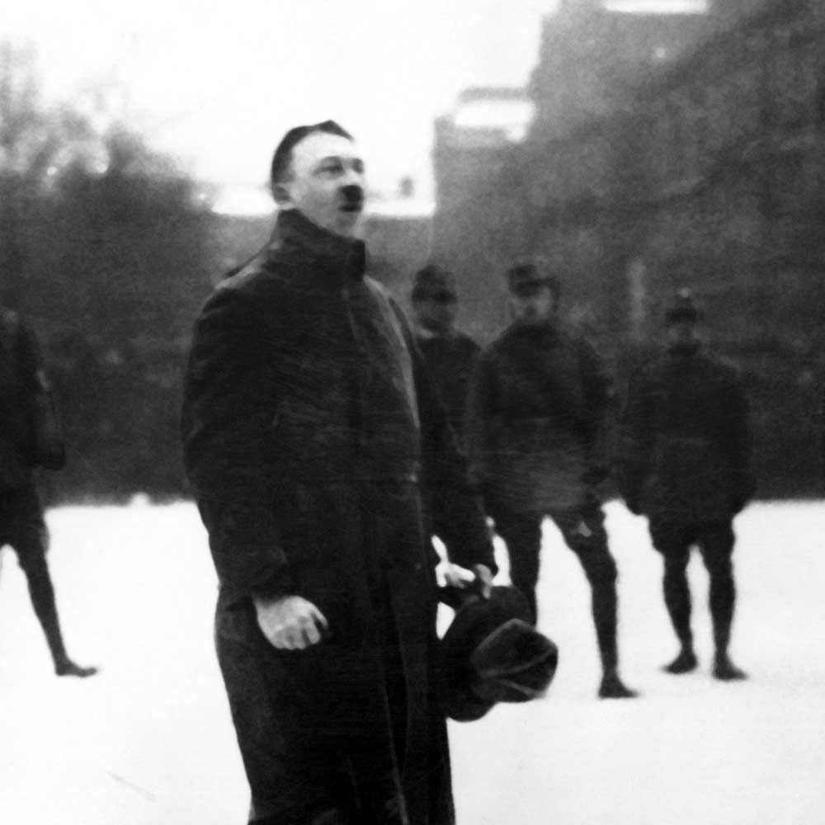
So much angry yelling…
The Nazi Party grew rapidly in 1920 from dozens to over 3000 in less than a year. By 1923 it grew to over 55,000.
They adopted the swastika in 1920 that also attracted attention and Hitler also dealt with members of opposition parties who showed up at Nazi rallies – he gathered ex-soldiers who “dealt with” rowdy crowds.
These same thugs became members of Hitler’s SA, Sturm Abteilung (Storm Troopers).
Notes:
Of the 55,000 members in 1923, 15,000 of them were in the party militia.

Slide 8
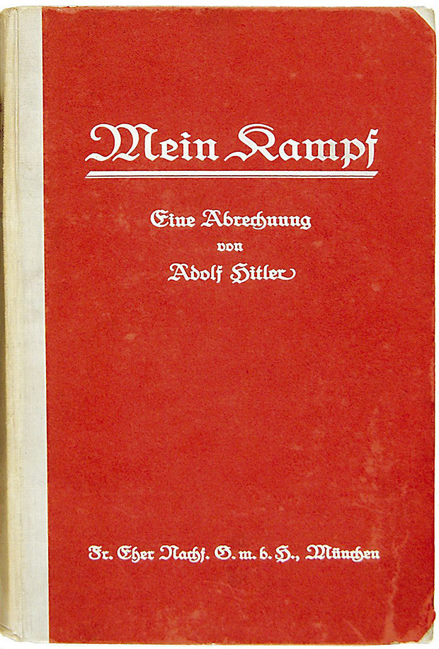
Be Mein…
In 1923 Hitler and the Nazi Party had grown confident enough to stage an armed uprising against the government. The uprising, called the Beer Hall Putsch, was quickly crushed and Hitler was sentenced to prison.
While in prison Hitler wrote Mein Kampf, or My Struggle, an account of his movement and its basic ideas.
In Mein Kampf, Hitler links extreme nationalism, anti-Semitism, and anticommunism together by a Social Darwinian theory of struggle.
This theory emphasizes the right of superior nations to lebensraum – “living space” –through expansion.
Notes:
This theory upholds the right of superior individuals to gain authoritarian leadership over the masses.

Slide 9
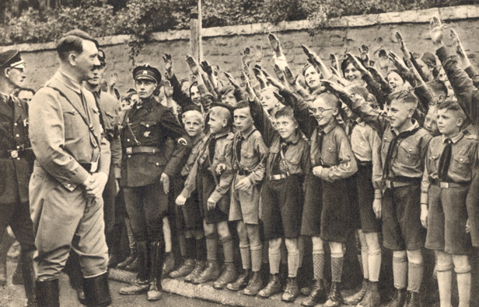
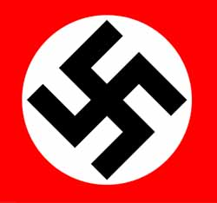
Excerpt from a handbook given to Hitler Youth between ages 10 and 14.
“Our beloved swastika flag appears at this time, too. The Führer himself designed it. For us, it is more than an outward symbol. We National Socialists [Nazis] see our program in our flag. We see the social in the red, the movement’s national thinking in the white, and in the swastika we see the symbol of the victory of Aryan humanity and the victory of productive humanity, which was always anti-Semitic and will always be anti-Semitic. When this flag flies, it is a parable of our desires: We think of national freedom and social justice, of racial purity and the victory of Nordic humanity. The swastika reminds us of the time when Nordic farmers and warriors marched to Italy and Greece. It was borne at the front of the soldiers as a holy symbol of the Germanic-German spirit.”
Notes:
“Nordic farmers and warriors” refers to the ancient migration of Aryan peoples, whom the Nazis considered to be a master race.

Slide 10
The rise of Nazism
While in prison, Hitler realized that the only way that his Nazi party would be successful was to obtain power through legal means and not by overthrowing the current Weimar Republic.
When he was released from prison Hitler expanded his party’s base and within 3 years the party had grown to over 800,000 members and became the largest party in the Reichstag – the German Parliament.
Germany’s continued economic struggle coupled with Hitler’s promise to end the struggle and his appeal to nationalism and militarism allowed him to convince more German citizen to join his cause.
Notes:
A teacher in Hamburg described the emotional response of the audience at one of Hitler’s rallies, “when the speech was over, there was roaring enthusiasm and applause…How many look up to him with touching faith as their helper, their saviour, their deliverer from the unbearable distress”

Slide 11
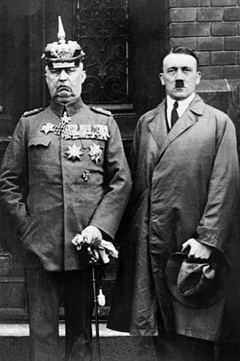
The Nazi Take Control
Hitler ran for president in 1932 but lost to decorated war hero General von Hindenburg but still managed to obtain 36% of the vote.
The very next year, under pressure from advisors and business leaders Hindenburg appointed Hitler as Chancellor in an attempt to use Hitler’s popularity to further their goals. *
Speech
Notes:
*Little did they know that when Hitler was appointed Chancellor he continued to expand his own powers and influences, all the while his supporters formed paramilitary groups who fought protestors in the streets. Hitler claimed the potential of a Communist takeover and that only he could restore law and order.

Slide 12
In 1933 a young worker was convicted of setting fire to the parliament building and Hitler seized the opportunity to convince the Reichstag to grant him emergency powers when they passed the “Enabling Act”.
This Act essentially appointed Hitler as a dictator and didn’t need approval from President Hindenburg or the Reichstag.
Within months he abolished the freedom of the press, outlawed oppositional parties and created anti-Jewish laws.
Hindenburg died in 1934 and it was clear that their would not be any new election as the office of the President was abolished as well as the position merged with the Chancellor position and was called the fuhrer.
Notes:
The “Enabling Act” was only supposed to give Hitler the ability to ignore the constitution for 4 years while he regained control and dealt with Germany’s civil problems.
In addition to the early changes Hitler rounded up many of his early radical supporter and potential rivals and they were executed.
The Nazi party also wasted no time setting up Concentration Camps which held individuals who opposed these new changes. Jewish people were removed from the civil service as they were blamed for the economic woes of Germany.

