Slide 1
1920s – Consumer Culture
Fun, Games and Attitudes

Slide 2
Pre-Lesson Activity
In your notebook, write out your “Christmas wish list”. Keep it realistic but pic at least 10-15 items that you would like to get.
Now identify which items are a “want” and which items are a “need”.
What did you notice?

Slide 3
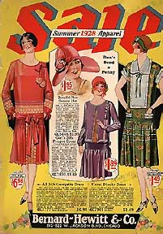
Consumer Culture
In 1920s Canada the economy was focused on the selling of consumer goods and the spending of consumer money.
A significant part of consumer culture is an emphasis on lifestyle and using material goods to attain happiness and satisfaction.

Slide 4
Consumer Culture Cont…
Consumer Culture focused on pleasure, image, social status and obtaining objects.
Are you a part of this consumer culture?
The Cycle of Economic Prosperity
Companies get richer
Companies produce more ‘things’
More jobs are created
People purchase ‘things’

Slide 5
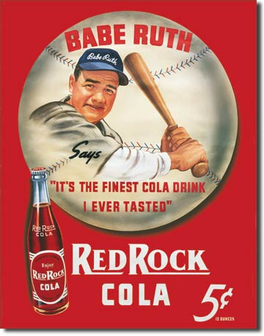
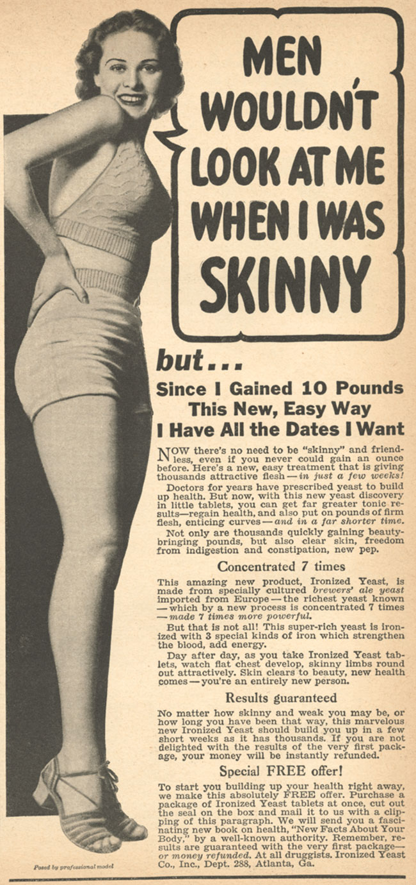
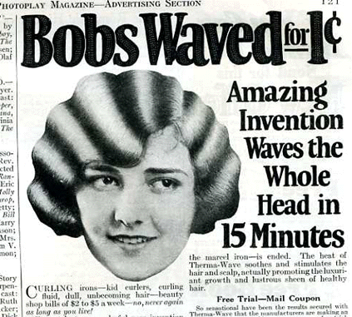

Slide 6
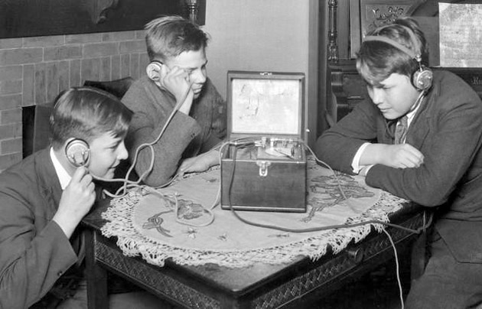
Leisure
The 1920s was a time when leisure activities was enriched through the inventions of the radio and television.
Early radios and TVs were not the greatest quality and but they were high in demand in the 1920s consumer age.
Notes:
The technology of the radio made leaps and bounds in the early 1910s as WW1 forced radio communications to improve to help the war effort.

Slide 7
Leisure
In 1925, Ted Rogers, a Canadian engineer, invented an electric radio that replaced the cumbersome battery powered radios and they soon began broadcasting news, music and other entertainment wirelessly through the air.
This new invention allowed music to spread from household to household, the jazz music was especially important as it enhanced the flapper lifestyle.
Notes:
Ted Rogers Sr. is the father of Edward Samuel (Ted) Rogers, 5th richest Canadian family in Cdn history, #3 is the Irving family.
Dancehalls and pubs would play music late into the night and alcohol was flowing, it was a good time to let loose.

Slide 8
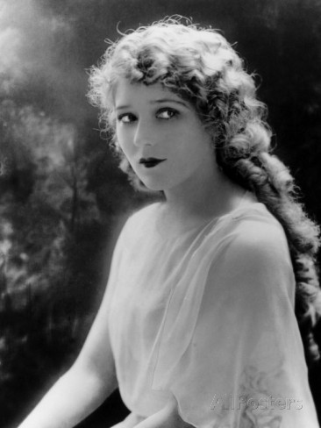
Film
Silent movies were also a popular form of entertainment and many Canadians were swept up in the Hollywood lifestyle.
Mary Pickford, Queen of the Silent Film, was a Toronto born actress who managed to make it big in the USA. She stared in many “talkies” later in the 1930s when movies with sound were created.

Slide 9
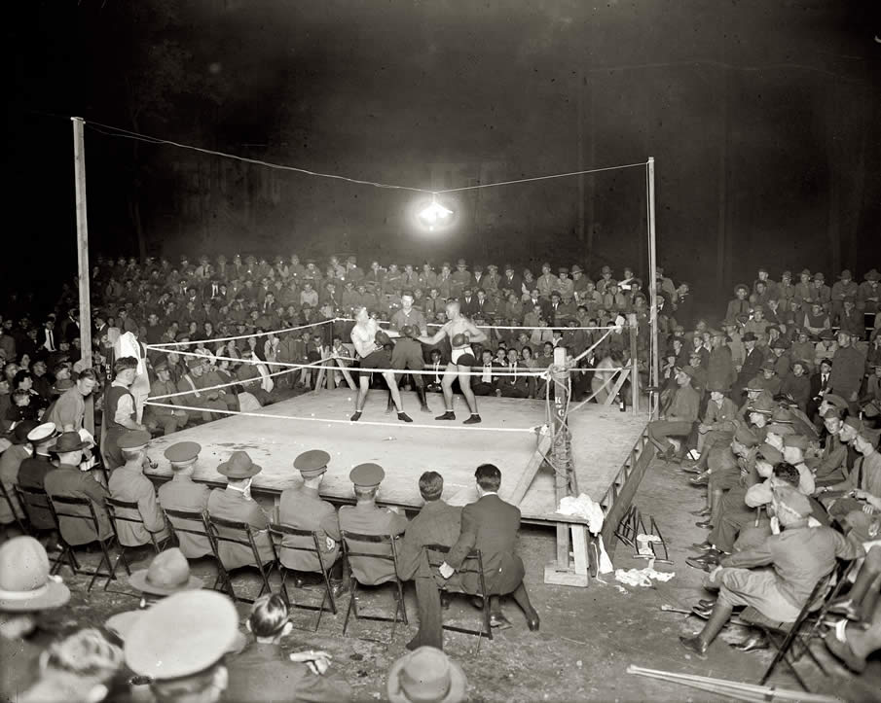
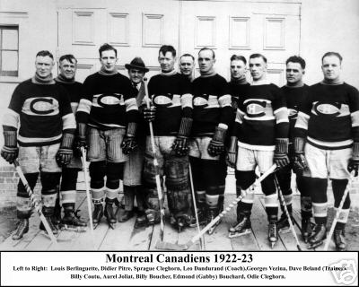
Sports in 1920s
With the economic prosperity in the 1920s Canadians had more money to spend on attending sports events like hockey, football, baseball and boxing.
Shorter working hours allowed people to spend more money and participate in these events.

Slide 10
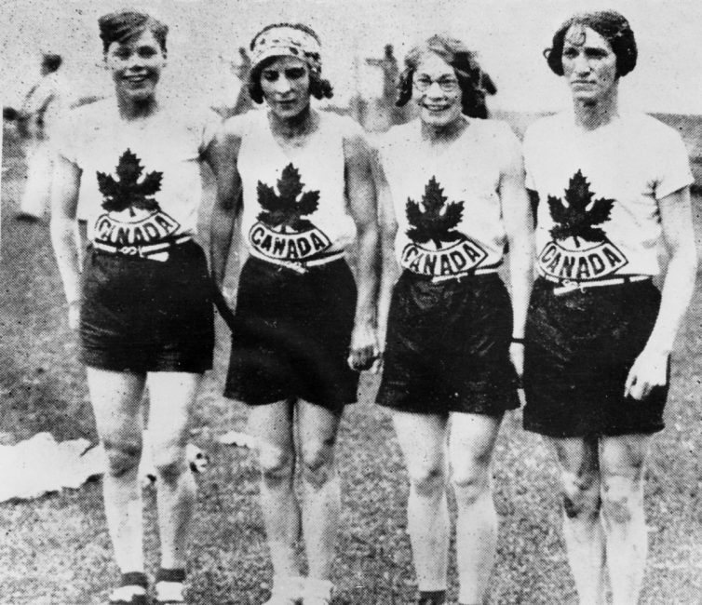
Women in Sport
Women too managed to take advantage of the increased disposable income and more free time. In 1928 women were allowed to compete in Track and Field at the Olympics for the first time, we even pulled off a gold medal at the 400-m relay race.
Women’s basketball gained international attention and the Edmonton Grads are still recognized as one of the sports most dominate teams.
Notes:
The team compiled a record of about 502 wins and some 20 losses between 1915 and 1940. In addition to dominating their sport in North America, the Grads also took on the best teams in Europe, ultimately defeating challengers in Paris, London, Amsterdam, and Berlin. The Grads swept four consecutive Olympic Games from 1924 to 1936, winning all 27 Olympic matches they played and out scoring their opponents 1863 to 297. This achievement was unrecognized on the medal podium as women's basketball did not become an official Olympic sport until the 1976 summer games in Montreal.

Slide 11
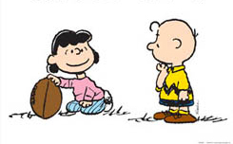
Women in Sport
Despite incredible performances by Canadian women at home and abroad it was still a struggle for female athletes.
Many rules and regulations were different from men’s rules and it was often considered unhealthy for women to exert themselves as much as men.

Slide 12
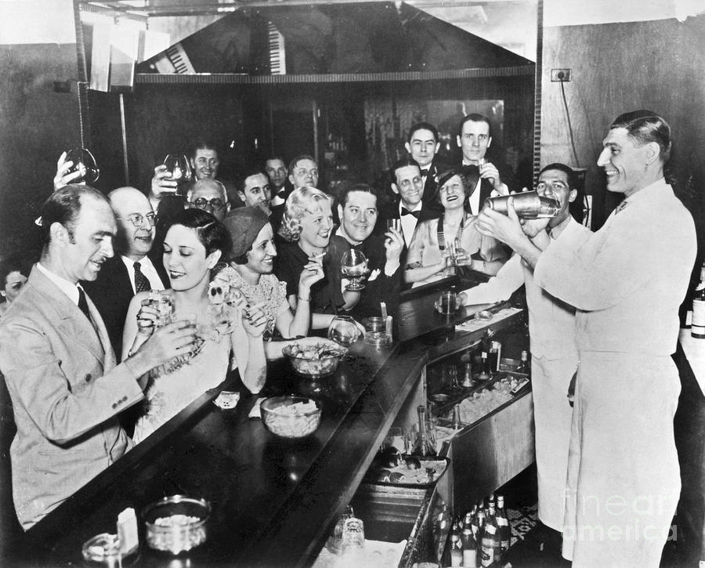
Changing and Conflicting Attitudes
Nightclubs became popular in the 1920s too. The clubs were places where people could relax, drink, smoke, listen to live music, and dance. These clubs were a reflection on the new attitudes of the day.

Slide 13
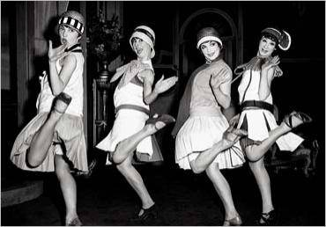
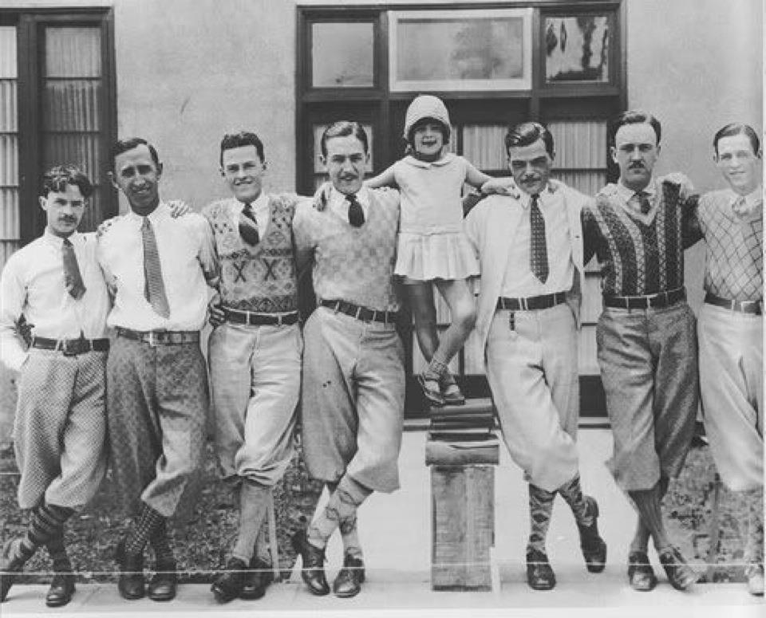
While many young people embraced this new lifestyle many others were appalled at the behaviors that went on; women were partaking in traditional male activities like smoking and drinking alcohol.
Fashion changed a great deal as well, women’s hairstyle went up and so did their hemlines. Men started to wear baggy pants and knickers, hats and bowties.

Slide 14
Questions to Complete
What cause and consequences can you find with the 1920s Consumer Culture.
What is the historical significance of the information just presented? Why is it important to understand?
What impact does this lesson have on us today?

