Slide 1
Reproduction and Cell Division

Slide 2
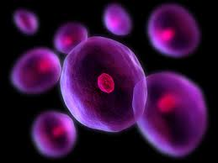
Modern cell theory
Keep in mind that:
All living things are made up of one or more cells.
The cell is the basic unit of life.
All cells come from preexisting cells

Slide 3
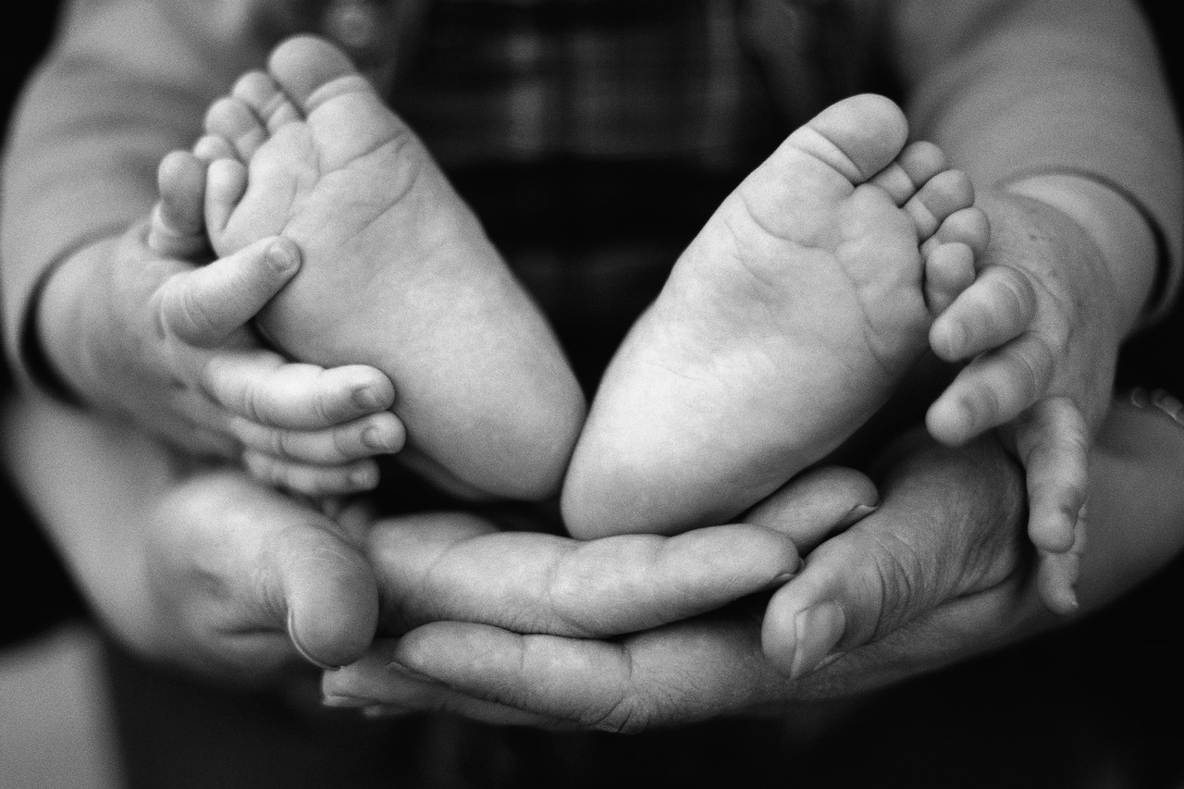
Just as cells reproduce as part of the Cell Cycle, living organisms reproduce as part of the life cycle.
Organisms of all species reproduce in two different ways; sexually or asexually.

Slide 4
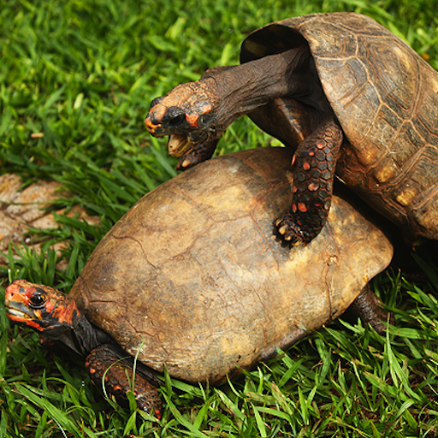
Sexual Reproduction
In sexual reproduction genetic information from two cells is combined to produce a new organism.
Usually, sexual reproduction occurs when two specialized sex cells unite to form a fertilized egg called a zygote.

Slide 5
Asexual Reproduction
In asexual reproduction a single organism gives rise to offspring with identical genetic information.
Animal cells, besides in the ovaries and testes, reproduce asexually.
Most single-celled organisms, such as bacteria, reproduce asexually.

Slide 6
Asexual Reproduction
There are 5 types of asexual cell reproduction we’re going to examine:
Binary fission
Budding
Fragmentation
Spore formation
Vegetative reproduction

Slide 7
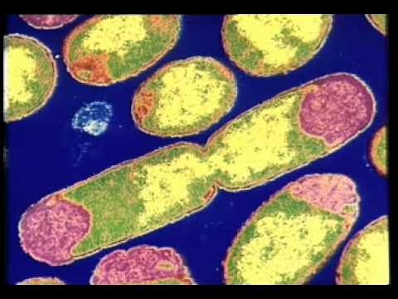
Binary Fission
Organisms splits directly into two equal-sized offspring, each with a copy of the parent’s genetic offspring.
This type of reproduction is common with single-celled organisms such as bacteria.

Slide 8
Binary Fission

Slide 9
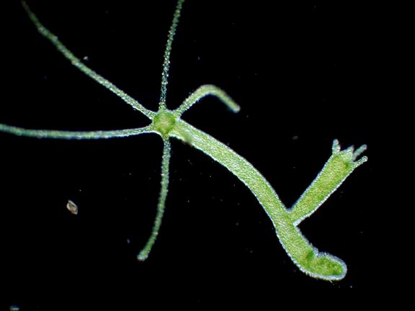
Budding
In budding, the offspring begins as a small outgrowth on the parent. Eventually this “bud” breaks off and becomes an organism on its own.
Hydra

Slide 10
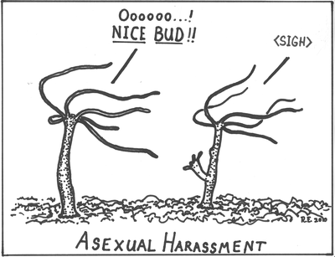

Slide 11
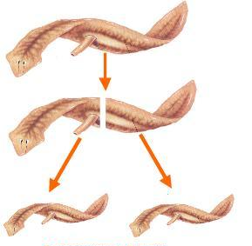
Fragmentation
In fragmentation, a new organism is formed from a part that breaks off from the parent.
Many types of algae and some plants and animals reproduce this way.
If a starfish is split along its central disk, each section will develop into a new starfish.
Planaria

Slide 12
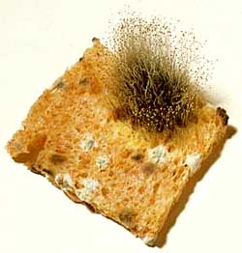
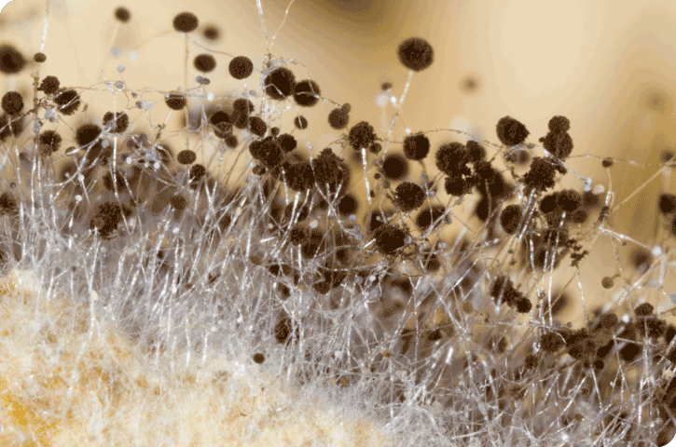
Spore Formation
Here the organism undergoes frequent cell division to produce many smaller, identical cells called spores. Spores are usually kept inside the parent until they are released.

Slide 13
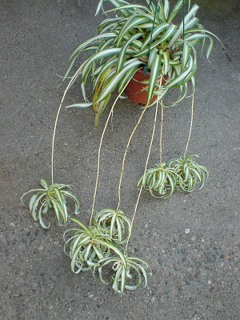
Vegetative Reproduction
Plants like strawberries and spider plants make use of vegetative reproduction. They produce runners that can develop into new plants with identical genetic information.

Slide 14
Note that some organisms use both methods of reproduction. For example, bacteria reproduce by binary fission (asexual) but can also exchange genetic information with other bacteria in the form of sexual reproduction.
Similarly, most plants reproduce sexually, in the process that results in seeds, but other can reproduce through runners.

Slide 15
Questions to Consider
How is asexual reproduction different from sexual reproduction?
How is the zygote, produced by sexual reproduction, different from daughter cells, produced by asexual reproduction?
What advantages and disadvantages can you find for asexual reproduction?

