Slide 1
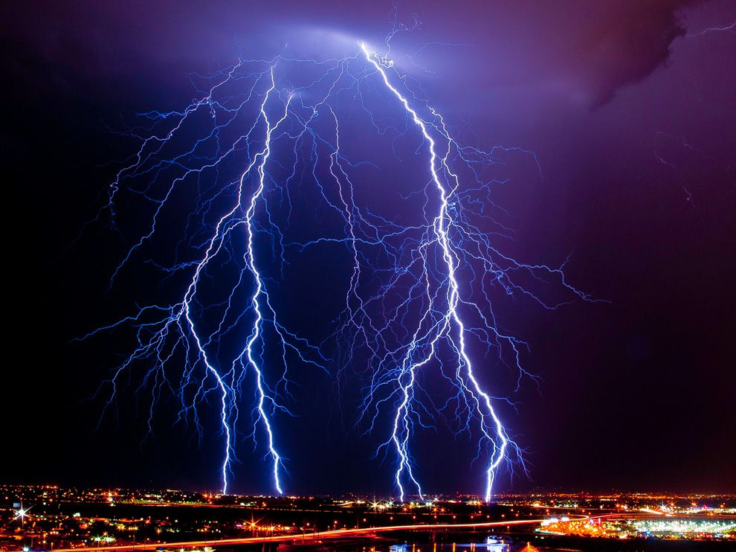
Static Electricity and Lightning

Slide 2
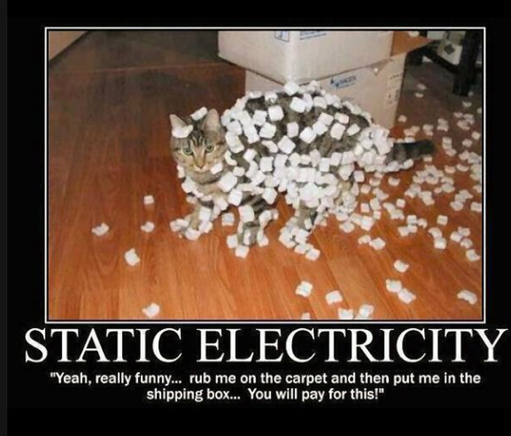
Reminder
Static electricity results from an uneven distribution of charges(+/-) on an object.
At close distances, this can attract other materials or…some of those charges can jump from one surface to another.
Ex. Small spark of electricity

Slide 3
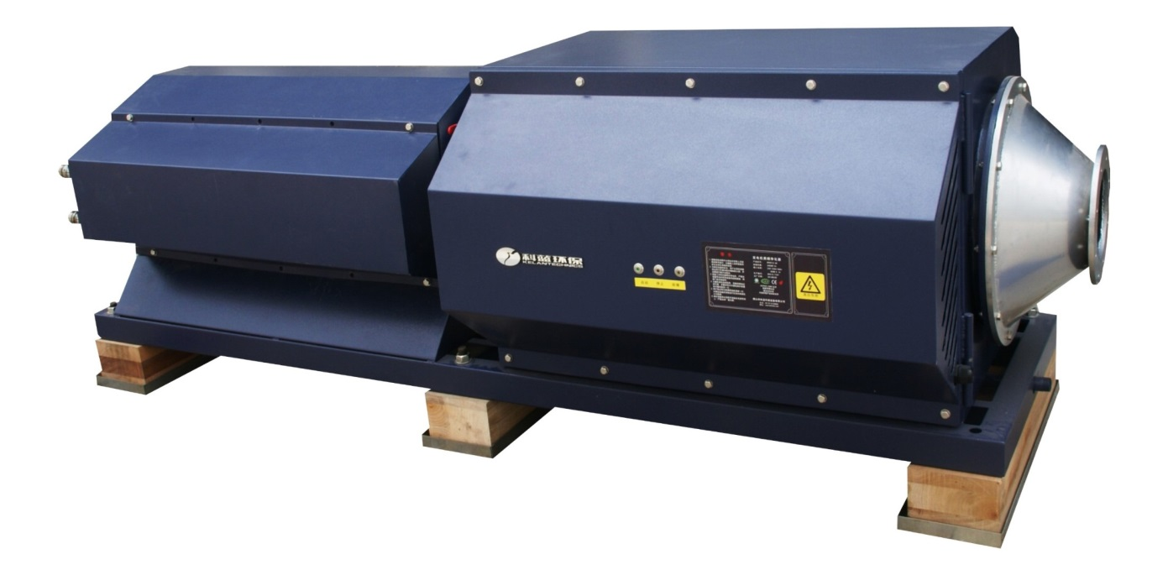
Advantages of Static Electricity
Although static electricity can be irritating at times, there are many practical uses for it.
The removal of pollutants and dust from the air in hospitals and industrial chimney stacks are two examples.
Industrial electrostatic air purifier

Slide 4
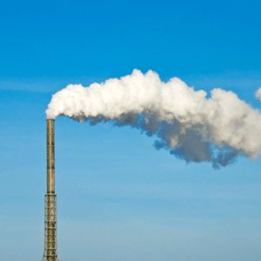
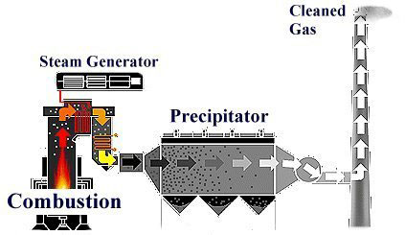
Chemical Precipitation in Industry
Static electricity is used in pollution control by applying a static charge to dirt particles in the air and then collecting those charged particles on a plate or collector of the opposite electrical charge. Such devices are often called electrostatic precipitators.

Slide 5
Disadvantages of Static Electricity
Static can be a nuisance - hair and dust cling to clothing…
Static can also be a danger as sparks creating fires and explosions
video

Slide 6
Lightning

Slide 7
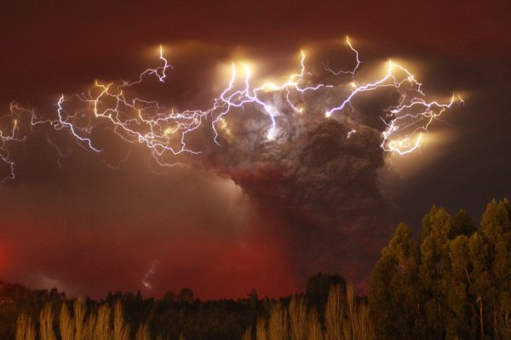
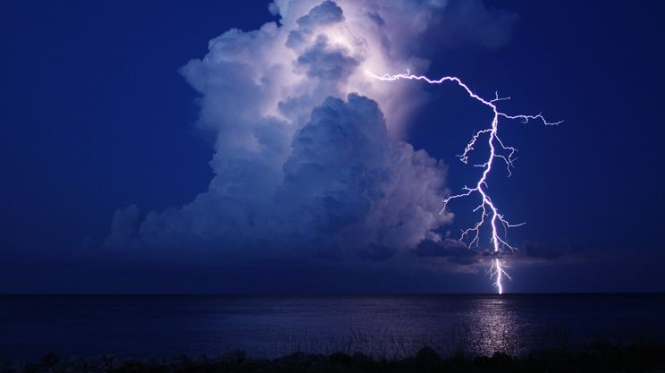
Lighten Up!
Nearly everyone has at least one vivid memory of a violent lightning storm.
Keep in mind that lightning storms may seem infrequent here in Atlantic Canada, many places around the world are prone to conditions that enhance lightning storms.
Around 2000 thunderstorms are raging around the planet at any given time, resulting in about 8 million strikes a day!

Slide 8
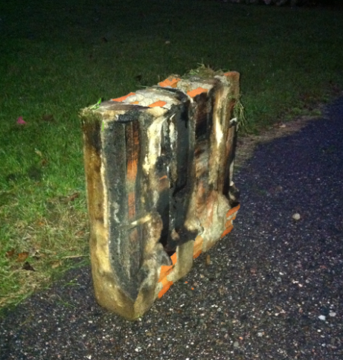
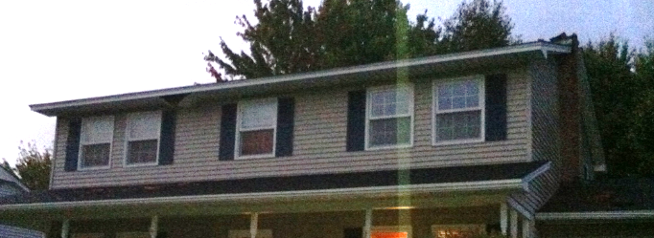

Slide 9
Lightning
Lightning is part of a natural process of exchanging electric charges between the atmosphere and the Earth.
Lightning is static electricity discharge between two clouds or a cloud and the ground – just like when you get a zap from touching something metal!

Slide 10
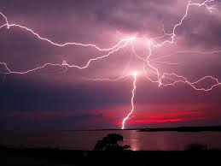
Did you Know!
A single bolt of lightning is five times hotter than the surface of the sun.

Slide 11
Lightning
There is still some debate about how lightning works but the scientific community believe that lightning occurs when the negative charges concentrated near the bottom of the cloud returned to the ground in a huge spark.
The concentration of negative electrons are the result of the movement of air and water particles around the Earth’s surface.

Slide 12
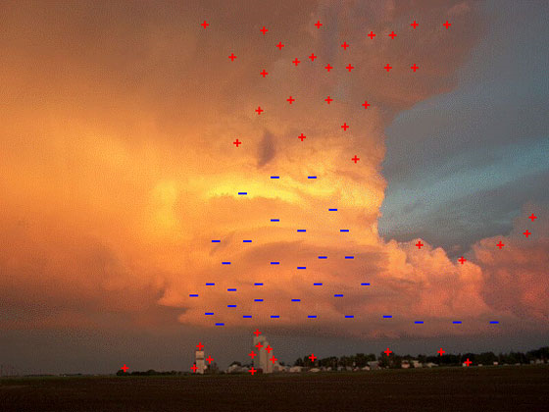
The turbulent wind environment of a thunderstorm with its updrafts and downdrafts is an ideal environment to separate electric charges: negative charges generally gather near the base of the cloud, while positive charges build in the upper reaches of the cloud. This allows electric fields to form and grow between the cloud and the ground and within the cloud itself - all necessary conditions for lightning to occur.

Slide 13
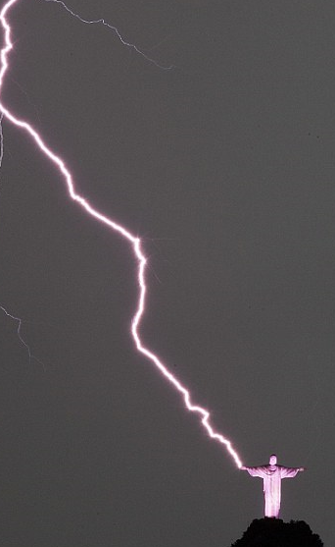
Lightning appears jagged because it follows concentrations of positive ions, of the path of least resistance that may be created by moisture in the air.
Tall objects such as trees and skyscrapers are most likely to become conductors.

Slide 14
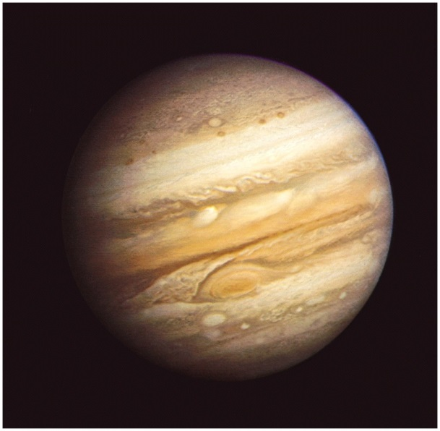
Did You Know!
The weather on Jupiter, like everything else about the planet, is large. Storms that grow to cover thousands of km within hours, winds whipping the clouds at 360 kph, and storms that last for hundreds of years are typical.
Lightening on Jupiter can be a thousand times as powerful as lightning on the Earth.

Slide 15
Let Me enLighten You
Sound travels through air at "the speed of sound." Officially, the speed of sound is 331.3 meters per second in dry air at 0 degrees Celsius. At a temperature like 28 degrees C (82 degrees F), the speed is 346 meters per second.
­As you can see, the speed of sound changes depending on the temperature and the humidity; but we can say that sound travels 1 kilometer in roughly 3 seconds.
When you see the flash of a lightning bolt, you can start counting seconds and then divide by 3 to see how far away the lightning struck. If it takes 12 seconds for the thunder to roll in, the lightning struck about 4 kilometers away.

Slide 16
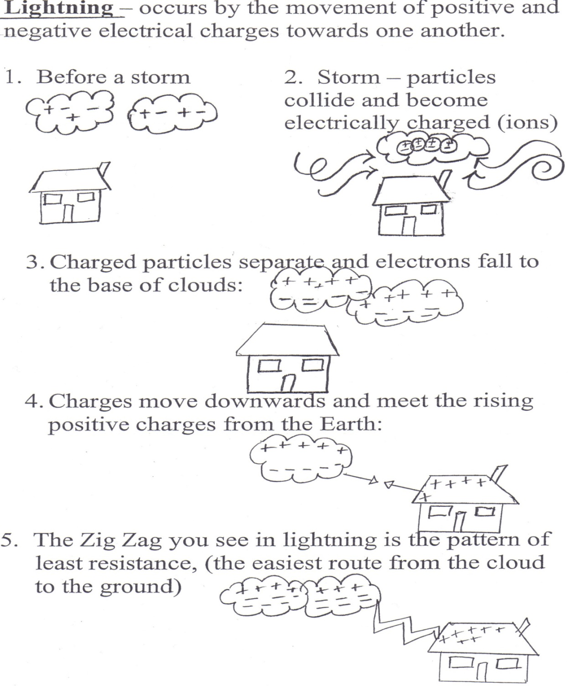
Take Note

Slide 17
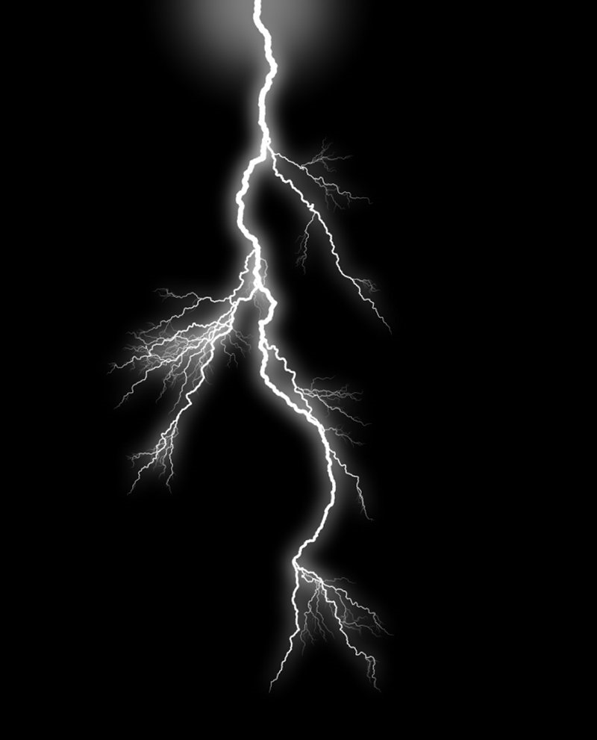
Slow-motion Lightning

Slide 18
Most lightning bolts are from cloud to cloud, but sometimes there are no positive charged clouds nearby, so the negative cloud sends its electrons to the ground or any object that may have a slight positive charge.
Air expands when it is heated and contracts when it cools. Since the spark happens so fast, the air expands and contracts very rapidly. When it contracts, the air slaps together, just like when you clap your hands or pop a balloon. The noise you hear from a spark is just a snap, because it is so small.

Slide 19
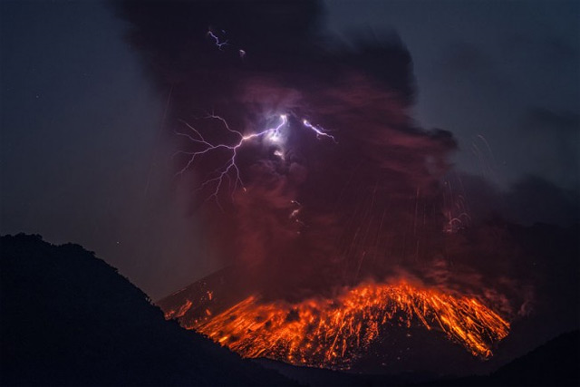
Lightning does not just happen in thunderstorms…
Lightning is also known to occur in dust storms, forest fires, and volcanic eruptions. Particles such as sand, smoke and ash, which exist in these environments, can also become electrically charged and create atmospheric conditions similar to that of a thunderstorm.

Slide 20
Staying Safe
Stay away from water: don't stand under an umbrella, or keep swimming;
Go indoors or into a car if possible
Stay away from telephone poles
Stay away from trees
Stay on low ground, and avoid being the tallest object
If you are in a field, crouch low
Stay away from anything metal, such as a bicycle, or golf club

Slide 22
If you are inside:
Stay away from windows and doors because of metal hinges and doorknobs.
Stay away from water taps that might conduct electricity like tubs or sinks.
Unplug any electric appliances like the television, a toaster, computer or iron.
Do not use a land-line phone unless it is an emergency.

