Slide 1
The Last Year of WW1

Slide 2
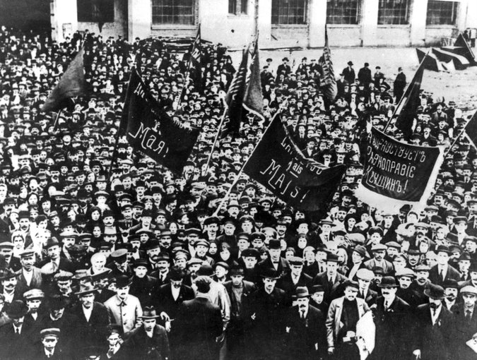
Coming and Going
1917 was a difficult year for the Allies. Offensives on the Western Front had suffered loses and one of their strongest allies, the Russians, were struggling with a revolution at home and on the battlefield. *
This Russian Revolution, which began in November of 1917, led to Russia withdrawing from the war in early March of 1918.
While the Russians were leaving the American were just showing up. American had begun to send troops in mid 1917 but they didn’t send the bulk of their army until 1918.
Notes:
Germany and Erich Ludendorf, in an attempt to force Russia our of the war, unknowingly unleashed a global threat that could be the most dangerous weapon the world has ever known. It’s story starts back in the mid 1800, 1848ish. This weapon, or more the creator of this “blueprint” had actually been dead for 34 years. The architect’s name is Karl Marx. While Marx may be the architect of this “blueprint”, it was another individual who took this blueprint and mutated it into a machine that would spread across the globe and threaten the very foundations of democracy as we know it.
Granted, Marx’s original idea wasn’t what eventually happened as his idea was nearly the opposite of what communism eventually became…. The individual that warped this blueprint was Vladimir Ilyich Ulyanov, also know as Vladimir Lenin.
Lenin was an incredible leader who not only was a intelligent individual he was also a man of action. David Lloyd George, PM of Britain wrote about how Lenin was one of the most intelligent leaders in govt that he had ever met…he also called Lenin a plague too.
Germany and Ludendorff helped Lenin return to Russia after years of exile in Switzerland. They hoped that Lenin would help undermine the provisional government in Russia after the Czar had abdicated the throne, it worked as he seized power and looked to get Russia out of the war to fight the more important fight at home in Russia. (page 775 – reading)
Russia had been experience heavy losses and struggled with providing support for their troops, at one point soldiers had to pair up, the lead soldier had the rifle and when he was killed or wounded his “shadow” picked up the rile and continued to fight.
In 1917 America had about 175000 soldiers in Europe but by 1918 they had over 2 million troops engaged in battle.
The entry of the Americans added a much needed boost as fresh troops and material from the US proved crucial to the effort against the German army.

Slide 3
All Russian No Finnish
On March 3rd, 1918 The Treaty of Brest-Litovsk was signed between the newly formed Russian Bolshevik government and the Central powers. The road to this treaty was rough as the Bolshevik party found themselves under pressure to seek peace and to bring the troops home from the war.
After much deliberation, stalling, and demands the Germans issued an ultimatum to Russia – sign in 5 days or the ceasefire would end and the war continues.
Notes:
By 1917 the Russian economy was in tatters as a result of the ongoing war effort and the astounding losses was enough to cause support at home to vanish. Russia had lost 2 million soldiers and another 4-6 million were wounded or captured.
(Ukraine was recovered in 1919, during the Russian Civil War.)

Slide 4
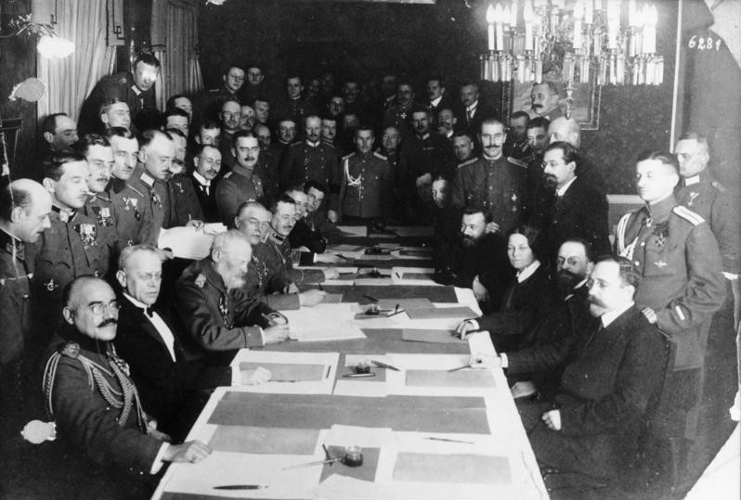
The Treaty of Brest-Litovsk
Under the terms of this new agreement Poland, Finland, the Baltic states and most of the Ukraine would be surrendered to Germany.
Russia would lose 1.3 million square miles of important territory, including important grain-growing regions in the Ukraine.
It would surrender 62 million people to German rule, or around one-third of its total population.
It would also lose 28 percent of its heavy industries and three-quarters of its iron and coal reserves. 25% of its railways were also lost.
Notes:
In addition to these losses the Russians also had to pay a fine of 6 Billion marks (3.5 billion US dollars)
By any measure the Brest-Litovsk agreement offered humiliating terms: it treated Soviet Russia as a defeated nation and Germany as a conquering power, entitled to the spoils of war.

Slide 5
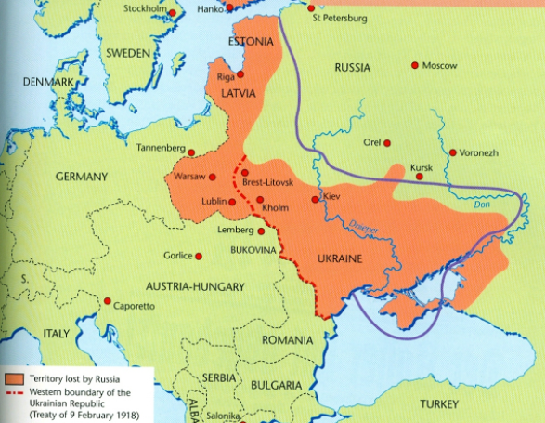

Slide 6
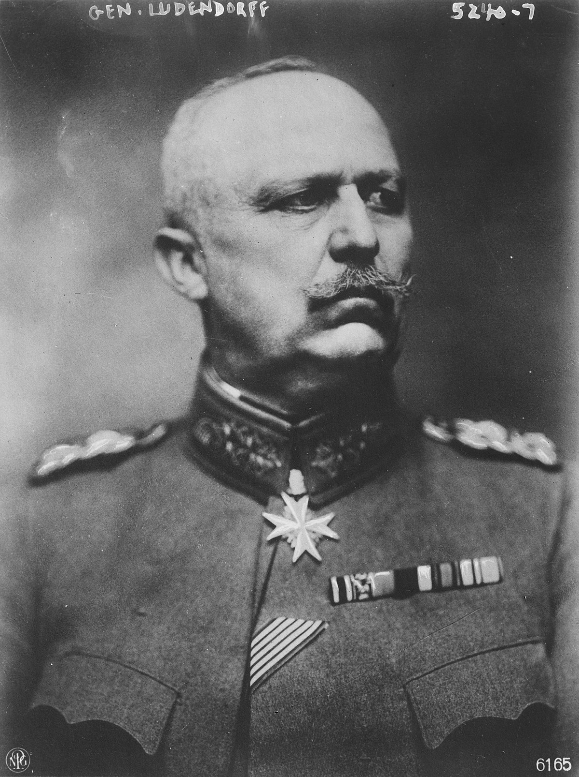
The New German Offensive
Russian withdrawal from the war in 1918 offered Germany a new hope for a successful end to the war as they were able to concentrate their efforts on the Western Front.
Erich Ludendorff, Quartermaster General of the German Army, attempted to make one final military gamble to break the stalemate.
At the time German lines were short of provisions, reserves were nearly depleted, and the German Homefront was tired of the growing number of deaths and the staggering cost of this prolonged war.
Notes:
The estimated cost of the war to Germany was around $38 billion, which is about $616 billion in today’s money.

Slide 7
The Gamble
The final push towards Paris started in March of 1918 and by April the Germans were within 80km of the city.
The advance of the German army was stopped at the 2nd Battle of the Marne on July 18. French, Moroccan and 140,000 fresh American troops supported by hundreds of tanks pushed the Germans back and on Aug. 8 the forces met at the 2nd Battle of the Somme.
Ludendorff wrote about this battle:
“August 8 put the decline on [our] fighting power beyond all doubt, and in such a situation, as regards reserves, I had no hope of finding a strategic expedient whereby to turn the situation to our advantage.”

Slide 8
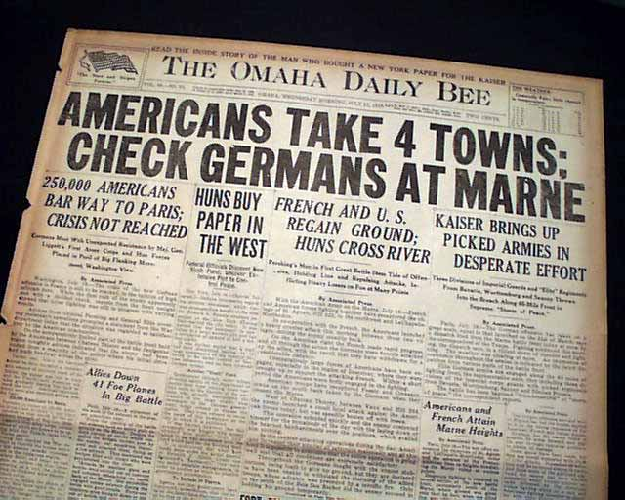

Slide 9
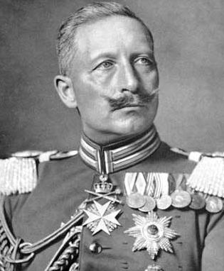
Armistice, more like DISARMistice
As 1918 rolls around a million more American troops pour into France and the Allies began an advance on Germany.
On September 29, 1918, General Ludendorff tells the German leaders that the war was lost and he demand that the government ask for an armistice at once.
While an armistice was wanted the Germans discovered that the Allies were not willing to make peace with the autocratic imperial government of Germany.
While mutinies and unrest swept across the German country Emperor Wilhelm II gave in to public pressure and left the country.

Slide 10
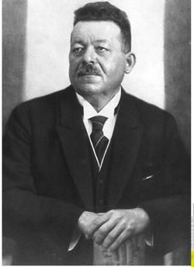
The Paris Peace Settlements
After Wilhelm II’s departure, the Social Democrats under Friedrich Ebert announce the creation of a democratic republic and on Nov. 11th the new German government sign an armistice.
The following January representatives of 27 victorious Allied nations met in Paris to create a final settlement for WW1.

Slide 11
Activity - debate
Use the handout that contains American President Woodrow Wilson’s 14 Points to prepare a debate discussing the pros and cons of these points.
You should prepare a brief argument for each point depending on if you represent the Allies or the Central Powers.

Slide 12
Summary of the 14 Points
No more secret agreements between countries. Diplomacy shall be open to the world.
International seas shall be free to navigate during peace and war.
There shall be free trade between the countries who accept the peace.
There shall be a worldwide reduction in weapons and armies by all countries.
Colonial claims over land and regions will be fair.
Russia will be allowed to determine its own form of government. All German troops will leave Russian soil.
German troops will evacuate Belgium and Belgium will be an independent country.
France will regain all territory including the disputed land of Alsace-Lorraine.
The borders of Italy will be established such that all Italians will be within the country of Italy.
Austria-Hungary will be allowed to continue to be an independent country.
The Central Powers will evacuate Serbia, Montenegro, and Romania leaving them as independent countries.
The Turkish people of the Ottoman Empire will have their own country. Other nationalities under the Ottoman rule will also have security.
Poland shall be an independent country.
A League of Nations will be formed that protects the independence of all countries no matter how big or small.

