Slide 1
The Periodic Table
Chapter 4.1

Slide 3
Dmitri Mendeleev

Slide 4
Dmitri Mendeleev
In the later 1800s Mendeleev looked for ways to organize the information on known elements.
He came up with the periodic table, which is an organized arrangement of elements that explained and predicted physical and chemical properties of elements.

Slide 5
Early Periodic Table

Slide 6
Dmitri Mendeleev
Initially, Mendeleev placed the elements in order based on their atomic mass.
He noticed that “periodically” properties would repeat.
When properties started repeating, Mendeleev would group these elements with similar properties in the same column.

Slide 7
The Periodic Table
Although atomic mass was originally used to order the periodic table, this didn’t always work.
Later, the periodic table was organized by atomic number, which is the number of protons in the nucleus and the key to an elements identity
This allowed predictions to be made about elements that were not even discovered yet.

Slide 8
Groups of Elements
The periodic table groups elements with similar properties.
Metals are found on the left side of the staircase.
Nonmetals are found on the right side of the staircase.

Slide 9
Chemical Groups
A Chemical Group (also known as a Chemical Family) is a set of elements in the same column on the periodic table.
Elements in the same group have similar physical and chemical properties.

Slide 10
Chemical Groups

Slide 11
Periods
A Period on the periodic table (also know as a series) is a horizontal row of elements.
For example the first period contains two elements: Hydrogen and Helium
As you go from left to right in a period, the elements change gradually from metallic to non metallic.

Slide 12
Periods

Slide 13
Representative Elements
Representative elements are the elements in Groups 1, 2 and 13 – 18.
These elements best follow the periodic law.
The laws and theories we discuss in this class are mainly restricted to these elements.

Slide 14
Representative Elements

Slide 15
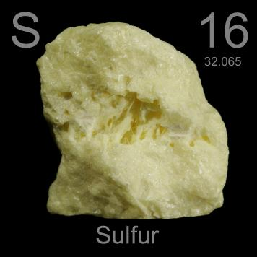
Representative Elements

Slide 16
Transition Elements
The elements in Groups 3 – 12
The elements exhibit a wide range of chemical and physical properties

Slide 17
Transition Elements

Slide 18
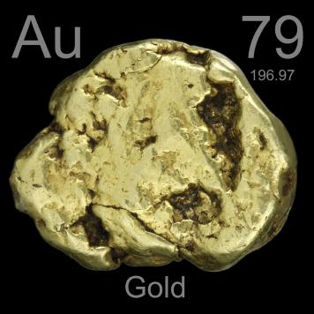
Transition Metals

Slide 19
The Periodic Law
States that if the elements are arranged in order of increasing atomic number, properties will start to repeat

Slide 20
Group of One
Hydrogen is a unique element
Hydrogen doesn’t have much in common with the alkali metals.
It is a colorless, odorless, tasteless, highly flammable gas
Almost all of earth’s hydrogen exists in combination with other elements. Its reactivity is too great for it to exist as a free element.

Slide 21
Group of One

Slide 22
Alkali Metals

Slide 23
Alkali Metals
Column 1 on the periodic table (the far left)
Are extremely reactive
Found in nature only as compounds
They are soft, silver, shiny metals
Ex: Lithium, Sodium, Potassium…

Slide 24
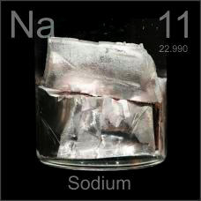
Alkali Metals

Slide 25
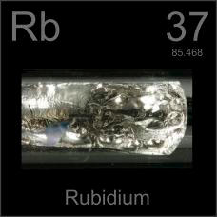
Alkali Metals

Slide 26
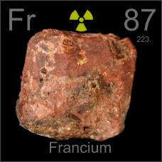
Alkali Metals

Slide 27
Alkaline Earth Metals

Slide 28
Alkaline Earth Metals
Column 2 on the periodic table
They are light, reactive metals that form oxide coatings when exposed to the air
They are shiny, silver metals
Ex: Beryllium, Calcium, Magnesium…

Slide 29
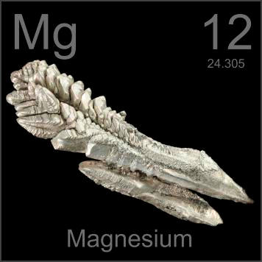
Alkaline Earth Metals

Slide 30
Metalloids

Slide 31
Metalloids
The elements along the staircase
Elements that possess both metallic and nonmetallic properties
The metalloids are:
Silicon, boron, germanium, arsenic, selenium, antimony, tellurium, and polonium

Slide 32
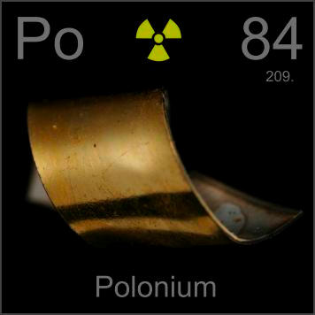
Metalloids

Slide 33
Halogens

Slide 34
Halogens
In the 17th column of the periodic table
Are the most reactive nonmetals
These almost always appear naturally as compounds, not elements
Ex: fluorine, chlorine, bromine

Slide 35
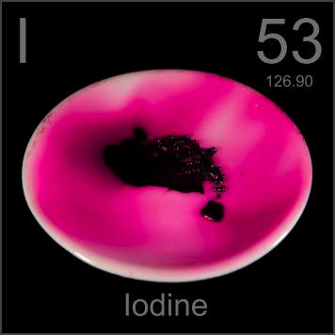
Halogens

Slide 36
Noble Gases

Slide 37
Noble Gases
Are in the 18th column (on the far right)
Are all gases at room temperature
Unreactive, almost never forming compounds with other elements
Argon makes up about 1% of every breath you take
Examples: Neon, Helium, Argon…

Slide 38
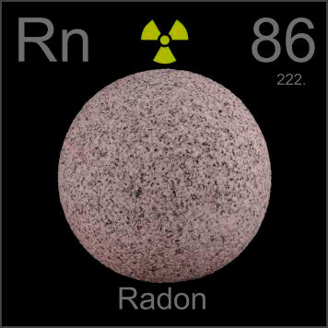
Noble Gases

Slide 39
Assignment
Refer to your periodic table
Use the color code below to color the sections of your periodic table:
Group of One – Green
Alkali Metals – Blue
Alkaline Earth Metals – Red
Transition Metals – Yellow
Metalloids – Dark Purple
Halogens – Light Pink
Noble Gas - Orange

