Slide 1
The Sun and Other Stars

Slide 2
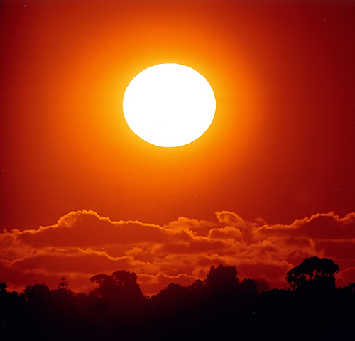
The Sun
As you already know the Sun is a vital part of life here on planet Earth; it provides us with the energy needed by all plants and animals and it’s gravitational pull keeps us in our steady orbit.
Scientists study the Sun to better understand how stars behave and can help us predict the life cycle of other stars.

Slide 3
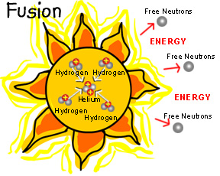
Where Does the Sun’s Energy Come From?
Like all stars, the Sun produces energy through a process called nuclear fusion.
During nuclear fusion, the sun's extremely high pressure and hot temperature cause hydrogen atoms to come apart and their nuclei to fuse or combine. Four hydrogen nuclei fuse to become one helium atom.

