Slide 1
DNA

Slide 2
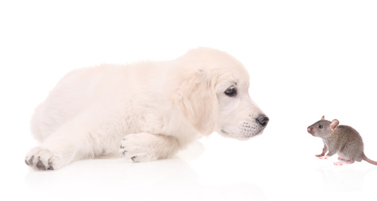
Genetic Material
Why don’t you have a tail? What makes you different from your neighbor’s dog or the mouse that lives in your garage?
The answer is it your body was shaped by the genetic information found in your unique DNA. Mice have 40 chromosomes and dogs have 78 but we humans have 46.
The chromosomes of all living things are made up of DNA, or Deoxyribonucleic acid.

Slide 3
Chromosome Numbers in Different Species

Slide 4
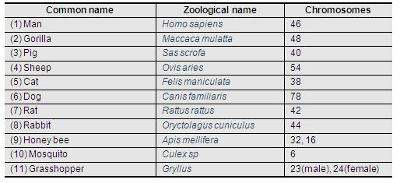

Slide 5
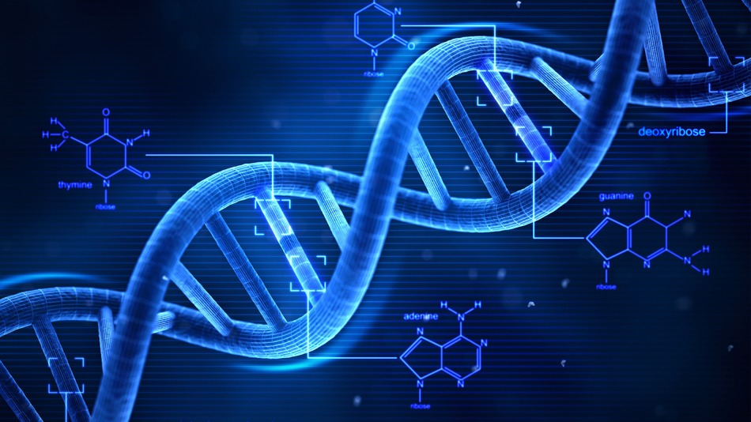
DNA
DNA provides:
directions that guide the repair of damaged cells
directions to create new parts
it describes how the cells will respond to changes in the environment
it describes how the cell will respond to messages from other cells
This information is sent from the DNA in the nucleus through the cytoplasm to the organelles using chemical messengers.

Slide 6
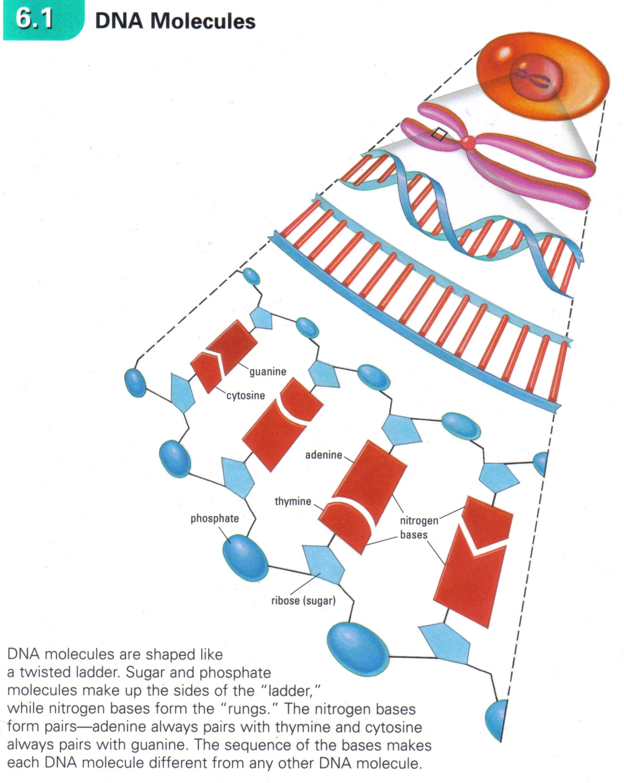
The Code
The DNA of all living things is similar because, upon closer inspection, it is comprised of a series of chemicals called nitrogen bases, held together in a long, winding helix.

Slide 7
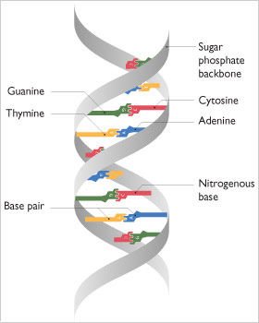
The Code
DNA uses a four-character code made up of nitrogen bases adenine (A), thymine (T), cytosine (c), and guanine (g).
The order that the bases appear in is the code. This order of bases form “stories” that can be read by cells and used as a blueprint that determines a characteristic.
The colour of your hair and eyes, the length of your nose, and skin colour are all characteristics that are determined by the “stories” or genes that make up the structure of your DNA.

Slide 8
The “Language of Life”
This genetic code, is stored in the 6 billion nitrogen bases of DNA, arranged in about 100,000 genes on the 46 chromosomes.
DID YOU KNOW! If the DNA from a single cell were stretched into a line, its length would be taller than you.
If you unraveled all of your DNA from all of your cells and laid out the DNA end to end, the strand would stretch from the Earth to the Sun hundreds of times!

Slide 9
DNA Replication
The DNA molecule can make perfect copies of itself in a process called replication.
Cell division would not be possible without the ability to replicate.
During interphase the DNA unzips to replicate and make a copy of itself before the cell divides.
During cell division the duplicates separate so each cell gets a complete set of genetic information.

Slide 10
DNA, Genes and Variation
Mice and humans are different because of the genes that they carry in their DNA. But what makes people different from one another?
You have 46 chromosomes, 23 from your father and 23 from your mother.
The chromosome from each parent carries the same genes but in each copy there may be small differences in the code.

Slide 11
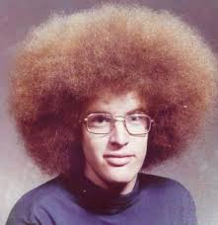
All humans carry a gene for follicle cells in our scalp to build hair. One gene determines the type of hair; curly, wavy, straight…
You may have two genes for curly hair or two for straight or one of each. How curly your hair will be is determined by the versions of genes on your chromosomes and how they interact with each other.

Slide 12
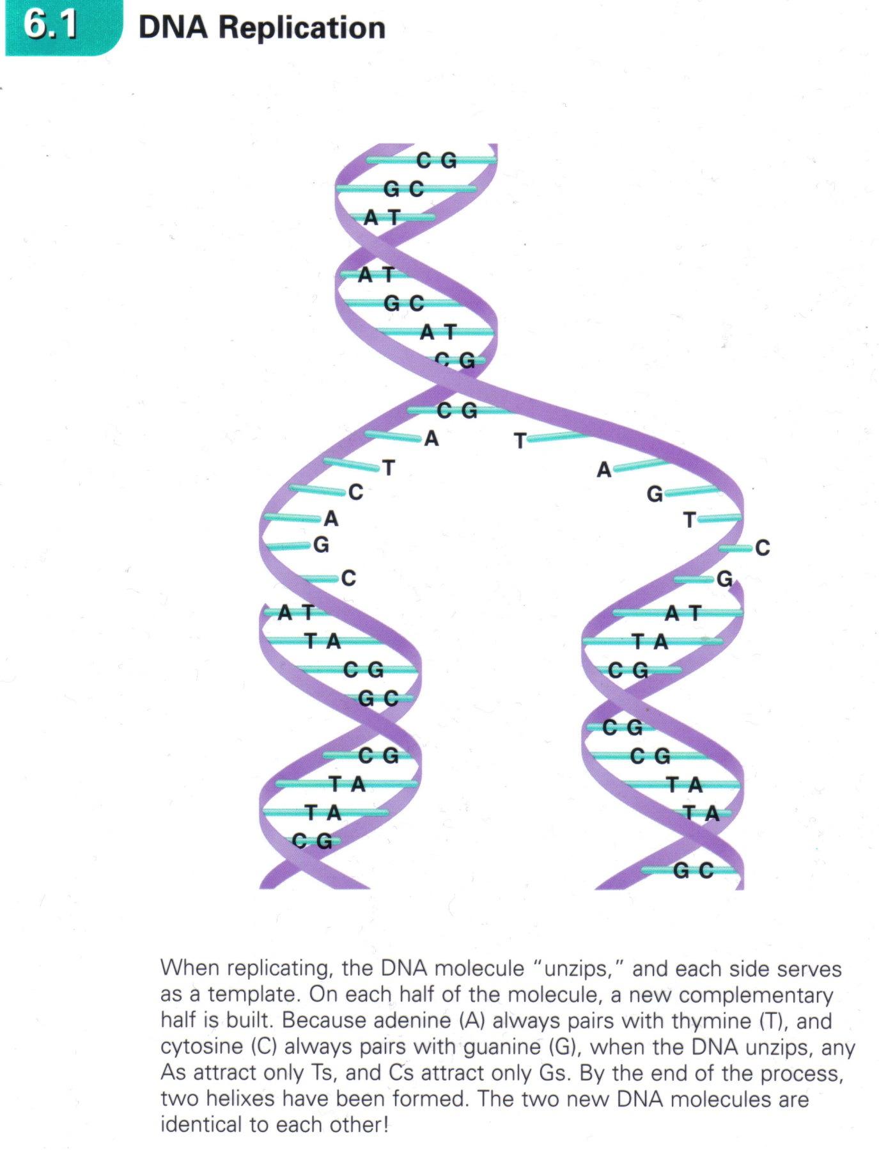

Slide 13
DNA Fingerprints
When you are conceived each parent provides one chromosome of each type (23 of them)
The DNA contained in your chromosomes is unique to you, unless you have an identical twin.

Slide 14
As you have noticed while watching tv and movies the uniqueness of DNA can be used to identify a person using the smallest amount of an individuals one-of-a kind “story”.

Slide 15
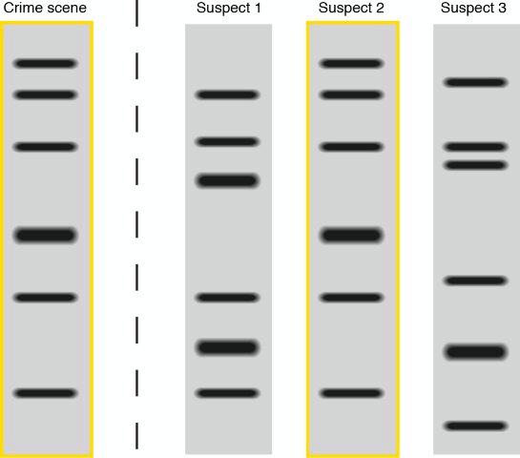
CSI Worthy

Slide 16
Questions to Consider
What molecule makes up the genetic material?
If there is only 4 different types of nitrogen bases found in DNA, why are so many organisms so different?
What possible benefits can DNA fingerprinting have on society? What are some problems it could create?

